Slide 1

VCT tutorial
Introduction to the platform

Slide 2
Outline
Purpose
Architecture
Configuring and running a simulation
Utilities
Data in VCT: Containers and Components
Writing a Module
Contributing
Installation
Practice

Slide 3
1. Purpose

Slide 4
Typical problems
We need to take design decisions during development of medical systems:
  Which panel? (compromise: viewing angle, noise, ...)
  Which backlight?
  How bright?
  Noise reduction or not?
  Can we apply lossy compression?
Today: we build a prototype, evaluate it internally, show it to a few clinical people and then decide if it is a good configuration.
To prove clinical quality of the display we need to perform costly time-consuming psychovisual/clinical tests.
Today: first decisions are mostly made based on physical measurements and not based on clinical quality (perception)
1. Purpose

Slide 5
VCT from Image Quality Circle
Customer Quality Preference
Market Share
...
$$
Application
Domain of Market Research
Image Quality Models
Domain of „Mononumerosis“
„unstable
short-cuts“
VCT
Customer Perceptions “Things we see -
The „nesses“
Image Quality
Circle™
Technology Variables
„Things we control“
Visual Algorithms
System
Models
Domain of Imaging Engineer
Domain of Technology
Physical Image Parameters
„Things we measure“
™ by P . G. Engeldrum,
A framework for Image Quality Models,
J. Imag. Sci. Tech. 39, p. 312, 1995
1. Purpose

Slide 6
Customer Quality Preference


Image Quality Models
Image Quality
Circle™
Technology Variables
„Things we control“
Customer Perceptions “Things we see -
The „nesses“
Visual Algorithms
System
Models
Physical Image Parameters
„Things we measure“
1. Purpose

Slide 7


Customer Quality Preference
Image Quality Models
Technology Variables
„Things we control“
Customer Perceptions “Things we see -
The „nesses“
Visual Algorithms
System
Models
SUBJECTIVE:
PERCEPTION
OBJECTIVE:
PHYSICAL
Physical Image Parameters
„Things we measure“
1. Purpose

Slide 8
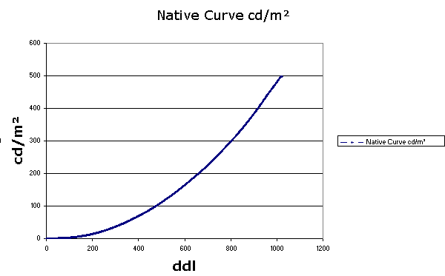
Example of the Image Quality Circle with GSDF*-DICOM
Customer Quality Preference

Image Quality Models
Image Quality
Circle™
Technology Variables
„Things we control“
Perception not taken into account
Customer Perceptions “Things we see -
The „nesses“
Visual Algorithms
System
Models
Physical Image Parameters
„Things we measure“
1. Purpose
*GSDF: Grayscale Display Function

Slide 9
Subjectively: it could be improved for the perception
Customer Quality Preference

Image Quality Models
Technology Variables
„Things we control“
Customer Perceptions “Things we see -
The „nesses“
Visual Algorithms
System
Models
Physical Image Parameters
„Things we measure“
1. Purpose

Slide 10
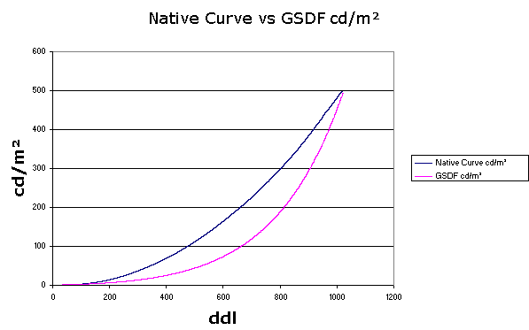
Subjectively: better perception
Customer Quality Preference

Image Quality Models
Image Quality
Circle™
Technology Variables
„Things we control“
Perception taken into account & improved
Customer Perceptions “Things we see -
The „nesses“
Visual Algorithms
System
Models
Physical Image Parameters
„Things we measure“
1. Purpose

Slide 11
VCT from Image Quality Circle
Customer Quality Preference
Market Share
...
$$
Application
Domain of Market Research
Image Quality Models
Domain of „Mononumerosis“
„unstable
short-cuts“
Customer Perceptions “Things we see -
The „nesses“
Image Quality
Circle™
Technology Variables
„Things we control“
Visual Algorithms
System
Models
Domain of Imaging Engineer
Domain of Technology
Physical Image Parameters
„Things we measure“
™ by P . G. Engeldrum,
A framework for Image Quality Models,
J. Imag. Sci. Tech. 39, p. 312, 1995
1. Purpose

Slide 12
VCT
VCT aims to develop a virtual medical imaging chain,
  Starting from: simulation of the image acquisition,
  Over a hardware and software image processing pipeline,
  Ending in the visualization by the medical specialist on the image display.
Start
End
1. Purpose

Slide 13
Goal
Virtual
Image
Capture
Modality λ
Virtual
Display
Display A
Display B
Virtual
specialist
Specialist λ
A
ROC
B
→For the specialist λ and modality λ,
display A is better than display B !
1. Purpose

Slide 14
VCT
Objective:
  Reduce number of observer studies
  To quantify perceived image quality
  Facilitate design of new medical systems
1. Purpose

Slide 15
VCT papers
Reference paper:
  C. Marchessoux, T. Kimpe and T. Bert. Virtual image chain for perceived and clinical image quality of medical display. Invited paper to special issue on medical displays, IEEE Journal of Technology Display, volume 4, number 4, pp 356-368, September 2008, ISSN 1551-319X
All papers provided with the tutorial (pdf version) and a mevic_upenn.bib file with all the references
1. Purpose

Slide 16
VCT papers
N. Odlum, G. Spalla, N. Van Assche, B. Vandenberghe, R. Jacobs, M. Quirynen & C Marchessoux. Preliminary display comparison for dental diagnostic applications. SPIE MI 2011
C. Marchessoux, N. Vivien, A. Kumcu and T. Kimpe. Validation of a new digital breast tomosynthesis medical display. SPIE MI 2011
L. Platisa, C. Marchessoux, B. Goossens and W. Philips. Performance evaluation of medical LCD displays using 3D channelized Hotelling observers. SPIE MI 2011
M. Vaz, Q. Besnehard and C. Marchessoux. 3D lesions insertion in digital breast tomosynthesis images. SPIE MI 2011
T. Kimpe, A. Xthona and C. Marchessoux. Medical Display Optimized for Digital Breast Tomosynthesis. breast imaging session, RNSA 2010
A. Vetsuypens, C. Marchessoux and T. Kimpe. A novel methodology for display 2D MTF evaluation: the Pixel Spread Function (PxSF). SPIE Medical Imaging, San Diego, 2010.
G. Braeckman, Joeri Barbarien, Q. Besnehard and C. Marchessoux. Perceptually optimal compression for heterogeneous image content in the context of medical networked applications. Submitted to SPIE Electronic Imaging, San Jose, 2010
G. Spalla, C. Marchessoux, M. Vaz and A. Ricker. Optimization of ct reconstruction parameters by using a medical virtual imaging chain. Medical Image Perception Conference XIII, Santa Barbara, 2009.
C. Marchessoux et al. Medical Virtual Imaging Chain. Medical Image Perception Conference XIII, Santa Barbara, 2009.
M.S. Vaz, R. Mersereau, G. Spalla and C. Marchessoux.CT Reconstruction from Truncated Scans. Fully3D, Beijing China, 5-10 September 2009
L. Ilic, E. Vansteenkiste, Bart Goossens, C. Marchessoux, T. Kimpe and W. Philips. Optimization of medical imaging display systems: using the channelized Hotelling observer for detecting lung nodules – experimental study. SPIE MI 2009
Mevic project invited for the SPIE 2009 Medical Imaging conference during the workshop session on observer interactions.
T. Kimpe, C. Marchessoux, G. Spalla, B. Goossens, H. Hallez, E. Vansteenkiste, S. Staelens and W. Philips. A software simulation framework to predict clinical performance of medical displays. Invited paper to SID, IDW 2008, Japan, December 2008
C. Marchessoux. Invited talk, Medical display conference, UKDL, 15th of October, 2008, London, UK
C. Marchessoux, G. Spalla and T. Kimpe. A new methodology for clinical and perceived quality of medical displays. SID, LA, USA, May 2008.
C. Marchessoux, A. Rombaut, T. Kimpe, B. Vermeulen and P. Demeester. Extension of a human visual system for display simulation. IS&T/SPIE EI, 2008.
C. Marchessoux, and T. Kimpe. Evaluating clinical performance of Coronis Fusion 6MP DL. White paper, 2007
C. Marchessoux and T. Kimpe. Specificities of a psycho-physical test room dedicated for medical display applications. International symposium, Society for Information Display, SID 2007, Long Beach, 15.3, book II, pp. 971-974, 2007

Slide 17
2. Architecture

Slide 18
Introduction
The simulation chain is
a pipeline!
Virtual
Image
Capture
Modality λ
Virtual
Display
Display A
Display B
What do we need?
A container to store the results at each stage
Modules in C++ for data processing
A configuration file defining:
  Inputs
  Modules:
    the parameters names
    the parameters values
  Outputs
Virtual
specialist
Specialist λ
A
ROC
B
→For the specialist λ and modality λ,
display A is better than display B !
2. Architecture

Slide 19



Principle
Virtual
image
capture
Virtual
display
Virtual
observer
Image capture
Display
Observer

Slide 20
Principle
Virtual
image
capture
Virtual
display
Virtual
observer
Each part is broken down as a chain of
Processing units (or «modules»)

Slide 21
Mevic = Pipeline
Input
Functions
Parameters
Pipeline
Output
Input
Module:
Generates output data depending on input and parameters
Parameters
Functions
Output
2. Architecture

Slide 22
Principle
CONF
Simulation
configuration
MEVIC Core
Module
Parameters
CONF
Module 1
Module 2
Result
of 1
Result
of 2
2. Architecture

Slide 23
Principle
CONF
Simulation
configuration
VCT Core
Module
Parameters
CONF
Module 1
Module 2
Module 3
Each step of the pipeline generates
the input of the next step
The results of each stage are kept
for later inspection
Result
of 1
Result
of 2
Result
of 3
2. Architecture

Slide 24
Modules - Virtual image capture part
Sequence loading (~dynamic background)
  SequenceRawGeneratorModule → module to be used for loading raw images & sequences
2. Architecture

Slide 25
Modules - virtual display
SequenceRAWGeneratorModule → also used for controlling the frame repeat
VideoCardModule
DisplayModule
DisplayLutModule
Rgb2XYZDisplayModule
sRgbDisplayModule
2. Architecture

Slide 26
Modules - virtual specialist
Channelized Hottelling Module:
  SingleSliceCHOModule
Statistical analysis:
  MRMCModule
2. Architecture

Slide 27
Modules available today - others
Various input and output modules
  ReaderModule: to load a simulation
  WriterModule: to save a simulation
Various conversion modules
  ConversionDDL2CDModule: ddl to cd/m²
  ConvertRawToChoBinModule: convert raw images to simulation files
Color metrics:
  DeltaE2000Module: ΔE₂₀₀₀
2. Architecture

Slide 28
Modules - others
Convenient modules for debugging:
  SaveFrameTXTModule
→ Module used currently for saving and checking intermediate results in the simulation, mainly for debugging
  SaveFrameBMPModule
  SaveFrameRAWModule
2. Architecture

Slide 29
Dependencies
Boost
OpenCV
Meschach
OpenCL
xmlParser
zlib
2. Architecture

Slide 30
Why to use it?
Dedicated platform for simulation:
  Runs fast (C++)
  Can handle any kind of image format:
    n-channels: 1, 3, 4 ....
    n-frames....
    n-Dimensions…
    int, float, int[10]....
    Any kind of representation and unit
    The only limit is our mind and computer capacity!
  Easy integration of new algorithms as Modules
  Easily configurable automated simulation
    Through SuperXML and “common xml” configuration files
  Support for compressed output (Huffman)
2. Architecture

Slide 31
Platform architecture
User input
- Simulation
configuration
- Data
<XML>
10110
VCT
Core
(runtime)
Modules
- Processing units
Utilities
- Shared objects
- Additional information persistence
between modules
2. Architecture

Slide 32




Project organization
ModulesList.cmake
Dependencies.cmake
Build_group
user_conf_example.txt
user_conf.txt (local)
CMakeLists.txt
vct
cmake
Common_Macros.cmake
BuildFull.cmake
For each module
cpp
Source files
src
module
lib
Libraries
Header files

Slide 33
Software design
XML file
Simulation 1
Module 1
Parameter 1
Parameter 2
Module 2
Parameter 1
…
…
…
MEVIC.exe
2. Architecture

Slide 34
Software design
Core
Do not modify
Dependencies
Modules
Utilities
Modifications / additions
2. Architecture

Slide 35
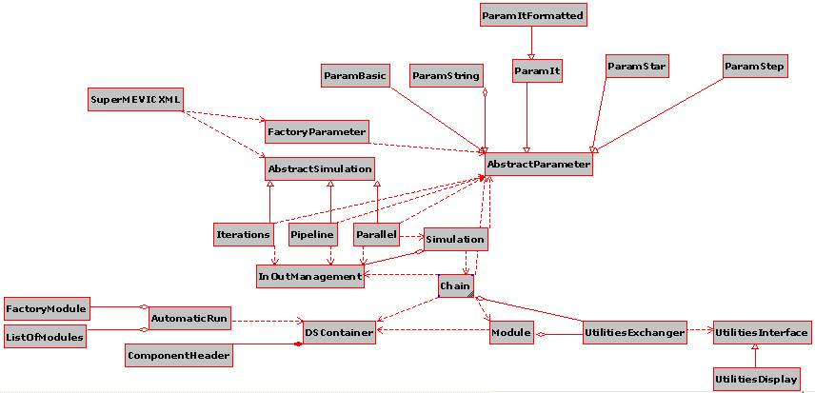
Software design
Core
Modules
Utilities
Parameters management
Simulation management
Utilities
2. Architecture

Slide 36
Software design
Core
Modules
Utilities
Parameters management
Utilities
2. Architecture

Slide 37
Software design
Core
Modules
Utilities
Utilities
2. Architecture

Slide 38
Software design
Core
Modules
Utilities
2. Architecture

Slide 39
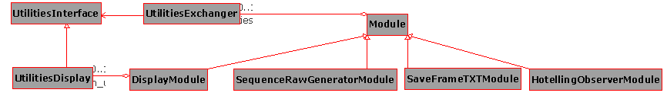
Core
Software design
Modules
Utilities
(many more modules are present)
2. Architecture

Slide 40
3. Configuring a simulation

Slide 41
SuperXML
The configuration format – SuperXML – tries to address the following problems :
  One simulation at a time: requires workarounds to perform simulations on a batch of data.
  Fixed file paths: the XML needs to be edited for each machine that needs to run the simulation.
  Parameters “lost” in the XML file
3. Configuring a simulation

Slide 42
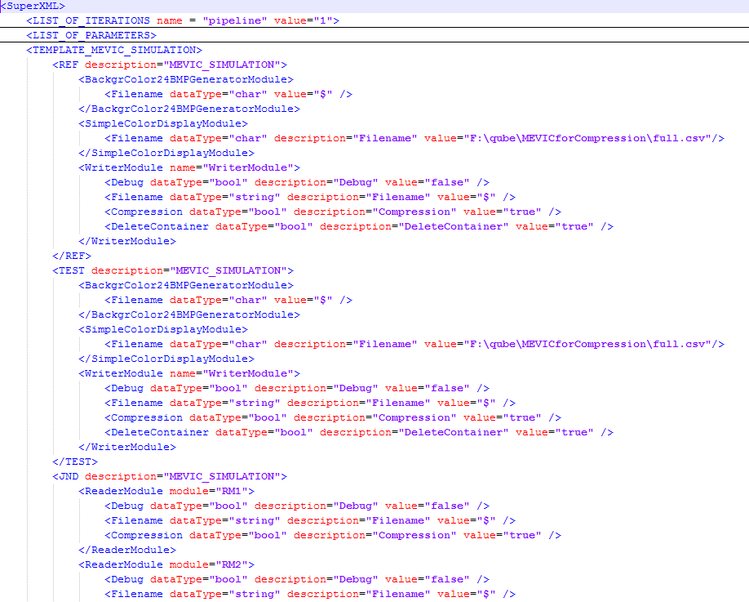
SuperXML
Root node:
the same for all
SuperXML files
Many simulations in one configuration file
Special headers
described later
Each simulation is given a unique arbitrary name:
here REF, TEST, JND
Each simulation has its own list of Modules
3. Configuring a simulation

Slide 43
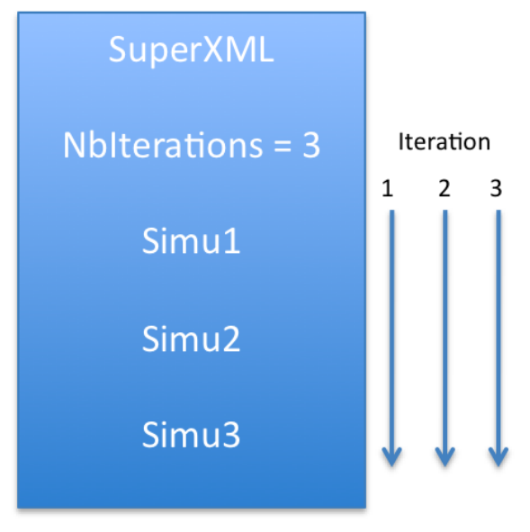
SuperXML: pipeline mode
<LIST_OF_ITERATIONS name = "pipeline" value = “3“>
Special header
just after the SuperXML node
3. Configuring a simulation

Slide 44
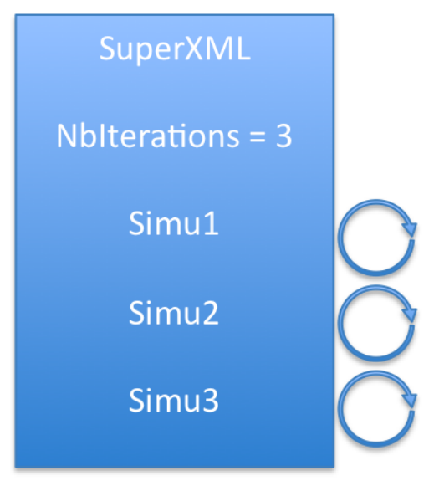
SuperXML: iteration mode
<LIST_OF_ITERATIONS name = “iterations">
  <Simu1 value=“3“>
  <Simu2 value=“4“>
  <Simu3 value=“10“>
</LIST_OF_ITERATIONS>
Simu1 is performed 3 times. Then…
… Simu2 is performed 4 times. And finally…
… Simu3 is performed 10 times.
3. Configuring a simulation

Slide 45
SuperXML: parallel mode
<LIST_OF_ITERATIONS name="parallel" value="5">
SuperXML
List of simulations
Simulation 1
Simulation 2
Simulation 3
1 List of simulation per processor.
To take into account: optimize the number of simulations according to the number of processors.
3. Configuring a simulation

Slide 46
SuperXML
Increasing parameters
  <SSIMModule name="pathForMaps" value = "[0:1:9]"/>
  0, 1, 2, 3, …, 9
Formated parameters
  <SSIMModule name="pathForMaps" value = "[0:1:9][number:000]"/>
  001, 002, 003, …, 009
List of parameters
  <BackgrBMPGeneratorModule name = "Filename" value = "[0,0.4,9,8]"/>
  0, 0.4, 9, 8
Wildcards parameters
  <BackgrBMPGeneratorModulename name="Filename“ value ="F:\gusp\[*].bmp"/>
  All bmp files in the “F:\gusp\” directory
3. Configuring a simulation

Slide 47
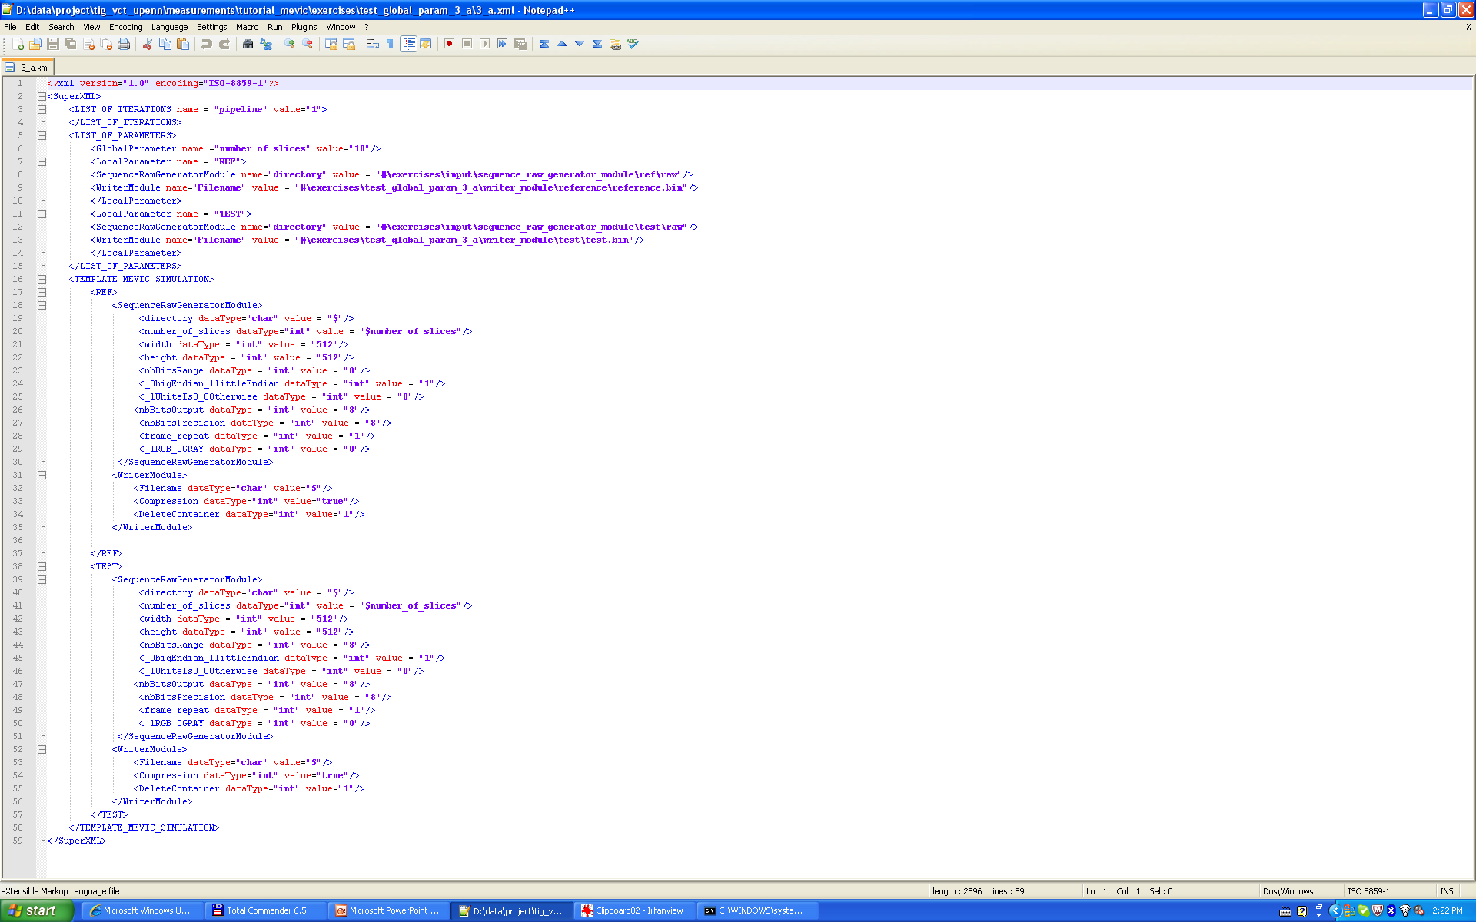
SuperXML
Global Parameters
  Available for all parts of the simulation
  For pipeline only
The global parameter “name” with a value of “10” can be used in any simulations of the pipeline
The use of a global parameter is marked by a “$name” symbol followed by the name of the parameter
3. Configuring a simulation

Slide 48
SuperXML
One extra parameter given as argument with ‘#’:
MEVIC.exe SuperXML 3_a.xml d:\data\project\

Slide 49
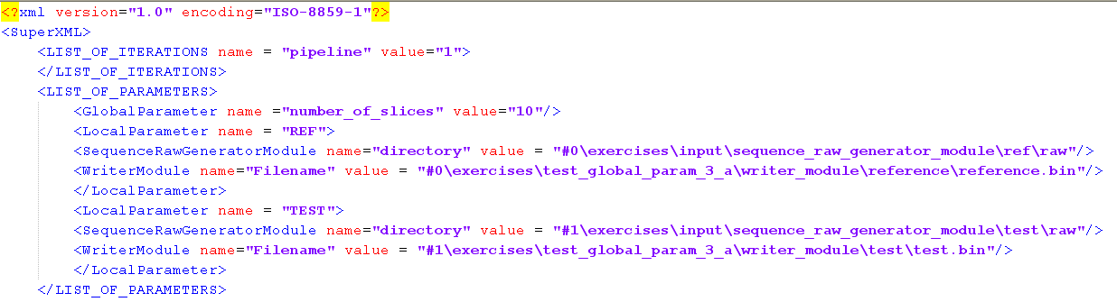
SuperXML
More than one parameter given as argument with ‘#n’:
MEVIC.exe SuperXML 3_a.xml d:\data\project\ d:\data\project2\
Up to 5 extra arguments

Slide 50


SuperXML - Plugging pipelines together
Acquisition
Reference
Test
Reference
display
Improved
display
Observer
Metrics

Slide 51
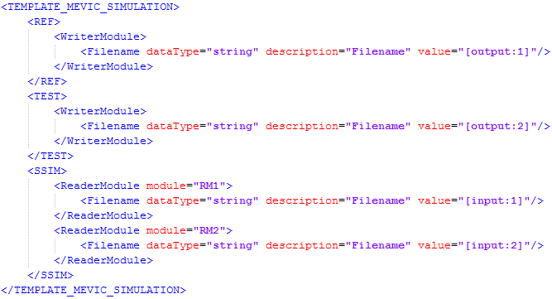
SuperXML - Plugging pipelines together
Solution: temporary files and simulation linkage
These parameters values tell the runtime that the value should be automatically generated by the platform
These parameters values tell the runtime that the value should be those generated by the [output:#] directives
3. Configuring a simulation

Slide 52
SuperXML: argument parameters
Its possible to pass parameters to a SuperXML file through the command line
MEVIC.exe SuperXML F:\test\test.xml C:\Programs C:\test
If this line is present in the XML file…
<Filename dataType=«char» description=«Filename» value=«#1\data.bin»/>
… then « C:\test\data.bin » will be the value of the parameter for the running simulation
« C:\Programs » will replace #0 in XML parameters
« C:\test » will replace #1 in XML parameters
3. Configuring a simulation

Slide 53
4. Utilities

Slide 54
Principle
Utilities are shared data objects.
They are used to pass data between Modules when the data cannot be expressed as image data.
Example:
  Many modules in the Virtual Display part need information about the display they simulate (e.g. native curve, calibrated curve,…).
  Therefore a UtilityDisplay exists.
Utilities are created by inserting “Utility generation” Modules in the simulation.
4. Utilities

Slide 55
Principle
The Utility Exchanger is an object that can be accessed by any Module.
It can be queried by the Modules for existing utilities.
Utility generation Modules are responsible for the instantiation of the utility objects and their linkage to the Exchanger.
CONF
Module 1
(Utility gen)
Module 2
Display
Result
of 2
UtilityExchanger
4. Utilities

Slide 56
5. Data in VCT: Containers and Components

Slide 57
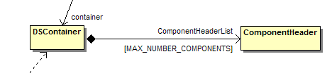
In 2 files and 2 classes
DSContainer.h
DSContainer.cpp
  2 classes:
5. Data in VCT: Containers and Components

Slide 58
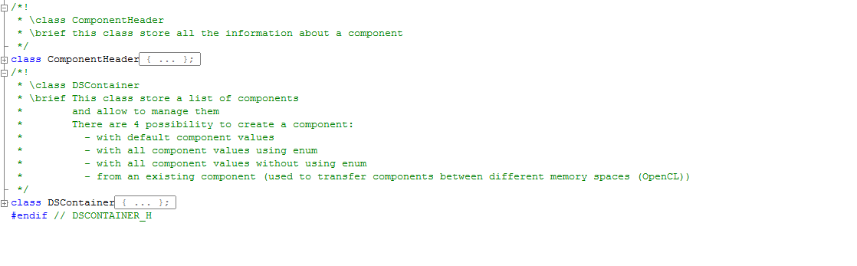
ComponentHeader describes the data
DSContainer is a list of ComponentHeader
objects. It provides an interface to create,
access and modify ComponentHeader objects.
5. Data in VCT: Containers and Components

Slide 59
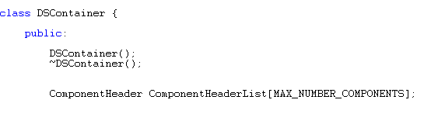
Container organization
Number of Components
Container Description
Component Header 1
The whole structure is very simple so as to be saved in a binary file
Elements/pixels component 1
Component Header 2
Elements/pixels component 2
Component Header 3
Elements/pixels component 3
Component Header …
Elements component …
5. Data in VCT: Containers and Components

Slide 60

Container description
5. Data in VCT: Containers and Components

Slide 61
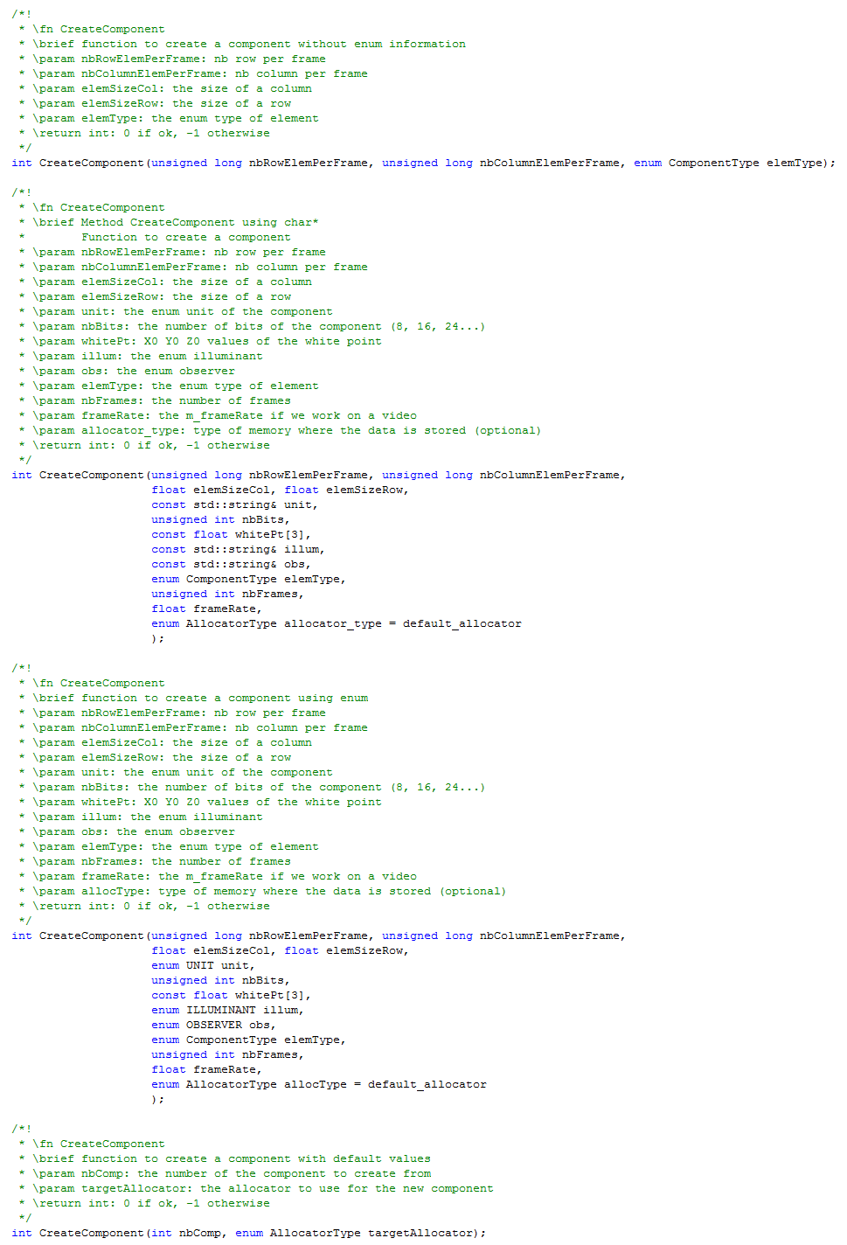

Create a component
4 methods:
Example:
5. Data in VCT: Containers and Components

Slide 62
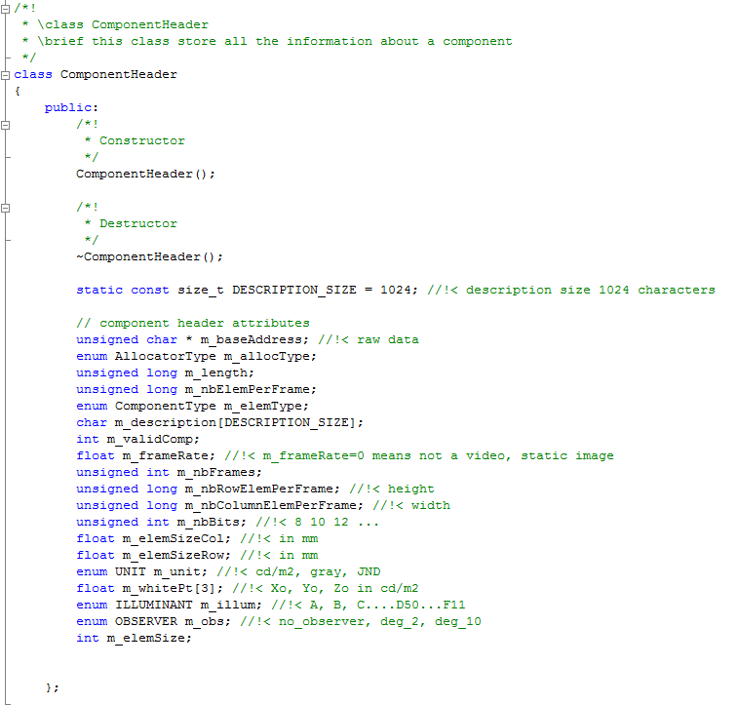
Component Header
5. Data in VCT: Containers and Components

Slide 63
Component Header: base_address
void pointer to memory where to store pixel elements
5. Data in VCT: Containers and Components

Slide 64
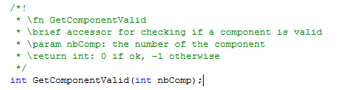
ComponentHeader: component valid
Valid if == 1
5. Data in VCT: Containers and Components

Slide 65

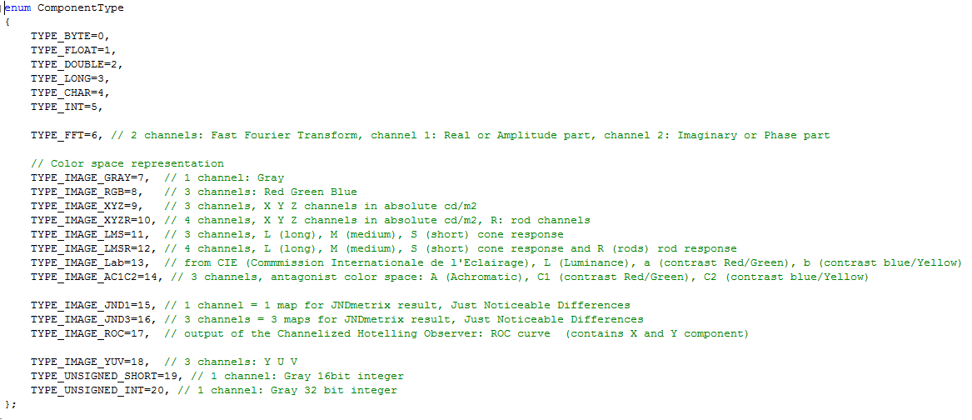
ComponentHeader: element type
Describes the content and the intent of the component:
physical/digital, int/float/double/…, number of channels
Number of Components
Container Description
Component Header 1
Elements/pixels component 1
5. Data in VCT: Containers and Components

Slide 66

ComponentHeader: m_elementSize
m_elementSize = sizeof(ComponentType)
Number of bytes for ONE pixel of the component
4. Data in VCT

Slide 67


ComponentHeader: image size
5. Data in VCT: Containers and Components

Slide 68

ComponentHeader: length
length = number_of_elements * sizeof(element_type)
Number of bytes of data in the component
4. Data in VCT

Slide 69

ComponentHeader: number of bits
For digital data represented by integers, the number of significant bits really used.
E.g. data could be represented in 10 bits (0..1024) but needs to be stored in 16 bits in the component (TYPE_UNSIGNED_SHORT)
5. Data in VCT: Containers and Components

Slide 70

ComponentHeader: element size column
= element-pixel size in mm
5. Data in MEVIC: Containers and Components

Slide 71

ComponentHeader: element size row
= element-pixel size in mm
5. Data in VCT: Containers and Components

Slide 72
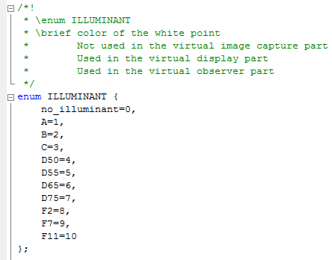
ComponentHeader: illum
enum ILLUMINANT
Describes the illuminant of the scene for an observer study
http://en.wikipedia.org/wiki/Standard_illuminant for more details
In method: CreateComponent, choice:
  enum
  char*
5. Data in VCT: Containers and Components

Slide 73
ComponentHeader: white_point
In cd/m²
5. Data in VCT: Containers and Components

Slide 74
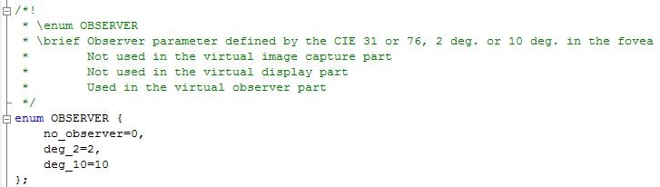
ComponentHeader: obs
enum OBSERVER
Describes the “observer” used for the study
http://en.wikipedia.org/wiki/CIE_1931_color_space#The_CIE_standard_observer for more details
In method: CreateComponent, choice:
  enum
  char*
5. Data in VCT: Containers and Components

Slide 75
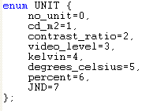
ComponentHeader: unit
enum UNIT
In method: CreateComponent, choice:
  enum
  char*
5. Data in MEVIC: Containers and Components

Slide 76
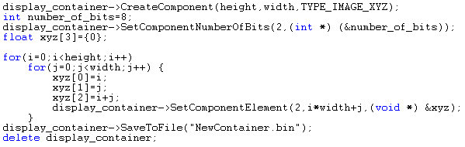
Load and save a container from a file
Save
Load
5. Data in MEVIC: Containers and Components

Slide 77
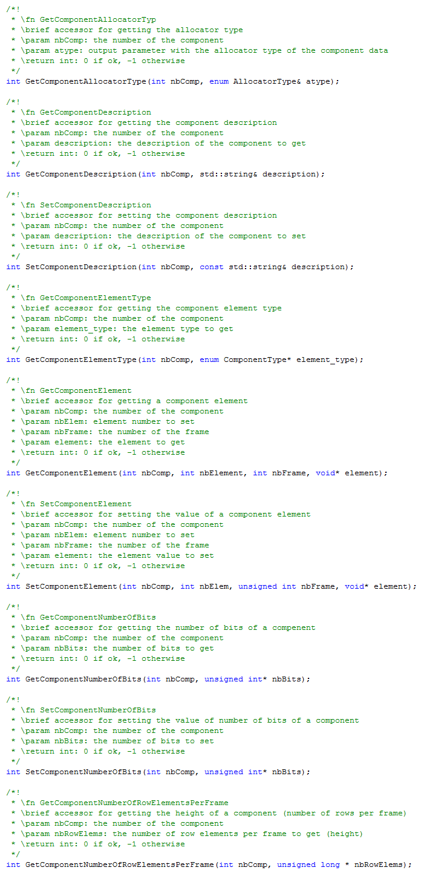
Get/Set: accessors to component properties from the Container
Get/Set
5. Data in VCT: Containers and Components

Slide 78
6. Writing a Module

Slide 79
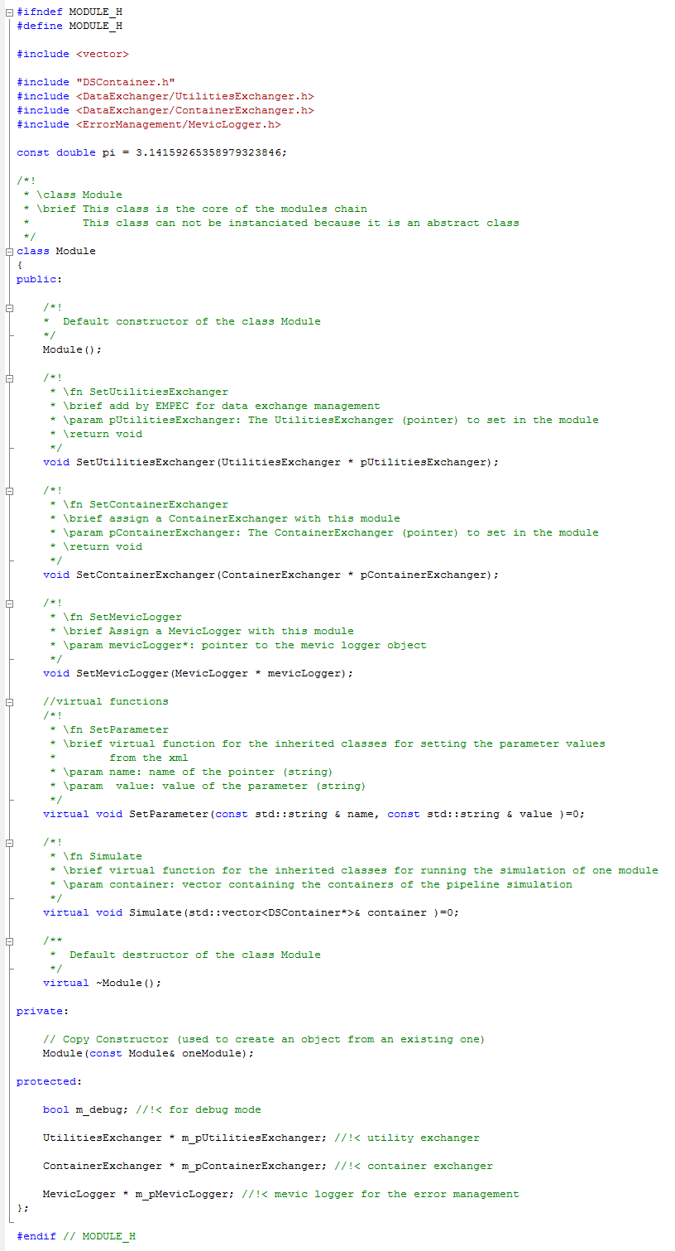
Writing a module
Base class
set
parameters
Run module
6. Writing a Module

Slide 80
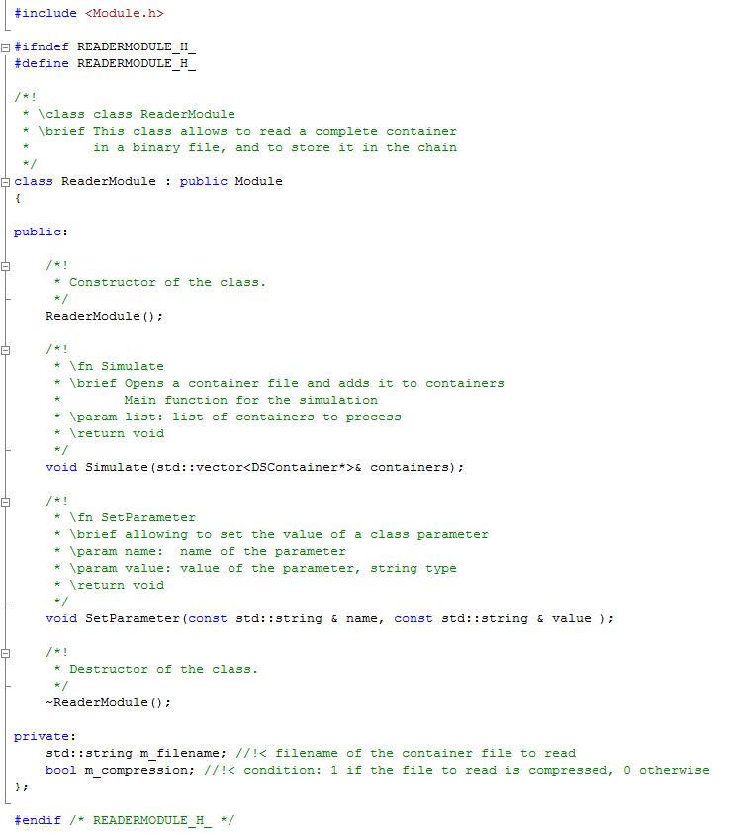
Example: ReaderModule
Derived from Module
Same interface as Module
6. Writing a Module

Slide 81
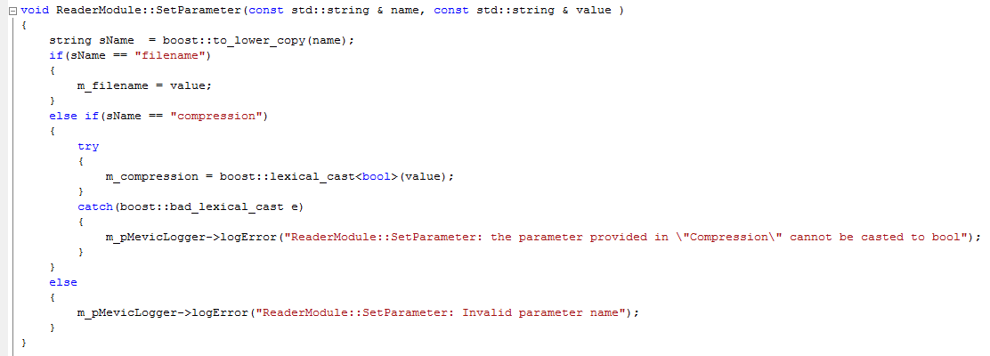
Example: ReaderModule
6. Writing a Module

