Slide 1
Salient Object
CNN · SOD · ECSSD
Detection
using CNN
Dataset: ECSSD
Architecture: CNN Encoder-Decoder
Loss: BCE + Dice · Optimizer: Adam
Fatbardh Fetoshi

Slide 2
Dataset, Preprocessing & Architecture
ECSSD Dataset
Preprocessing
Architecture
Real-world images with ground truth binary masks
Resize all images to fixed dimensions
CNN Encoder-Decoder design
Split into Train / Validation / Test sets
Normalize pixel values to [0, 1]
Encoder: extracts high-level features
Test set never seen during training
Binary masks: 0 = background, 1 = object
Decoder: reconstructs saliency mask
Augmentation: H-flip, rotation, brightness
Output: single-channel probability map

Slide 3
Training Process
Training
Flow
Loss Function
Loss = BCE(pred, target) + Dice(pred, target)
1. Load & Augment Data
Optimizer
Learning Rate
2. Forward Pass
Adam
0.001
3. Compute BCE + Dice
Batch Size
Experiments
2
15 epochs · 20 epochs
4. Backpropagate
Checkpoint
Augmentation
Best model saved on val loss
H-flip, rotation, brightness
5. Save Best Checkpoint
6. Early Eval on Val Set

Slide 4
Quantitative Results
IoU
+0.003
15 ep: 0.431 → 20 ep: 0.434
Precision
−0.019
15 ep: 0.569 → 20 ep: 0.550
Recall
+0.033
15 ep: 0.708 → 20 ep: 0.741
F1-Score
+0.000
15 ep: 0.608 → 20 ep: 0.608
MAE
+0.009
15 ep: 0.242 → 20 ep: 0.251

Slide 5
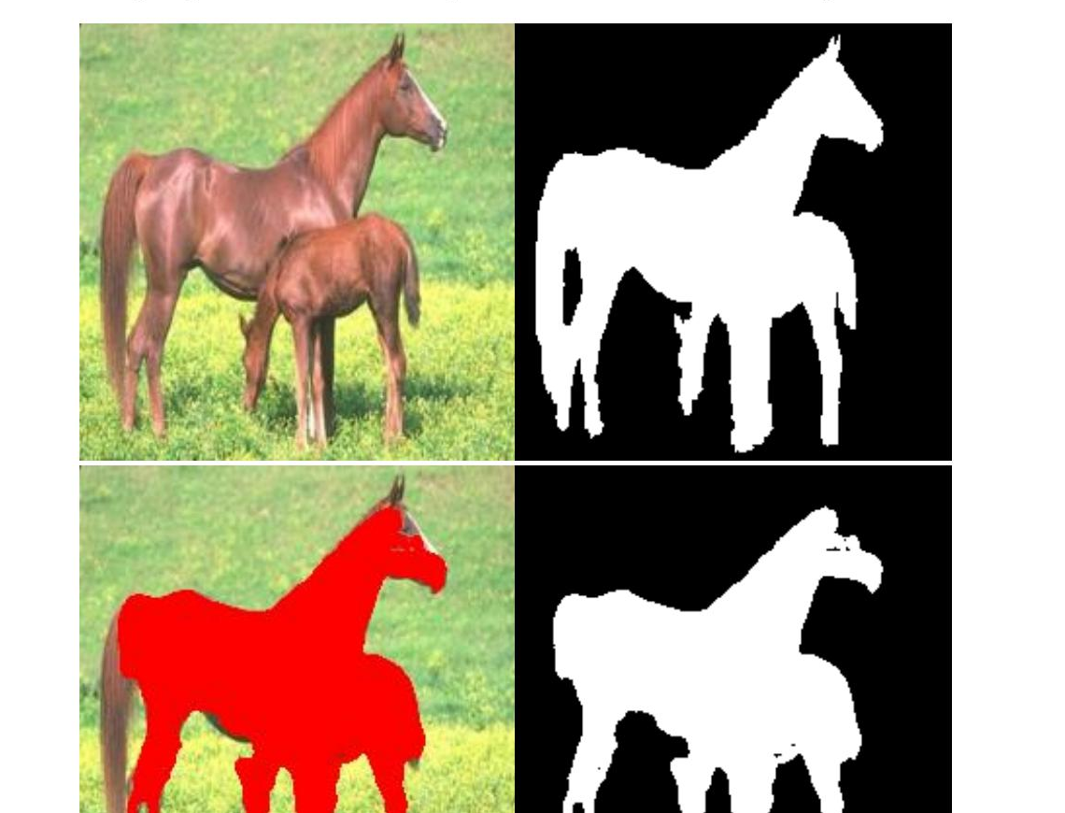
Visualization & Conclusions
✓
Model Detects Main Objects
CNN encoder-decoder successfully identifies the primary salient region in most images.
↑
Recall Improves with Epochs
20-epoch model detects more of the target object (+3.3 pp), showing better coverage.
↕
Precision–Recall Trade-off
More epochs boost recall but slightly lower precision — the model captures more background.
◈
Boundary Challenges Remain
F1 and IoU gains are marginal. Fine boundary detail needs more advanced techniques.
Input · Ground Truth · Overlay · Prediction

