Slide 1

Unified Probabilistic Deep Continual Learning
Through Generative Replay and Open Set Recognition
Martin Mundt, Sagnik Majumder, Iuliia Pliushch,
Yong Won Hong, and Visvanathan Ramesh
2020
Bardia Mojra
September 22, 2021
Robotic Vision Lab
University of Texas at Arlington

Slide 2
Introduction
Based on Extreme Value Theory (EVT)
Probabilistic open set recognition
Allows for continual learning
Prevents catastrophic forgetting
Does not store entire data set
Model:
  Combines joint probabilistic encoder with a GAN
  Tight classification bound on high-density learned parameter regions
  Only use high-density data points in regenerative model training

Slide 3
Variational Bayesian Inference
Inference hidden variables
Deterministic
Easy to gauge convergence
Requires dozens of iterations
No conjugacy requirement
More complicated math (slightly)
Notes:
Inference hidden variables
Deterministic (unlike MCMC)
Easy to gauge convergence (unlike MCMC)
Requires dozens of iterations (unlike MCMC where 1000s of samps are needed)
No conjugacy requirement
More complicated math (slightly)

Slide 4
Open Set Recognition
Definition per Scheirer et al. [31]:
  “For any recognition function f over an input space , the open set is defines as , where is a union of balls of radius including all of the training examples for known classes “.
M
O
X
Empirical Risk
S_k
Open Space Risk

Slide 5
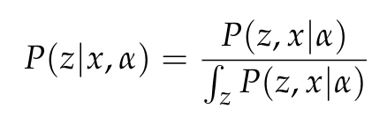
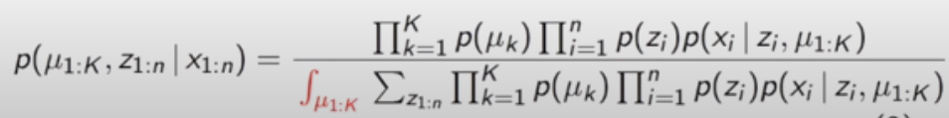
Bayesian Probability
Observations – x
Hidden variable – z
Fixed (learned) parameters – alpha
Bayesian Inference:
  Posterior requires calculating over all means and cluster assignments

Slide 6
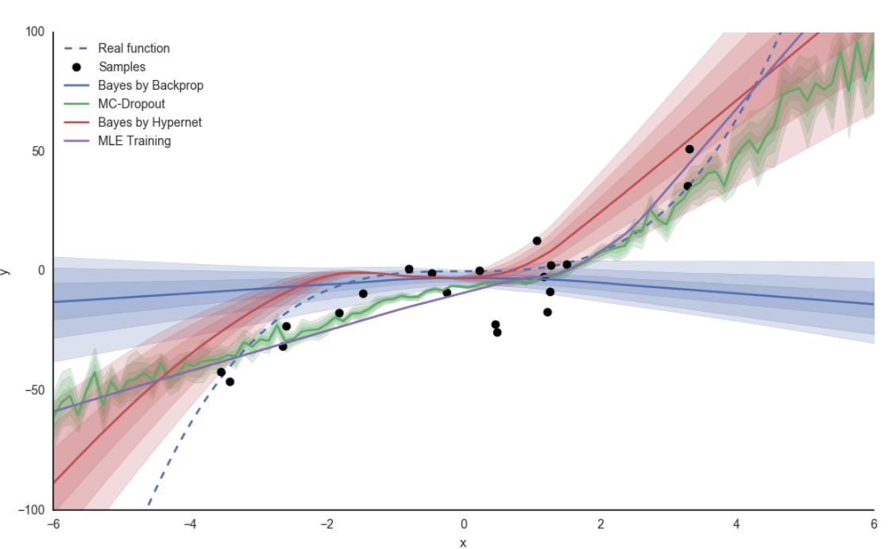
Bayesian Uncertainty
Naturally rejects statistical outlier by dilution
100s to 1000s of forward passes with MCMC (Bayesian approx.)
Fewer but many forward passes with MC Dropout (Bayesian approx.)
Direct calculation not feasible
Relies on the max entropy principle assumption
  Directly contradicts with the Open Set Recognition definition
Source:Implicit Weight Uncertainty in Neural Networks - http://bayesiandeeplearning.org/2017/papers/36.pdf

Slide 7
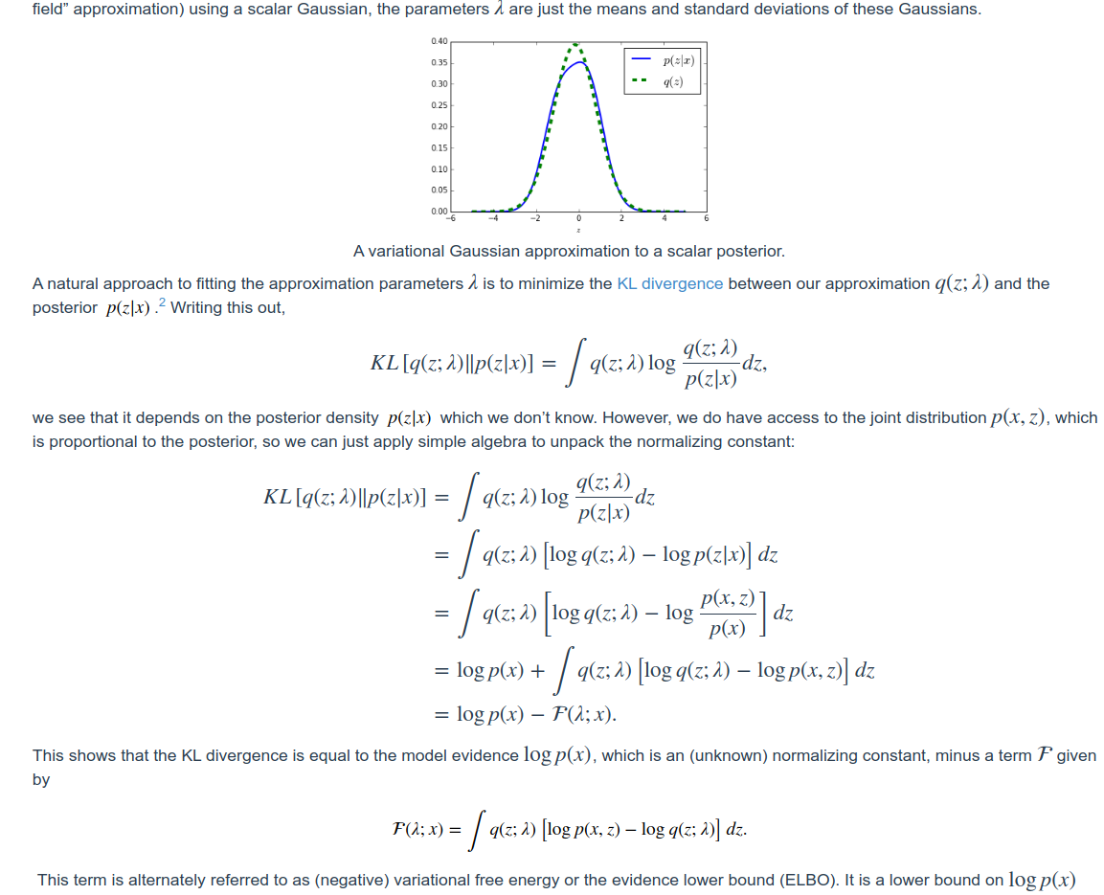
Variational Inference
Source: Variational Inference in 5 Minutes
- http://davmre.github.io/blog/inference/2015/11/13/elbo-in-5min

Slide 8
Calibration
What to do with outliers?
  [38] uses perturbation and temperature scaling
  [39] uses a separate GAN with additional loss term for outliers
  [40] uses unknown class label and true negative samples
They use a GAN and outlier rejection using EVT (ELBO)
M
O
X
S_k

Slide 9
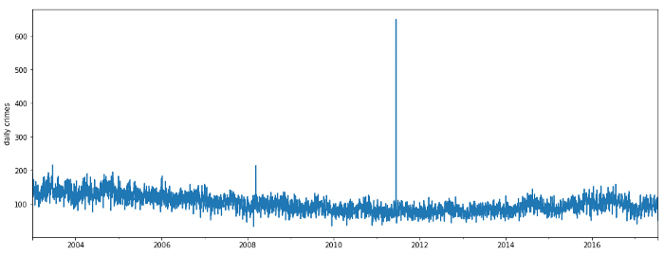
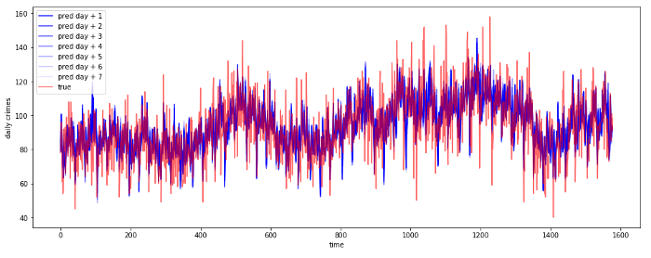
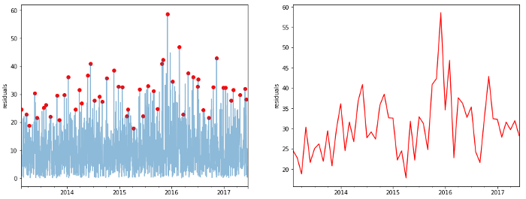
Extreme Value Theory (EVT)
Consider training residual absolute values, Extreme Values
Model Extreme Values and assign distribution, Dirichlet distribution
Compare empirical and estimated distribution
Expect similar number of anomalies
Source: https://towardsdatascience.com/anomaly-detection-with-extreme-value-analysis-b11ad19b601f

Slide 10
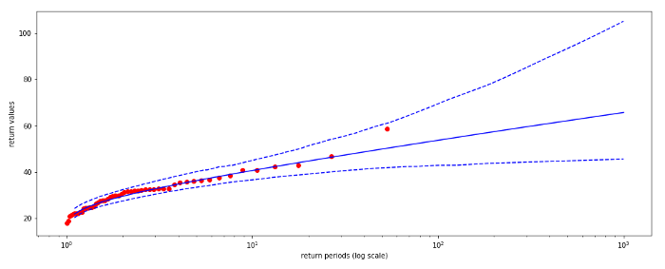
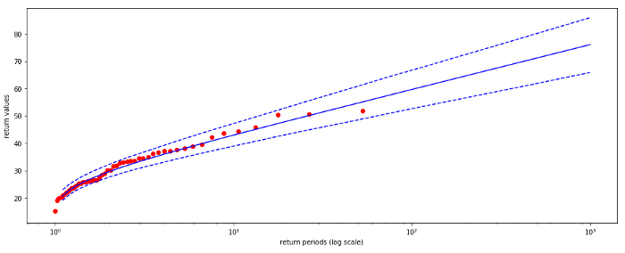
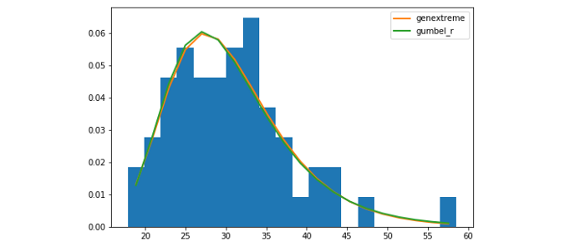
Extreme Value Theory (EVT)
Consider training residual absolute values, Extreme Values
Model Extreme Values and assign distribution, Dirichlet distribution
Compare empirical and estimated distribution
Expect similar number of anomalies
Source: https://towardsdatascience.com/anomaly-detection-with-extreme-value-analysis-b11ad19b601f

Slide 11
Extreme Value Theory (EVT)
In this paper:
  Use EVT to bound approximate posterior, instead of assigning confidence
  Use it to bound high density class distributions
  Used on each class separately
M
O
X
S_k

Slide 12
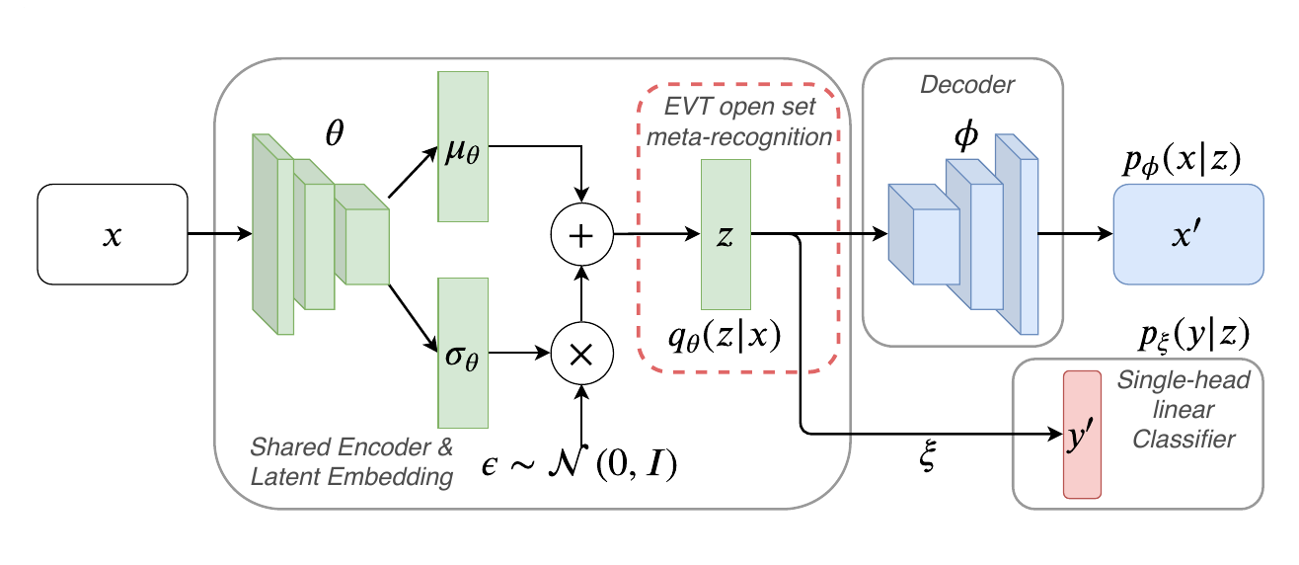
Model

Slide 13
Loss Function
θ – shared encoder parameters
φ – decoder parameters
ξ – linear classifier parameters

Slide 14
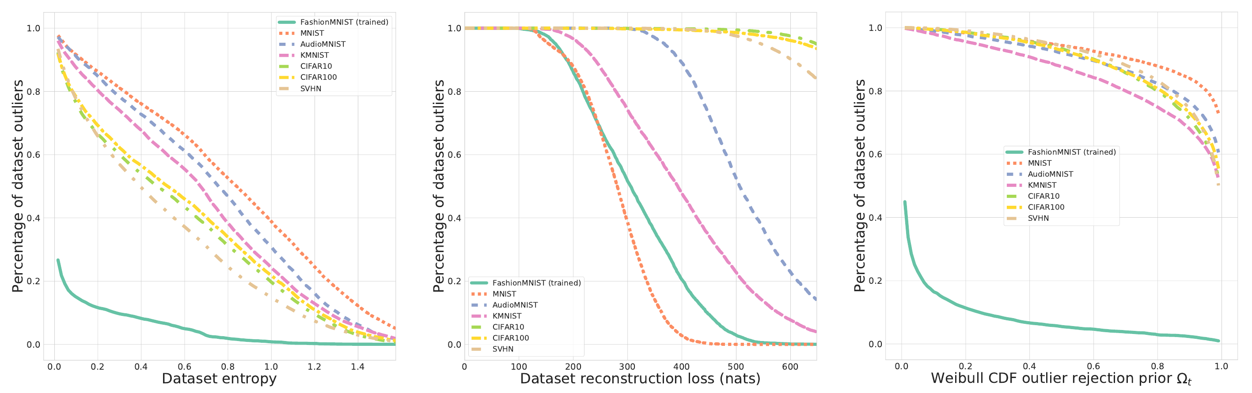
Performance

Slide 15
Thank you!

