Slide 1
ComputeCOVID19+: Accelerating COVID-19 Diagnosis and Monitoring via High-Performance Deep Learning on CT Images
Garvit Goel, Atharva Gondhalekar, Jingyuan Qi,
Zhicheng Zhang, Gouhua Cao, and Wu-chun Feng
50th International Conference on Parallel Processing
2021 - ACM
Bardia Mojra
3/29/2022 (TBD)
CSE 5351 - Spring 2022
University of Texas at Arlington

Slide 2
Overview
Problem statement
ComputeCOVID19+ framework
Computational aspects
Parallel processing aspects and challenges
Parallel approaches and methodology
Experiments and results
Analysis and conclusion
Future work and remaining problems
References
Questions

Slide 3
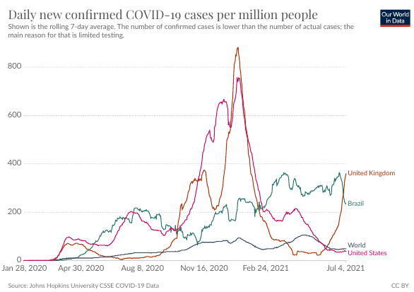
Problem Statement
6 million lives lost due to COVID-19
Disrupted the global transportation, food production, manufacturing supply-chain and more
Early and accurate detection is a key factor for speedy recovery and reduction in death toll
The reverse-transcription polymerase chain reaction (RT-PCR) test has limitations:
Long turnaround time: about 2 to 3 days
Compromised test accuracy: it has an accuracy lower bound of 67%, which is greatly affected by how the test was collected and handled

Slide 4
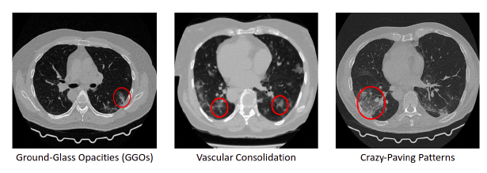
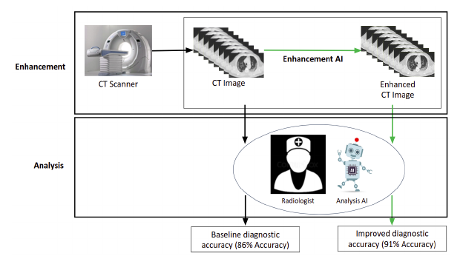
ComputeCOVID19+ Framework
Computed tomography-based, uses CT-scans for detection
Leverages deep learning (DL):
Based on DDnet (DenseNet and Deconvolution Network)
Enhances image resolution
Detects hallmark features such as ground-glass opacities (GGOs), linear opacities, and more
Achieves:
Increases accuracy of 91%, compared to 86% (SOTA)
Reduces turnaround time from days to 5 minutes
Leverages High Performance Computing (HPC) for fast training
Highly portable inference model:
Tested on heterogeneous platforms i.e. multi-core CPUs, many-core GPUs and FPGAs

Slide 5
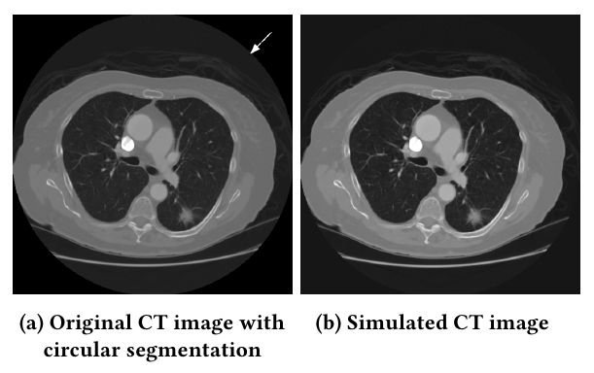
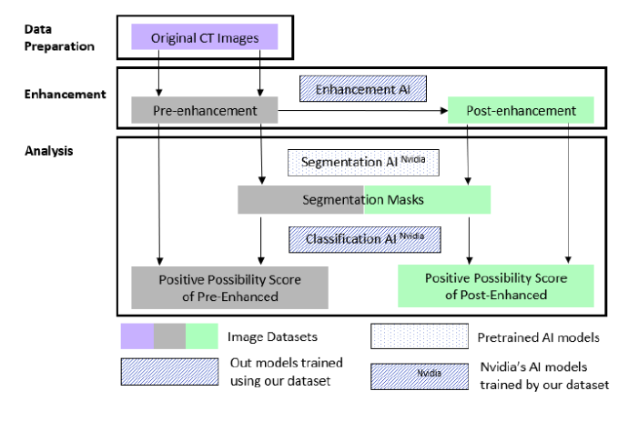
Computational Aspects
Enhancement AI
Leverages DDnet [45] for image enhancement
Deep convolution-deconvolution architecture: extracts low dimensional features in the reconstruction process and mitigates the vanishing and exploding gradient problems
Shortcut connections: makes the model more responsive as information flow per epoch is increased
Segmentation AI
Leverages pre-trained Nvidia Segmentation AI [33], [27]
3D segment masks from stack of 2D binay pixel-wise maps:
Foreground: lungs
Background: everything else
Classification AI
Uses a modified DenseNet-121 [16] for 3D volume classification
Infers positive or negative diagnosis

Slide 6
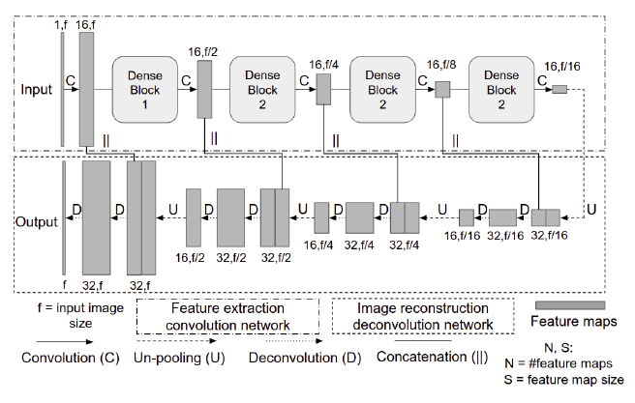
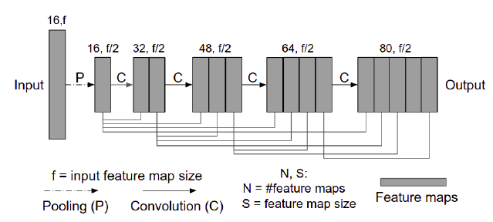
Parallel Processing Aspects and Challenges
Enhancement AI
Trained with 1,500 512x512 pixel CT chest images using sparse-view reconstruction super-resolution application [45]
Converts hounsfield units (HU) to floating point, [0,1]
Loss function combines mean square error (MSE) and multi-scale structural similarity index metric (MS-SSIM) [42]:
𝓛 = ∥y - f(x)∥₂² + 0.1 ×⁡ (1 - L_{MS-SSIM}(Y, f(X)))
Adam optimizer and 50 images per batch
Segmentation AI
Array multiplication (bitwise mask operation)
Classification AI
Used Nvidia’s Clara Train pipeline [33] for training and domain adaptation
Classification train with 3D CT frames of size 512x512xN
Keeps hounsfield units (HU) data representation
Binary cross-entropy loss function:
H_{p}(q) = - (1/N) ∙ ∑_{i=1} y_{i} ∙ log[p(y_{i})] + (1 - y_{i}) ∙ log[1 - p(y_{i})]

Slide 7
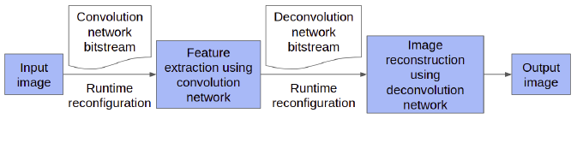
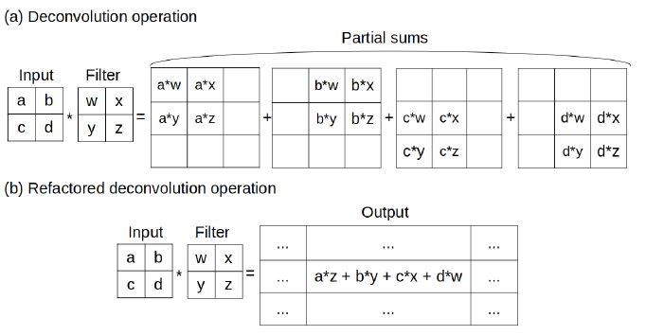
Parallel Approaches and Methodology
Training of Enhancement AI:
Batch-level parallelism via PyTorch Distributed Data Parallel library [35]:
Independent forward propagation
Synchronized back propagation:
Sync weight updating via Gloo communication backend [8]
Inference of Enhancement AI:
Implemented in both PyTorch and OpenCL [32]
Validated performance on heterogeneous systems, i.e. CPUs, GPUs, and FPGAs
Application-specific opts.: refactored deconv. (lookup partial sum) [4], [44]
Architecture-aware opts.:
Memory prefetching: reduces load time during run-time
Loop unrolling: handles multiple iterations at once via hardware [17]
FPGA-specific opts. (highly dynamic hardware architecture!):
Compute unit replication: conv.-deconv. units; improved performance via compute replication [17], [18]
Vectorization: increases SIMD instruction execution on data, i.e. vector load and vector multiply [17]
Dedicated kernels: increases throughput by eliminating redundant initialization
Runtime reconfiguration: run-time optimizer manages all other optimizations and reconfigures if needed

Slide 8
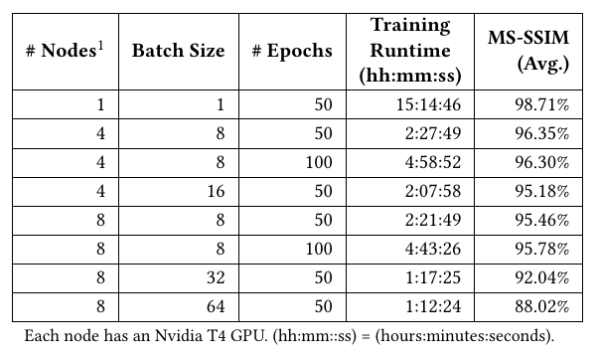
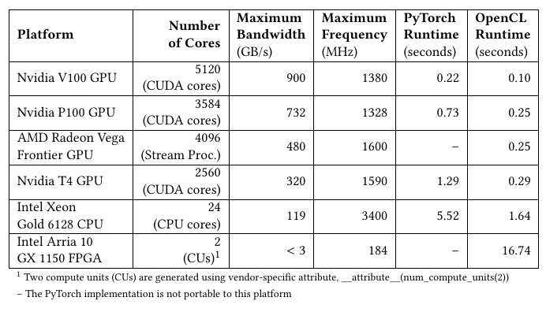
Experiments and Results
Training and inference of Classification AI and Segmentation AI:
Workstation equipped with Intel Core i9, Nvidia RTX 3090 and 32GB of memory
Training of Enhancement AI:
Virginia Tech’s Advanced Research Computing (ARC) Infer cluster with 18 compute nodes
Each node: 2x Intel Xeon Gold CPUs, 1x Nvidia Tesla GPU, and 192GB of memory
Performance and accuracy results (top table):
Sublinear speedup due to synchronization
Increasing batch size increases node utilization but decreases accuracy
Inference of Enhancement AI on heterogeneous systems:
Many-core GPUs Nvidia V100, P100, T4 and AMD Frontier; Multi-core CPU: Intel Xeon Gold; FPGA: Intel Arria
Performance results (bottom table):
OpenCL faster by 3.4x on CPU and by 2.0x on GPU
Parallelized deconv-conv kernels speedup 278x and 64x on Xeon Gold CPU
Inference optimizations highly effective on HPC inference task

Slide 9
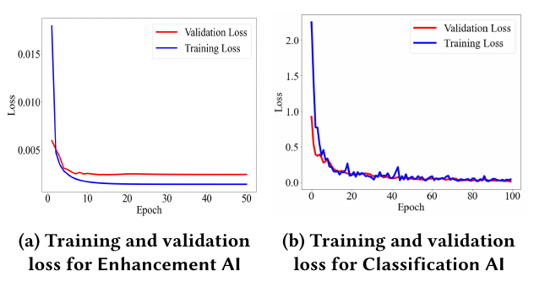
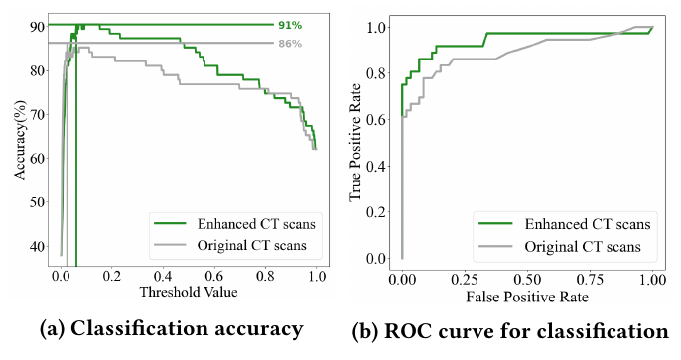
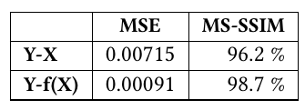
Analysis and Conclusion
Accuracy:
Acc: (TP + TN)/(TP + FP + FN + TN)
AUC-ROC:
Area Under the Curve (AUC) of Receiver Characteristic Operator (ROC)
ROC curve plotted using the true-positive rate (TPR), the false-positive rate (FPR), and N is total number of negatives
TPR: TP/N = TP/(TP + FN)
TPR: FP/N = FP/(FP + TN)
Enhancement AI:
Average 98.7% multiscale structural similarity accuracy (table)
Segmentations AI and Classification AI:
Impact of Enhancement AI on classification performance (bottom):
Key factor in achieving state of the art performance
Improves classification accuracy form 86% to 91%
Improves enhancement AUC-ROC from 0.890 to 0.942

Slide 10
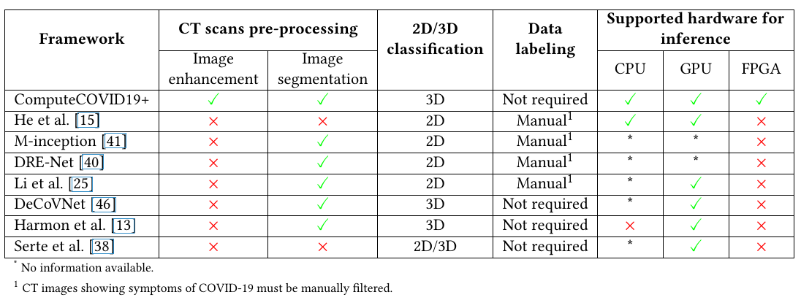
Future Work
No mentioned open problems!
Integration of other data modality to achieve higher accuracy
Expand research on low-dose CT image data for similar application
Expand research to other maladies, i.e. viral pneumonia and cancer

Slide 11
References (1)
M. Aharon et al. 2006. K-SVD: An Algorithm for Designing Overcomplete Dictionaries for Sparse Representation. IEEE Transactions on Signal Processing 54, 11 (2006), 4311–4322.
T. Ai et al. 2020. Correlation of Chest CT and RT-PCR Testing for Coronavirus Disease 2019 (COVID-19) in China: A Report of 1014 Cases. Radiology 296, 2 (2020), E32–E40.
M. Beister et al. 2012. Iterative Reconstruction Methods in X-ray CT. Physica Medica 28, 2 (2012), 94–108.
J. Chang et al. 2018. An Energy-Efficient FPGA-based Deconvolutional Neural Networks Accelerator for Single Image Super-Resolution. IEEE Transactions on Circuits and Systems for Video Technology 30, 1 (2018), 281–295
H. Chen et al. 2017. Low-Dose CT with a Residual Encoder-Decoder Convolutio- nal Neural Network. IEEE Trans. on Medical Imaging 36, 12 (2017), 2524–2535.
L. Cheng et al. 2017. Accelerated Iterative Image Reconstruction Using a Deep Learning Based Leapfrogging Strategy. International Conference on Fully Three- Dimensional Image Reconstruction in Radiology and Nuclear Medicine. 715–720.
E. Dong et al. 2020. An Interactive Web-based Dashboard to Track COVID-19 in Real Time. Lancet Infectious Diseases 20, 5 (May 2020), 533–534.
Facebook. [n.d.]. GLOO Communication Backend. https://github.com/facebookincubator/gloo/
Y. Fang et al. 2020. Sensitivity of Chest CT for COVID-19: Comparison to RT-PCR. Radiology 296, 2 (2020), E115–E117.
H. Gietema et al. 2020. CT in Relation to RT-PCR in Diagnosing COVID-19 in The Netherlands: A Prospective Study. PLOS One 15, 7 (2020), e0235844.
W. Guan et al. 2020. Clinical Characteristics of Coronavirus Disease 2019 in China. New England Journal of Medicine 382, 18 (2020), 1708–1720.
Y. Han et al. 2016. Deep Residual Learning for Compressed Sensing CT Recon- struction via Persistent Homology Analysis. arXiv:1611.06391 preprint (2016).
S. Harmon et al. 2020. Artificial Intelligence for the Detection of COVID-19 Pneumonia on Chest CT using Multinational Datasets. Nature Communications 11, 1 (Dec. 2020), 1–7.
K. He et al. 2020. Momentum Contrast for Unsupervised Visual Representation Learning. In IEEE Conf. on Computer Vision & Pattern Recognition. 9729–9738.
X. He et al. 2020. Sample-Efficient Deep Learning for COVID-19 Diagnosis Based on CT Scans. MedRxiv (2020).
G. Huang et al. 2017. Densely Connected Convolutional Networks. In Proc. of IEEE Conference on Computer Vision and Pattern Recognition. 4700–4708.
Intel [n.d.]. Intel FPGA SDK for OpenCL Pro Edition: Best Practices Guide. Intel. https://www.intel.com/content/dam/www/programmable/us/en/pdfs/literature/hb/opencl-sdk/aocl-best-practices-guide.pdf
Intel [n.d.]. Intel FPGA SDK for OpenCL Pro Edition: Programming Guide. Intel. https://www.intel.com/content/www/us/en/programmable/documentation/mwh1391807965224.html
K. Jin et al. 2017. Deep Convolutional Neural Network for Inverse Problems in Imaging. IEEE Transactions on Image Processing 26, 9 (2017), 4509–4522.
M. Johansson et al. 2021. SARS-CoV-2 Transmission from People Without COVID-19 Symptoms. J. American Medical Assoc. (Jan. 2021).
Johns Hopkins Coronavirus Resource Center. 2020. COVID-19 Map. https://coronavirus.jhu.edu/map.html

Slide 12
References (2)
N. S. Keskar et al. 2016. On Large-Batch Training for Deep Learning: Generaliza- tion Gap and Sharp Minima. arXiv:1609.04836 preprint (2016).
D. Kingma et al. 2014. Adam: A Method for Stochastic Optimization. arXiv:1412.6980 preprint (2014).
L. Kucirka et al. 2020. Variation in False-Negative Rate of Reverse Transcriptase Polymerase Chain Reaction-based SARS-CoV-2 Tests by Time Since Exposure. Annals of Internal Medicine 173, 4 (2020), 262–267.
L. Li et al. 2020. Using Artificial Intelligence to Detect COVID-19 and Community- Acquired Pneumonia Based on Pulmonary CT: Evaluation of the Diagnostic Accuracy. Radiology 296, 2 (2020), E65–E71.
S. Li et al. 2014. Dictionary Learning Based Sinogram Inpainting for CT Sparse Reconstruction. Optik 125, 12 (2014), 2862–2867.
S. Liu et al. 2017. 3D Anisotropic Hybrid Network: Transferring Convolutional Features from 2D Images to 3D Anisotropic Volumes. Lecture Notes in Computer Science (including subseries Lecture Notes in Artificial Intelligence and Lecture Notes in Bioinformatics) 11071 LNCS (Nov. 2017), 851–858.
J. Long et al. 2015. Fully Convolutional Networks for Semantic Segmentation. In Proc. of IEEE Conference on Computer Vision and Pattern Recognition. 3431–3440.
Lung Image Database Consortium Image Collection. [n.d.]. LIDC-IDRI - The Cancer Imaging Archive (TCIA) Public Access – Cancer Imaging Archive Wiki. https://wiki.cancerimagingarchive.net/display/Public/LIDC-IDRI
Medical Imaging & Data Resource Ctr. [n.d.]. MIDRC. https://www.midrc.org/
Medical Imaging Databank of the Valencia Region. [n.d.]. BIMCV-COVID19 – BIMCV. https://bimcv.cipf.es/bimcv-projects/bimcv-covid19/
A. Munshi. 2009. The OpenCL Specification. In IEEE Hot Chips Symposium. 1–314.
NVIDIA GPU Cloud (NGC). [n.d.]. Clara Train SDK. https://ngc.nvidia.com/catalog/containers/nvidia:clara-train-sdk
R. Plater. 2020. As Many as 80 Percent of People with COVID-19 Aren’t Aware They Have the Virus. Healthline (May 2020).
PyTorch 2021. Distributed Data Parallel. https://pytorch.org/docs/stable/generated/ torch.nn.parallel.DistributedDataParallel.html
M. Roser et al. 2020. Coronavirus Pandemic (COVID-19). Our World in Data (2020). https://ourworldindata.org/coronavirus.
R. Schofield et al. 2020. Image Reconstruction: Part 1 – Understanding Filtered Back Projection, Noise and Image Acquisition. Journal of Cardiovascular Computed Tomography 14, 3 (2020), 219–225.
S. Serte et al. 2021. Deep Learning for Diagnosis of COVID-19 using 3D CT Scans. Computers in Biology and Medicine (2021), 104306.
R. Siddon. 1985. Fast Calculation of the Exact Radiological Path for a Three- Dimensional CT Array. Medical Physics 12, 2 (1985), 252–255.
Y. Song et al. 2020. Deep Learning Enables Accurate Diagnosis of Novel Coronavirus (COVID-19) with CT Images. MedRxiv (2020).
S. Wang et al. 2020. A Deep Learning Algorithm Using CT Images to Screen for Coronavirus Disease (COVID-19). MedRxiv (2020).
Z. Wang et al. 2004. Image Quality Assessment: from Error Visibility to Structural Similarity. IEEE Transactions on Image Processing 13, 4 (2004), 600–612.
T. Würfl et al. 2016. Deep Learning Computed Tomography. In Int’l Conf. on Medical Image Computing and Computer-Assisted intervention. Springer, 432–440.

Slide 13
References (3)
X. Zhang et al. 2017. A Design Methodology for Efficient Implementation of Deconvolutional Neural Networks on an FPGA. arXiv:1705.02583 preprint (2017).
Z. Zhang et al. 2018. A Sparse-View CT Reconstruction Method Based on Combina- tion of DenseNet and Deconvolution. IEEE Transactions on Medical Imaging 37, 6 (2018), 1407–1417.
C. Zheng et al. 2020. Deep Learning-based Detection for COVID-19 from Chest CT using Weak Label. MedRxiv (2020).

Slide 14
Questions!
Thank you!

