Slide 1
Machine Learning
Regression-Based Classification & Gaussian Discriminant Analysis
© Manfred Huber 2021

Slide 2
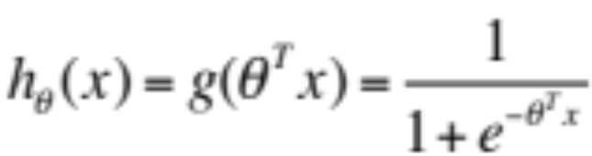
Logistic Regression
Linear regression provides a nice representation and an efficient solution to a regression problem
  Can we apply this representation to classification ?
    Using linear regression directly leads to too many output values that do not match any class well
    Logistic regression tries to address this by applying a logistic function in order to achieve outputs that are closer to class values
© Manfred Huber 2021

Slide 3
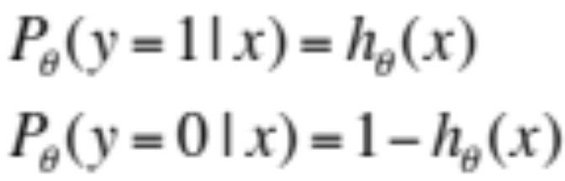
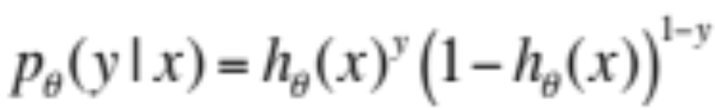
Logistic Regression
For two classes we can map the class labels to 1 and 0, respectively
  Using this we can interpret the output as the probability to belong to a given class
    Simplified this gives
© Manfred Huber 2021

Slide 4
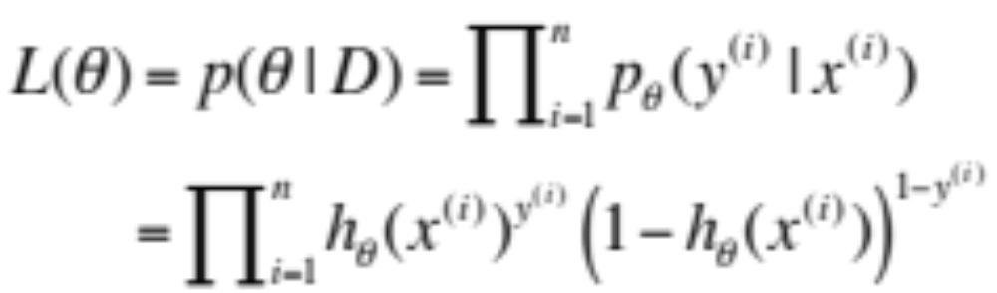
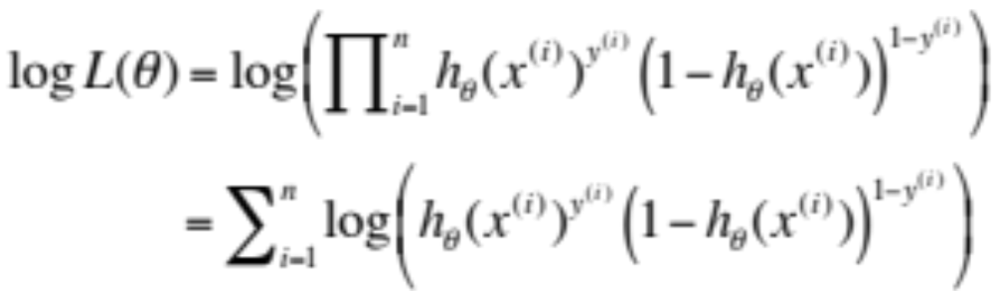
Logistic Regression
  This gives the likelihood of the parameters as
  Converted to log likelihood
© Manfred Huber 2021

Slide 5
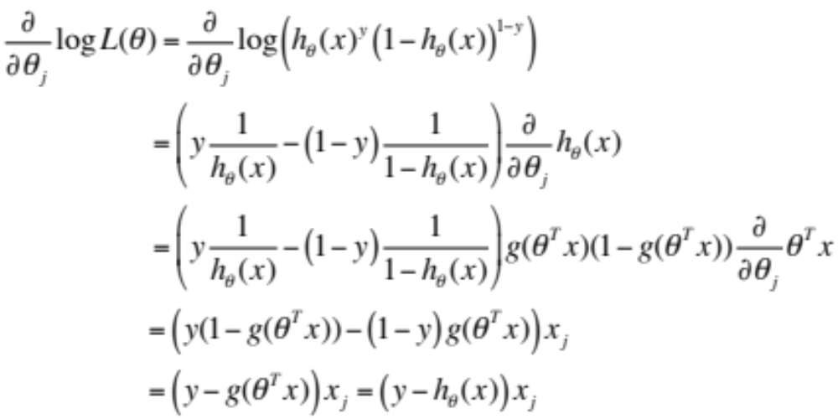
Logistic Regression
  Solving for the maximum likelihood optimization using stochastic gradient descent
© Manfred Huber 2021

Slide 6
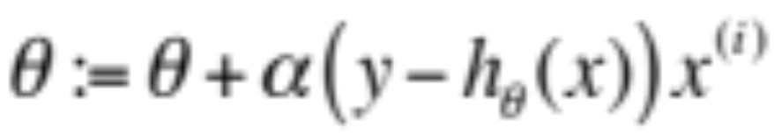
Logistic Regression
Gives us a stochastic gradient descent learning method for logistic regression
  This allows us to use regression for classification problems
© Manfred Huber 2021

Slide 7
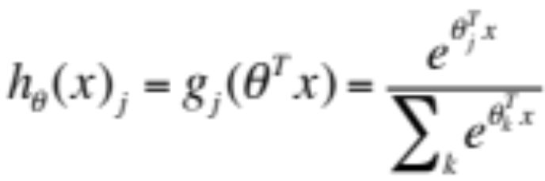
Softmax Regression
Logistic regression allows us to address a classification problem with two classes
  How can we address classification with more than 2 classes ?
    Multiclass classifier – need to compute a probability for each of the classes
      Corresponds to multinomial distribution
© Manfred Huber 2021

Slide 8
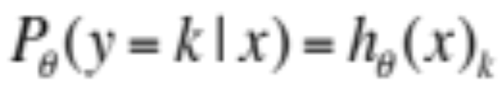
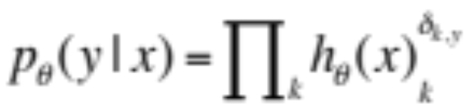
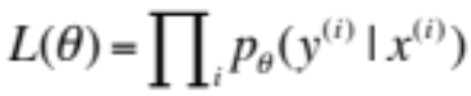
Softmax Regression
For each class we can interpret the output as the probability to belong to a given class
    Simplified this gives
  This gives the likelihood of the parameters as
© Manfred Huber 2021

Slide 9
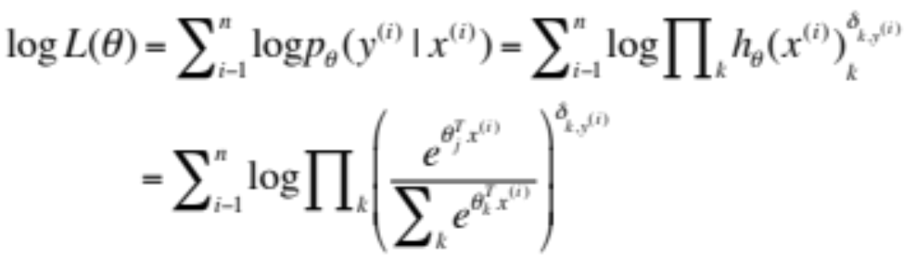
Softmax Regression
  Converted to log likelihood
  Derivative is slightly more complex
    Can be maximized using gradient ascent
© Manfred Huber 2021

Slide 10
Generative Approaches
Logistic and softmax regression are discriminative approaches to classification using a linear parameter representation
  Can we build generative algorithms that provide similar classification ?
    To build a generative algorithms we need to be able to predict a probability density for the input for a class
      Gaussian Naïve Bayes made the restrictive assumption that all dimensions are independent
      We can relax this and assume a multivariate Gaussian to give us Gaussian Discriminant Analysis
© Manfred Huber 2021

Slide 11
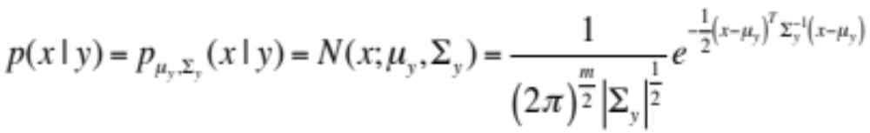

Gaussian Discriminant Analysis
GDA assumes that the probability density function for the data in a class follows a multivariate Gaussian
  Prior is assumed to be from a Bernoulli distribution
  Using Bayes law a log likelihood function for the parameters can be derived
© Manfred Huber 2021

Slide 12
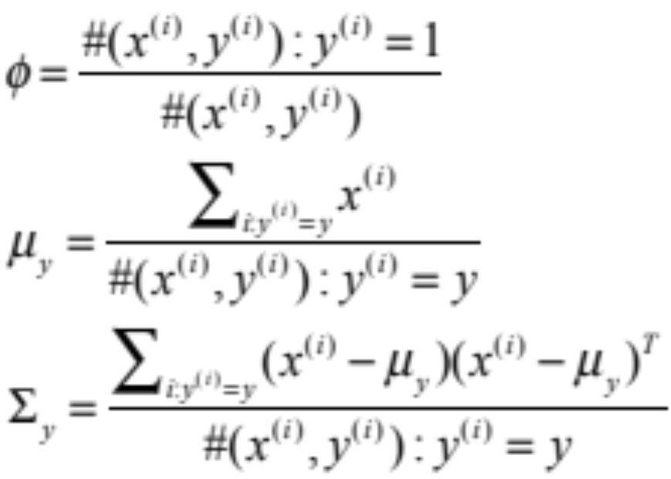
Gaussian Discriminant Analysis
Learning the parameter takes again the form of finding maximum likelihood parameters given the data
© Manfred Huber 2021

Slide 13
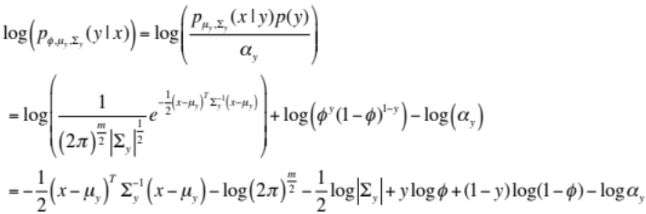
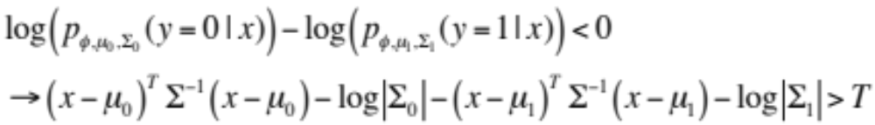
Gaussian Discriminant Analysis
The log likelihood of a class can be written as
  This forms a decision boundary
0
1
© Manfred Huber 2021

Slide 14
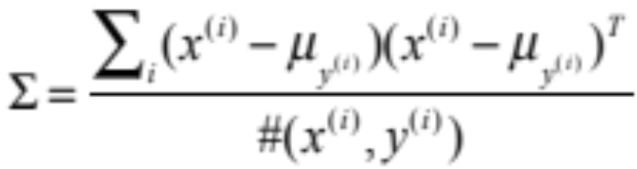
Linear Discriminant Analysis
If we make the homoscedastic assumption, i.e. if we assume that the (co)variances of the two classes are identical this results in linear discriminant analysis (LDA)
  Parameter maximization for the (co)variance is
    More stable for small amounts of data
© Manfred Huber 2021

Slide 15
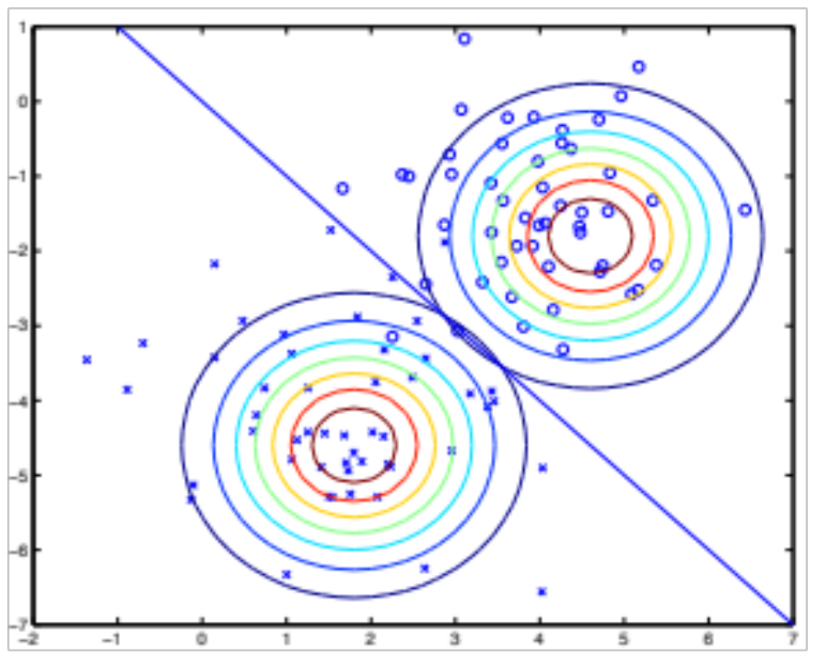
Linear Discriminant Analysis
With equal (co)variances the discriminant surface becomes linear
© Manfred Huber 2021

Slide 16
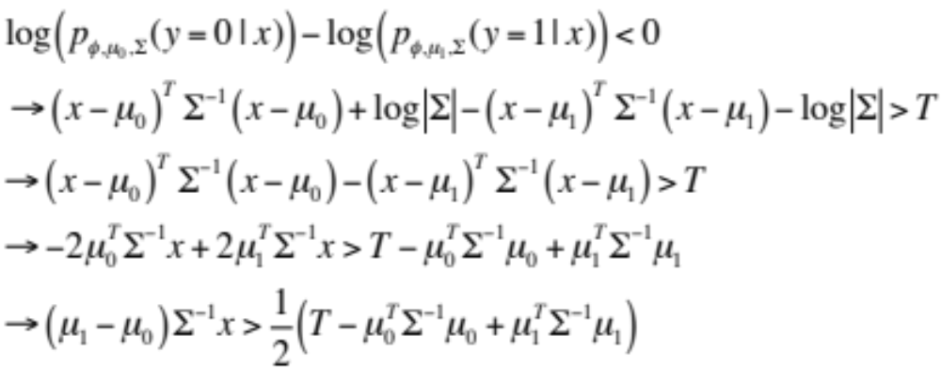
Gaussian Discriminant Analysis
In the decision boundary linearity arises as
© Manfred Huber 2021

Slide 17
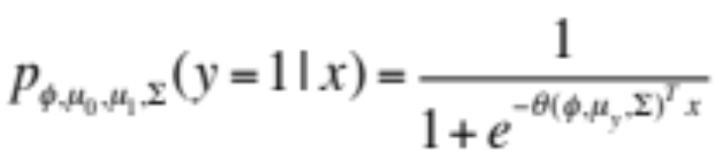
Linear Discriminant Analysis
In the case of linear discriminant analysis the class likelihood can be rewritten as
  Solution to linear discriminant analysis has similar form as the representation for logistic regression
    LDA is more restrictive (only allows some types of θ)
      If the distributions are Gaussian with same (co)variance then LDA will find the solution more efficiently and usually more precisely
      Logistic regression is more robust (it covers more than just Gaussian distributions and less sensitive to modeling errors
© Manfred Huber 2021

Slide 18
Quadratic Discriminant Analysis
If we do not make the homoscedastic assumption, the discrimination surface becomes quadratic resulting in Quadratic Discriminant Analysis (QDA)
  QDA is more flexible but also more complex
    Requires more data to train
0
1
© Manfred Huber 2021

Slide 19
Logistic Regression and Linear Discriminant Analysis
Logistic regression and Linear discriminant analysis are frequently used for classification
  Logistic regression provides an effective discriminative classification approach
    Same learning rule as for linear regression
  LDA provides generative classification that, if its assumptions are met, solves the same problem
  Softmax regression generalizes logistic regression
    Harder to train
  QDA provides a more general generative classifier
    Requires more data
© Manfred Huber 2021

