Slide 1
Machine Learning
Decision Trees
© Manfred Huber 2021

Slide 2
Decision Trees
Classifiers covered so far have been
  Non-parametric (KNN)
  Probabilistic with independence (Naïve Bayes)
  Linear in features (Logistic regression, SVM)
Decision trees use a different representation that is inherently non-linear
  Hypothesis space contains logic sentences over boolean variables and feature functions (e.g.=, >)
    Intuitive representation
    Can be converted into rules relatively easily
© Manfred Huber 2021

Slide 3
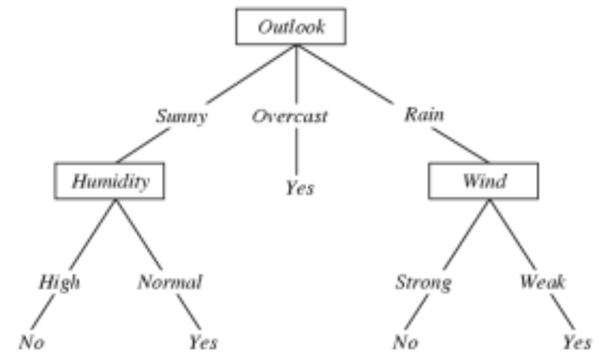
Decision Trees
Hypotheses are represented as trees
  Nodes are variables (features)
  Leaves are class predictions (or class probabilities)
    Leaves can also contain subsets of the training set
  Arcs represent node evaluations
© Manfred Huber 2021
Example from
Tom Mitchell

Slide 4
Decision Trees
Decision trees represent logical sentences in disjunctive normal form (DNF)
  Consecutive elements in a branch form conjuncts
  Branches with same leaf label form disjuncts
Variables/features are assumed to be independent
Can be converted into rules by making the sentences into implications with class as the right hand side
© Manfred Huber 2021

Slide 5
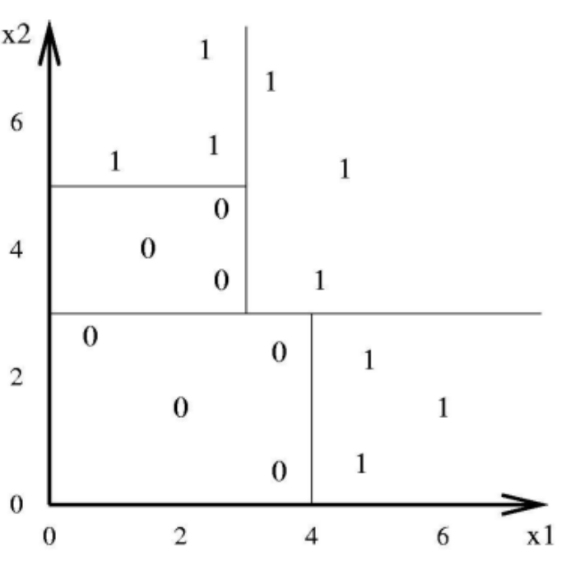
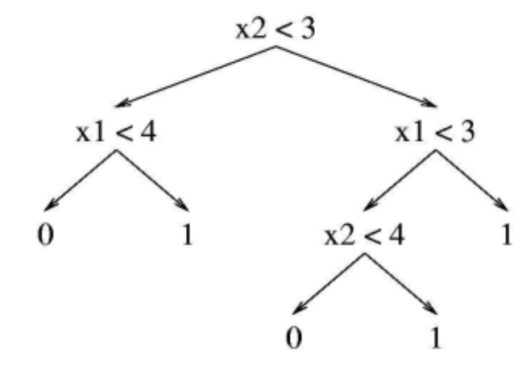
Decision Trees
Decision trees work with continuous and discrete variables and form complex decision boundaries
  Non-continuous
  Non-differentiable
Decision trees can dramatically overfit noisy data
© Manfred Huber 2021

Slide 6
Decision Trees
Variables can occur multiple times on a branch of the tree if they are non-boolean
  Decision trees with “predicates” = , < represent all possible DNF sentences with arbitrary thresholds
    Trees can have very different depths
    Unlimited hypothesis space
    Generally many decision trees for same classification
  Decision trees can be extended
    Use additional features
    Including additional “predicates” for evaluation
© Manfred Huber 2021

Slide 7
Learning Decision Trees
There is no continuous interpretation of either the probability or the decision boundary
  No derivative with respect to tree parameters
To optimize performance, decision tree algorithms generally use search
  Since the space of all trees is intractable they typically use greedy, fixed lookahead search
    Each greedy search adds one node to the tree
    The resulting tree is generally not optimal
© Manfred Huber 2021

Slide 8
Learning Decision Trees
Performance function
  Classification performance
    “Purity” of the prediction
Tree construction criterion
  Tree simplicity
    Usually in terms of number of nodes or depth of the tree
Basic algorithms iterates as follows
  Do lookahead search to find “best” feature node
    Terminate if feature does not improve performance
  Add node and split parent data set on node values
© Manfred Huber 2021

Slide 9
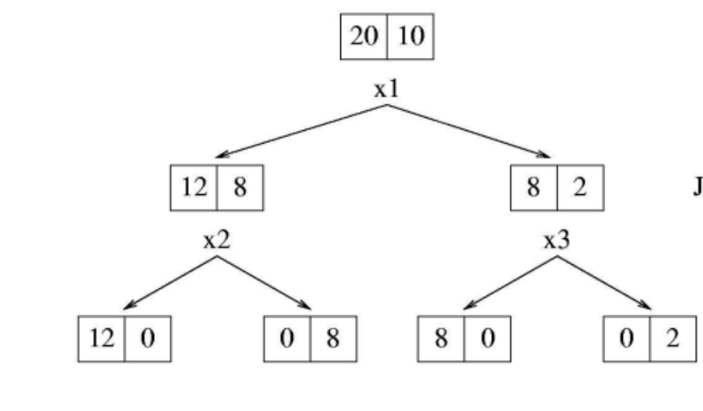
Learning Decision Trees
How can we pick the best feature ?
  Error in terms of number of misclassified data points
    Does not consider whether the result of the split might allow for a better split later
© Manfred Huber 2021

Slide 10
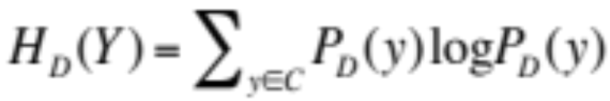
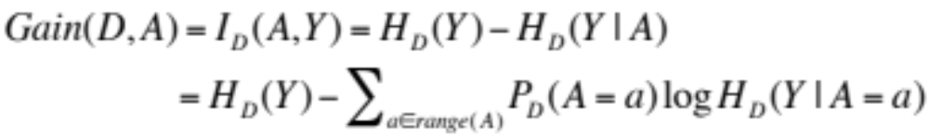
Learning Decision Trees
How can we pick the best feature ?
  Information gain (reduction in the Entropy)
    Performance function is entropy
    Best feature is the one that reduces entropy the most (has the highest information gain)
      Prefer “purer” sets
© Manfred Huber 2021

Slide 11
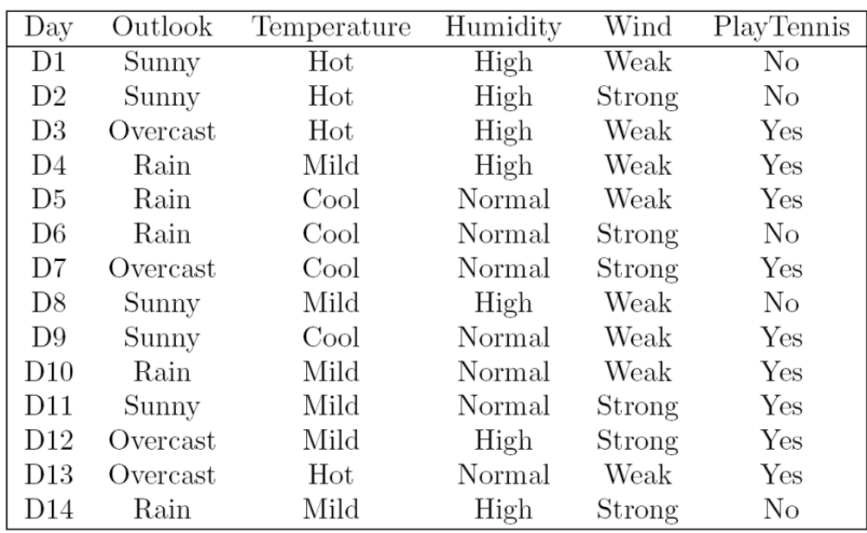
Example
© Manfred Huber 2021
Example form Tom Mitchell

Slide 12
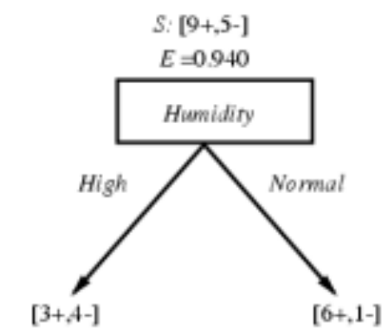
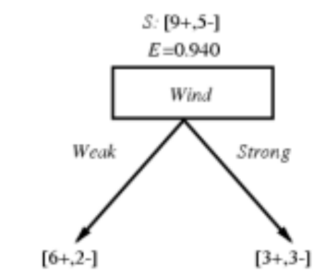
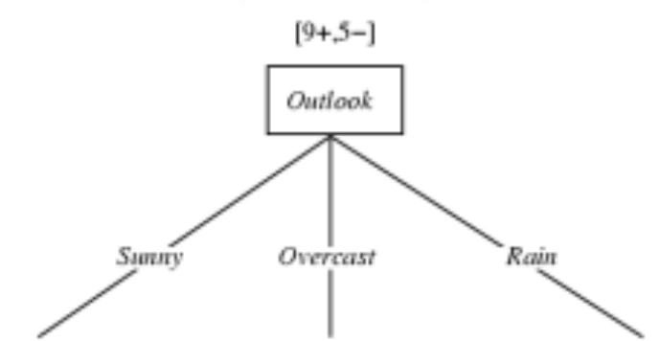
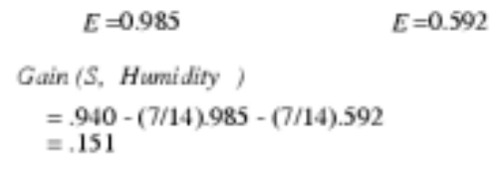
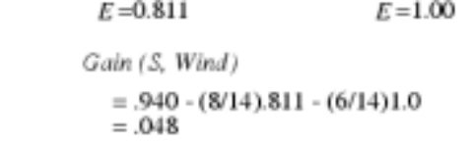
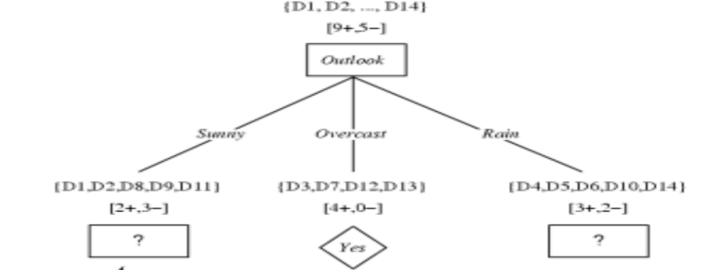
Example
E=0.971 E=0 E=0.971
Gain(S, Outlook)
=.940 - (5/14).971 – (4/14)0 – (5/14).971
= 0.246 .
© Manfred Huber 2021

Slide 13
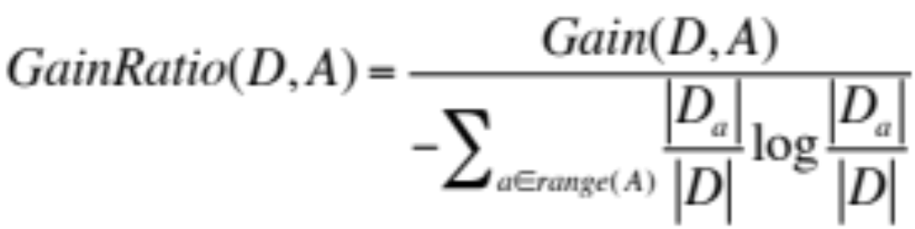
Multi-Valued Features
Features with multiple values have to be treated differently
  Many-way splits result in very small sets and thus unreliable estimates of the entropy
    Gain ratio provides one possible way to overcome this
      Gain ratio looks at the information gain relative to the intrinsic information of the feature
      Tries to compensate for the benefits of multiple options
© Manfred Huber 2021

Slide 14
Continuous features
Continuous Features have to be converted into boolean (or multi-valued)
  For continuous variables a threshold for the < “predicate” has to be picked
    Sort data elements and evaluate every possible threshold at which the classification changes
      Other points can not result in maximum
    Use the threshold with the highest gain
© Manfred Huber 2021

Slide 15
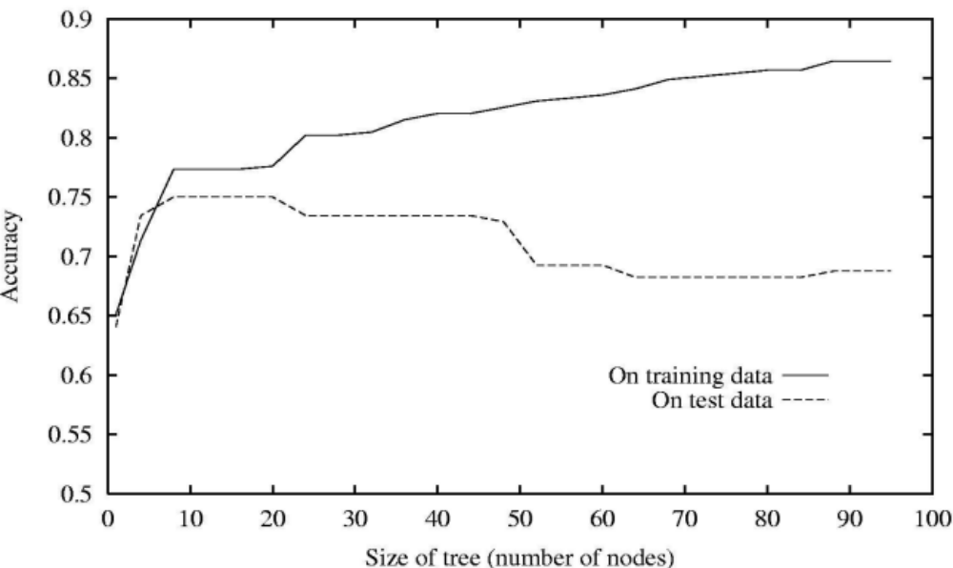
Overfitting in Decision Trees
If there is noise in the data, decision trees can significantly overfit
  To determine overfitting, we need to use test data that was not used for training
© Manfred Huber 2021

Slide 16
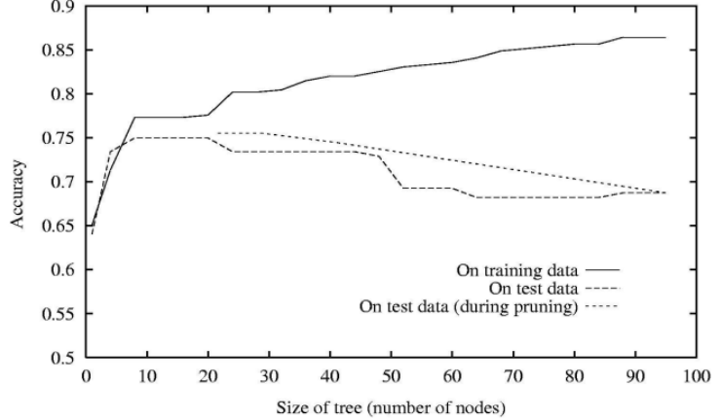
Overfitting in Decision Trees
There are two basic mechanisms to address overfitting
  Early stopping when split is not significant
  Post-pruning after complete learning
    Evaluate benefit of pruning on accuracy in test set and remove the node (branch) with highest accuracy gain
© Manfred Huber 2021

Slide 17
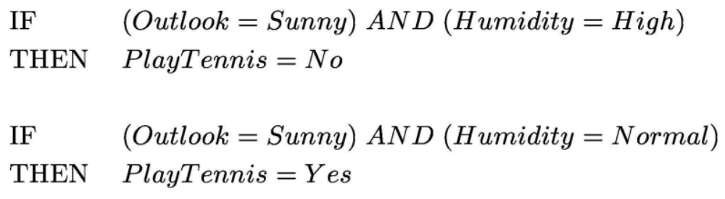
Decision Trees and Rules
Decision trees can be easily converted into a set of rules (one rule per branch)
  In C4.5 (and a number of other decision tree algorithms) pruning is performed on the rules
    Prune each rule individually
    Sort rules into desired sequence for faster use
© Manfred Huber 2021

Slide 18
Decision Trees
Decision trees are a very frequently used type of classifier in particular when discrete features are present
  Can represent highly non-linear classes
  Can be translated into rules
  Result is easy to understand and interpret
  Does not represent continuous relationships
    Can be augmented by including logistic regression “predicates” and multi-variate feature functions
Many practical algorithms: ID3, C4.5, …
© Manfred Huber 2021

