Slide 1
Machine Learning
Regression
© Manfred Huber 2021

Slide 2
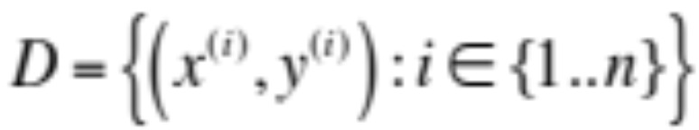
Regression
Regression refers to supervised learning problems where the target output is one or more continuous values
  Continuous output values imply that outputs can be interpolated and that they can be (at least partially) ordered
  Training data:
  The task is to learn a function (hypothesis), h, such that that h(x^{(i)}) is a “good” predictor for y^{(i)}
© Manfred Huber 2021

Slide 3
Regression
Regression is often better formulated as a discriminative learning task
  Continuous output would require learning a conditional probability density function with continuous conditions for the generative scenario
  For discriminative learning, we explicitly form a representation for the the function h estimating the MLE/MAP value for the input x
    Lower dimensional function
    Does not need to represent the full distribution, only the estimate
© Manfred Huber 2021

Slide 4
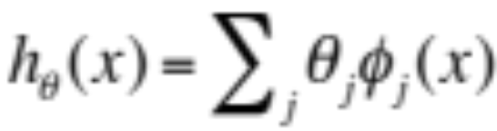
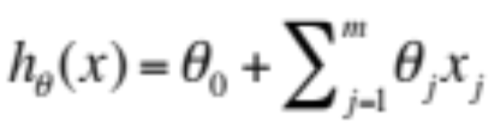
Linear Regression
The simplest representation for regression is a linear function with a set of parameters
  In a linear representation, the function is linear in terms of the function parameters θ but not necessarily in the features of the input x
    A special case of this is the traditional linear representation in the original data features
      This represents a line in the original feature space
© Manfred Huber 2021

Slide 5
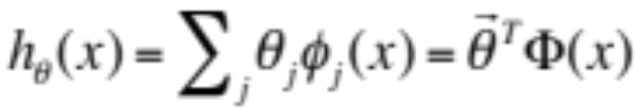
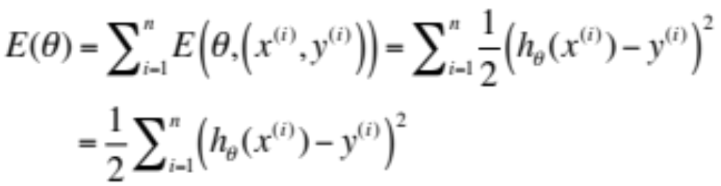
Linear Regression
Often we will write this in vector/matrix notation
Since we do not have a probabilistic representation we do need a different performance function
  Squared error
© Manfred Huber 2021

Slide 6


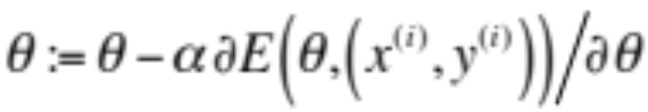
Error Minimization
There are different ways we can minimize an error (or other performance) function
  Analytic optimization
    Find parameters where the derivative is 0
    Ensure it is a minimum and not a maximum
  Batch gradient descent
  Stochastic/incremental gradient descent
© Manfred Huber 2021

Slide 7
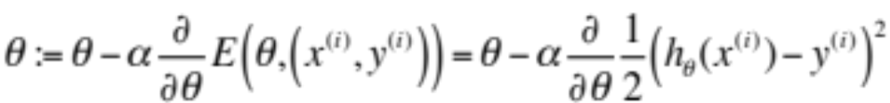
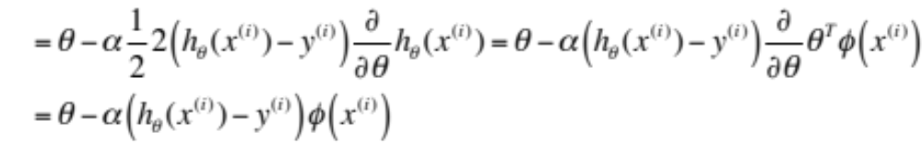
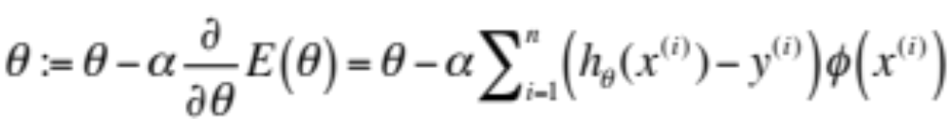
Linear Regression
Using the Least Square error function we can derive a stochastic gradient descent method
  This is also called the Widrow-Hoff learning rule
Converting this to batch gradient descent
© Manfred Huber 2021

Slide 8
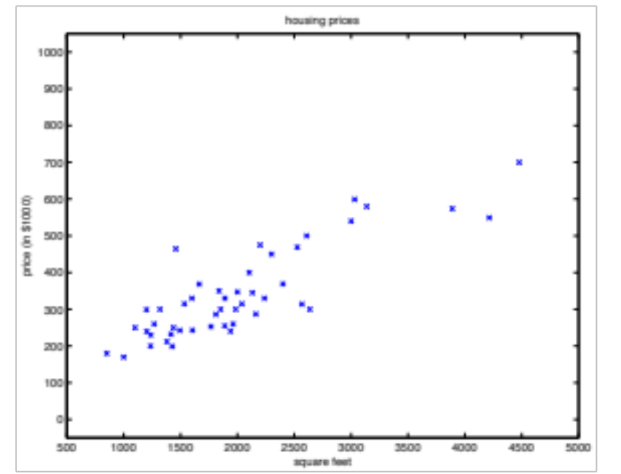
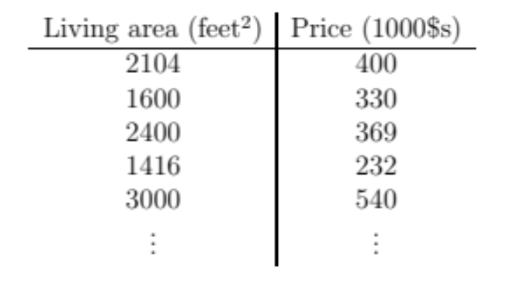
Linear Regression Example
Example from Andrew Ng.
  Using simple representation linear in the features
© Manfred Huber 2021

Slide 9
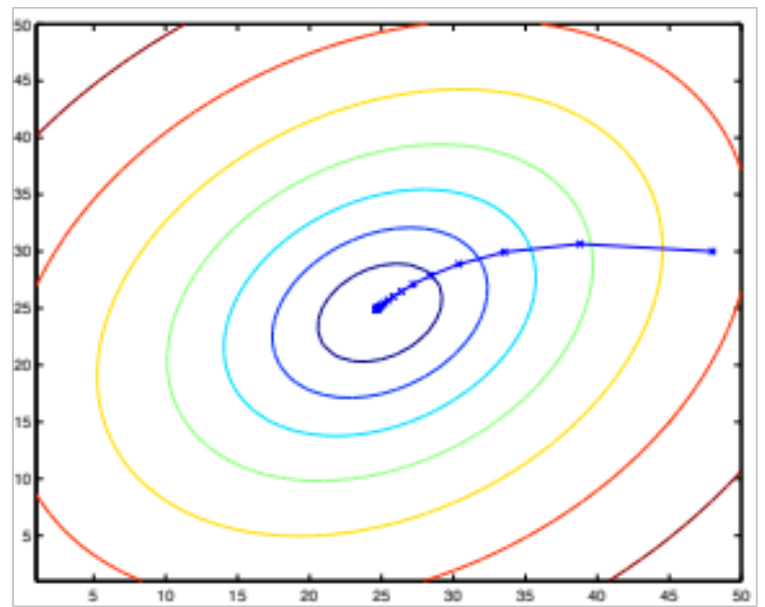
Linear Regression Example
Using batch gradient descent
© Manfred Huber 2021

Slide 10
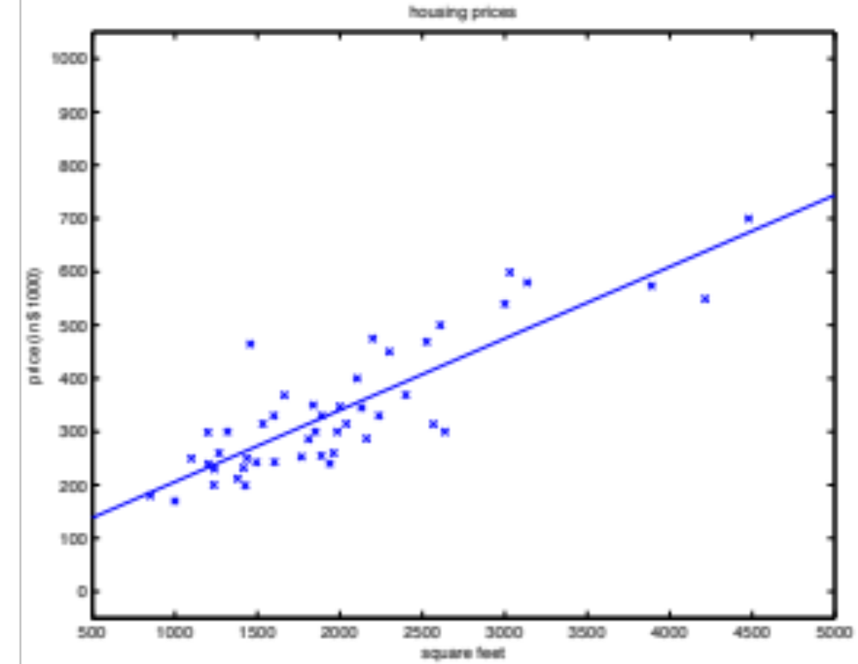
Linear Regression Example
Resulting in a linear predictor
© Manfred Huber 2021

Slide 11
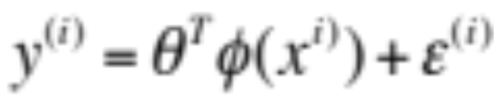
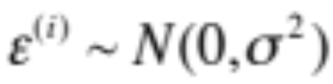
Least Square Error and Maximum Likelihood
Why is least square a good performance function for Linear regression ?
  Under certain assumption least square for linear regression leads to the maximum likelihood parameters for a linear function
    Assume that the real function is linear with noise
    Assume that the noise is normally distributed
© Manfred Huber 2021

Slide 12
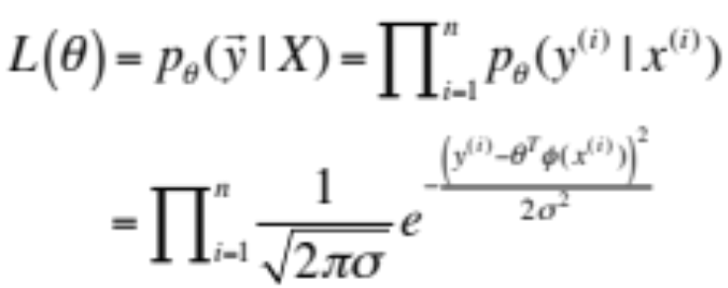
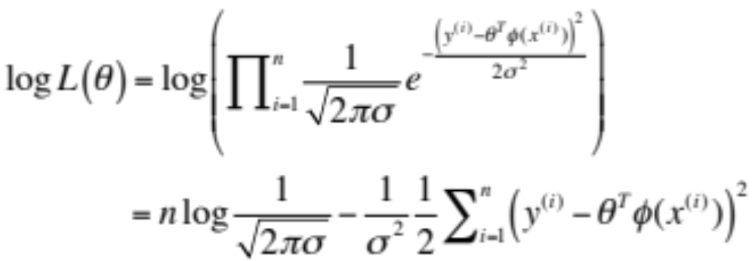
Least Square Error and Maximum Likelihood
Under these assumptions we can express the likelihood of the parameters
  Converting this to log likelihood
    Maximum likelihood is the same as least squares
© Manfred Huber 2021

Slide 13
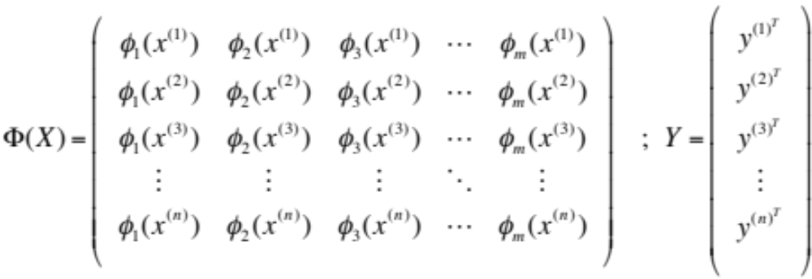
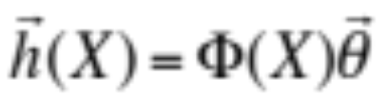
Analytic Optimization
To simplify notation we convert data and target values into matrices
  Using this the vector of predicted values h(X) can be computed as
© Manfred Huber 2021

Slide 14
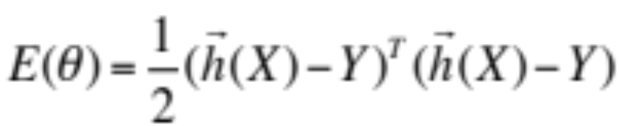
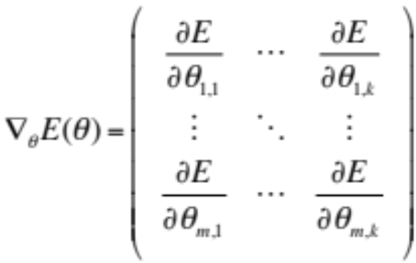
Analytic Optimization
The squared error function can then be rewritten as
  To optimize we have to calculate the derivative
    Derivative of a matrix is the matrix of its partial derivatives with respect to all the parameters
      This is also called its Jacobian
© Manfred Huber 2021

Slide 15
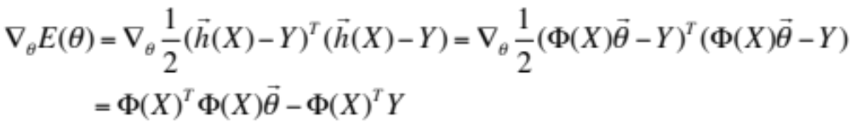
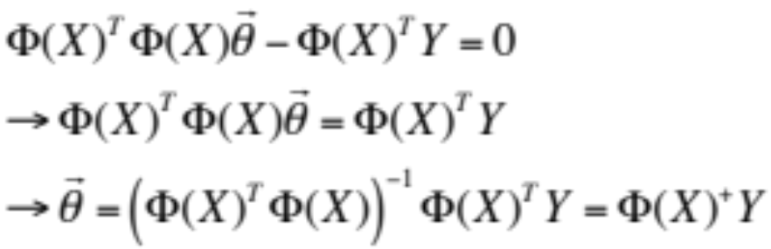
Analytic Optimization
For linear regression the derivative can be derived
  This leads to an analytic solution
    A⁺ is called the Moore-Penrose Pseudoinverse
These are the Normal Equations of the Least Squares problem
© Manfred Huber 2021

Slide 16
Analytic Optimization
Using Pseudoinverse poses challenges
  Computation the Pseudoinverse for matrices with a large number of rows can be numerically unstable
  Pseudoinverses can be ill-conditioned, leading to numerically unstable/incorrect results
  Results should always be verified
There are more stable ways to solve this optimization problem
  E.g. use of extended system and QR factorization
  Incremental optimization
© Manfred Huber 2021

Slide 17
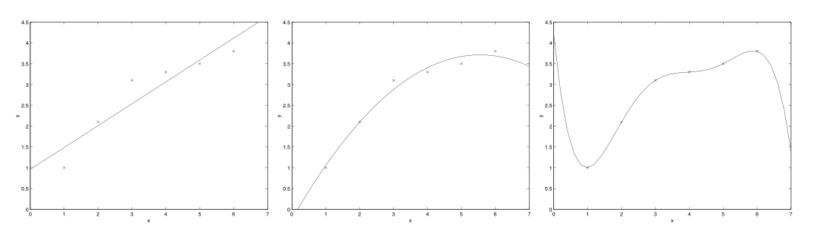
Linear Regression
Choosing feature functions ϕ(x) allows linear regression to represent non-linear functions
  Still linear in the learned parameters
    Can not learn the type of non-linearity (only choose it)
  Adding many feature functions leads to overfitting
    Locally Linear Regression learns different parameters for different regions of ϕ(x)
© Manfred Huber 2021

Slide 18
Locally Weighted Linear Regression
Different ways to increase the types of relations that linear regression can form exist
  Locally weighted linear regression combines ideas of linear regression with ideas from non-parametric representations
    Error is weighted squared error where the weight determines influence of a point and is based on similarity
      Weights are not parameters to be learned but fixed functions of the point for which the error is calculated
© Manfred Huber 2021

Slide 19
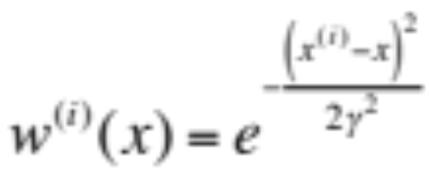
Locally Weighted Linear Regression
Common weights are local to the point, e.g.:
  Since weights are positive they can be pulled into the design matrix Φ(X) and the target output Y
  Can be solved the same way as linear regression once the data point x is known
© Manfred Huber 2021

Slide 20
Locally Weighted Linear Regression
For each point weights can be computed, reducing it to a weighted least squares problem with fixed weights
  Corresponds to optimizing a different Error function for each query
Locally linear regression forms one regression line for each data point, leading to a smooth regression curve using linear regression
  Can have problems when there is limited data for which the weight function is sufficiently large
© Manfred Huber 2021

Slide 21


Overfitting
Locally linear regression addresses overfitting by allowing a function to be approximated with fewer features
Another method to address overfitting is regularization
  Introduce penalty term for the factor introducing overfitting: complexity of the representation
    Penalize large coefficients as a measure of complexity
      L1 regularization: Add penalty of
      L2 regularization: Add penalty of
© Manfred Huber 2021

Slide 22
Linear Regression
Linear regression is a powerful technique to build Maximum Likelihood predictors for regression problems
  Has only to be linear in the learning parameters and can thus represent limited non-linear function in terms of the input
    Choice of feature functions is important for its expressiveness
  Analytic solution can be computed but is sometimes numerically unstable
  Incremental techniques can be used for on-line learning or if analytic solution is not stable
© Manfred Huber 2021

