Slide 1
Machine Learning
Supervised Learning
© Manfred Huber 2021

Slide 2
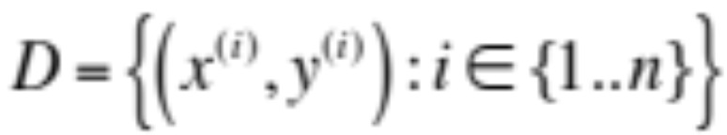
Supervised Learning
Supervised learning is learning where the training data contains the target output of the learning system.
  Training data
  The type of output data determines the type of supervised learning problem
    If y is a real number it is a regression problem
    If y is an enumeration type it is a classification problem
© Manfred Huber 2021

Slide 3

Supervised Learning
The task of supervised learning is to learn a function (hypothesis), h, such that that h(x^{(i)}) is a “good” predictor for y^{(i)} :
  The representation used is an encoding of h
  The hypothesis space is the space of all functions that can be represented with the representation
  The evaluation/performance function determines what “good” means
  When probabilistic criteria are used, h can also be chosen to represent P(y) followed by either a MLE,MAP, or expected value pick of y
© Manfred Huber 2021

Slide 4
Supervised Learning Representations
The space for all possible supervised learning solutions is the space of all functions
  Infinitely large, requires infinite representation
    It is intractable to design an algorithm with a universal and precise hypothesis space
      Can limit the type of function
      Can limit how precisely to represent the function
    Parametric representations limit the type of function and encode the function using a set of parameters
    Non-parametric functions limit the precision to which they model the function and represent it in terms of weighted data points
© Manfred Huber 2021

Slide 5
Supervised Learning Representations
Example representations include
  Parametric
    Polynomials of fixed degree
    Parametric exponential functions
    Neural networks
    …
  Non-parametric
    Point-based density estimators
    Point-based mixture distributions
    Tile coding
    …
© Manfred Huber 2021

Slide 6
Point-Based Estimators
Point-based estimators are a non-parametric way to represent arbitrary functions with the precision limited by the number of points
  Each data point represents the location of a specific (kernel) function and its weight represents the magnitude of its contribution
    Kernel functions define the change in function value contribution when moving away from the point in terms of a similarity measure
  The function estimate at another point is the sum or average of all the kernel functions’ values at that point
© Manfred Huber 2021

Slide 7
Point-Based Probability Density Estimators
To (approximately) represent an arbitrary probability density function we can use a point-based estimator where the kernel function is a valid probability density function and the weights are the probability of the point contributing (i.e. weights are a probability distribution over points)
  At any point, the probability density is the weighted sum of the probability densities of the kernel functions at that point
    The more points used, the more precise a function can be represented
© Manfred Huber 2021

Slide 8
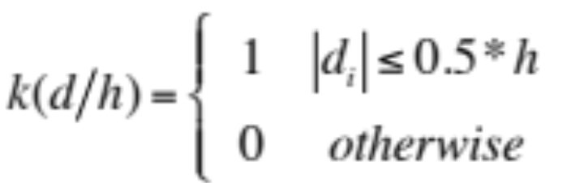
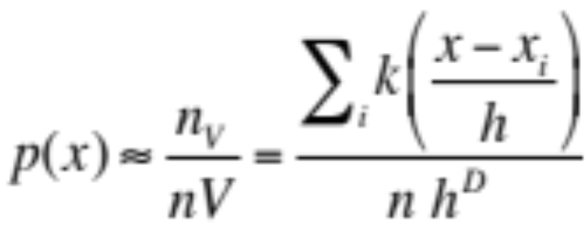
Point-Based Probability Density Estimators
Computation can be reduced by limiting how many points are used for any evaluation
  If the kernel function has limited extent, we only need to use a subset of the points to estimate the density
    E.g. Parzen window kernel
    The expected number of points, n_{V} , contributing to any estimate is related to the probability density at that point and the size of the window, V=h^{D}
© Manfred Huber 2021

Slide 9
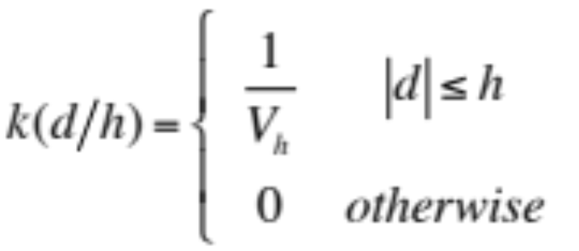
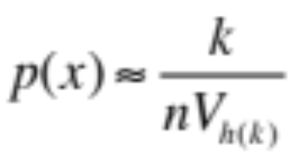
Point-Based Probability Density Estimators
  Alternatively, the size of the kernel function can be regulated such that a constant number of points contribute to the estimate
    Easiest using a hyperspherical window rather than a Parzen window
    The value for d (and thus V) at a point is set such that exactly k data points fall within it. Then:
© Manfred Huber 2021

Slide 10
Non-Parametric Supervised Learning – An Example
One of the simplest machine learning approaches is K-Nearest Neighbor (KNN)
  Given a set of (class) labeled data points and a query x
  {(x₁,c₁),…, (x_{n},c_{n})}
    Can also be used for regression problems
  Pick the k data points most similar to x
  Return the label that is associated with the largest number of the data points
KNN is a supervised learning algorithm using a point-based density representation
© Manfred Huber 2021

Slide 11
KNN Classification
What is the answer to the KNN learning problem ?
  Data: {((1, 1); S),((2, 1); F),((2, 2); F),((1, 3); S),(3, 3; S)}; K=3; Point=(1.25, 1.75)
  Answer:
    Three nearest points (using Cartesian distance) are: ((1, 1); S), ((2, 2); F), ((2, 1); F)
    Answer is F
  Why is that a good answer ?
    What would the elements of a formal learning algorithm be that gives us this solution ?
© Manfred Huber 2021

Slide 12
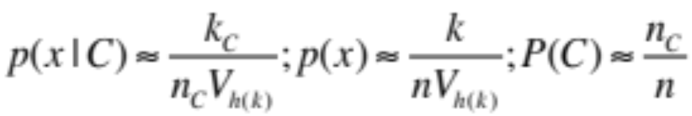
KNN Classification
Representation
  Hypothesis space:
    Set of point-based class probability distributions
  Representation:
    sets of labeled data points and a distance/similarity measure forming a kernel-based probability distribution
      In the simplest form the kernels are spherical windows
    Data points represent limited range probability estimates supporting the class label
© Manfred Huber 2021

Slide 13
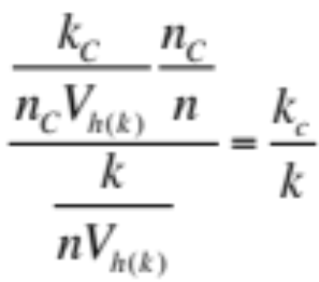
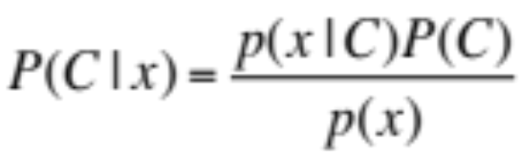

KNN Classification
Evaluation
  Performance function:
    Probability of a data point at x having label l assuming generalization through the chosen kernel function
      In standard KNN the kernel is a hyperspherical window
  Optimization criterion:
    Maximum Posterior Estimate (MAP) in the spherical region around x containing K data points
=
© Manfred Huber 2021

Slide 14
KNN Classification
KNN is a simple algorithm that provides an approximate MAP estimate of the class
  Makes a number of assumptions
    Probability density interpolates according to kernel
      Weighted KNN corresponds to distance-dependent kernels
    Point estimates are independent
  Can be extended to regression problems by using weights and estimated value as the output
  Requires no training time but significant prediction time that grows with the size of the training set
© Manfred Huber 2021

Slide 15
Representation for Classification
KNN uses a non-parametric representation to learn MAP classification
  Representation contains all data pints in the training data set
    There are ways to reduce this size
Other, parametric representations can be used for the same problem
  Simplest representation would be storing the underlying parameters of the MAP problem
    P(c), P(x|c) - Bayesian Learning
© Manfred Huber 2021

Slide 16
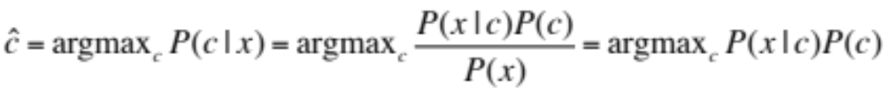

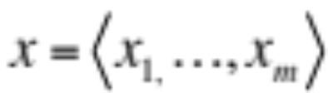
Bayesian Classification
Bayesian classification determines the class with the highest a posteriori (MAP) probability for a given input using the training data set
  Class is picked as the one with the highest MAP probability
  Training data set is used to learn the best parameters for the classifier
    The parameter space is exponential in the number of features x_{i} in x
© Manfred Huber 2021

Slide 17
Bayesian Classification
Bayesian classification using conditional probabilities as parameters is intractable
  Number of features grows rapidly
    Very fast exceeds the amount of memory available
  Often more parameters than data points
    Parameters can not be learned well from the data
To use Bayesian classification, some assumptions have to be made
  Conditional independence of features given a class
© Manfred Huber 2021
Notes:
Text classification:
10,000 words
1000 words per article
Feature space: 10,000^1000=10^4000 (there are only 10^80 atoms in the universe)
Without order:
Sum n=1-1000 (10,000 choose n) still way too big

Slide 18
Bayesian Classification
Conditional independence of some of the features leads to a reduction of the parameter space
  Partial conditional independence – features are conditionally independent of some other features, but not all of them
    Bayesian networks
  Complete conditional independence – all features are conditionally independent given the class
    Naïve Bayes
© Manfred Huber 2021

Slide 19

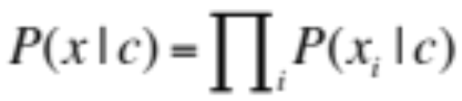
Naïve Bayes Classification
Making the assumption that all features are conditionally independent given the class reduces the number of parameters
  Number of parameters is linear in the number of features
  MAP parameters can be computed from the smaller set of parameters
© Manfred Huber 2021
Notes:
Conditional independence for text classification implies independence of order in text if features are words

Slide 20
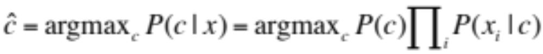
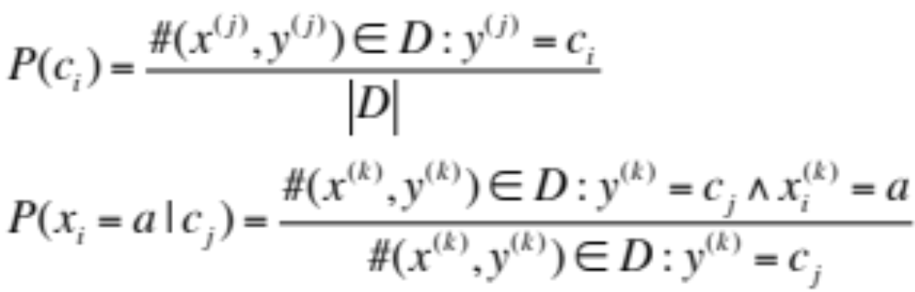
Naïve Bayes Classification
Independence reduces the classifier to
  Learning requires determining the parameters P(c_{i}) and P(x_{i}|c_{i}) from the data
    MLE for the parameters can be used
© Manfred Huber 2021

Slide 21
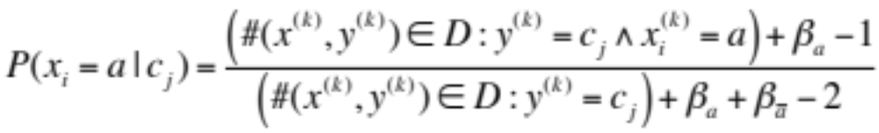
Naïve Bayes Classification
MLE for the parameters has problems
  Estimation quality deteriorates when there is limited data
    Many parameters end up 0 or 1
Can use MAP estimate instead
  For binary features the answer is the MAP of a Bernoulli distribution with a Beta distribution prior
© Manfred Huber 2021

Slide 22
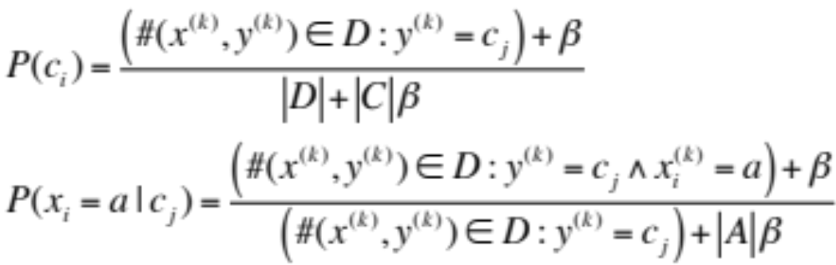
Naïve Bayes Classification
  For multinomial features MAP corresponds to a multinomial distribution with its conjugate Dirichlet prior
    This corresponds to Laplace smoothing
      For the case where we all β are the same this gives
      This is equivalent to adding β observations to each count
© Manfred Huber 2021

Slide 23
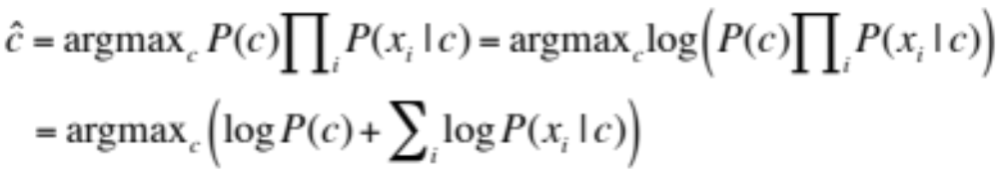
Naïve Bayes Classification
Naïve Bayesian classification (and Bayesian classification in general) has additional numeric problems
  The more features, the smaller the posterior in general
    More stable to solve Bayesian classification in log likelihood space
© Manfred Huber 2021
Notes:
Conditional independence for text classification implies independence of order in text if features are words

Slide 24
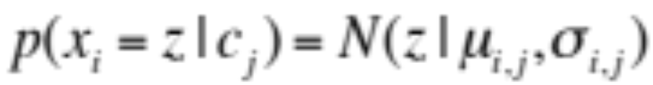
Bayesian Classification
If features are continuous it is no longer possible to represent all conditional probability density values even under the Naïve Bayes assumption
  Need to introduce parameters to represent the probability density function of every feature given a class
    Common choice is a Gaussian distribution
© Manfred Huber 2021
Notes:
bb

Slide 25
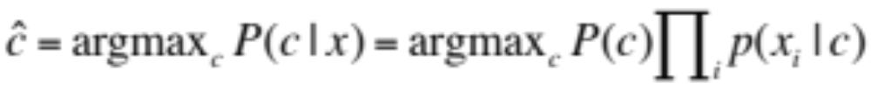
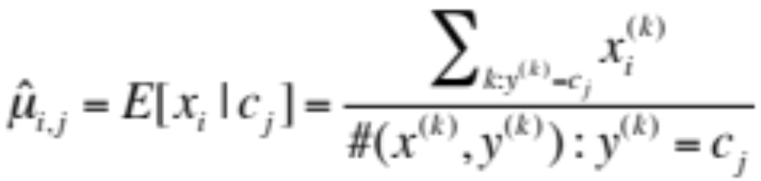
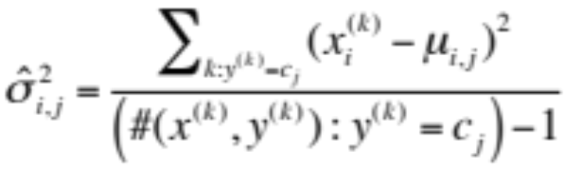
Gaussian Naïve Bayes
Naïve Bayes criterion stays the same
  Need to learn the Gaussian parameters from data
    Using MLE the expected mean of the Gaussian Gaussian is the expected value in the data
    Similarly the expected variance is the unbiased variance of the data in the class
© Manfred Huber 2021

Slide 26
Naïve Bayes Classification
Naïve Bayes is a commonly applied technique for probabilistic classification
  Naïve Bayes is usually relatively easy to apply
  Uses relatively intuitive parameters
  Number of parameters is linear in the number of features
  Often yields good results
  Independence assumption is usually not strictly correct
  Requires significant data to estimate its parameters
  Makes relatively limiting assumptions for continuous features
© Manfred Huber 2021

Slide 27
Generative vs. Discriminative Learners
Supervised learning algorithms are often divided into two groups
  Generative algorithms
  Discriminative algorithms
Generative algorithms are algorithms that learn a model for the process that generates the data and use this to predict the output
Discriminative algorithms directly learn to predict/discriminate the output
© Manfred Huber 2021

Slide 28
Generative vs. Discriminative Learners
Generative algorithms allow to predict the output and to generate simulated data
  Learn p(x | y) and potentially p(y)
  Use MLE or MAP to predict the output
Discriminative algorithms directly learn to predict/discriminate the output
  Learn p(y | x) or directly the MAP estimate for y
© Manfred Huber 2021

Slide 29
Generative vs. Discriminative Learners
Both types of learners have their advantages and disadvantages
  Generative algorithms can be used to produce simulated data
  Parameters for generative algorithms are often easier to extract from the data
  Discriminative algorithms often have more compact representations (particularly if they directly learn to predict the MAP estimate)
© Manfred Huber 2021

