Slide 1
Machine Learning
Feature Learning
© Manfred Huber 2021

Slide 2
Feature Learning
Feature representations are important for supervised learning problems as well as Reinforcement Learning problems
  Feature representation can change the complexity of the decision boundary
  Feature representation can change the dimensionality of the problem
Features can be either designed or learned
  Supervised: e.g. ANN hidden units learn features
  Unsupervised: e.g. cluster IDs as features
© Manfred Huber 2021

Slide 3
Unsupervised Feature Learning
Unsupervised features have to be built around general principles for “good” features
  Metric for “good” features has to be built into the algorithm
Clustering can be used to form features IDs can be used as discrete features (similar items have the same/similar features)
  Cluster ID as discrete feature
  Cluster probability as continuous feature
Other criteria for “good” features can be used
© Manfred Huber 2021

Slide 4
Unsupervised Feature Learning
A common criterion for “good” features are
  How precisely they can represent the data
  How compact the basis is
Representation accuracy is aimed at ensuring that the unsupervised feature learning does not loose significant amounts of information
  Information loss might make some subsequent tasks impossible to do/learn
Compactness is aimed at simplicity
  Reduce overfitting
  Reduce complexity for subsequent tasks
© Manfred Huber 2021

Slide 5
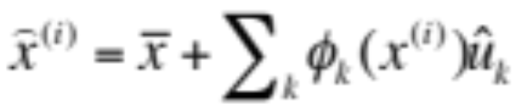
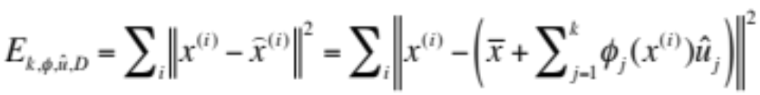
Principal Component Analysis
Principal component analysis (PCA) is one of the most used approaches for unsupervised learning of a compact feature space
  Uses both accuracy of representation of data and compactness of the representation
  Assumes linear representation of data in terms of learned, constant, unit length basis vectors
    Accuracy of representation is defined in terms of a common criterion for “good” features are
© Manfred Huber 2021

Slide 6
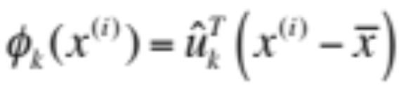
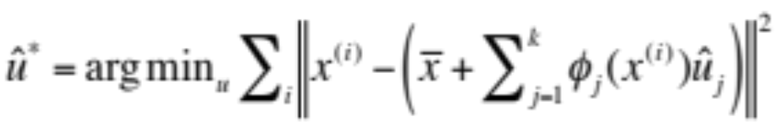
Principal Component Analysis
PCA basically forms a new basis for the data in such a way that for every number of features, k, the resulting basis minimizes the square reconstruction error
  Each feature tries to capture as much of the remaining data variation as possible, reducing the squared error as much as possible
    Feature value that minimizes the error for all k:
    Corresponding basis vectors have to minimize the error
© Manfred Huber 2021

Slide 7
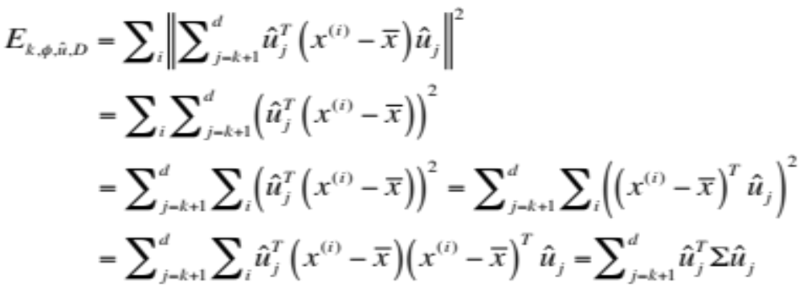
Principal Component Analysis
To solve for the basis it is important to note:
  The vectors have to be orthogonal
  The error for k=d is 0
Thus the error for a k is equal to the value of the higher components
© Manfred Huber 2021

Slide 8
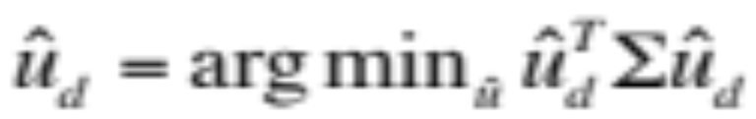
Principal Component Analysis
Solving from top down, starting with k=d we can notice that has its solution for the smallest eigenvector of Σ
  In the same way, each earlier basis vector corresponds to the next smaller eigenvector of Σ
Principal components of a data set are the eigenvectors of normalized data’s covariance matrix in order of increasing eigenvalue
  If scales of original dimensions are incompatible, data can be normalized with standard deviation
© Manfred Huber 2021

Slide 9
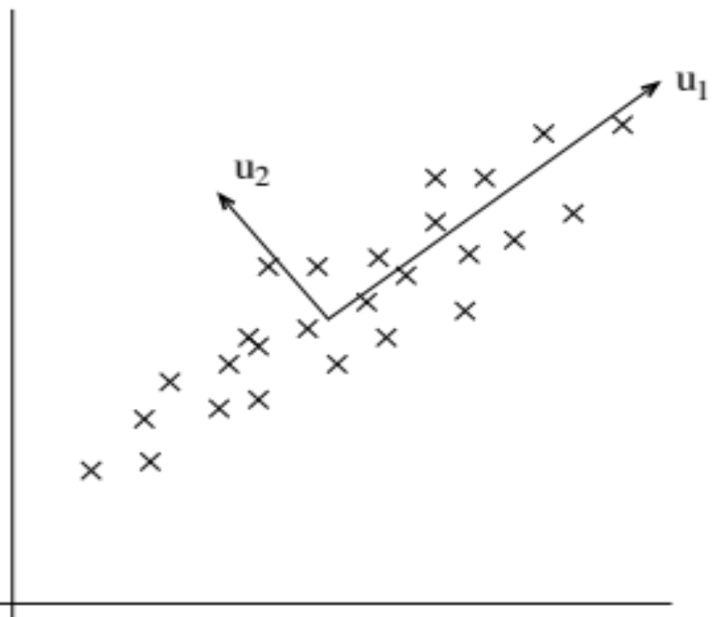
Principal Component Analysis
PCA example
© Manfred Huber 2021

Slide 10
Principal Component Analysis
PCA algorithm
  Create n x d data matrix D
  Normalize columns by subtracting column average
    If desired, normalize columns with standard deviation
  Compute scaled covariance matrix Σ=D^{T}D of data
  Find eigenvectors and eigenvalues of Σ
  Sort by eigenvalue for Principal Components
Eigenvalue indicates loss when not using the principal component
  Shorter representation by ignoring higher components
© Manfred Huber 2021

Slide 11
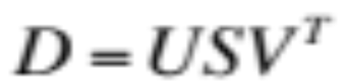
Principal Component Analysis
If d is large the eigenvector calculation becomes expensive and potentially numerically unstable
  Can solve using Singular Value Decomposition
    S is a diagonal matrix of the eigenvalues of D^{T}D
    The columns of V are the eigenvectors of D^{T}D
  SVD is more stable and often more efficient
© Manfred Huber 2021

Slide 12
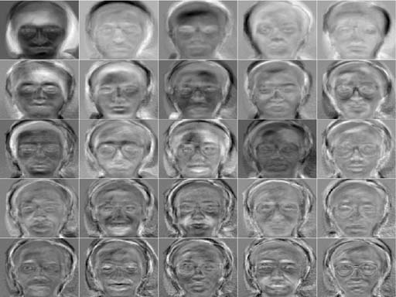
Principal Component Analysis
PCA is one of the most commonly used feature learning approaches
  E.g. Eigenfaces:
    25 most significant principal components of a set of face images:
© Manfred Huber 2021
C. DeCoro

Slide 13
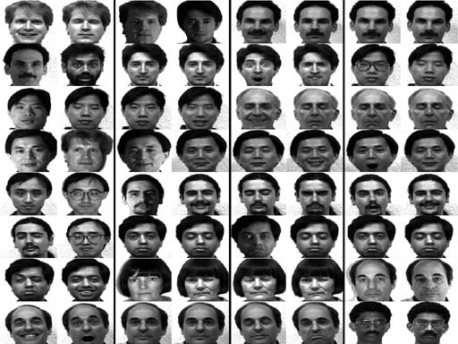
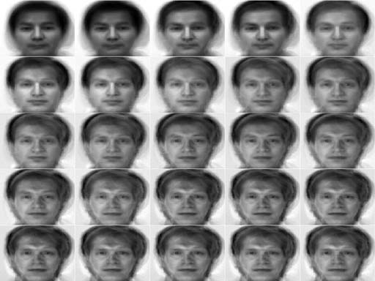
Eigenfaces
Using these 25 features we use nearest neighbor to identify the person
  Reduction to a 25 dimensional representation
  Recognition rate is above 80% for the test set
  Reconstruction:
C. DeCoro
© Manfred Huber 2021

Slide 14
Feature Learning
Other techniques exist to learn a different feature representation
  Independent component analysis (ICA)
    Similar to PCA but finds most statistically independent components
      Minimizes mutual information between components
      Or: maximizes non-Gaussianity
    Used to separate multiple sources of stochastic data
  Sparse PCA
    PCA where components can be in at most k dimensions
  Sparse coding
    PCA with a regularization term over feature values
© Manfred Huber 2021

Slide 15
Self-Organizing Maps
Self-organizing maps are neural networks that are trained in an unsupervised fashion
  Hidden units are arranged in a k-dimensional lattice with a distance function
    Weight vectors to a unit map into the lattice
    Neighboring unit’s weight vectors are weakly linked based on the distance function
    Training “deforms” lattice to map onto data points
      Topological mapping
  Units compete for Best Matching Unit (BMU)
    Units cooperate with BMU, updating based on distance to BMU
© Manfred Huber 2021

Slide 16
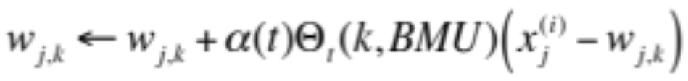
Self-Organizing Maps
Randomly initialize hidden unit weight vectors
For each data point find the unit that has the weight vector most similar to the data (BMU)
  Similarity is usually Cartesian distance
Update the weights of all the units
  Θ_{t}(k,l) is the similarity between the lattice location of nodes k and l
Repeat with next data point until iteration limit
© Manfred Huber 2021

Slide 17
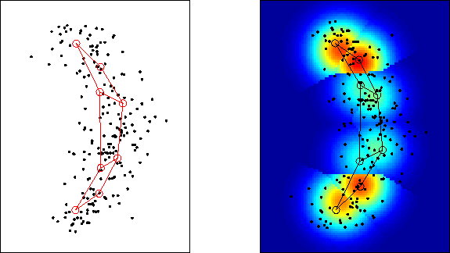
Self-Organizing Maps
SOM example
J. Lampinen
T. Kostiainen
© Manfred Huber 2021

Slide 18
Unsupervised Feature Learning
Unsupervised feature learning finds possible feature representations based on characteristics built into the algorithm
  PCA is the most commonly used
    PCA can always perfectly represent the original data
  ICA and sparse methods can find more features than in the original space
    Features can be more expressive
    Features can be more causal
  SOM establishes a topological mapping onto a k-dimensional lattice
    Can be seen as a non-linear PCA
© Manfred Huber 2021

