Slide 1
Machine Learning
Background
© Manfred Huber 2021

Slide 2
Machine Learning
To perform machine learning there are generally three common, important elements
  Representation
    How the learning system represents/encodes the data and the learning results
  Evaluation / Performance estimation
    How the learning system determines the quality of what it has learned
  Optimization
    The mechanism that improves performance with more data
© Manfred Huber 2021

Slide 3
Representation and Hypothesis Space
The representation used in the learning approach defines the hypothesis space
  A hypothesis is a possible output of the learning system
  The hypothesis space defines the space of all possible outputs of the system and can be defined in different terms
    Parametrically through a set of parameters
      E.g. the set of all 2nd order polygons for regression
      …
    Non-parametrically through sets of data points
© Manfred Huber 2021

Slide 4
Hypothesis Space and Data Complexity
The complete hypothesis space of a problem is usually enormous
  In Boolean function approximation / classification it is exponential in the number of random variables
    Every possible boolean function is one hypothesis
  To learn the precise function requires generally to see all possible data
    Learning the precise function is generally intractable
© Manfred Huber 2021

Slide 5
Hypothesis Space and Data Complexity
To address the complexity of the hypothesis space, learning has to have a way to select among all the available solutions
  Operate on a reduced hypothesis space
    Removes possible solutions, leading to only approximate solutions
  Use a preference criterion to select among possible hypotheses
    Change the evaluation/performance/optimization function to distinguish/select between the different hypotheses.
© Manfred Huber 2021

Slide 6
Hypothesis Space and Data Complexity
“Simplicity” of the hypothesis is one of the most commonly used criteria to select between hypotheses
  E.g. minimum description length
  Lowest degree polynomial function
  Minimum number of hidden variables
  Rationally usually based on either reduced complexity of subsequent use or Occam’s razor
Other criteria include “closes” hypothesis, etc.
© Manfred Huber 2021

Slide 7
Evaluation
The evaluation/performance measure determines what is to be learned from the data.
  “Similarity
  Error
  Likelihood
  Accuracy
  Cost/Value
  …
© Manfred Huber 2021

Slide 8
Evaluation in Supervised Learning
In supervised learning, the evaluation is largely based on the target output in the data
  Evaluation expresses the quality of the hypothesis, e.g.
    Error - Sum of squared differences between hypothesis and the target values over the data instances
    Likelihood – Probability that the hypothesis will generate the target value for the data instances
    Accuracy – (negative) Entropy of the hypothesis predictions in the set of data instances
    Value – Utility of the hypothesis over the set of instances
© Manfred Huber 2021

Slide 9
Evaluation
Based on the type of representation and evaluation used, machine learning make use of different fields
  Probability Theory
    E.g. maximum likelihood methods
  Information Theory
    E.g. minimum Entropy approaches
  Utility Theory
    E.g. maximum utility criteria
© Manfred Huber 2021
Notes:
b

Slide 10
Probability and Statistics
Probability and statistics are often used interchangeably but are different, related fields
  Probability
    Mainly a field of theoretical mathematics
    Deals with predicting the likelihood of events given a set of assumptions (e.g. a distribution)
  Statistics
    Field of applied mathematics
    Deals with the collection, analysis, and interpretation of data
© Manfred Huber 2021
Notes:
Lottery examples:

Slide 11
Statistics
Statistics deals with real world data
  Data collection
    How do we have to collect the data to get valid results
  Analysis of data
    What properties does the data have
    What distribution does it come from
  Interpretation of the data
    Is it different from other data
    What could cause issues in the data
© Manfred Huber 2021
Notes:
Lottery examples:

Slide 12
Probability
Probability is a formal framework to model likelihoods mainly used to make predictions
  There are two main (interchangeable) views of probability
    Subjective / uncertainty view: Probabilities summarize the effects of uncertainty on the state of knowledge
    In Bayesian probability all types of uncertainty are
    combined in one number
    Frequency view: Probabilities represent relative frequencies of events
      P(e) = (# of times of event e) / (# of events)
© Manfred Huber 2021
Notes:
Lottery examples:

Slide 13
Probability
Random variables define the entities of probability theory
  Propositional random variables:
    E.g.: IsRed, Earthquake
  Multivalued random variables:
    E.g.: Event, Color, Weather
  Real-Valued random variables:
    E.g.: Height, Weight
© Manfred Huber 2021
Notes:
Lottery examples:

Slide 14
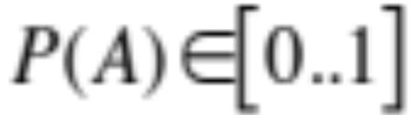

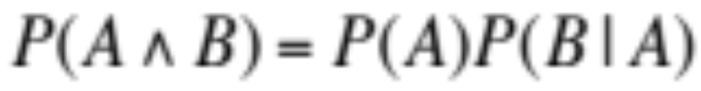
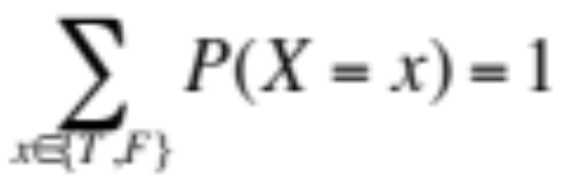
Axioms of Probability
Probability follows a fixed set of rules
  Propositional random variables:
© Manfred Huber 2021
Notes:
The same can be formulated for enumeration or continuous random variables

Slide 15

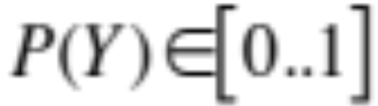
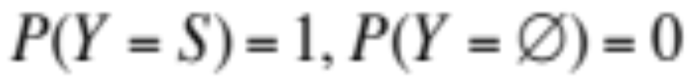
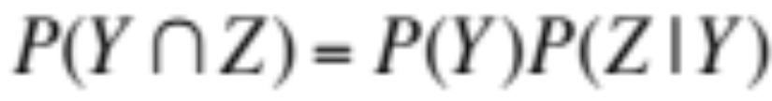
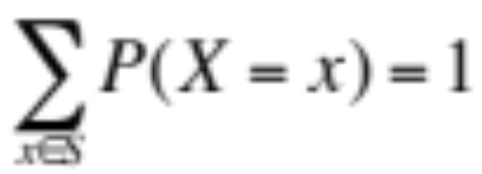
Axioms of Probability
The same axioms apply to multi-valued and continuous random variables
  Multi-valued variables ( ):
© Manfred Huber 2021
Notes:
The same can be formulated for enumeration or continuous random variables

Slide 16

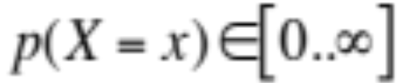
Continuous Random Variables
The probability of continuous random variables requires additional tools
  The probability of a continuous random variable to take on a specific value is often 0 for all (or almost all) possible values
    Probability has to be defined over ranges of values
    Individual assignments to random variables have to be addressed using probability densities
© Manfred Huber 2021
Notes:
The same can be formulated for enumeration or continuous random variables

Slide 17
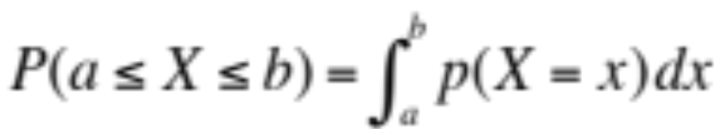
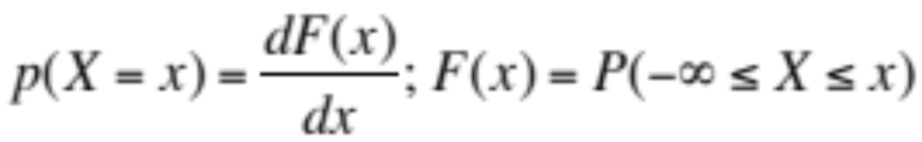
Continuous Random Variables
  Probability density is a measure of the increase in likelihood when adding the corresponding value to the range of values
    The probability density is effectively the derivative of the cumulative probability distribution
© Manfred Huber 2021
Notes:
The same can be formulated for enumeration or continuous random variables

Slide 18
Probability Syntax
Unconditional or prior probabilities represent the state of knowledge before new observations or evidence
  P(H)
A probability distribution gives values for all possible assignments to a random variable
A joint probability distribution gives values for all possible assignments to all random variables
© Manfred Huber 2021

Slide 19
Conditional Probability
Conditional probabilities represent the probability after certain observations or facts have been considered
  P(H|E) is the posterior probability of H after evidence E is taken into account
  Bayes rule allows to derive posterior probabilities from prior probabilities
    P(H | E) =
P(E | H) P(H)/P(E)
© Manfred Huber 2021
Notes:
Run doctor example:
P(meningitis) = 0.0001
P(stiff neck| menengitis) = 0.8

Slide 20
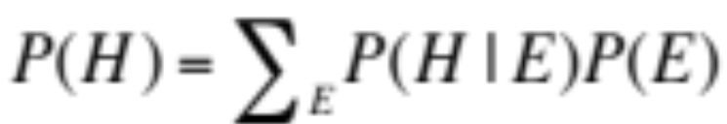
Conditional Probability
Probability calculations can be conditioned by conditioning all terms
  Often it is easier to find conditional probabilities
Conditions can be removed by marginalization
© Manfred Huber 2021

Slide 21
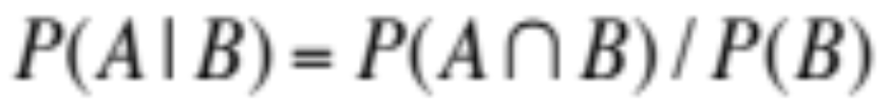
Joint Distributions
A joint distribution defines the probability values for all possible assignments to all random variables
  Exponential in the number of random variables
  Conditional probabilities can be computed from a joint probability distribution
© Manfred Huber 2021

Slide 22
Inference
Inference in probabilistic representation involves the computation of (conditional) probabilities from the available information
  Most frequently the computation of a posterior probability P(H|E) form a prior probability P(H) and new evidence E
© Manfred Huber 2021

Slide 23
Statistics
Statistics attempt to represent the important characteristics of a set of data items (or of a probability distribution) and the uncertainty contained in the set (or the distribution).
  Statistics represent different attributes of the probability distribution represented by the data
  Statistics are aimed at making it possible to analyze the data based on its important characteristics
© Manfred Huber 2021
Notes:
Lottery examples:

Slide 24
Experiment and Sample Space
A (random) experiment is a procedure that has a number of possible outcomes and it is not certain which one will occur
The sample space is the set of all possible outcomes of an experiment (often denoted by S).
  Examples:
    Coin : S={H, T}
    Two coins: S={HH, HT, TH, TT}
    Lifetime of a system: S={0..∞}
© Manfred Huber 2021
Notes:
Lottery examples:

Slide 25
Statistics
A number of important statistics can be used to characterize a data set (or a population from which the data items are drawn)
  Mean
  Median
  Mode
  Variance
  Standard deviation
© Manfred Huber 2021
Notes:
Lottery examples:

Slide 26

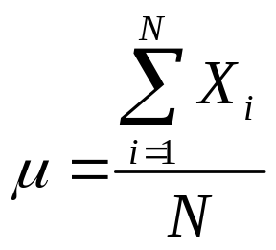
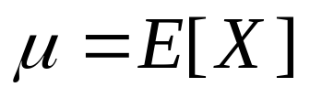
Mean
The arithmetic mean represents the average value of data set {X_{i}}
  The arithmetic mean is the expected value of a random variable, i.e. the expected value of a data item drawn at random from a population
© Manfred Huber 2021
Notes:
Lottery examples:

Slide 27
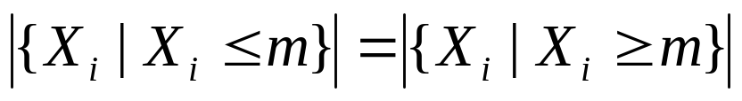
Median and Mode
The median m is the middle of a distribution
The mode of a distribution is the most frequently (i.e. most likely) value
© Manfred Huber 2021
Notes:
Lottery examples:

Slide 28

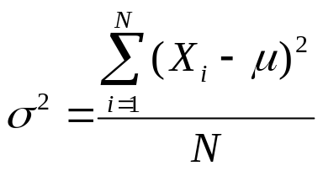
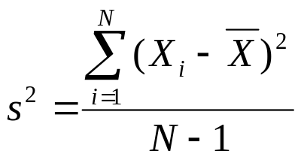

Variance and Standard Deviation
The variance represents the spread of a distribution
  In a data set {X_{i}} an unbiased estimate s² for the variance can be calculated as
    N-1 is often called the number of degrees of freedom of the data set
The standard deviation is the square root of the variance
  In the case of a sample set, s is often referred to as standard error
© Manfred Huber 2021
Notes:
Lottery examples:

Slide 29
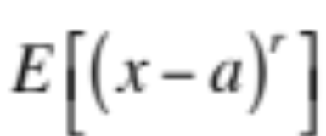
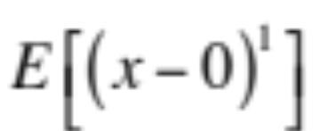
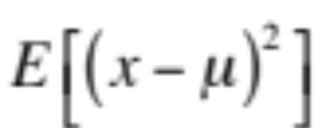

Moments
Moments are important to characterize distributions
  r^{th} moment:
  Important moments:
    Mean:
    Variance:
    Skewness:
© Manfred Huber 2021
Notes:
Lottery examples:

Slide 30
Information Theory
Information theory address the question how much information a particular event (or message) contains assuming no background knowledge
  Information theory does not deal with the semantics (i.e. the meaning) of the event or the message.
  It solely deals with the minimal amount of information required to represent its content in the absence of background information
    How much information is required to perfectly remember the event/message ?
    What is the minimal size to which the event/message can be compressed ?
Information theory was established by Claude Shannon in the 1940s
© Manfred Huber 2021

Slide 31
Information Theory
Information theory deals with a number of problems associated with information
  How much information does an even provide us with ?
  How far can we compress a message ?
  What is the most compact encoding of a message ?
  How much capacity does a transmission channel have if we use a particular encoding ?
Information theory disregards any semantics of the message or knowledge outside the actual message
  Information is directly tied to the probability of the event or message
    Events that are easily predictable contain less information than ones that are more difficult to predict
    Events that are known with certainty to occur do not provide any information since we already knew their content beforehand
© Manfred Huber 2021

Slide 32



Information
The Information content, I(p), of an event with likelihood p has to fulfill a number of properties
  Information can not be negative
    No occurrence of an event can take away from a the information in previous events since we are not modeling their semantics but rather are only looking at remembering / representing the events
  An event that has probability 1, contains no information
    We obtain no information from observing such an event and need no information to remember it.
  The information provided by two independent events has to be the sum of the information from each one
    The occurrence one event can not provide us with any information about the occurrence of an independent event.
© Manfred Huber 2021

Slide 33
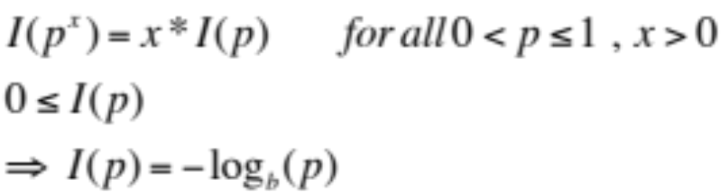
Information
Based on the required properties for a measure of information and assuming that it is continuous we can derive a measure for information:
  The based b selects the unit in which we measure the information but is not important for any of the calculations
    b=2 : bits
    b=3 : trits
    b=e : nats
    b=10 : Hartleys
© Manfred Huber 2021

Slide 34
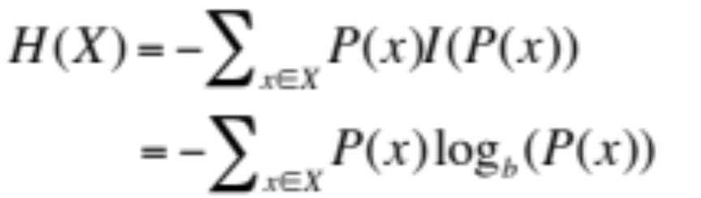
Entropy
Entropy represents the information content of a distribution
  Entropy is the expected amount of information in a random sample from the distribution
  The best predictions are the ones that do not leave any entropy
© Manfred Huber 2021

Slide 35
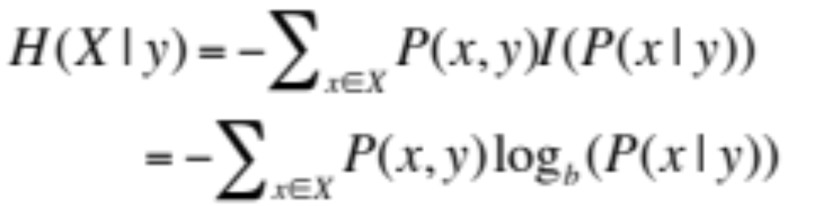

Conditional Entropy
The Conditional Entropy represents the incremental information beyond the condition
  This is akin to the posterior entropy
Conditional entropy and (differential) entropy are related through
© Manfred Huber 2021

Slide 36
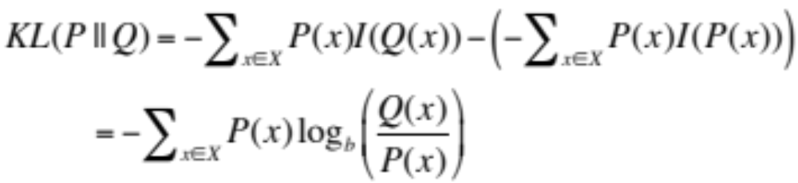
Relative Entropy /
Kullback-Leibler Divergence
To address additional information needed when modeling a distribution P using a different distribution Q we use relative entropy
  This is a measure of the dissimilarity of P and Q
© Manfred Huber 2021

Slide 37
Utility Theory
Utility:
  quantifies the degree of preference across different alternatives
  models the impact of uncertainty on preferences
  represents a mapping from an agent’s state (or situation) to the degree of happiness (expected future payoff) for being in this state
We will introduce this formally later
© Manfred Huber 2021

Slide 38
Evaluation/Performance
Evaluation or Performance functions in machine learning algorithms can usually be defined in one of these frameworks
  Probability theory is used for likelihood criteria
  Information theory is usually used in accuracy/error rate criteria
    Note that there is a strong link between entropy and probability and thus sometimes information theoretic criteria can be formulated as probabilistic criteria
  All evaluation functions have to obey utility theory
© Manfred Huber 2021

Slide 39
Optimization
The core of the learning algorithm is trying to improve (optimize) the value of the evaluation function
Optimization can fall into two types depending on the available hypothesis space
  Unconstrained optimization
    All elements of the hypothesis space are allowed
  Constrained optimization
    Only some parts of the hypothesis space are allowed and the allowed part is defined by constraints
© Manfred Huber 2021

Slide 40
Optimization
Different types of optimization techniques:
  Global optimization
    Analytic
      Requires certain properties of the evaluation function, e.g.:
        Continuous, differentiable almost everywhere
        Absence of local minima (or only a finite number of them)
      Uses the fact that the derivative of a function is 0 at local extrema
    Incremental
      Combinatorial search
      Annealing techniques
      …
  Global optimization is most of the time not tractable
© Manfred Huber 2021

Slide 41
Optimization
Different types of optimization techniques:
  Local optimization
    Analytic
      Requires certain properties of the evaluation function, e.g.:
        Continuous, differentiable almost everywhere
      Uses the fact that the derivative of a function is 0 at local extrema
    Incremental
      Gradient ascent/descent (requires continuity and differentiability)
      …
  Addresses tractability issues but might not end up with the best solution
© Manfred Huber 2021

Slide 42
Optimization
Different types of optimization techniques:
  Local improvement
    Incremental
      Hill climbing
      …
  Local improvement has the smallest number of requirements for the evaluation function but often progresses relatively slowly
© Manfred Huber 2021

Slide 43
Background
Most machine learning techniques use elements from these theories and techniques to derive the algorithms
  Throughout the course we will identify these for the learning approaches covered
    Will go into more detail of the specific aspects of the formalism and the specific techniques then
© Manfred Huber 2021

