Slide 1
Machine Learning
A First Learning Task
© Manfred Huber 2021

Slide 2
Machine Learning
Designing the elements of machine learning techniques is important for their operation and to understand what they actually learn
  Representation
  Evaluation / Performance estimation
  Optimization
© Manfred Huber 2021

Slide 3
Simple Learning Task
Consider the following problem:
  We pick up a pebble and paint a flat part of it in blue. Then we repeatedly toss it and mark the times when the blue side is at the bottom as success (S) and other tosses as fail (F).
    Repeatedly tossing it, we get the following outcomes: S, F, S, S, F
  Learn the characteristics of the pebble.
© Manfred Huber 2021

Slide 4
Simple Learning Task
What type of learning problem is this ?
  Unsupervised model learning problem
    Data does not contain desired output
    D=<S, F, S, S, F>
  Supervised probabilistic prediction
    Data has no input, only desired output
    <( ,S), ( , F), ( , S), ( , S), ( , F)>
  Interpretation depends what we consider the target output of the learning algorithm
© Manfred Huber 2021

Slide 5
Simple Learning Task
What is the answer to the model learning problem ?
  Data: <S, F, S, S, F>
  Most common answer:
    Probability of success is 0.6
  Why is that a good answer ?
    What would the elements of a formal learning algorithm be that gives us this solution ?
      Representation ?
      Evaluation Function ?
      Optimization technique ?
© Manfred Huber 2021

Slide 6
Simple Learning Task
Representation
  Hypothesis space:
    Set of Bernoulli Distributions
    Represents the probability of an outcome for independent tosses with two outcomes
  Representation:
    Parametric with probability of successful outcome as parameter, P(S)
© Manfred Huber 2021

Slide 7


Simple Learning Task
Evaluation
  Performance function:
    Probability of generating the data
    Bernoulli distribution gives answer for parameter P(S)
  Optimization criterion:
    Maximum Likelihood Estimation (MLE)
    Find P(S) that maximizes P(<S, F, S, S, F> | P(S))
© Manfred Huber 2021

Slide 8
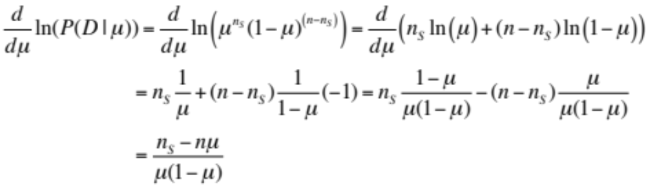
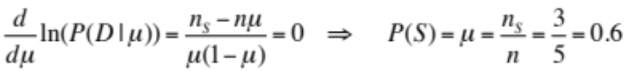
Simple Learning Task
Optimization
  Optimization approach:
    Analytic global optimization (since it is feasible)
      Convert to log likelihood:
      Computer derivative:
      Solve for extremum:
© Manfred Huber 2021

Slide 9
Simple Learning Task
What is the answer to the model learning problem ?
  Data: <S, F, S, S, F>
  Most common answer:
    Probability of success is 0.6
  Why is that a good answer ?
    Simple answer is the maximum likelihood estimate (MLE) for the underlying Bernoulli process
      Maximizes probability that the model generates the data
  Is this the best answer ?
© Manfred Huber 2021

Slide 10
Simple Learning Task
Is this the best answer ?
  Depends on whether there is other information available
    What happens if instead of picking up a pebble I picked up a random coin ?
      Prior probability of coins would make P(S)=0.5? a better answer
  A better answer might also tell me how likely this is the correct answer
    Probability that the data actually represents the expected outcomes
© Manfred Huber 2021

Slide 11
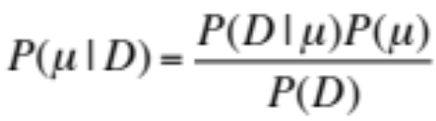
MLE and MAP
MLE does not take into account the prior probability of the parameters
  Bayes law gets us to the posterior estimate
Maximum a posterior estimate (MAP) finds the best parameter considering the prior
  Learning with the posterior is Bayesian learning
  MLE corresponds to MAP with uniform prior
© Manfred Huber 2021

Slide 12
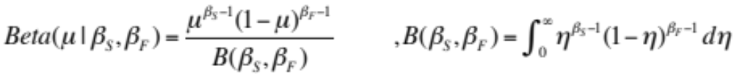
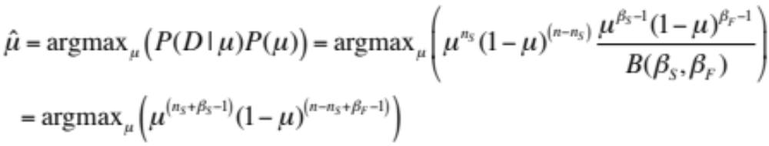
MAP
To compute MAP a prior over the parameters has to be provided
  Prior represents knowledge about the system
    General priors make the problem very difficult to solve
    Conjugate priors are special forms of priors that lead to a closed form for the posterior
      Conjugate prior for Bernoulli/Binomial is the Beta distribution
      Behaves like the addition of samples to the dataset
© Manfred Huber 2021

Slide 13
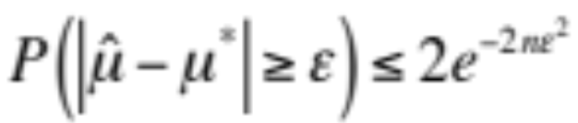
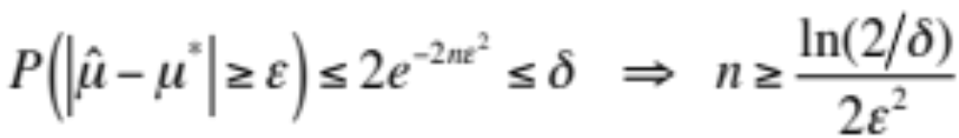
Simple Learning Task
How do I know how close my answer is ?
  The data in the dataset can be biased
    Sample and Sampling variance give us estimates for the reliability of the estimate calculated from the data
    Hoeffding's inequality provides an upper bound on the variation and thus of the estimate for random sampling
      In the case of repeated Bernoulli trials with MLE:
      Can use this to indicate reliability or to determine how many samples we need to get a good estimate
© Manfred Huber 2021

Slide 14
Simple Learning Task
If we can determine these bounds with probabilistic evaluation criteria we get PAC learning
  Probably Approximately Correct (PAC)
  PAC learning provides probabilistic guarantees on the quality of the results of learning
    With some distributions and evaluation functions PAC learning results are known and achievable
© Manfred Huber 2021

Slide 15
Simple Learning Task
Could we have addressed this task differently ?
  Treat the task as an expected value problem
    Model outcomes as numbers, S=1, F=0
    E[M]=P(S)*S=P(S)
    Find model that minimizes the error generating the data
  Hypothesis space:
    Value of the expected outcome
  Representation:
    Parametric with expected outcome as parameter
      Gives us a probability in this special case since the expected value is the probability
© Manfred Huber 2021

Slide 16
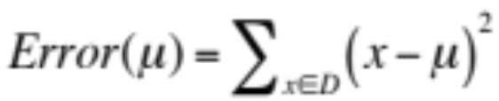
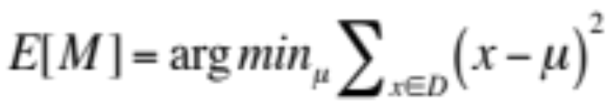
Simple Learning Task
Evaluation function:
  Squared error (or alternatively root square error (RSE) or root mean squared error (RMSE))
  Optimization criterion:
    Minimum squared error
© Manfred Huber 2021

Slide 17
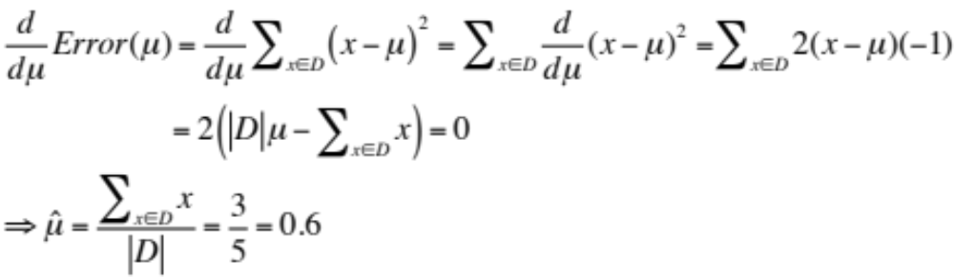
Simple Learning Task
Optimization:
  Analytic global optimization
  In this case the answer is the same as for MLE
    In general, squared error and MLE do not address the same objective and do not yield the same result
      MLE optimizes the prediction in a binary fashion
      Squared error optimizes prediction in terms of Cartesian similarity
© Manfred Huber 2021

Slide 18
Simple Learning Task
Did the previous solution give us the best estimate in terms of expected error ?
  Task definition made some hidden assumptions
    We are only interested in the error on the data, not the expected error on the models
      These are only the same if the data sample does not provide biased estimates for the mean and variance
    We did not take into account the prior likelihood of the models
  If we want to get the most precise model we need to address expected model error
    Address parameter error
© Manfred Huber 2021

Slide 19
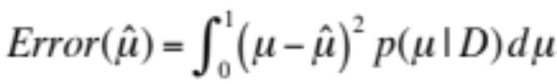
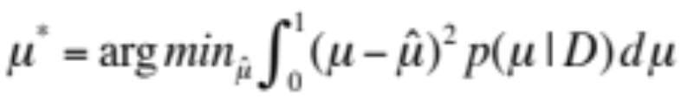
Simple Learning Task
Evaluation function:
  Expected squared error of the model parameter
    “Similarity” of the learned to the real model
  Optimization criterion:
    Minimum squared error
© Manfred Huber 2021

Slide 20
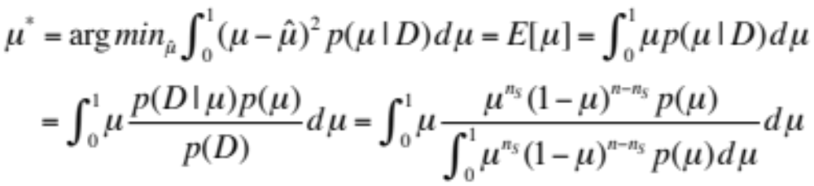
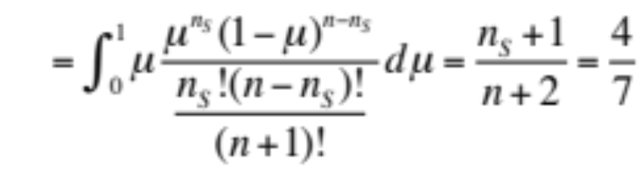
Simple Learning Task
Optimization:
  Analytic global optimization
    Minimum of squared error is the expected value
      If prior p(μ) is uniform between 0 and 1 we get a Beta distribution
    Note: The expected value is not the same as the MAP
      Expected value considers bias/variance in the mean of the dataset
© Manfred Huber 2021

Slide 21
Takeaway
Learning tasks can often be formulated in different ways by defining the data differently
  Supervised vs. unsupervised learning sometimes just differs in the interpretation of the data
  They can sometimes use the same evaluation/performance function
    In supervised learning it has to be defined in terms of the target output while it is defined in terms of only the input data for unsupervised learning
  They can use the same optimization approach
© Manfred Huber 2021

Slide 22
Takeaway
Different evaluation functions represent different characteristics and lead to different learning results
  MLE and MAP consider “precision” in terms of a binary evaluation
  Squared error considers “precision” in terms of a real valued similarity
  It is important to choose the evaluation function carefully as it determines what is learned
© Manfred Huber 2021

Slide 23
Designing/Choosing Machine Learning Algorithms
To design/choose the right machine learning algorithm it is important to decide
  What is the performance function
    What should the algorithm learn ?
  What type of learning problem is it
  What is an efficient representation for the problem
    What is the hypothesis space
    How can the hypotheses be formulated
      Parametric vs. non-parametric
      What parameters
  What is the most effective optimization approach
© Manfred Huber 2021

