Slide 1
PCA-Based KNN Animal Classification
CSE6363 – Machine Learning
Final Project
Bardia Mojra
May 14, 2021
CSE6363 – Dr. Huber
University of Texas at Arlington

Slide 2
Introduction
Principal Component Analysis (PCA)
  Feature extraction
  Data compression
K-Nearest Neighbor (KNN)
  Classification

Slide 3
PCA
Process dataset:
  Training and test sets must be consistent
  Resize and crop square
  Reshape images to row vectors and stack dataset
Normalize dataset, standardize
Calculate Covariance, EigenVectors and EigenValues:
  Sort EigenVectors by EigenValues
Dot product multiply top n EigenVectors (PC’s) by the dataset

Slide 4
KNN
KNN classification
Simple voting and weighted voting (distance)

Slide 5
Test Configuration
knn_k = 7
image_size = 30 # pixels, equal height and width
samples_per_class = 300
shuffles = 10 # shuffle n times to mix data
testfrac = .2 # 0-1.0 | test set fraction of main set
PC_ratio = 100 # % / 5, 10, 30, 60, 100%
numPC = int((PC_ratio/100)*samples_per_class) ------/ fix, PCs are features
Clen = 4 # dog, horse, chick, sheep

Slide 6
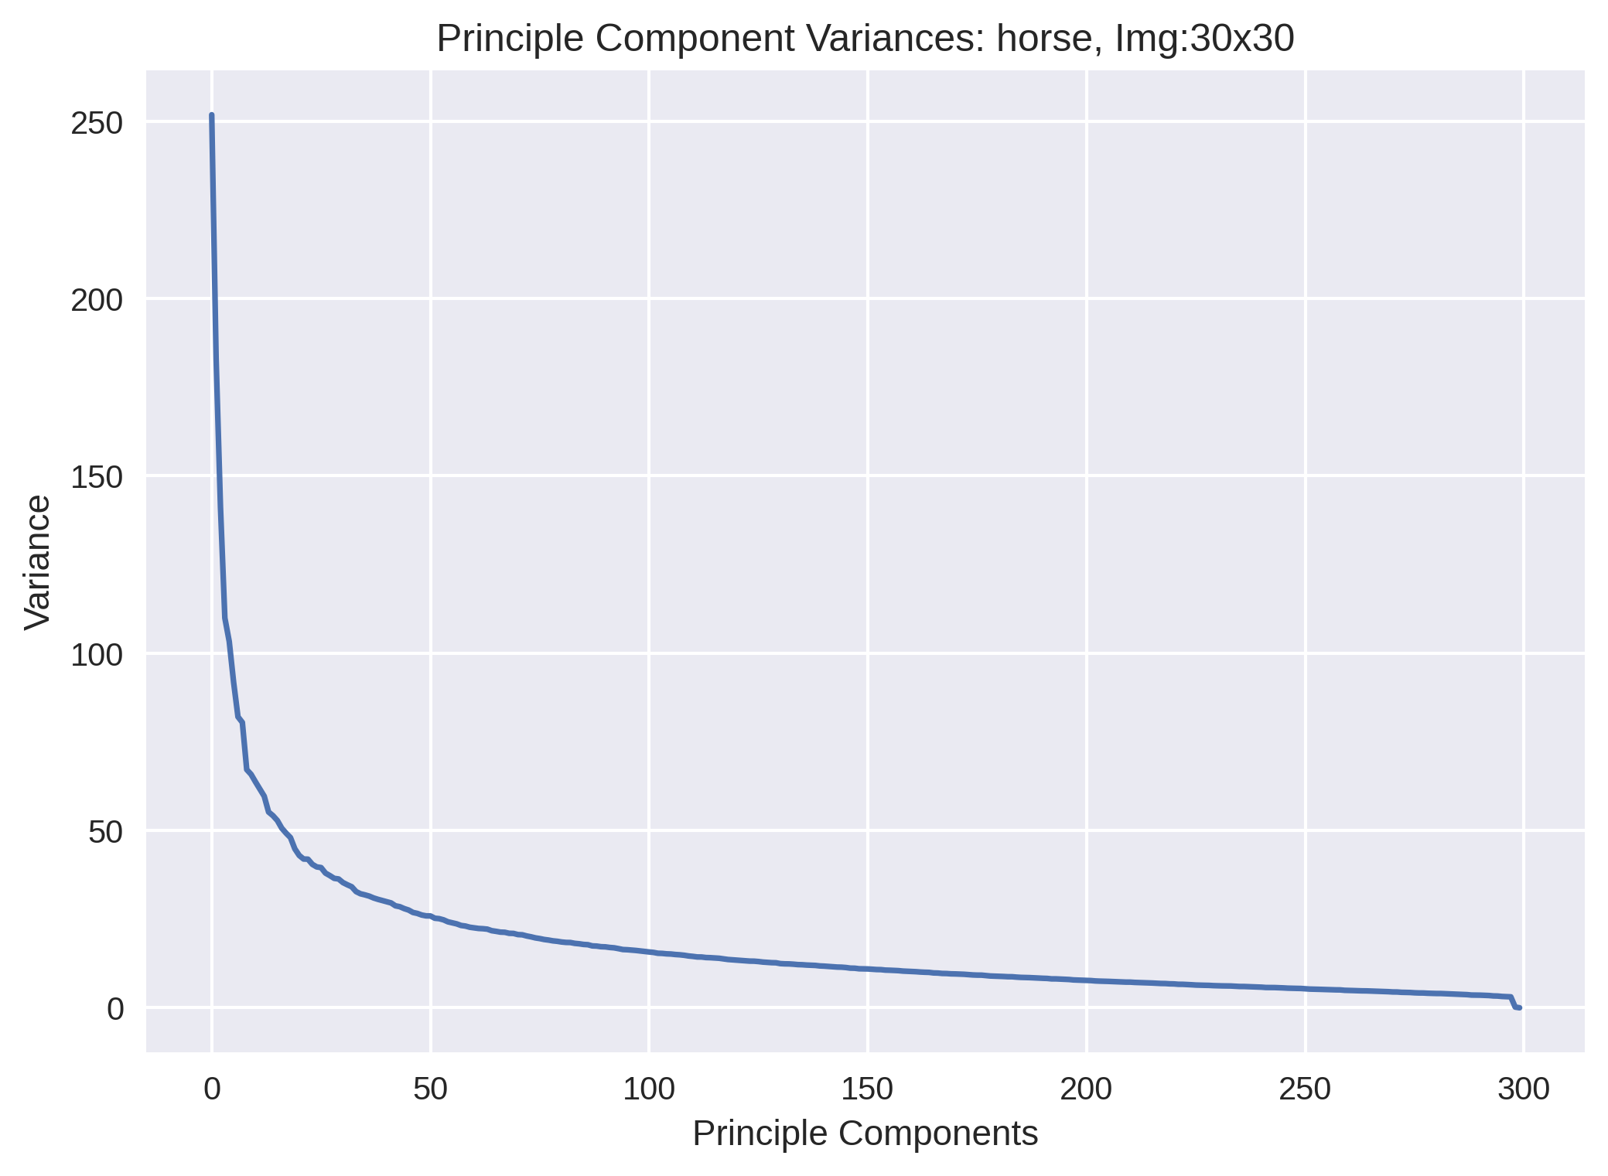
Principle Components and Covariance

Slide 7
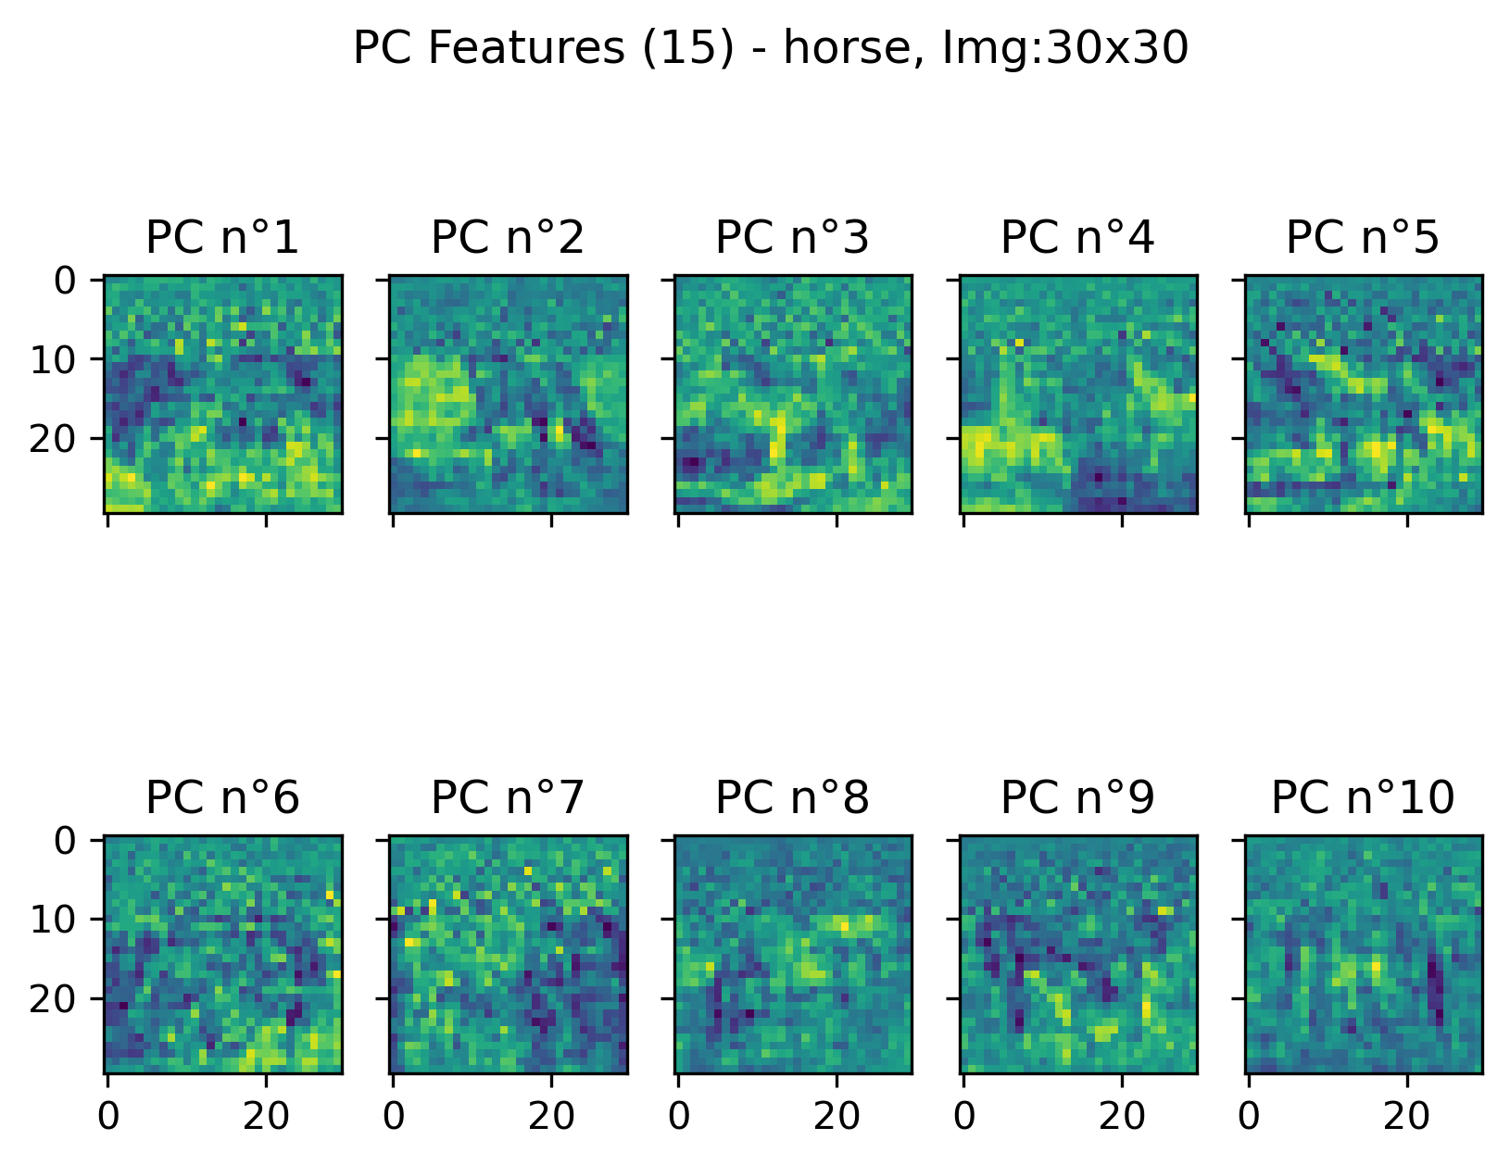
Principal Components

Slide 8
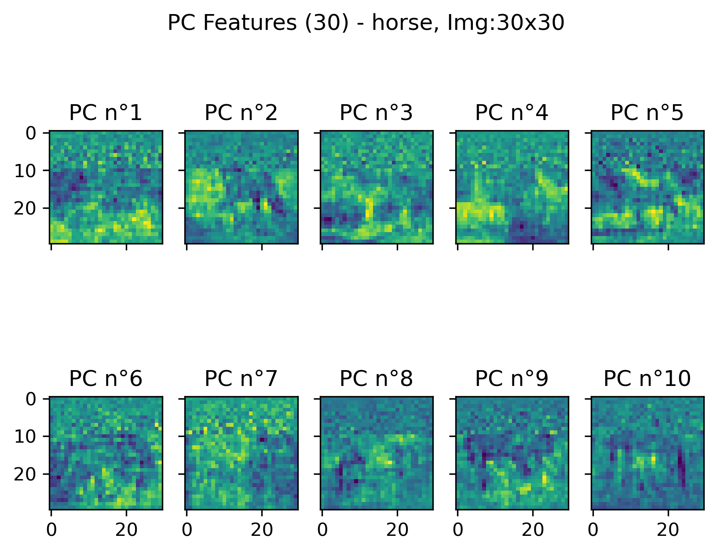
Principal Components

Slide 9
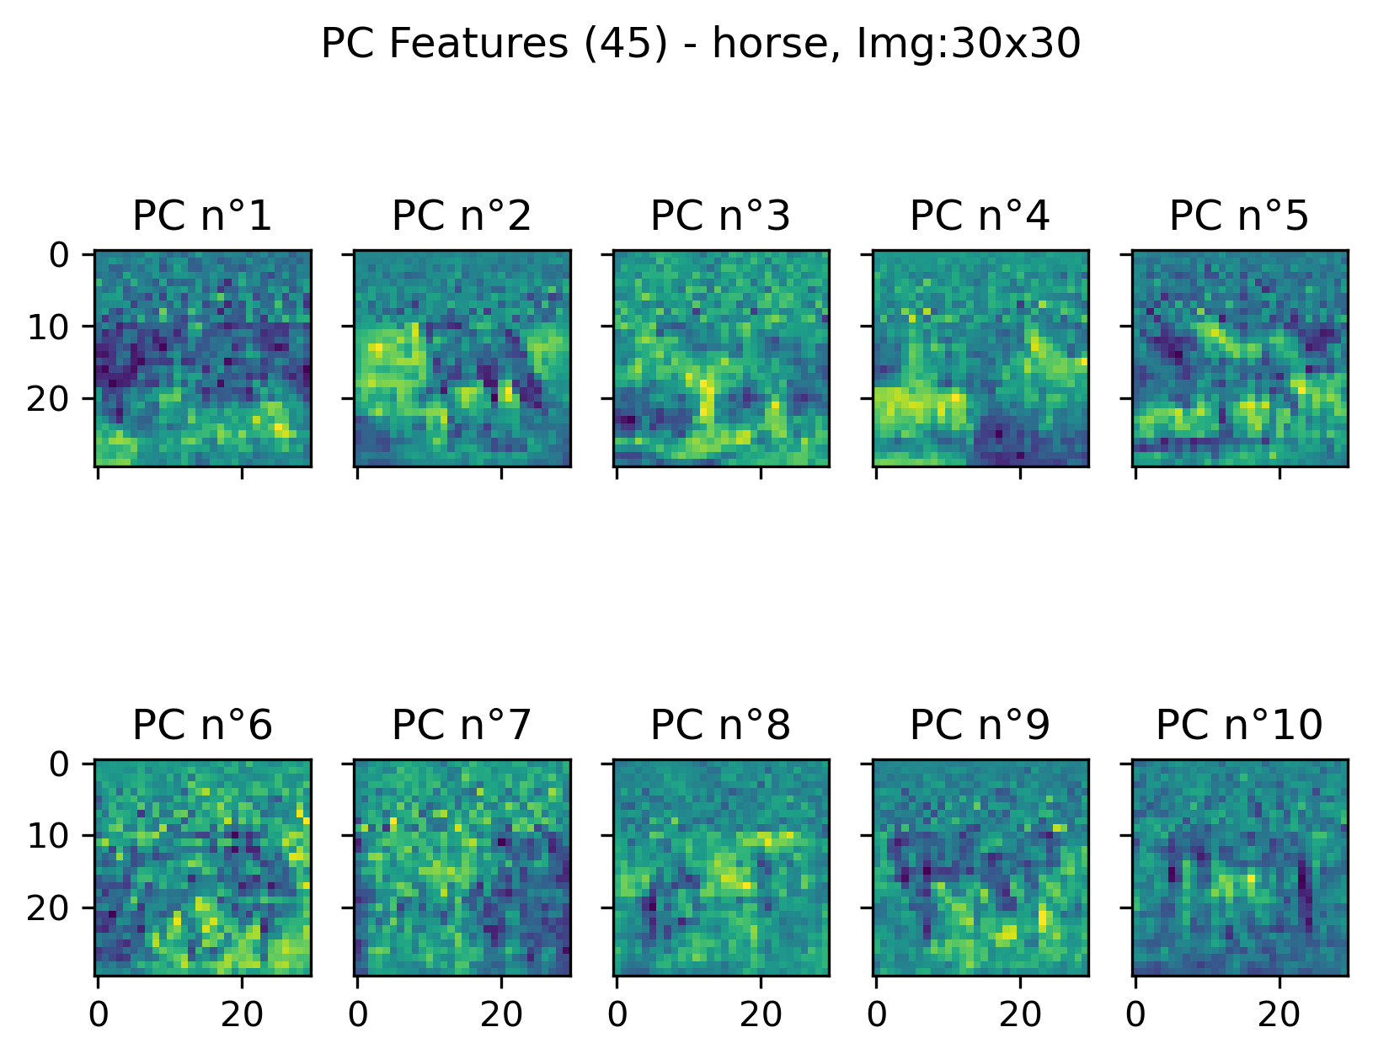
Principal Components

Slide 10
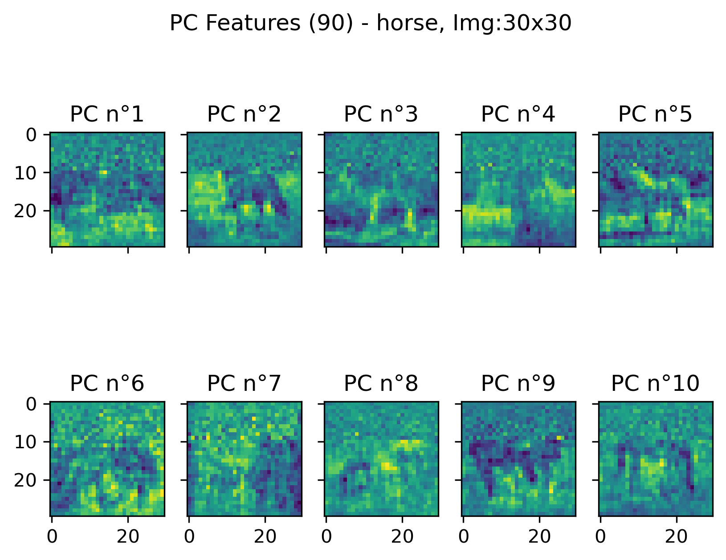
Principal Components

Slide 11
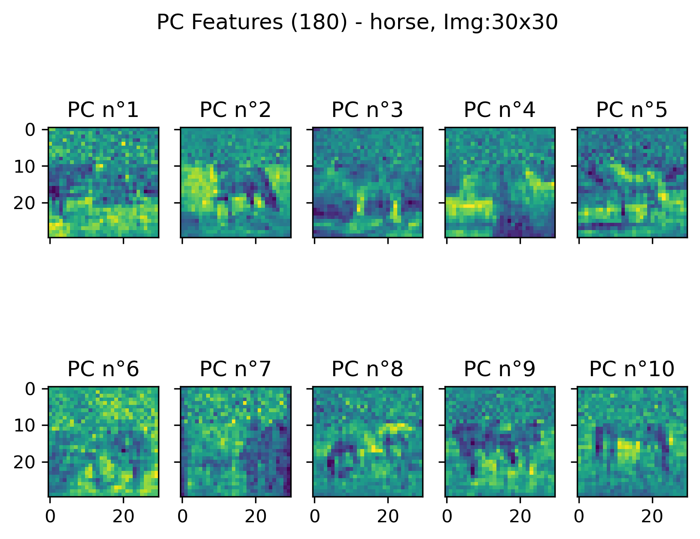
Principal Components

Slide 12
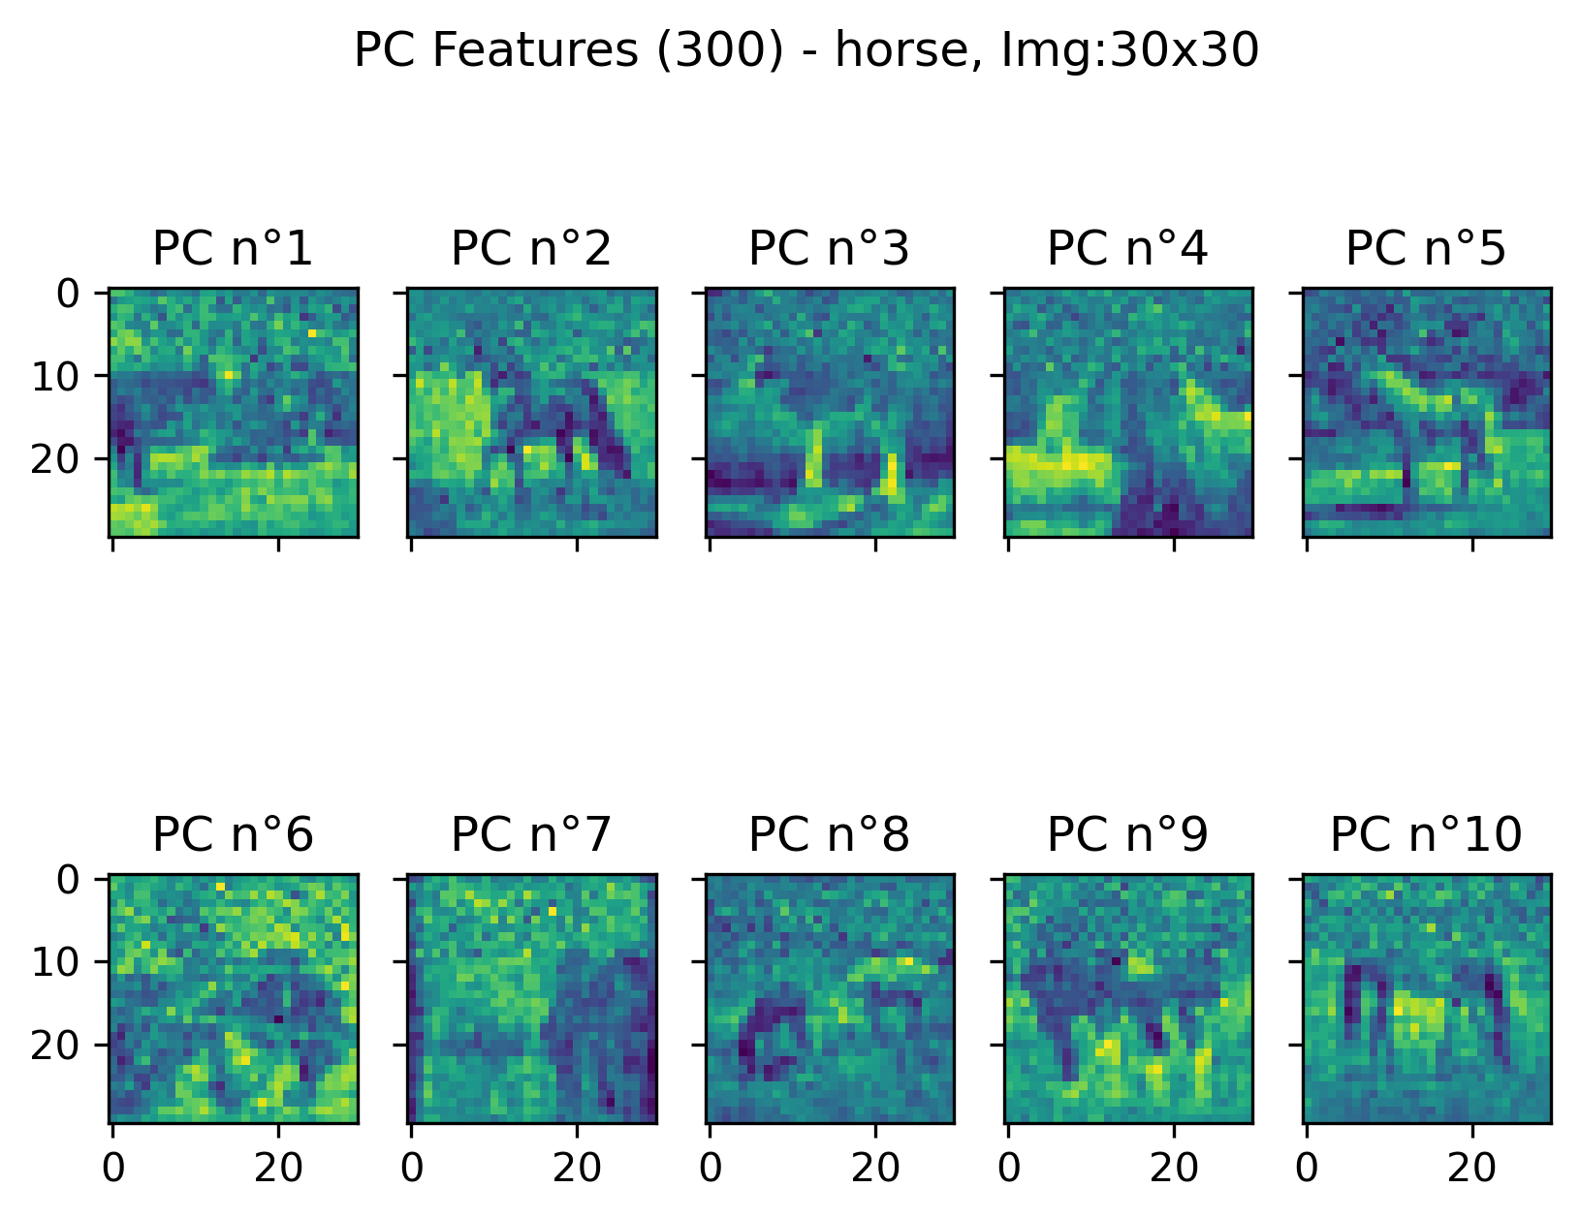
Principal Components

Slide 13
Results
Experiment: CL4_Res48_PC15training data (weighted): 100.000%training data (simple): 87.812%test data (weighted): 85.417%test data (simple): 82.500%
Experiment: CL4_Res30_PC15training data (weighted): 100.000%training data (simple): 89.896%test data (weighted): 82.083%test data (simple): 81.667%
Experiment: CL4_Res48_PC30training data (weighted): 100.000%training data (simple): 91.771%test data (weighted): 87.083%test data (simple): 87.500%
Experiment: CL4_Res30_PC30training data (weighted): 100.000%training data (simple): 93.646%test data (weighted): 91.667%test data (simple): 90.833%
Experiment: CL4_Res30_PC45training data (weighted): 100.000%training data (simple): 94.896%test data (weighted): 93.333%test data (simple): 92.500%
Experiment: CL4_Res48_PC45training data (weighted): 100.000%training data (simple): 93.438%test data (weighted): 93.333%test data (simple): 92.500%
Experiment: CL4_Res48_PC90training data (weighted): 100.000%training data (simple): 94.062%test data (weighted): 89.583%test data (simple): 88.750%
Experiment: CL4_Res30_PC90training data (weighted): 100.000%training data (simple): 94.792%test data (weighted): 91.667%test data (simple): 89.167%
Experiment: CL4_Res30_PC180training data (weighted): 100.000%training data (simple): 95.625%test data (weighted): 93.750%test data (simple): 93.333%
Experiment: CL4_Res30_PC300training data (weighted): 100.000%training data (simple): 96.562%test data (weighted): 90.833%test data (simple): 91.250%
Experiment: CL4_Res48_PC300training data (weighted): 100.000%training data (simple): 91.875%test data (weighted): 85.833%test data (simple): 87.083%
Experiment: CL4_Res48_PC180training data (weighted): 100.000%training data (simple): 89.583% test data (weighted): 85.417%test data (simple): 84.167%

Slide 14
Thank you!

