Slide 1
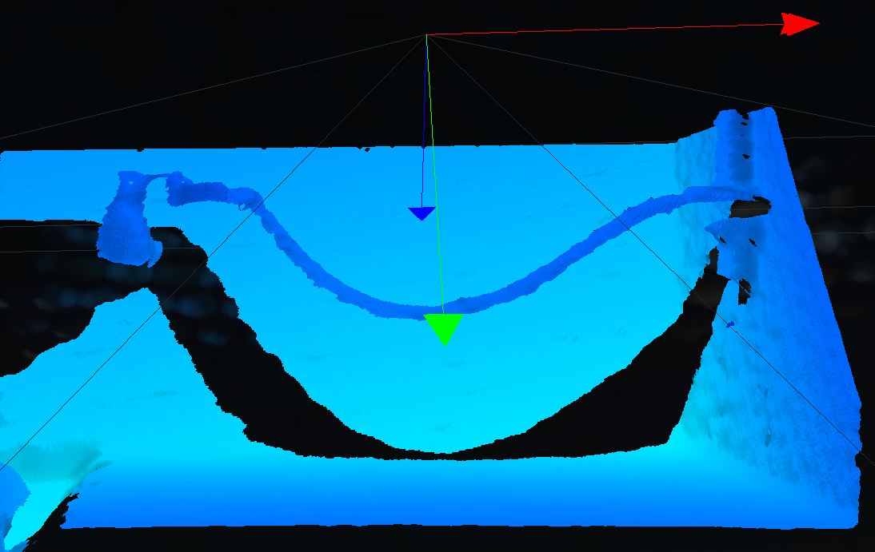
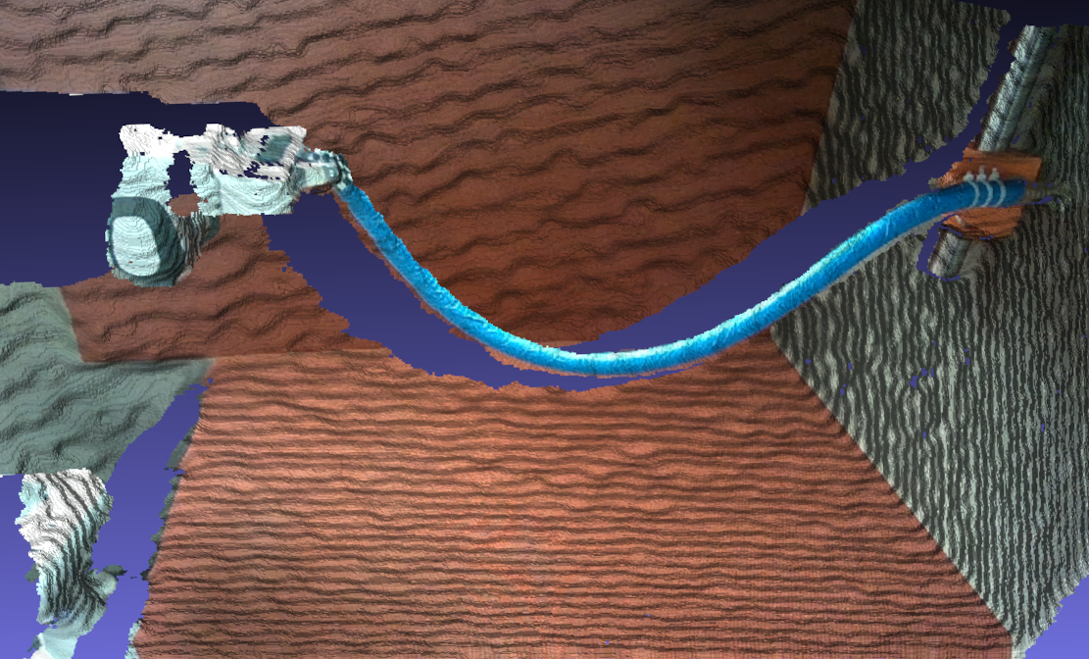
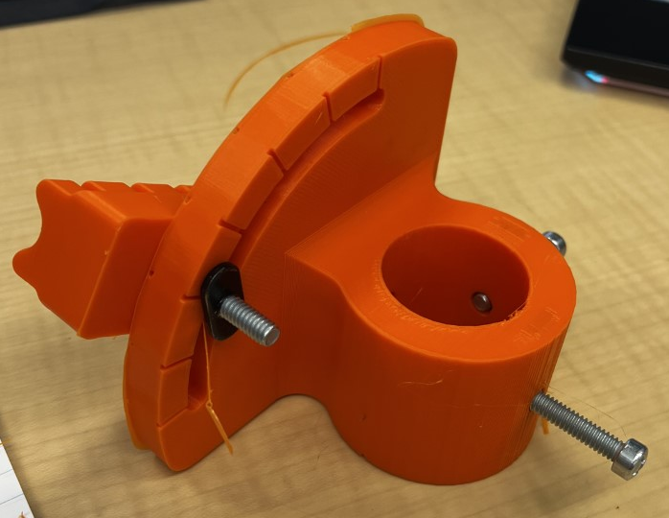
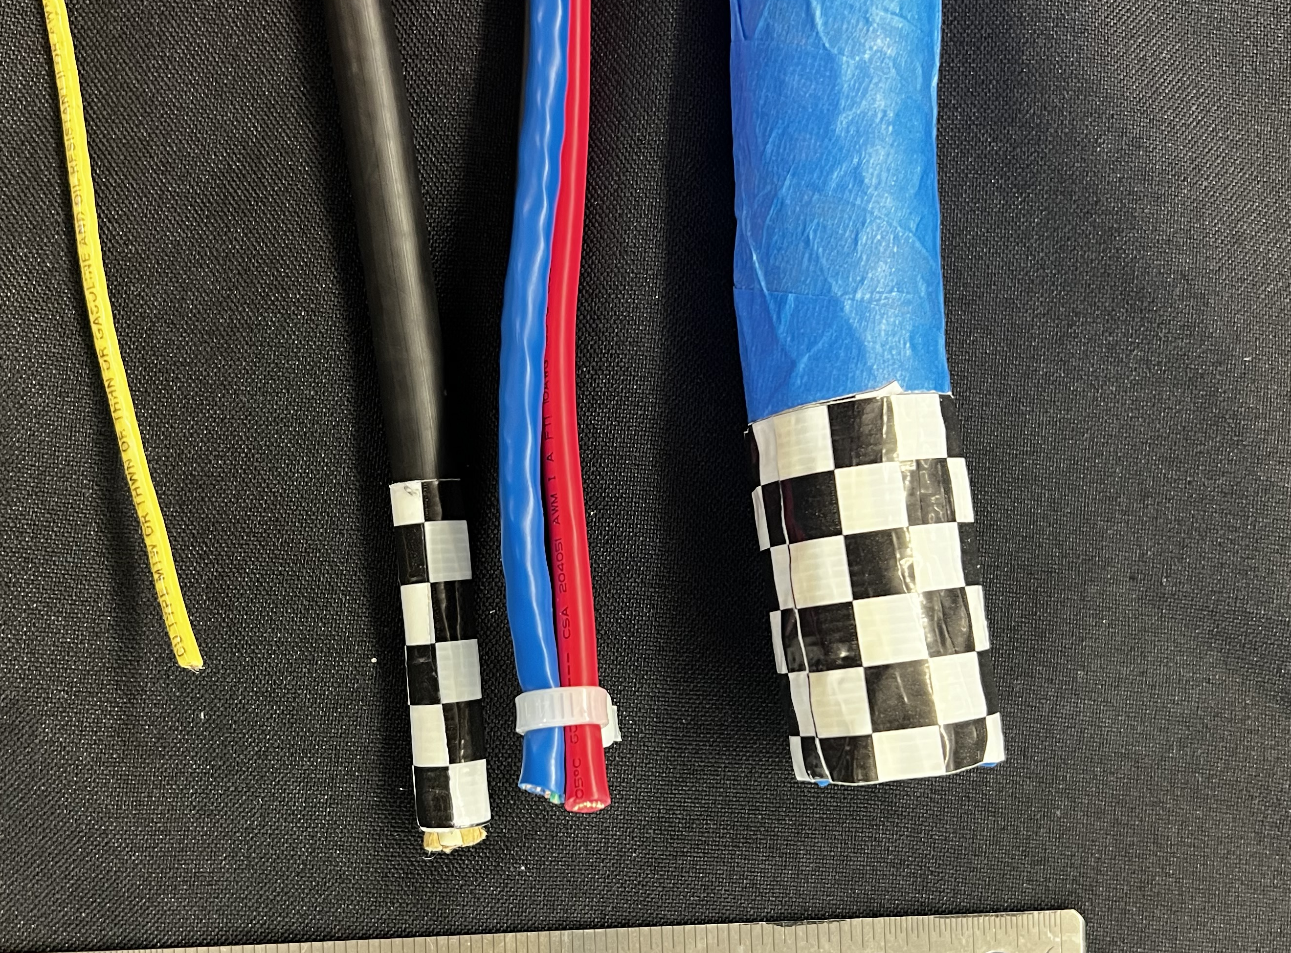
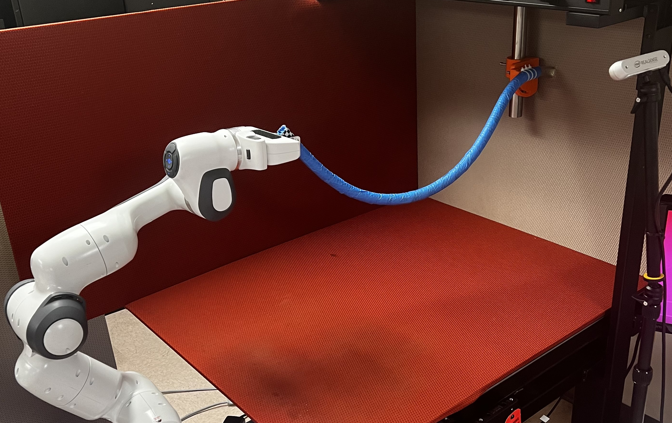


DLO-RoboMan: Dataset and Dynamic Test for Robotic Manipulation of Deformable Linear Objects
Bardia Mojra, William J. Beksi, and Nicholas R. Gans
Robotic Vision Laboratory and UT Arlington Research Institute (UTARI)
Abstract
Related Work
Dataset
Applications
Despite the impressive progress achieved in the robotic manipulation of deformable linear objects (DLOs), e.g., cable, hose, and wire, robots can only manipulate DLOs with prior knowledge and costly domain-specific training. This is primarily due to the high dimensional representation of object geometry and physical configuration. In this work, we build on the assumption that DLO dynamics in a dual-arm configuration is governed by low-dimension closed-loop control laws. In this letter, we introduce DLO-RoboMan, a novel dataset and dynamic test for the robotic manipulation of DLOs for industrial settings.
This work introduces a novel dataset for real-world manipulation of
deformable linear objects (DLOs) that aim to enable capturing the objects' intrinsic dynamics in free-hanging applications.
The goal is to produce an information-rich dataset that reduces training time while taking advantage of the objects' characteristic dynamism; continuity of Hamiltonian systems. We increase [the signal-to-noise -- take out] ratio of dynamic information within each test episode, effectively reducing training time. We present a set of robotic manipulation episodes with four DLOs in various settings, configurations, and initial conditions. Furthermore, we define a set of simple dynamic tests for a DLO, allowing more efficient learning of its intrinsic dynamics. Lastly, we introduce a framework for automatic annotation, allowing for rapid dynamic data generation for individual real-world DLOs.
This work introduces a novel dataset for real-world manipulation of
deformable linear objects (DLOs) that aim to enable capturing the objects' intrinsic dynamics in free-hanging applications.
The goal is to produce an i
Introduction
Setup
This work introduces a novel dataset for real-world manipulation of
deformable linear objects (DLOs) that aim to enable capturing the objects' intrinsic dynamics in free-hanging applications.
The goal is to produce an information-rich dataset that reduces training time while taking advantage of the objects' characteristic dynamism; continuity of Hamiltonian systems. We increase [the signal-to-noise -- take out] ratio of dynamic information within each test episode, effectively reducing training time. We present a set of robotic manipulation episodes with four DLOs in various settings, configurations, and initial conditions. Furthermore, we define a set of simple dynamic tests for a DLO, allowing more efficient learning of its intrinsic dynamics. Lastly, we introduce a framework for automatic annotation, allowing for rapid dynamic data generation for individual real-world DLOs.
Summary and Future Work
This work introduces a novel dataset for real-world manipulation of
deformable linear objects (DLOs) that aim to enable capturing the objects' intrinsic dynamics in free-hanging applications.
The goal is to produce an information-rich dataset that reduces training time while taking advantage of the objects' characteristic dynamism; continuity of Hamiltonian systems. We increase [the signal-to-noise -- take out] ratio of dynamic information within each test episode, effectively reducing training time. We present a set of robotic manipulation episodes with four DLOs in various settings, configurations, and initial conditions. Furthermore, we define a set of simple dynamic tests for a DLO, allowing more efficient learning of its intrinsic dynamics. Lastly, we introduce a framework for automatic annotation, allowing for rapid dynamic data generation for individual real-world DLOs.
This work introduces a novel dataset for real-world manipulation of
deformable linear objects (DLOs) that aim to enable capturing the objects' intrinsic dynamics in free-hanging applications.
The goal is to produce an information-rich dataset that reduces training time while taking advantage of the objects' characteristic dynamism; continuity of Hamiltonian systems. We increase [the signal-to-noise -- take out] ratio of dynamic information within each test episode, effectively reducing training time. We present a set of robotic manipulation episodes with four DLOs in various settings, configurations, and initial conditions. Furthermore, we define a set of simple dynamic tests for a DLO, allowing more efficient learning of its intrinsic dynamics. Lastly, we introduce a framework for automatic annotation, allowing for rapid dynamic data generation for individual real-world DLOs.
In recent years, the active control of deformable objects has become a topic of interest among researchers, with applications in various industries, e.g., surgical robotics, food handling, and manufacturing [1]. However, active control of deformable objects remains particularly challenging as they exhibit strong nonlinear dynamics when subject to external forces and are particularly sensitive to initial conditions. We divide deformable objects into three main categories, 1D or linear objects, e.g., rope and cable; 2D or planar objects, e.g., paper and cloth; and 3D or volumetric objects, e.g., pillow and sponge. To be more precise, we are interested in active vision applications that involve real-time configuration control of DLOs.
Researchers have introduced numerous methods addressing both the perception and control tasks in applications that involve active control of DLOs, [2, 3, 4, 5]. However, the robust estimation and control DLOs remain an open challenge in industrial settings. Existing models do not generalize well to unknown DLOs and tasks with different initial conditions, end-goal configurations, and input speeds for the arm. Moreover, existing methods require expert mathematical modeling of object geometry, time-consuming data annotation, and costly computation for individual objects and tasks.
References
[1] J. Sanchez, J.-A. Corrales, B.-C. Bouzgarrou, and Y. Mezouar, “Robotic manipulation and sensing of deformable objects in domestic and industrial applications: a survey,” The International Journal of Robotics Research, vol. 37, no. 7, pp. 688–716, 2018.
[2] R. Laezza, R. Gieselmann, F. T. Pokorny, and Y. Karayiannidis, “Reform: A robot learning sandbox for deformable linear object manipulation,” in 2021 IEEE International Conference on Robotics and Automation (ICRA). IEEE, 2021, pp. 4717–4723

