Slide 1

A Simple Approach to Continual Learning By
Transferring Skill Parameters
K.R. Zentner, Ryan Julian, Ujjwal Puri,
Yulun Zhang, and Gaurav S. Sukhatme
2021
Bardia Mojra
January 26, 2022
Robotic Vision Lab
University of Texas at Arlington

Slide 2
Introduction
Problem:
  existing transfer learning methods are too inefficient for vision-motor tasks (robotic manipulation)
  Storing past experiences entirely, takes too much space and recall time
Proposed:
  Store previous knowledge only in terms of skill policies (parameters)
  Use general purpose latent state skill representations for decomposed skills
  Construct more complex skills based on simpler and prior skills
  Use the propose optimal curriculum learning method for efficient transfer

Slide 3
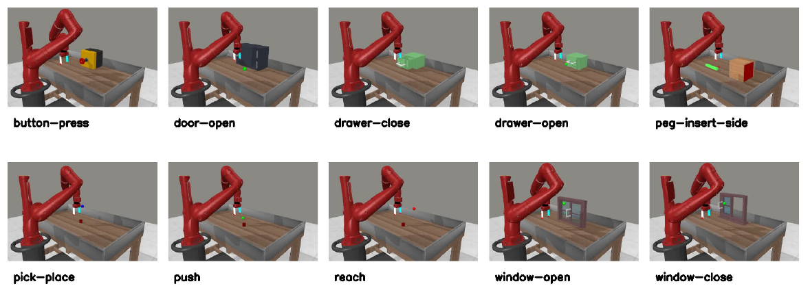
Meta-World
Web-based simulation environment for training DRL models for robotic tasks
Notes:
Inference hidden variables
Deterministic (unlike MCMC)
Easy to gauge convergence (unlike MCMC)
Requires dozens of iterations (unlike MCMC where 1000s of samps are needed)
No conjugacy requirement
More complicated math (slightly)

Slide 4
Transfer Learning
Defined as learning by transferring knowledge (known skills) from another agent
Problems:
  Traceability problem
  Reward function estimation and tuning problem
  Bad transfer

Slide 5
Continual Learning
Defined as learning new skills either through real-world experimentation or transferring and re-tuning in simulation
Problems:
  Multi-task learning: could destroy prior skill (pessimal example)
  Catastrophic forgetting
  Current methods are too inefficient

Slide 6
Reusable Skill Libraries (DRL-Based Models)
Associative Skill Memories
Probabilistic Movement Primitive
Latent space parameter decomposition

Slide 7
Continual Learning with Skill Libraries and Curricula
Learn skills in form of factorized policy model classes
Train an online model-based planner for reusing skills with high level action space (domain) for hierarchical RL
Use on-policy RL to directly update skills

Slide 8

Setting
T: a possibly-unbounded discrete space of tasks.
S: a single continuous state space shared among all tasks T.
A: a single continuous action space shared among all tasks T.
The MTRL problem: (T , S, A), and each task τ ∈ T is an infinite-horizon Markov decision process (MDP)
M_i: represents the set is manipulation skills the robot is initialized or pre-trained with
i: ith the epoch number

Slide 9
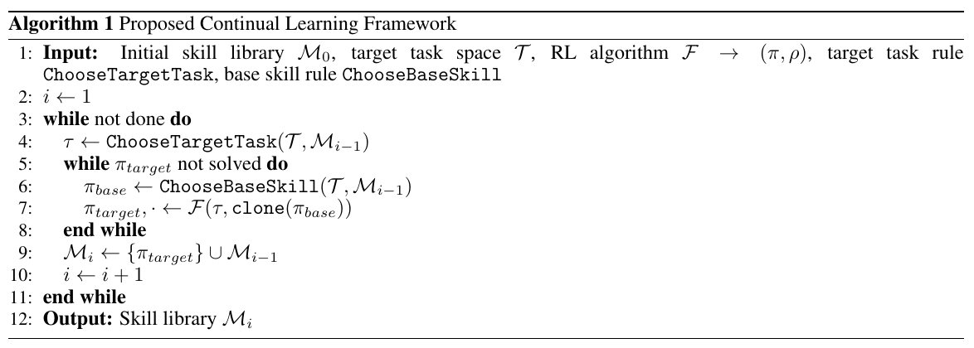
Simple Continual Learning with Skill Transfer

Slide 10
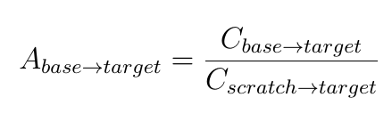
Other Techniques
Warm-up procedure for value function transfer
Rejecting bad transfers
Skill-skill transfer cost
  Number of samples needed to acquire target skill
Predicted skill-skill transfer cost

Slide 11
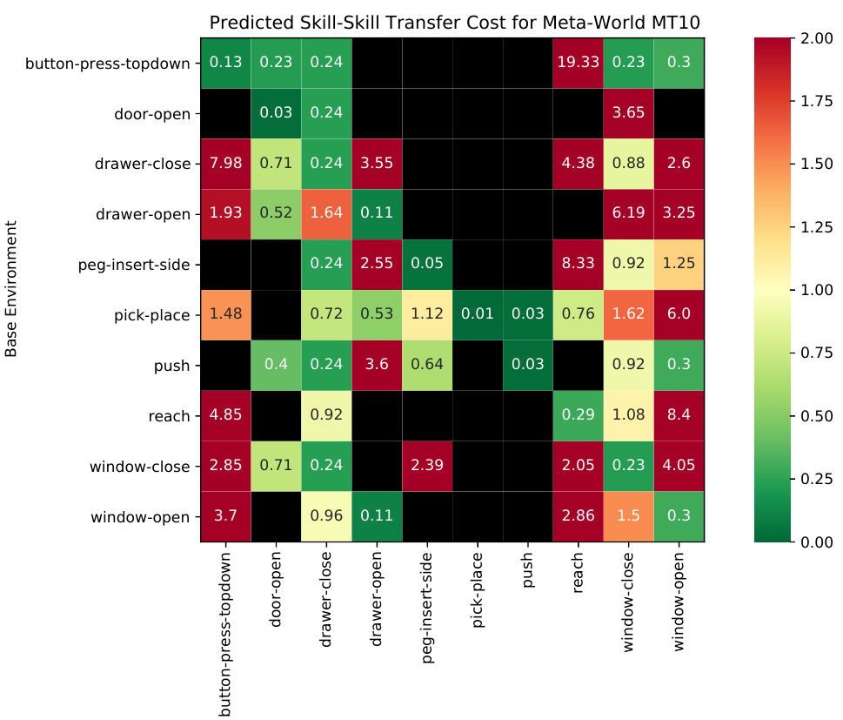
Predicted Skill-Skill Transfer Cost

Slide 12
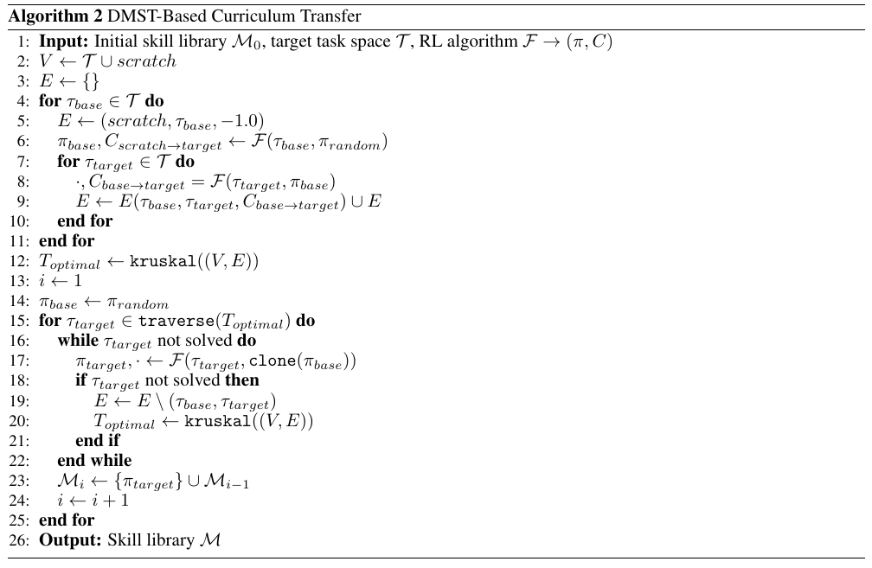
Curriculum Selection Algorithm

Slide 13
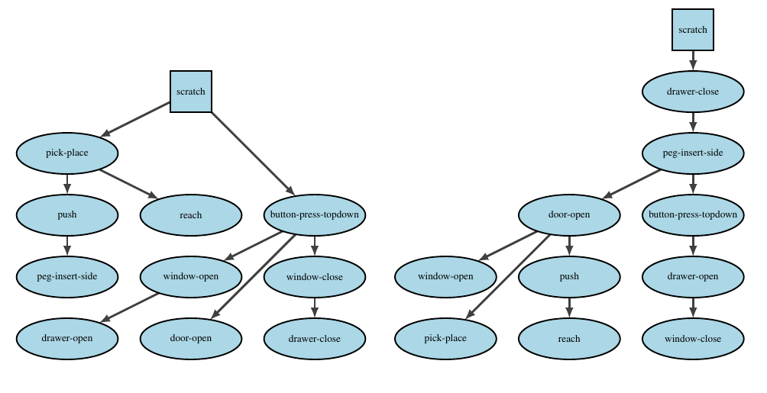
Optimal and Pessimal Curricula

Slide 14
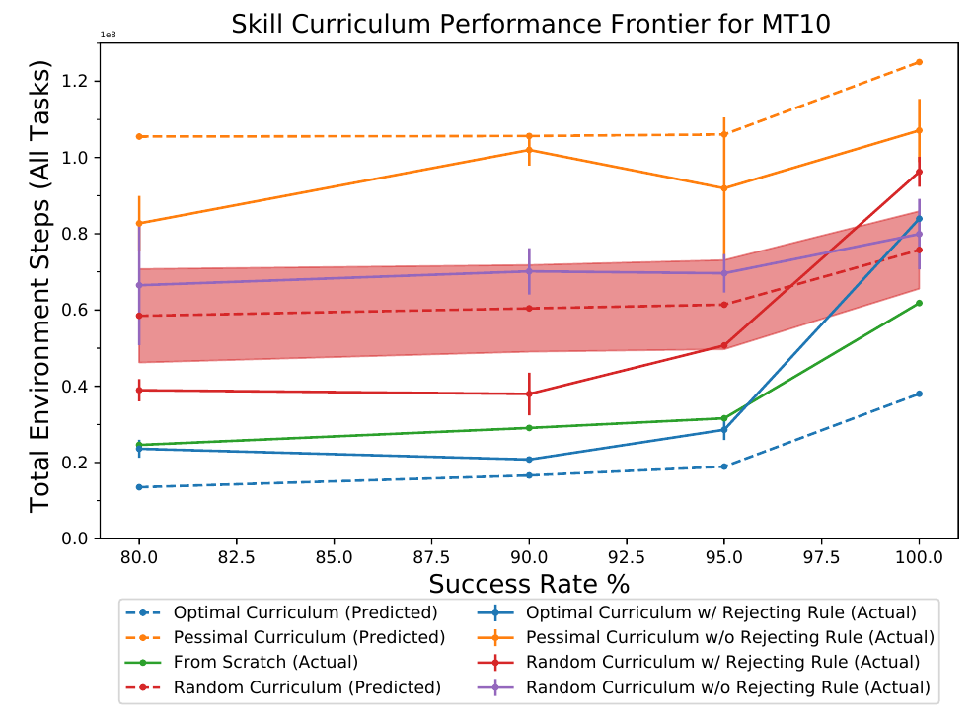
Experiments

Slide 15
Thank you!

