Slide 1

Task-Aware
Variational Adversarial Active Learning
Kwanyoung Kim, Dongwon Park,
Kwang In Kim, Se Young Chun
CVPR - 2021
Bardia Mojra
February 2, 2022
Robotic Vision Lab
University of Texas at Arlington

Slide 2
Introduction
Active learning (AL)
Task-agnostic vs task-aware
Learning Loss Ranker
TA-VAAL Architecture
Latent space with global representation
Experiments

Slide 3
Active Learning
In deep learning, labeling large amount of data is challenging due to high labeling cost and time required for training
Active learning (AL) seeks to improve training rate by asking the most informative questions
Two main directions:
  Task-Agnostic or distribution-based
  Task-Aware or model uncertainty-based
Notes:
Inference hidden variables
Deterministic (unlike MCMC)
Easy to gauge convergence (unlike MCMC)
Requires dozens of iterations (unlike MCMC where 1000s of samps are needed)
No conjugacy requirement
More complicated math (slightly)

Slide 4
Task-Agnostic AL
Based on distribution of labeled data
Good for finding clusters and influential points
Gaussian processes
Notes:
Inference hidden variables
Deterministic (unlike MCMC)
Easy to gauge convergence (unlike MCMC)
Requires dozens of iterations (unlike MCMC where 1000s of samps are needed)
No conjugacy requirement
More complicated math (slightly)

Slide 5
Task-Aware AL
Based on conditional distribution of output given labeled data
Good for finding difficult points
Good for finding probability in overlapping regions in classification tasks
Bayesian processes
Notes:
Inference hidden variables
Deterministic (unlike MCMC)
Easy to gauge convergence (unlike MCMC)
Requires dozens of iterations (unlike MCMC where 1000s of samps are needed)
No conjugacy requirement
More complicated math (slightly)

Slide 6
Learning Loss Ranker
Predicts relative rankings of losses
Loss rankings are embedded into the latent space of VAAL with the conditional latent variable r
Smooth differentiable function with nice convergence properties for optimization
Motivation:
  Easier to learned and predict ranked relative attributes than the absolute attribute values
  For AL, ranking the data points to labels is often sufficient
Notes:
Inference hidden variables
Deterministic (unlike MCMC)
Easy to gauge convergence (unlike MCMC)
Requires dozens of iterations (unlike MCMC where 1000s of samps are needed)
No conjugacy requirement
More complicated math (slightly)

Slide 7
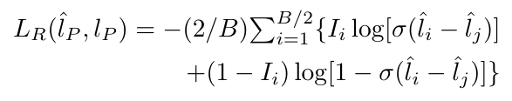

Learning Loss Ranker
(eq. 1)
(eq. 2)
Notes:
Inference hidden variables
Deterministic (unlike MCMC)
Easy to gauge convergence (unlike MCMC)
Requires dozens of iterations (unlike MCMC where 1000s of samps are needed)
No conjugacy requirement
More complicated math (slightly)

Slide 8
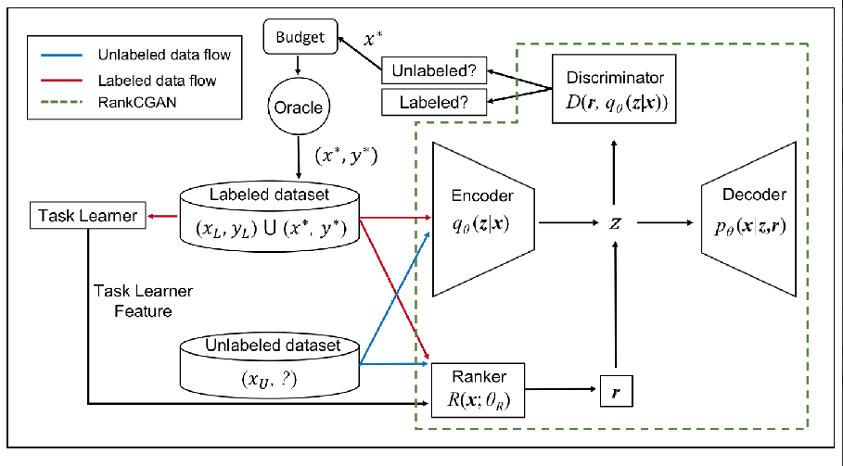
TA-VAAL
R: Ranker
  assigns r to x_u & x_l
Z: Latent space var.
  z_l ~ p_x_l
  Forms global distribution
Notes:
Inference hidden variables
Deterministic (unlike MCMC)
Easy to gauge convergence (unlike MCMC)
Requires dozens of iterations (unlike MCMC where 1000s of samps are needed)
No conjugacy requirement
More complicated math (slightly)

Slide 9
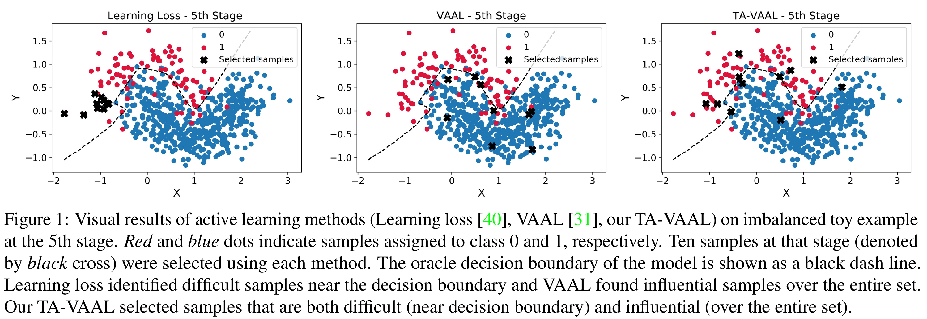
Latent Space Global Dist.
Notes:
Inference hidden variables
Deterministic (unlike MCMC)
Easy to gauge convergence (unlike MCMC)
Requires dozens of iterations (unlike MCMC where 1000s of samps are needed)
No conjugacy requirement
More complicated math (slightly)

Slide 10
TA-VAAL
Notes:
Inference hidden variables
Deterministic (unlike MCMC)
Easy to gauge convergence (unlike MCMC)
Requires dozens of iterations (unlike MCMC where 1000s of samps are needed)
No conjugacy requirement
More complicated math (slightly)

Slide 11
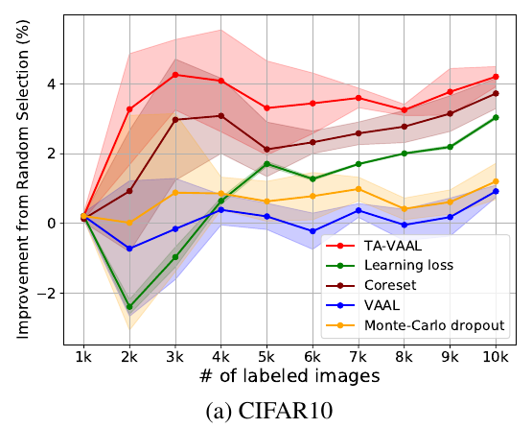
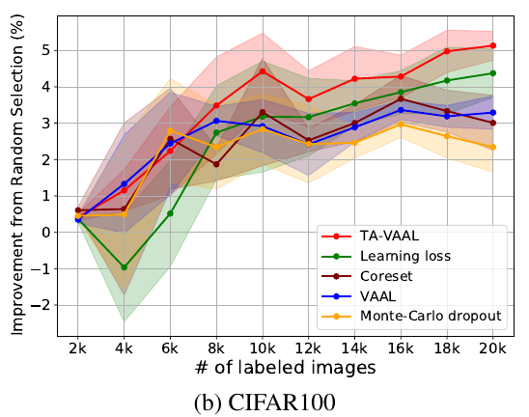
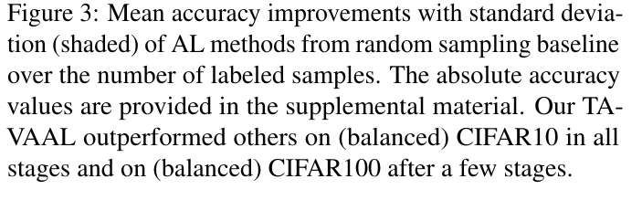
Experiments
Notes:
Inference hidden variables
Deterministic (unlike MCMC)
Easy to gauge convergence (unlike MCMC)
Requires dozens of iterations (unlike MCMC where 1000s of samps are needed)
No conjugacy requirement
More complicated math (slightly)

Slide 12
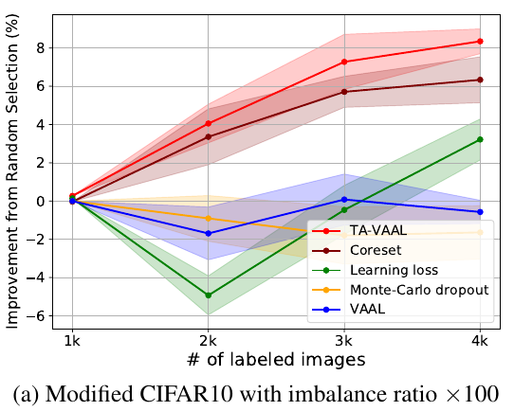
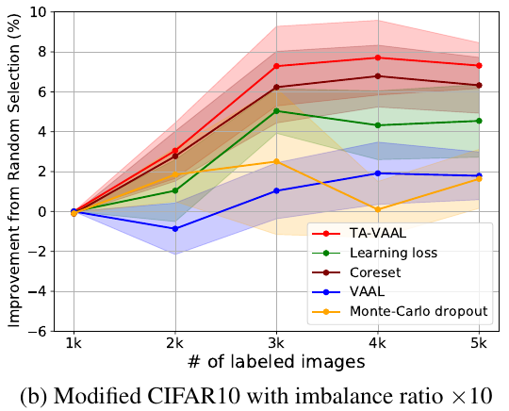
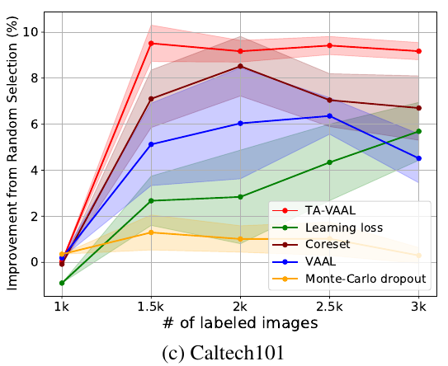
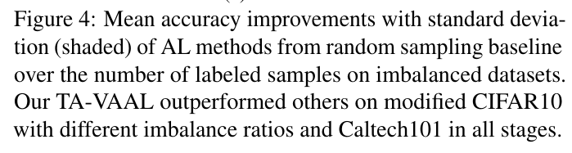
Experiments
Notes:
Inference hidden variables
Deterministic (unlike MCMC)
Easy to gauge convergence (unlike MCMC)
Requires dozens of iterations (unlike MCMC where 1000s of samps are needed)
No conjugacy requirement
More complicated math (slightly)

Slide 13
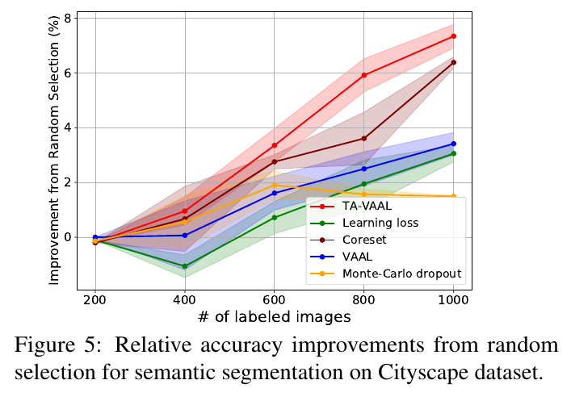
Experiments
Notes:
Inference hidden variables
Deterministic (unlike MCMC)
Easy to gauge convergence (unlike MCMC)
Requires dozens of iterations (unlike MCMC where 1000s of samps are needed)
No conjugacy requirement
More complicated math (slightly)

Slide 14
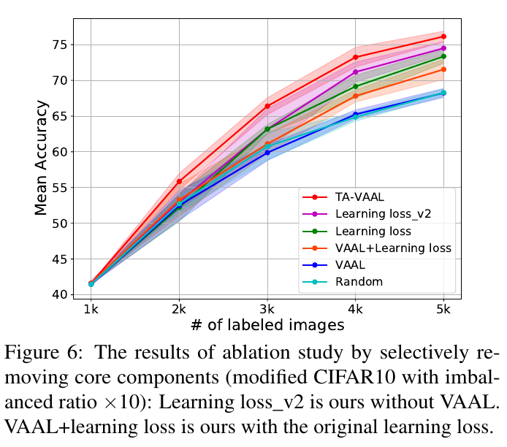
Experiments
Notes:
Inference hidden variables
Deterministic (unlike MCMC)
Easy to gauge convergence (unlike MCMC)
Requires dozens of iterations (unlike MCMC where 1000s of samps are needed)
No conjugacy requirement
More complicated math (slightly)

Slide 15
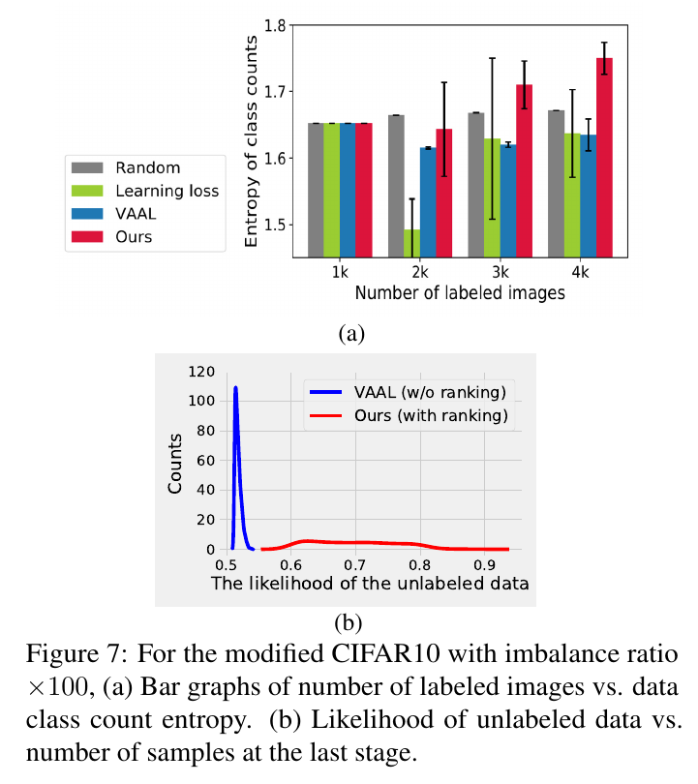
Experiments
Notes:
Inference hidden variables
Deterministic (unlike MCMC)
Easy to gauge convergence (unlike MCMC)
Requires dozens of iterations (unlike MCMC where 1000s of samps are needed)
No conjugacy requirement
More complicated math (slightly)

Slide 16
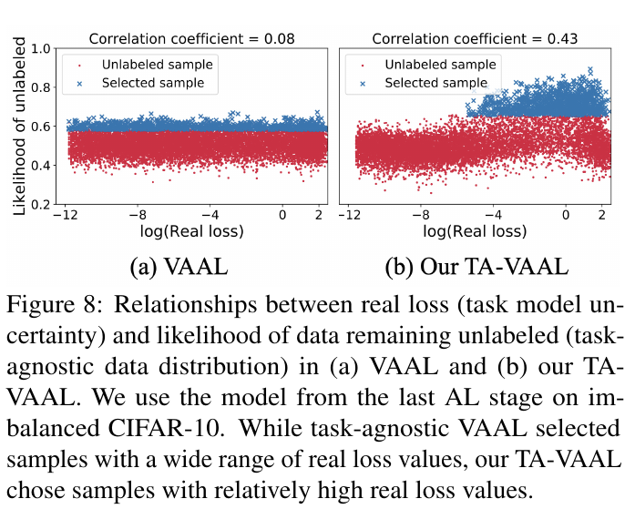
Experiments
Notes:
Inference hidden variables
Deterministic (unlike MCMC)
Easy to gauge convergence (unlike MCMC)
Requires dozens of iterations (unlike MCMC where 1000s of samps are needed)
No conjugacy requirement
More complicated math (slightly)

Slide 17
Questions!

Slide 18
Thank you!

