Slide 1
Reinforcement Learning of Active Vision for Manipulating Objects under Occlusions
Ricson Cheng, Arpit Agarwal, Katerina Fragkiadaki
2019
Bardia Mojra
February 24, 2021
Robotic Vision Lab
University of Texas at Arlington

Slide 2
Introduction
A RL monocular RGB grasping system where camera pose is controlled through visual feedback to reduce occlusions.
The authors pose the question of learning manipulation policies under occlusions and propose agents capable of hand-eye movement coordination with various distractors present in the scene.
They introduce a modular actor-critic network architecture based on HER.
They highlight the importance of Curriculum Learning methods.

Slide 3
Multi-Goal POMDP
Multi-goal Partially Observable Markov Decision Process
States, Goals, Action-Gripper, Action-Camera
Action Space A: A^c X A^g
Reward: r_g: S x A → R
Policy: pi: O x G → A
Results in reward r_t = r_g(o_t, a_t)
Low dimensional embeddings for
  object frame appearance, f_t
  Estimation target object pose, \hat{o_t}
  and known gripper position h_t

Slide 4
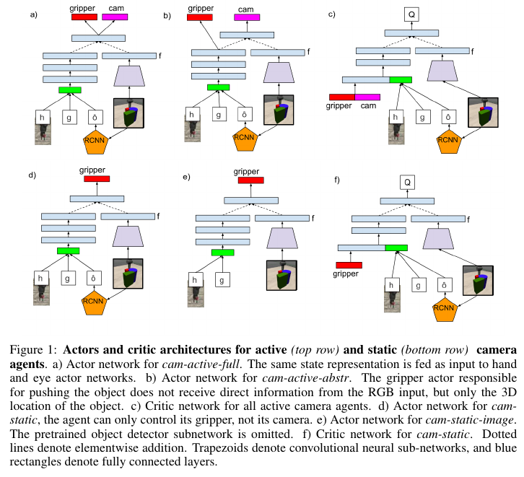
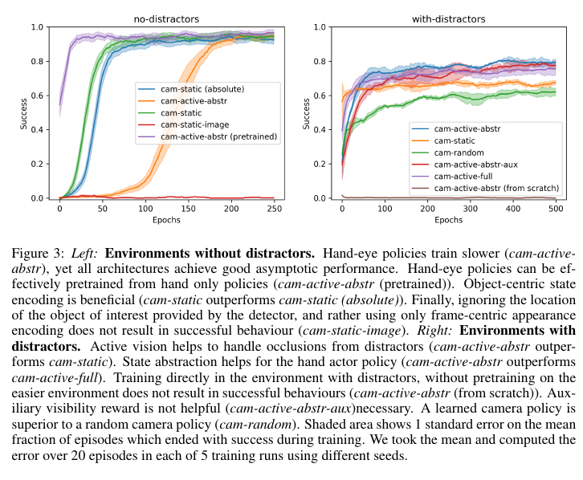
RL Networks

Slide 5
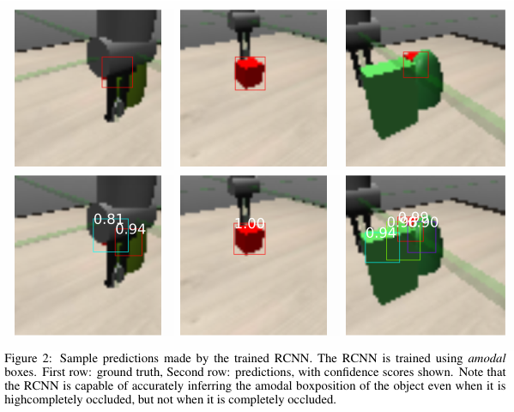
Curriculum Learning

Slide 6
Curriculum Learning

Slide 7
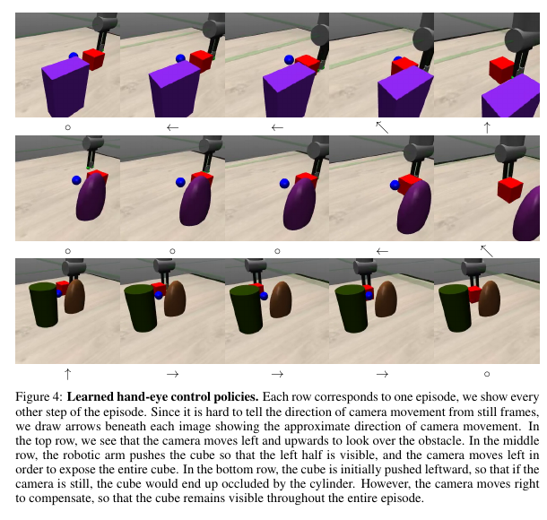
Curriculum Learning

Slide 8
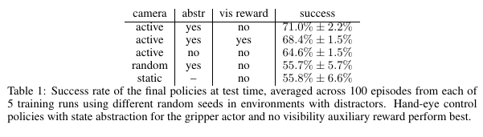
Visual Reward

Slide 9
Thank you!

