Slide 1



AK: Attentive Kernel for Information Gathering
Weizhe Chen, Roni Khardon, and Lantao Liu
Bardia Mojra
January 25, 2023
Robotic Vision Lab
The University of Texas at Arlington

Slide 2
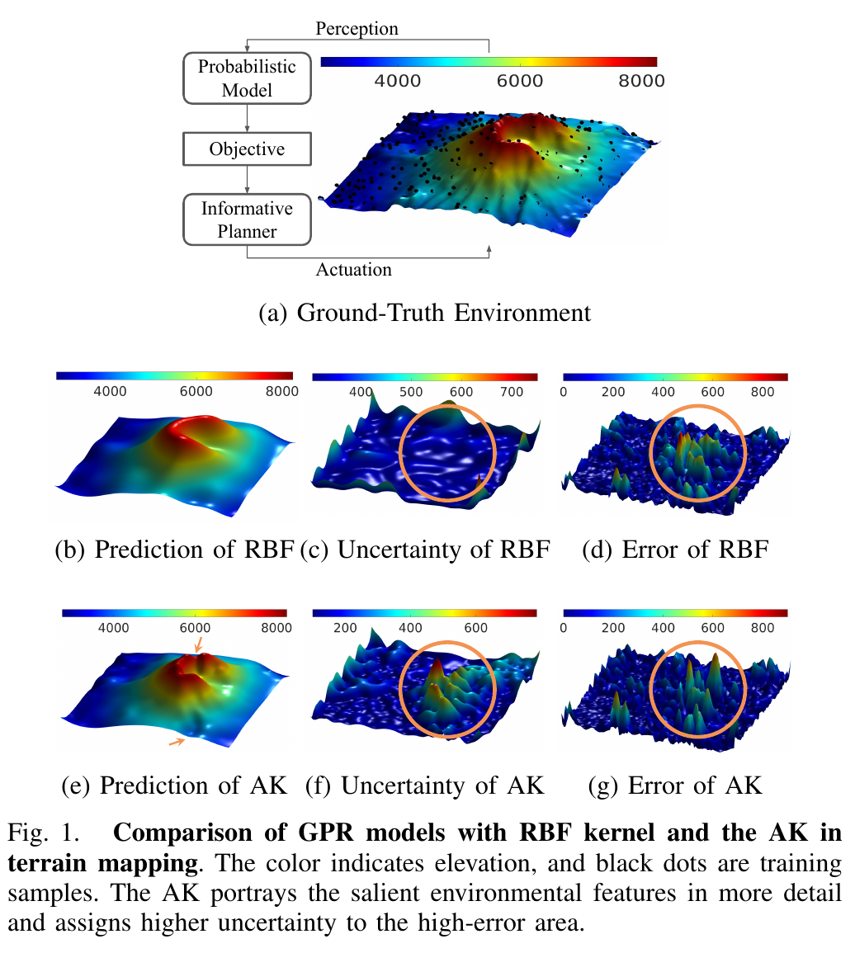
Introduction
Mapping topological features in a salient environment with sparse samples and an online planner
Robotic Information Gathering (RIG) planners
  Rely on the uncertainty of the probabilistic topological model
Common kernel for spatial modeling:
    Gaussian process (GP)
    Radial basis function (RBF)
Informative planning:
  RIG planners prioritize regions with the highest uncertainly

Slide 3
Problem Statement
Gaussian process regress (GPR) with stationary kernels:
  Struggle to capture 21fine details
  Inconsistent prediction error and uncertainty
Non-stationary models:
  Often too flexible to be trained

Slide 4
Problem Statement
Gaussian process regress (GPR) with stationary kernels:
  Struggles to capture fine and random topological details
  Inconsistent prediction error and uncertainty
Non-stationary models:
  Often too flexible to be trained

Slide 5
Thank you!

