Slide 1
Title
Subtitle
Name
December 17, 2021
Robotic Vision Lab
University of Texas at Arlington

Slide 2
Outline
Introduction
Abundance of data and compute power, yet fragile generalization (Problem Statement)
Digital Twin (general intro to the topic)
RVL DT (intro to your solution)
Detail 1 – Photo-Realistic Training Data for countless application, show image quality and ...
Detail 2 – Physics-based simulation, show detailed components
Detail 3 – Integration and data collection suite for other application
Difficulties and issues
Future plans, integration with DLO project
Model integration
Learning object dynamics
Real-time synchronization and measuring time divergence
Questions

Slide 3
Introduction
Git vs. Github, Gitlab, Mercurial, SVN and etc
Created by Linus Torvalds in 2005
Designed for FAST for synchronization of source code across a distributed network:
A patch could require 250 atomic operations and all must be applied under 3 seconds, otherwise not scalable → Journaling File System (similar to Linux Kernel)
Other design criteria [wiki/Git ]:
Take Concurrent Versions System (CVS) as an example of what not to do; if in doubt, make the exact opposite decision.
Support a distributed, BitKeeper-like workflow.
Include very strong safeguards against corruption, either accidental or malicious.

Slide 4
Git Basics
Create or clone a repo:
Create repo on web then clone it to local (recommended for beginners)
Create repo on server, init local clone then push it
Clone an existing repo to local
Add git-ignore and read me files
Update git-ignore file per project needs
Add initial files and make initial commit before starting development

Slide 5
Basic Operations
Create or clone a repo:
Create repo on web then clone it to local
cd git
git clone https://BardiaMojra@github.com/BardiaMojra/test001.git

Slide 6
Basic Operations
Create or clone a repo:
Create repo on server, init local clone then push it
cd git
mkdir test001
cd test001/
echo '# test001' >> README.md
git init
git add README.md
git commit -m 'first commit'
git branch -M main
git remote add origin https://BardiaMojra@github.com/BardiaMojra/test001.git
git push -u origin main

Slide 7
Git Ignore
What to ignore?
Almost everything
All binary files except the final output file!
Data
Dev and build files
Any file with unknown extensions
What not to ignore?
Source code
Final output file (yes even if it is binary)
Dev meta data

Slide 8
Git Ignore Example
https://github.com/github/gitignore/blob/main/TeX.gitignore

Slide 9
Read-Me File and Markdown Language
Cheat sheet:
https://www.markdownguide.org/cheat-sheet/
Basic Syntax:
https://www.markdownguide.org/basic-syntax
Extended Syntax:
https://www.markdownguide.org/extended-syntax

Slide 10
Branching
This is the core feature that support git agility
Developers can create unlimited number of branches
Developers can use arbitrary and long names for naming branches
That’s it…
So the idea is that…
Each developer:
First creates their own branch to work on a specific task
Keep developing in an isolated branch while being able to see and compare source code in other branches
Once the feature is ready in a separate branch, only then it should be queued for merging in coordination with a maintainer!

Slide 11
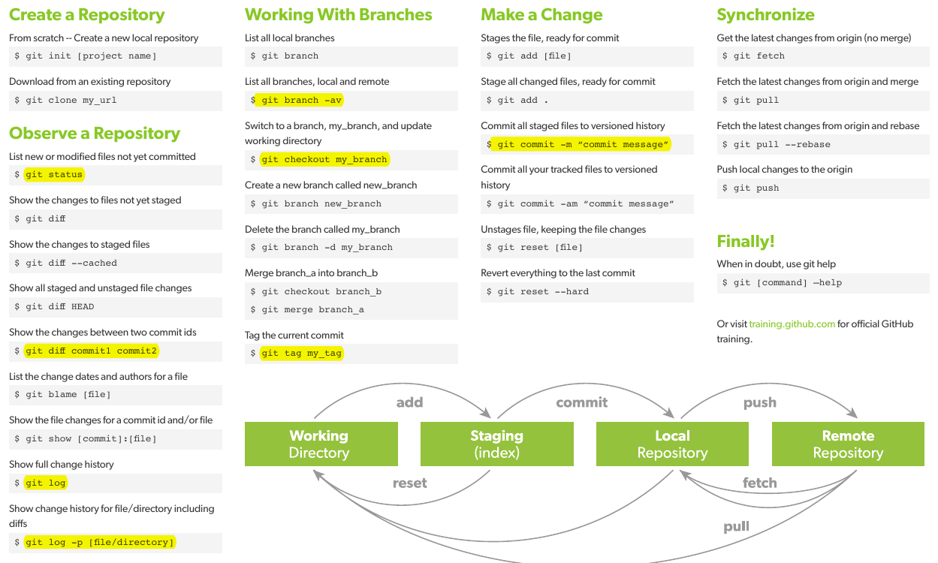
Branching Basics
https://zeroturnaround.com/rebellabs/git-commands-and-best-practices-cheat-sheet/

Slide 12
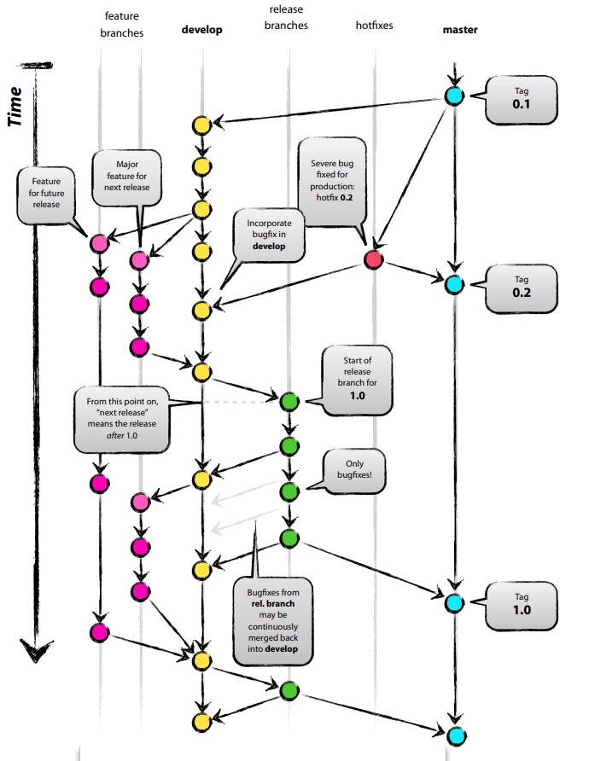
Branching Strategies
Essentially a hierarchical naming strategy
e.g. our paper repository branches would be something like:
Main (master) – unique
Journal_Papers_2021_Archive – unique
Use for backups or manually commit every 3-6 months
Performs no merge operation, simply archiving
Journal_Papers_2021_Active – unique
Use for active merging of paper/project directories
Adds extra layer of protection for active merging operation
JP_2021_QEKF_dev_00x – many
JP_2021_QEKF_update_00x – very few
For source code, use hotfix
I use dev branch instead
JP_2021_QEKF_merge_00x – few
JP_2021_QEKF_review_00x – few
JP_2021_QEKF_release_00x – very few
https://nvie.com/posts/a-successful-git-branching-model/

Slide 13
Thank you!

