Slide 1
Unified Probabilistic Deep Continual Learning
Through Generative Replay and Open Set Recognition
Martin Mundt, Sagnik Majumder, Iuliia Pliushch, Yong Won Hong, and Visvanathan Ramesh
2020
Bardia Mojra
September 22, 2021
Robotic Vision Lab
University of Texas at Arlington

Slide 2
Introduction
Based on Extreme Value Theory (EVT)
Probabilistic open set recognition
Allows for continual learning
Prevents catastrophic forgetting
Does not store entire data set
Model:
  Combine joint probabilistic encoder with a GAN
  Tight classification bound on high-density learned parameter regions
  Only use high-density data points in regenerative model training

Slide 3
Variational Bayesian Inference
Inference hidden variables
Deterministic
Easy to gauge convergence
Requires dozens of iterations
No conjugacy requirement
More complicated math (slightly)
Notes:
Inference hidden variables
Deterministic (unlike MCMC)
Easy to gauge convergence (unlike MCMC)
Requires dozens of iterations (unlike MCMC where 1000s of samps are needed)
No conjugacy requirement
More complicated math (slightly)

Slide 4
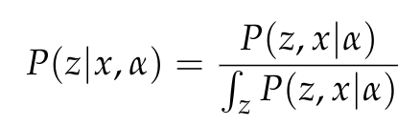
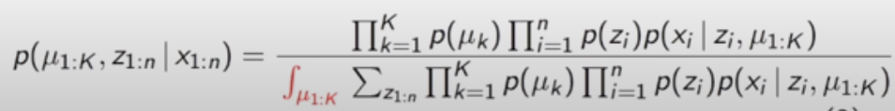
Bayesian Probability
Observations – x
Hidden variable – z
Fixed (learned) parameters – alpha
Bayesian Inference:
  Posterior requires calculating over all means and cluster assignments

Slide 5
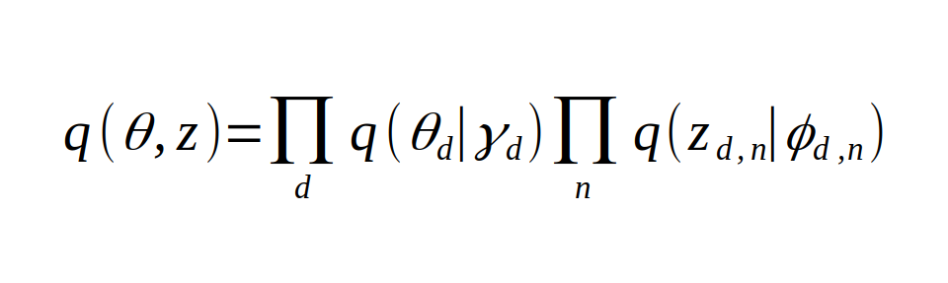
Bayesian Inference over Latent Variable
Variational Distribution
Theta – per-datum latent variable distribution (multinomial distribution)
Z – Class assignment (discrete random variable)
Gamma – class labels distribution (Dirichlet distribution)
Phi – Learned parameters distribution over class assignments (multinomial distribution)

Slide 6
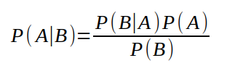
Variational Bayesian Inference
Bayes’ rule:
P(A|B): Pos

Slide 7
Introduction
Bayes’ rule:
    Remember your priors (Bayes’ rate neglect)
    Imagine your theory is wrong. Would the world look different?
    Update incrementally (snow flakes of evidence)

Slide 8
Problem Statement
Models are often underperform and make miscalibrated predictions ("classifier score")
For a prediction of i.e. 40% to be considered calibrated, there has to be an occurrence of 40% for a give large test set
  Dataset:
    Must be large enough with respect to solution space size
    Test dataset must be randomly selected (for more insight read on Central Limit Theorem – super important)

Slide 9
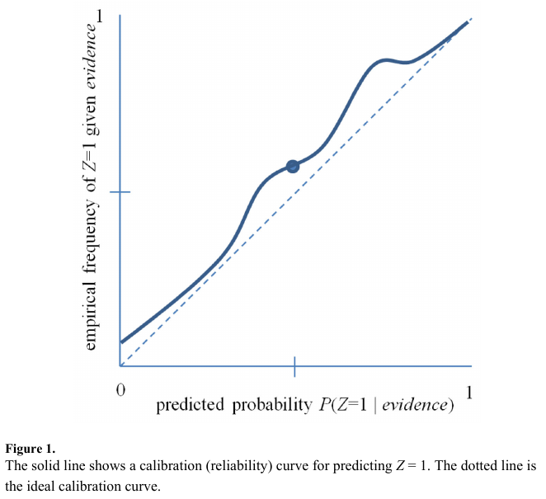
Problem Statement
Figure 1 is a reliability curve (DeGroot and Fienberg 1983; Niculescu-Mizil and Caruana 2005) that is used as an example of a predictive model with poorly estimated probabilities.

Slide 10

Related Work
BBQ is an extension of simple histogram binning method (Zadrozny and Elkan 2001). The authors added capability to consider different binning models (different number of bins) and their combinations under a Bayesian frame work (Heckerman, Geiger, and Chickering, 1995).
The generated Bayesian score is provides further insight into Bayesian network structure and is used for combining binning models.

Slide 11
Related Work
The marginal likelihood, P(D | M), has a closed form solution under the following 3 conditions (Heckerman, Geiger, and Chickering, 1995):
  All samples are under i.i.d. assumption and the class distribution P(Z|B=b), which is class distribution for bin b, with a binomial distribution with parameter θ_b.
  Bin distributions are independent.
  The prior distribution over binning model parameters θ's are modeled using a Beta distribution.

Slide 12
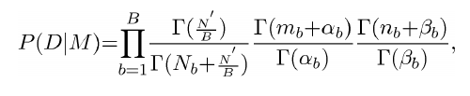
Related Work
Marginal likelihood closed form, (Heckerman, Geiger, and Chickering, 1995)
Where:
  Gamma(n) = (n-1)!
  N_b: total number of training instances in the b'th bin.
  n_b: total instances of class *zero* among all training instances N_b.
  m_b: total instances of class *one* among all training instances N_b.
  P(M): prior distribution of binning model M, uniform distribution for initial condition.

Slide 13


BBQ
Where:
T: total number of binning models considered.
P(z=1 | y, M_i): probability estimate using model M_i for uncalibrated classifier output y.
B: number of bins

Slide 14

Calibration Measures
ECE: Expected Calibration Error is calculated over the bins.
MCE: Maximum Calibration Error is calculated among the bins.
Where:
    o_i: true fraction of positive instances in the i^th bin
    e_i: mean of the post-calibrated probabilities in the i^th bin
    P(i): empirical probability (fraction) of all instances in the i^th bin

Slide 15
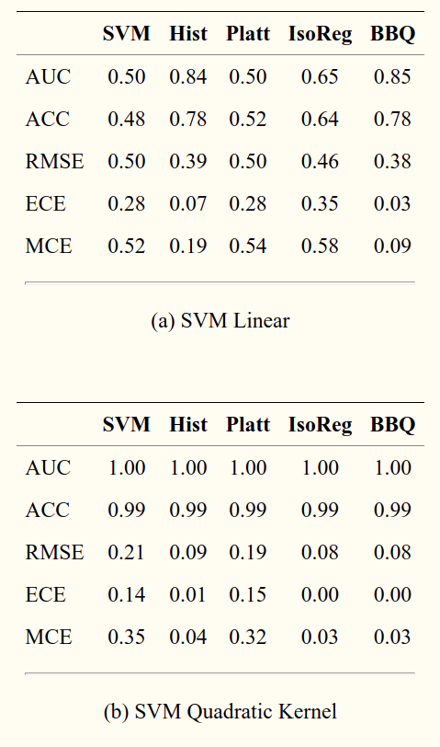
Empirical Results
Acc: accuracy
AUC: area under the ROC curve (receiver operator characteristic curve)
RMSE
ECE
MCE

Slide 16
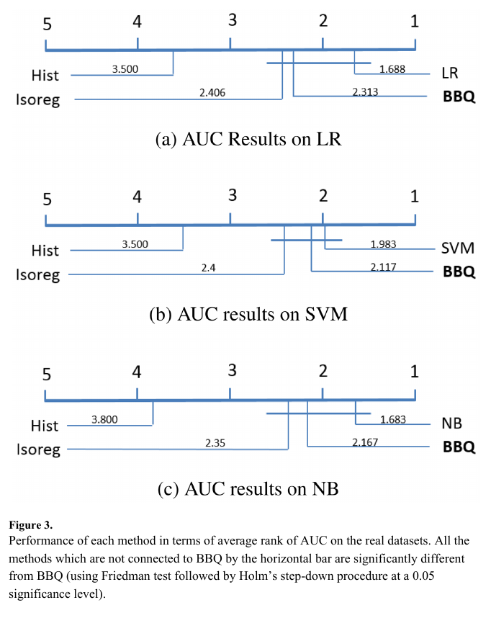
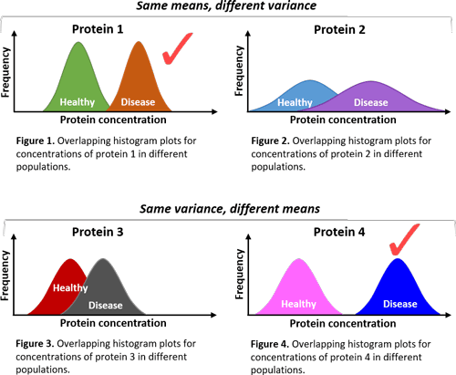
Friedman Test with Holm’s Post-Hoc Procedure
Friedman test: non-parametric version of ANOVA test
In statistics, this technique is used to compare survey and reject null hypothesis.

Slide 17
Thank you!

