Slide 1



Diagnostic Evaluation
Supervisor: Dr. William Beksi
Mentor: Dr. Nicholas Gans
Bardia Mojra
UTA: 1000766739
October 19, 2022
Robotic Vision Lab
UTA Research Institute
University of Texas at Arlington

Slide 2
Committee
Dr. William Beksi
Dr. Nicholas Gans
Dr. Yan Wan
Dr. Vassilis Athitsos
Dr. Manfred Huber
Dr. Deok Gun Park

Slide 3
Research Interests
Real-time robotic control and manipulation: deformable linear objects (DLO) manipulation
Optimal control of nonlinear and chaotic systems: MPC-Koopman control and online system identification
Real-time system identification from high dimensional data: DMD, piDMD
Vision-based navigation and scene reconstruction: Xest (QuEst+VEst+QEKF), XSfM (X structure from motion from multiple images)
Advanced and agile manufacturing: Digital twin, digital thread, photo-realistic and physics-based simulation

Slide 4
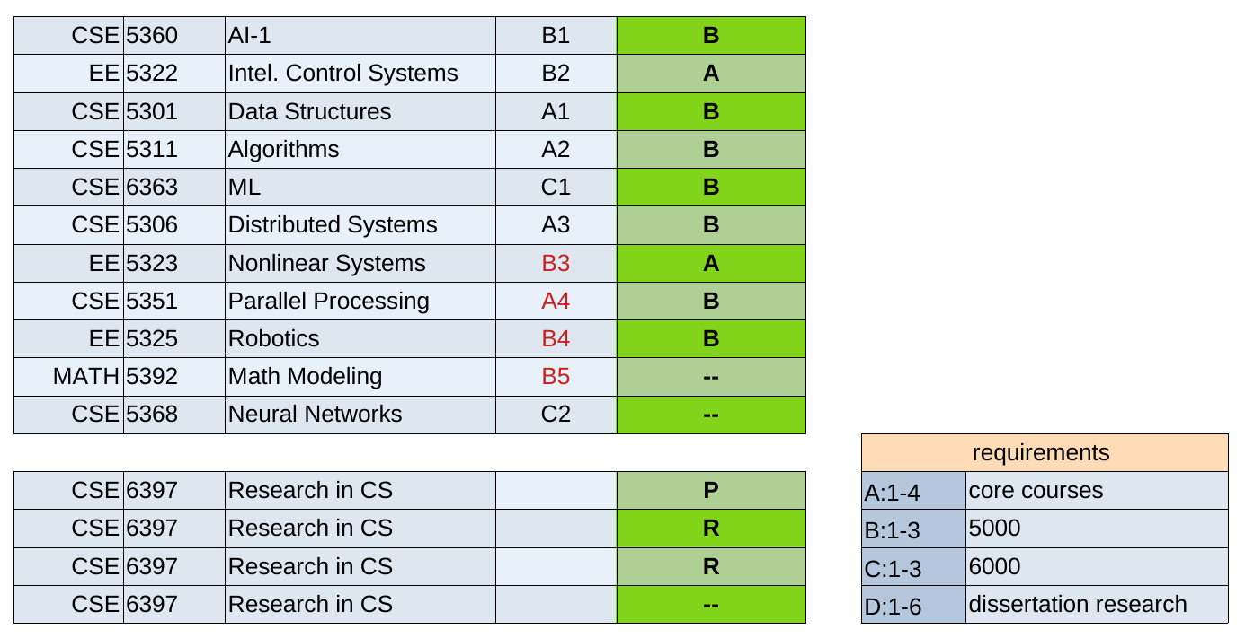
Course Work

Slide 5
Requirements
A BS to PhD student must enroll for a minimum of 30 semester hours of coursework as follows:
Completion of 4 core courses with a minimum GPA of 3.5:
  CSE 5311 - Design and Analysis of Algorithms (completed) and three of the following:
    CSE 5301 - Data Analysis and Modeling Techniques (completed)
    CSE 5306 - Distributed Systems (completed)
    CSE 5317 - Design and Construction of Compilers
    CSE 5350 - Computer Systems Architecture or CSE 5351 - Parallel Processing (completed)
    Completion of at least three 6000 level courses (9 hours) as PhD student at UTA: 6369, 6367, 6363

Slide 6
Research Direction
Vision-based navigation and scene reconstruction: Xest (QuEst+VEst+QEKF), XSfM (X structure from motion from multiple images) → DMD as denoising solution to QuEst
Real-time manipulation of deformable linear objects (DLO): piDMD+Koopman → develop end-to-end explicit modeling from data and optimal control via MPC-Koopman controller, dataset for a cable
Digital twin (DT) on Nvidia Omniverse: Reinforcement learning, rapid data generation, and sim2reality transfer
DT for rapid expansion to 2D and 3D deformable object: Introduce unit segment object for deformable, object oriented programming (OOP), and hierarchical state machine (HSM) → agile implementation, computationally optimal for a given hardware

Slide 7
Thank you!

