Slide 1
CAPSTONE PROJECT (WEEK 3 & 4) THE BATTLE OF THE NEIGHBORHOODS
Bardiya B.

Slide 2
Problem Description:
Investigation of the types and numbers of venues in neighborhoods
Identify needed venue types with business potential
Identify neighborhoods with need for some venue types and business potential

Slide 3
Idea:
Investigate correlation between different venue types
Make an educated guess about competetive and supporting venues in a strongly correlated cluster
Subcluster into K1: competitive venues, K2: supproting venues for K1
I.e. K1: Different types of restaurant, K2: venues which don‘t compete but correlate strongly with K1

Slide 4
Idea PART 2:
For each neighborhood:
Train a model to predict the number of occurencies of venues in K1 based on K2
Interpret the difference between predicted/expected number and real number as business opportunity or over-saturation of the market

Slide 5
DATA :
The data we are going to use is the same as before.
We are going to scrape the following Wikipedia site for information about Toronto: https://en.wikipedia.org/wiki/List_of_postal_codes_of_Canada:_M
We are going to use the CSV file provided in the previous assignments to get the coordinates of the neighborhoods of Toronto
We will use the Foursquare API to get information about venues in the different neighborhoods.

Slide 6

Methodology:
Correlation $C_{xy}$between two types of venues $x, y$ :
$$C_{xy}= \sum_{i}{\frac{(n_{x,i}−μ_{n_{x}})(n_{y,i}−μ_{n_{x}})}{σ_{n_{x}}σ_{n_{y}}}}$$
$n_{x,i}:$ number of venues of type $x$ in neighborhood $i$,
$_{n_{x}}$: average number of venues of type $x$ over all neighborhoods
$_{n_{x}}:$ corresponding standard deviation

Slide 7
Methodology PART 2:
Restrict to venues that occur often enough, for proper statistics
Find cluster of stronly correlated venues
Split cluster:
K1: Competitive venues to make predictions for
K2: Other venues to base prediction on

Slide 8

Methodology PART 3:
Use linear regression to make predictions:
$$n_{x,i}^{pred}=\sum_{y∈K_{2}}{A_{xy}n_{y,i }, x∈}K_{1}$$
Define Business opportunity for venue type x and neighborhood i
$opp_{x,i}$ = $n_{x,i}^{pred}−n_{x}$
Define overall business opportunity in cluster K1 by
$$overallopp_{K_{1},i}=\sum_{x∈K_{1}}{opp_{x,i}}$$

Slide 9
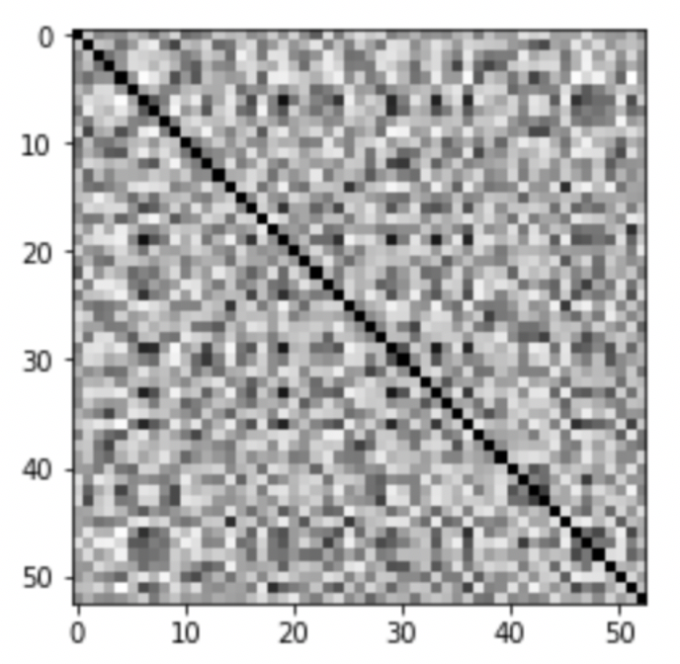
Results:
Taking the top 25% venues in the neighborhoods of torronto we find the correlation heat map:

Slide 10
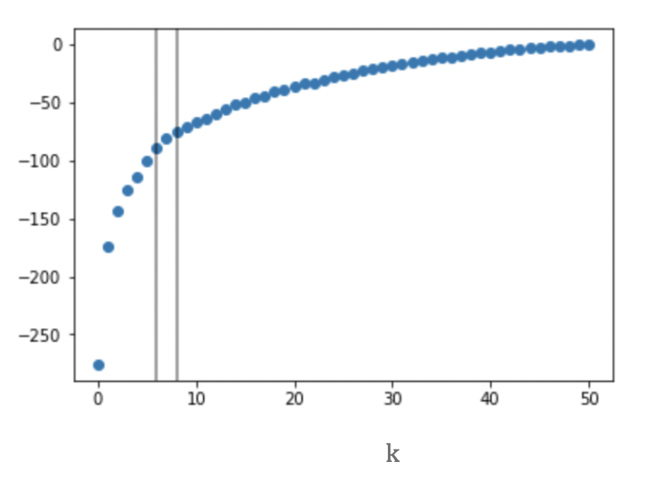
Results:
Running K-Mean on the rows of the correlation matrix
Elbow-point at k=7

Slide 11
Results:
Running K-Mean on the rows of the correlation matrix
Elbow-point at k=7

Slide 12
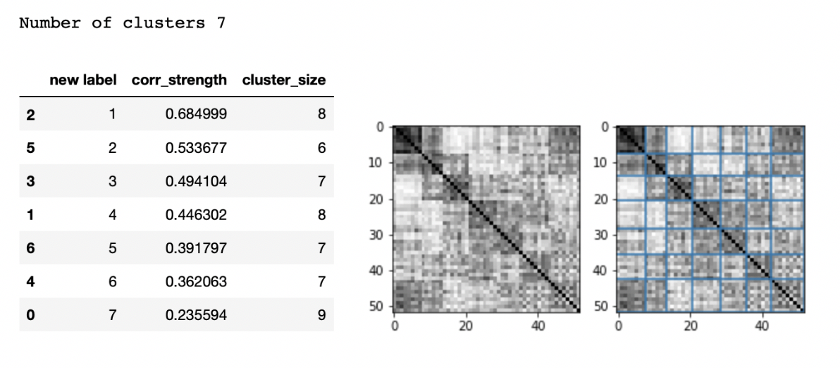
Results:
Strongly correlated cluster of size 8
Cluster stays stable when varrying k around k=7

Slide 13
Results:
['Steakhouse', 'Mediterranean Restaurant', 'Thai Restaurant']
['Steakhouse', 'Mediterranean Restaurant', 'Thai Restaurant']
Cluster given by:
['Farmers Market', 'Plaza', 'Steakhouse', 'Hotel‘, 'Concert Hall', 'Mediterranean Restaurant’ ,
'Thai Restaurant', 'Theater’]
Split into
K1: 'Steakhouse', 'Hotel‘, 'Concert Hall', 'Mediterranean Restaurant’ , 'Thai Restaurant’, K2: Rest
Make predictions for the number of venues in K1 based on K2 from linear regression

Slide 14
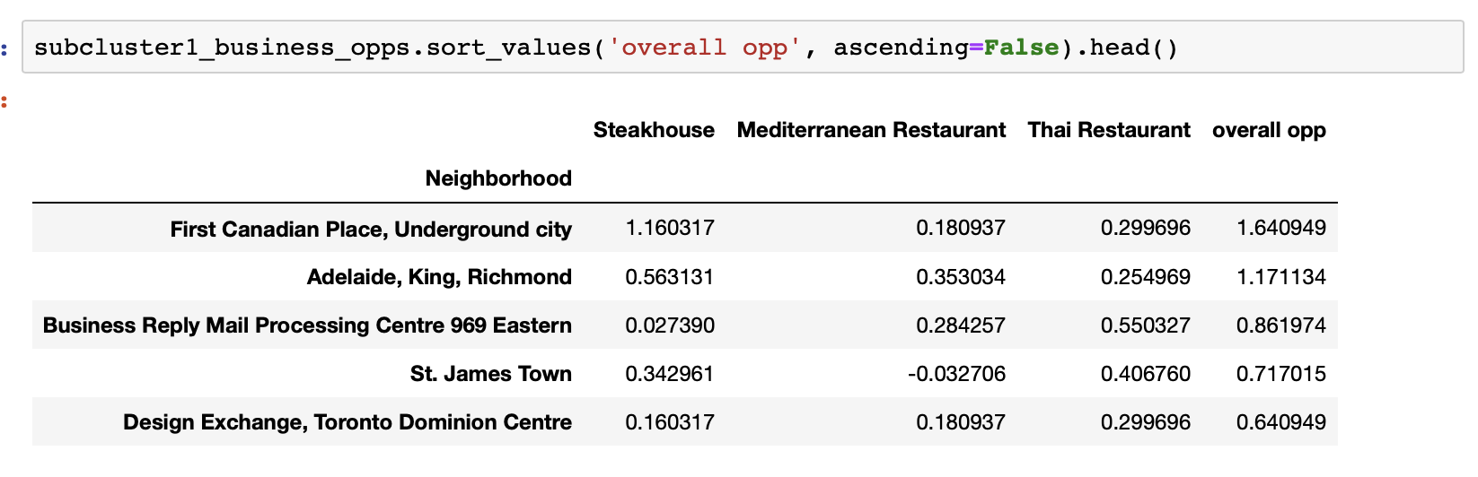
Results:
['Steakhouse', 'Mediterranean Restaurant', 'Thai Restaurant']
['Steakhouse', 'Mediterranean Restaurant', 'Thai Restaurant']
Business opportunities for venues in K1, from difference between prediction/expectation vs. Real number of values
Best overall opportunities

Slide 15
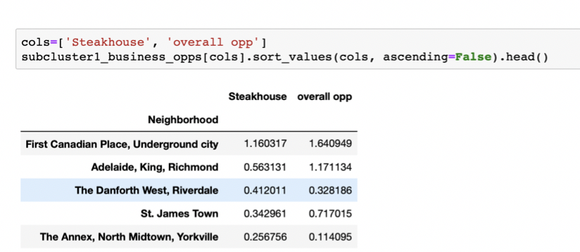
Results:
['Steakhouse', 'Mediterranean Restaurant', 'Thai Restaurant']
['Steakhouse', 'Mediterranean Restaurant', 'Thai Restaurant']
Best opportunities for Steakhouses

Slide 16
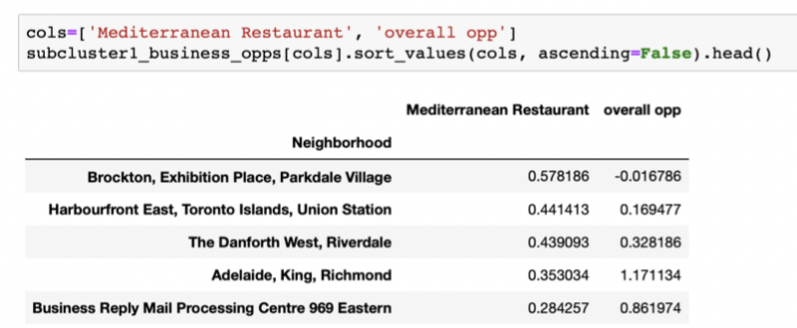
Results:
['Steakhouse', 'Mediterranean Restaurant', 'Thai Restaurant']
['Steakhouse', 'Mediterranean Restaurant', 'Thai Restaurant']
Best opportunities for Medditerranean Restaurants

Slide 17
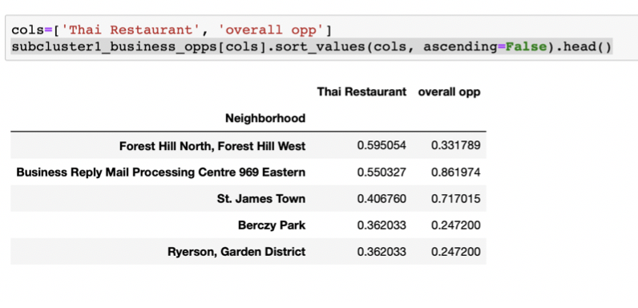
Results:
['Steakhouse', 'Mediterranean Restaurant', 'Thai Restaurant']
['Steakhouse', 'Mediterranean Restaurant', 'Thai Restaurant']
Best opportunities for Thai Restaurants

Slide 18
Discussion & Conclusions:
['Steakhouse', 'Mediterranean Restaurant', 'Thai Restaurant']
['Steakhouse', 'Mediterranean Restaurant', 'Thai Restaurant']
We have suggested a method to identify neighborhood with business
opportunities & identification of venue types with potential
Problems:
Need more data for better statistics
Need to take into account more neighborhoods, cities, countries
Therefore need generalized model, mixed data split into train and test set
Try out other models, polynomial regression, random forrests, neural networks

Slide 19
tHANK YOU
['Steakhouse', 'Mediterranean Restaurant', 'Thai Restaurant']
['Steakhouse', 'Mediterranean Restaurant', 'Thai Restaurant']

