Slide 1
Development and Implementation of a tracking algorithm for Unmanned Aerial Vehicles
Author: Pablo Ramón Soria
Tutor: Begoña C. Arrúe Ullés

Slide 2
Índice
Estructura
Segmentación
Estimación
Simulaciones
Estructura de los Programas
Vrep
Experimentos
Future Works
BOViL

Slide 3

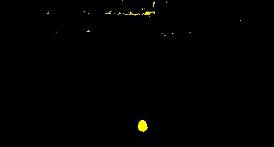

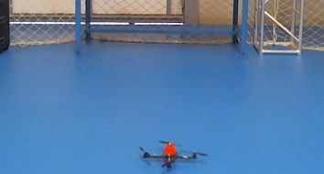
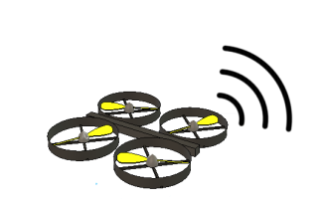
Estructura
Data{
obj1{T, (X, Y), (Tx, Ty, Bx, By)}
obj2{T, (X, Y), (Tx, Ty, Bx, By)}
…
}
Communication
Data
Communication
Segmentation
Data processing

Slide 4
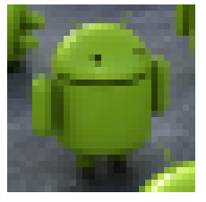
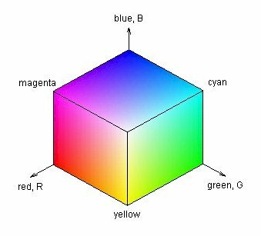
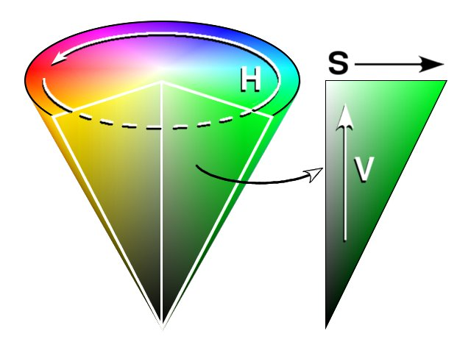
Segmentación
(H,S,V)
RGB Color Space
HSV Color Space
Fast Comparison
Green

Slide 5
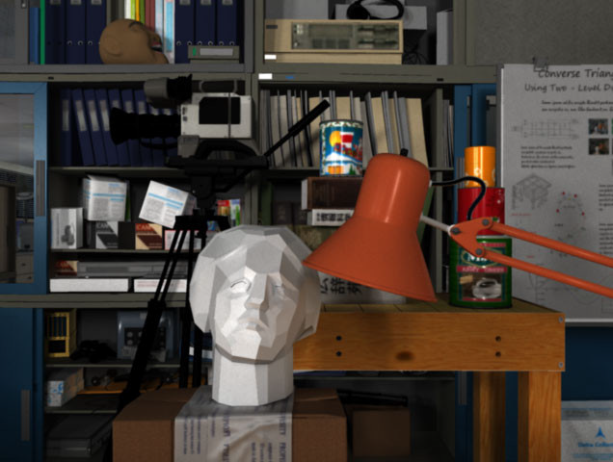
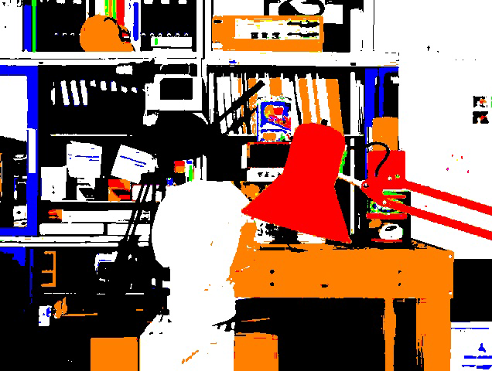
Segmentación – Resultados
Original
Segmentada

Slide 6
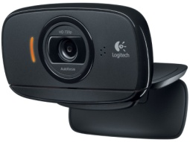
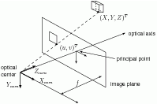
Estimación
Noise
System’s Model
Obj = Time
Centroid
Bouncing box
EKF
Estimated Position

Slide 7
Simulaciones

Slide 8
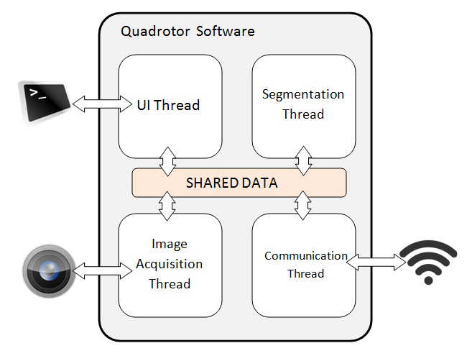
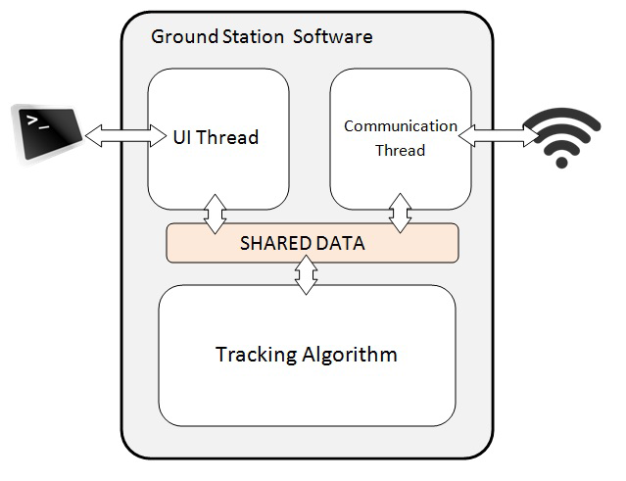
Estructura de los programas

Slide 9
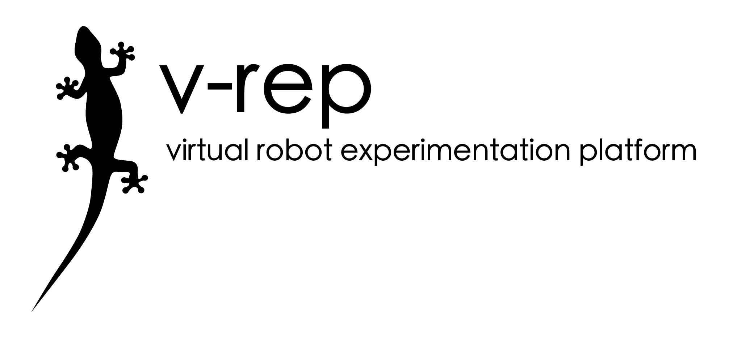
The robot simulator V-REP, with integrated development environment, is based on a distributed control architecture: each object/model can be individually controlled via an embedded script, a plugin, a ROS node, a remote API client, or a custom solution. This makes V-REP very versatile and ideal for multi-robot applications. Controllers can be written in C/C++, Python, Java, Lua, Matlab, Octave or Urbi.

Slide 10
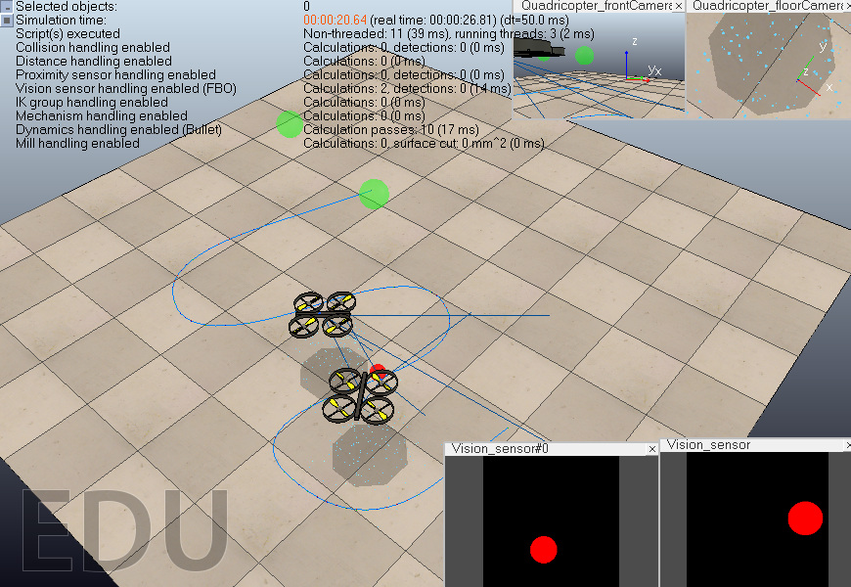
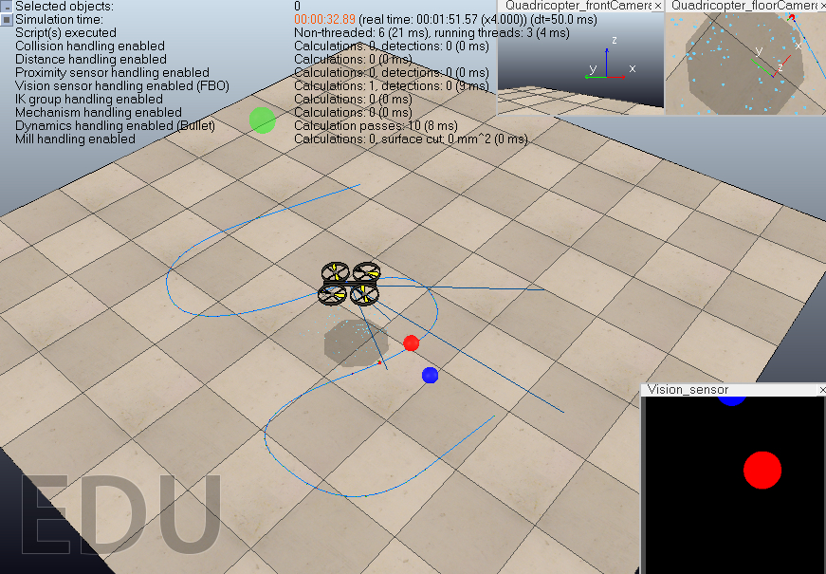
Vrep
Simulaciones
Stereo-Tracking
Multiple objects

Slide 11
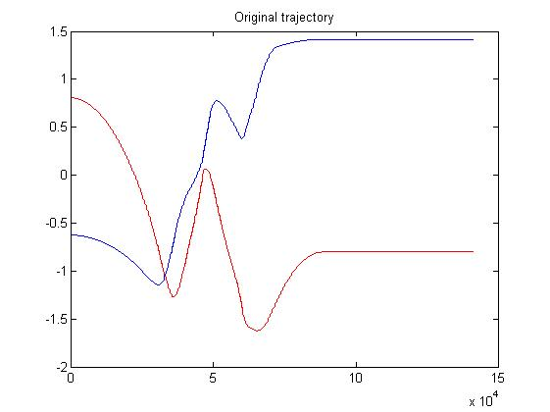
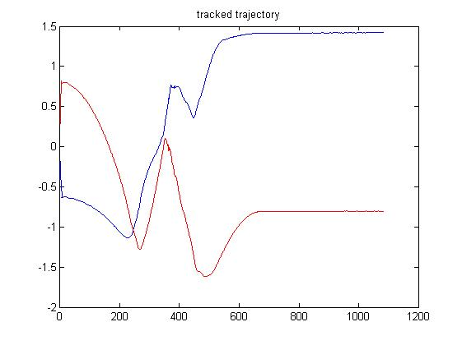
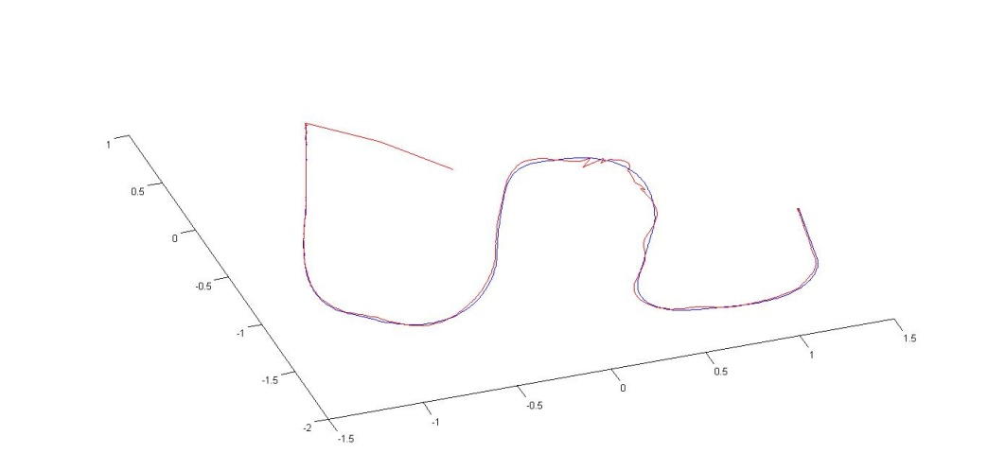
Vrep
Resultados:
Stereo-Tracking:

Slide 12
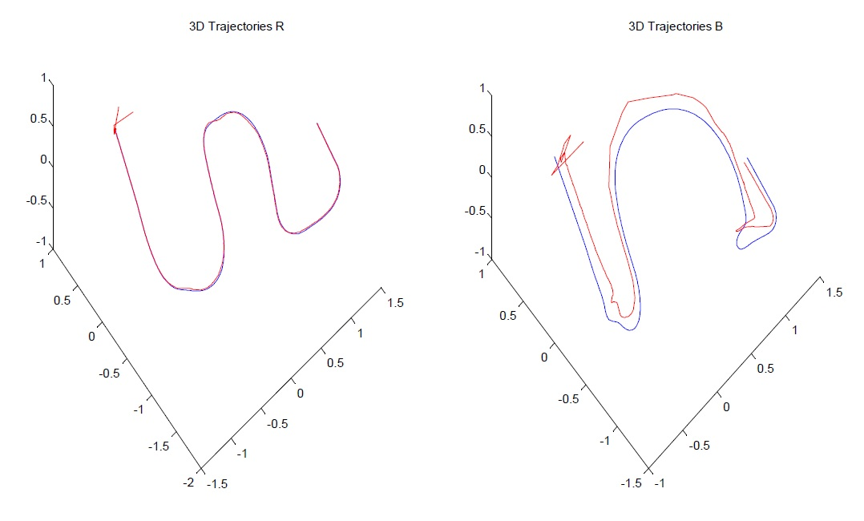
Vrep
Resultados:
Multiple objects
Red Target
Blue Target

Slide 13
DataSets
Estructura

Slide 14
DataSets
Resultados

Slide 15
Future Works

Slide 16
BOViL

