Slide 1
Inventory Management System
Module 12 Final Database Project - C# WinForms + SQLite
A working desktop system for product records, stock movement, and inventory reports.

Slide 2
System Overview
• Tracks products, categories, suppliers, customers, and stock transactions.
• Supports CRUD operations and real-time dashboard totals.
• Uses normalized relational tables with primary and foreign keys.
• Built with C# WinForms and SQLite database.

Slide 3
Project Requirements Covered
ER Diagram
Included
Normalized Tables
7 tables
SQL Scripts
Schema + data
Queries Report
5 queries
Presentation
10 slides
C# System
WinForms app

Slide 4
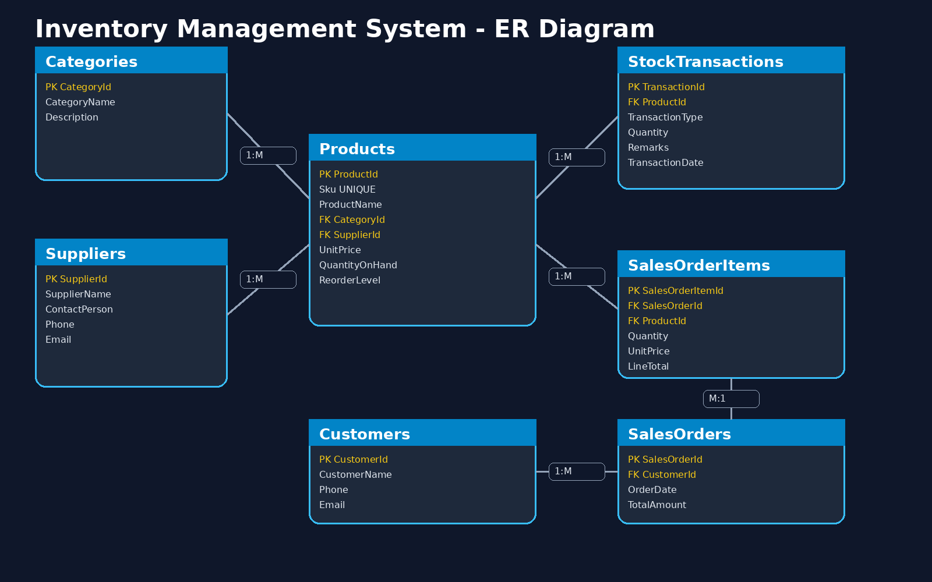
ER Diagram

Slide 5
Normalized Tables
• Categories - stores product classifications.
• Suppliers - stores supplier contact information.
• Products - stores inventory items and stock levels.
• StockTransactions - records stock-in and stock-out.
• Customers, SalesOrders, and SalesOrderItems support sales records.

Slide 6
SQL Scripts and Queries
• schema_sqlite.sql creates all tables and constraints.
• sample_data.sql provides starter records.
• query_report.sql includes product list, low stock, valuation, stock history, and category count queries.
• Foreign keys connect categories, suppliers, products, customers, and orders.

Slide 7
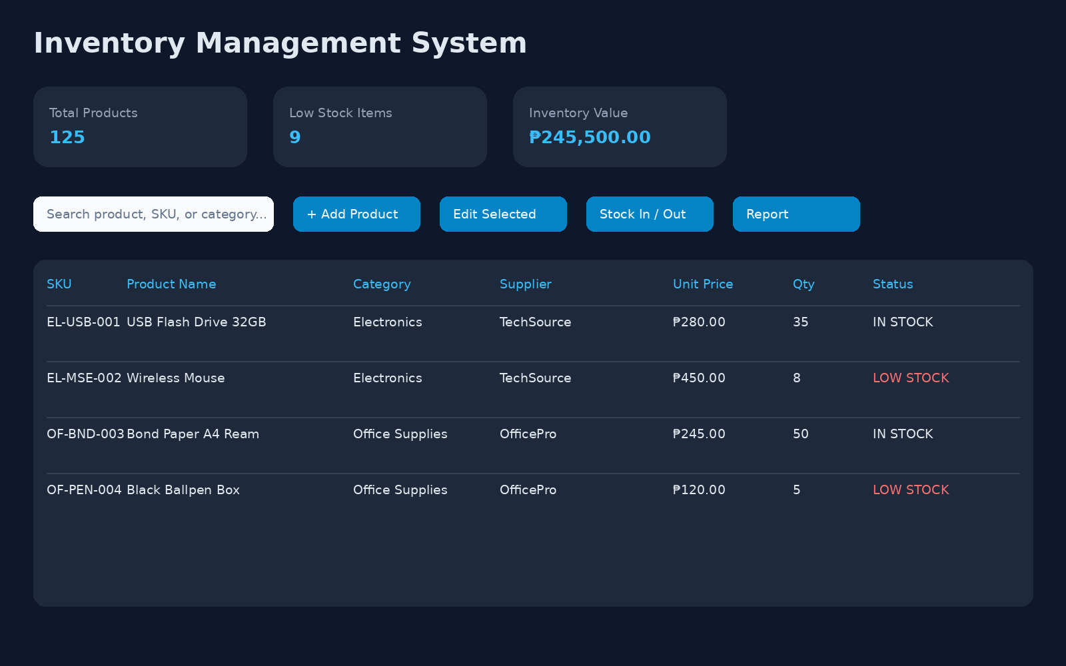
C# Application UI

Slide 8
Main Features
• Add, edit, delete, and search products.
• Dashboard shows total products, low stock count, and inventory value.
• Stock-in and stock-out transactions update quantities.
• Validation prevents stock-out when quantity is insufficient.
• Transaction report shows movement history.

Slide 9
Database Normalization
• 1NF: each field contains atomic values.
• 2NF: non-key fields depend on the whole primary key.
• 3NF: lookup details are separated into Categories and Suppliers.
• Sales order details are separated from order header records.

Slide 10
Conclusion
• The project meets all Module 12 requirements.
• The database is normalized and includes SQL scripts.
• The C# desktop app provides a clean and usable interface.
• Reports help users monitor stock and make purchasing decisions.

