Slide 1

The Watch
Topic: Conditioning
Presented by Barend Stroobants

Slide 2

Conditioning
Conditioning in behavioral psychology is a theory that the reaction ("response") to an object or event ("stimulus") by a person or animal can be modified by 'learning', or conditioning.

Slide 3
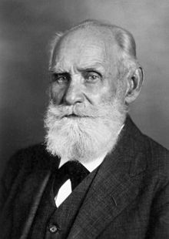
Ivan Petrovich PAVLOV
14 or 26 Sep 1849 - 27 Feb 1936 (87 years old)
Ryazan, Russian Empire
University of Saint Petersburg
2002: ranked 24th most cited psychologist
Nobel Prize for Physiology or Medicine 1904

Slide 4




How does it work

Slide 5
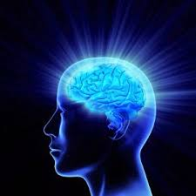
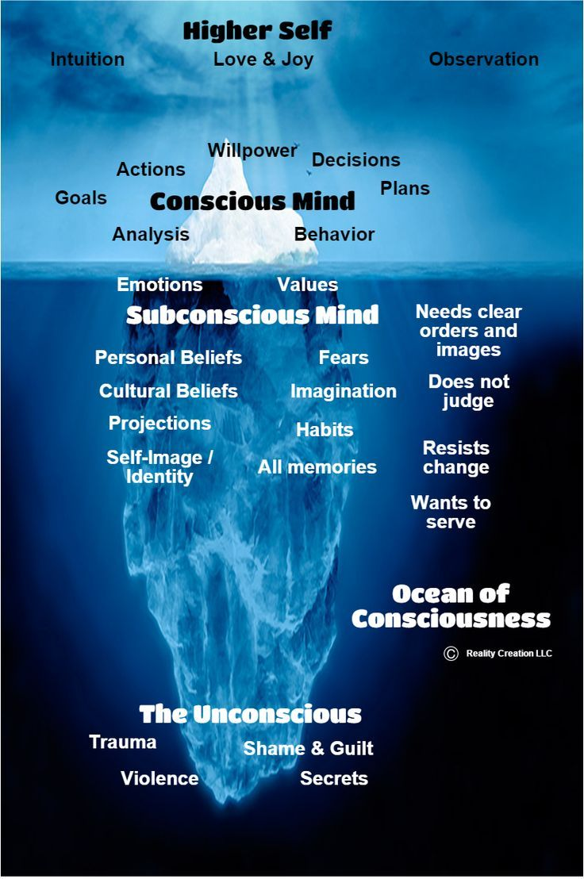

Conscious vs Subconscious
The Thinking mind
Tape Player Mind

Slide 6
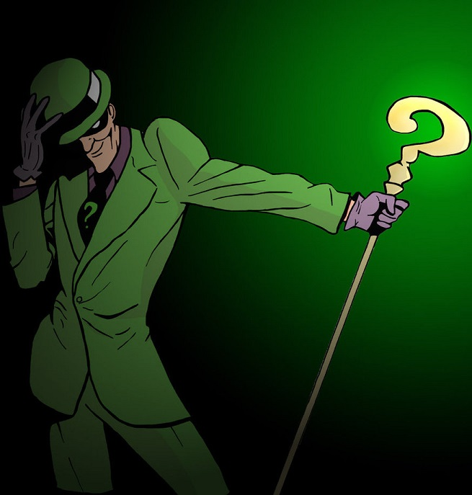
Riddle me this
Whats
the
technical
link?

Slide 7
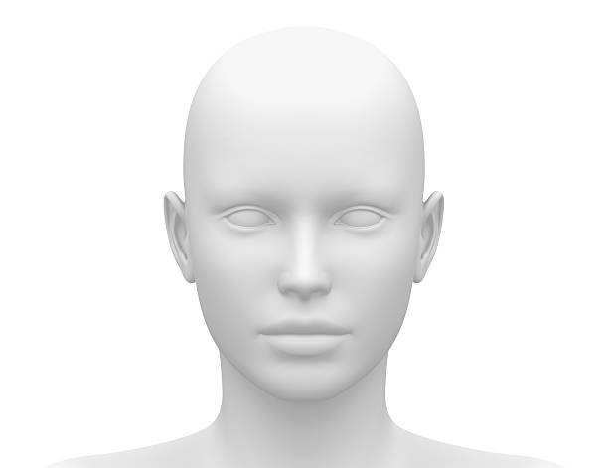
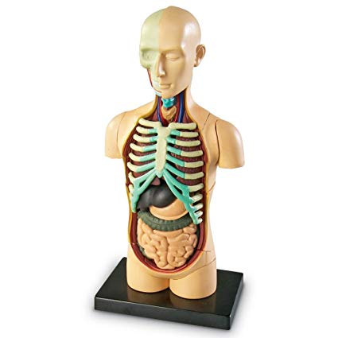
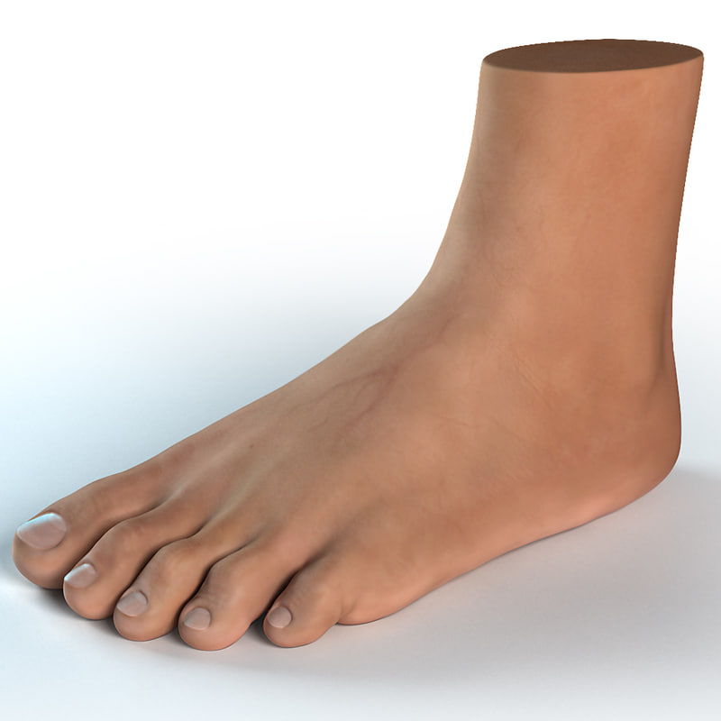
Just like with HTML and CSS
Since we all
have one,
let’s Use it
Add valuable
content
and style
Walk your walk
then
talk your talk

Slide 8

Questions

