Slide 1
爬虫简介

Slide 2
大纲
爬虫是什么
基础知识
爬虫分类
爬虫架构
反抓取
网页解析
工具介绍

Slide 3
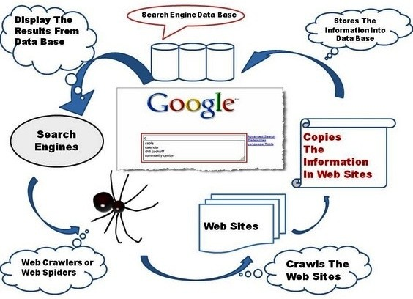
爬虫是什么
名字
Crawler、Spider、Bot
Web Scraping(verb)
定义(wiki)
A Web crawler, sometimes called a spider, is an Internet bot that systematically browses the World Wide Web, typically for the purpose of Web indexing
Spider

Slide 4
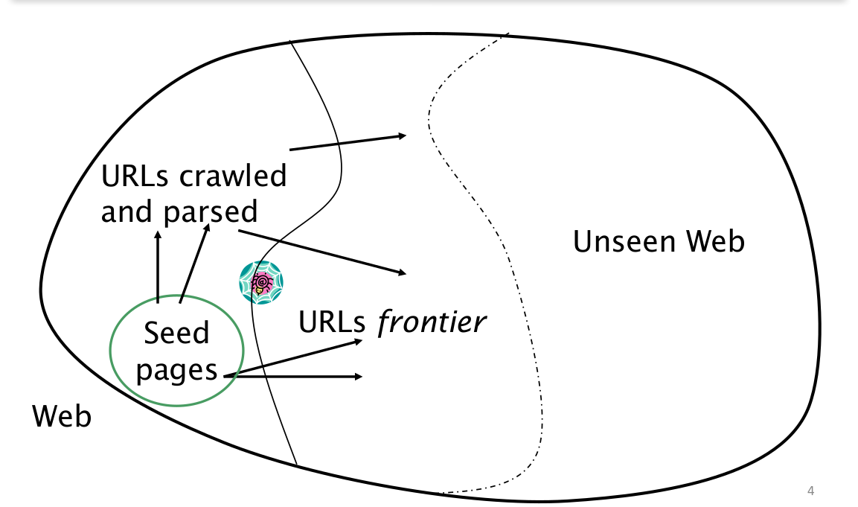
爬虫的抓取过程
从“种子”链接开始
把它们加到待抓取“队列”
While True:
从队列中取任务
抓取内容并且抽取链接
把链接去重后加入队列

Slide 5
基础知识
URL
HTML/CSS/JS
HTTP
DNS

Slide 6
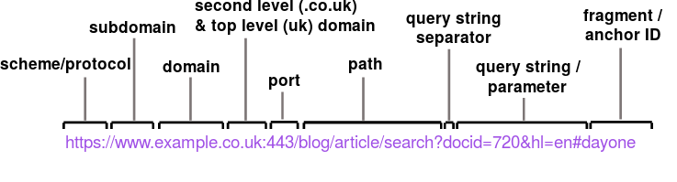
URL
Uniform Resource Locator
colloquially termed a web address, is a reference to a web resource that specifies its location on a computer network and a mechanism for retrieving it
scheme:[//[user:password@]host[:port]][/]path[?query][#fragment]

Slide 7
URL
Encoding/Decoding
https://www.baidu.com/s?ie=utf-8&f=8&rsv_bp=0&rsv_idx=1&tn=baidu&wd=%E5%A4%A9%E6%B0%94
Fragment
http://www.tagindex.net/html/link/anchor_example2.html#a003

Slide 8
URL Normalization
HTTP://www.Example.com/ → http://www.example.com/
http://www.example.com/a%c2%b1b → http://www.example.com/a%C2%B1b
http://www.example.com:80/bar.html → http://www.example.com/bar.html
Google Bot remove fragment
https://en.wikipedia.org/wiki/URL_normalization

Slide 9
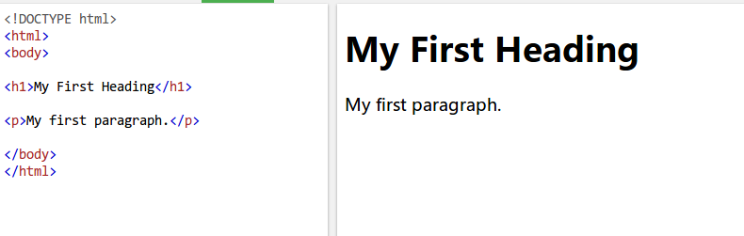
HTML
Hypertext Markup Language (HTML) is the standard markup language for creating web pages and web applications. With Cascading Style Sheets (CSS) and JavaScript, it forms a triad of cornerstone technologies for the World Wide Web
https://www.w3schools.com/html/tryit.asp?filename=tryhtml_basic_document

Slide 10
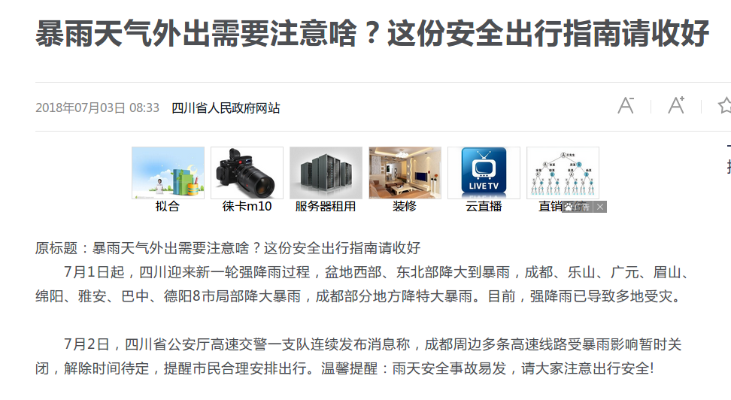
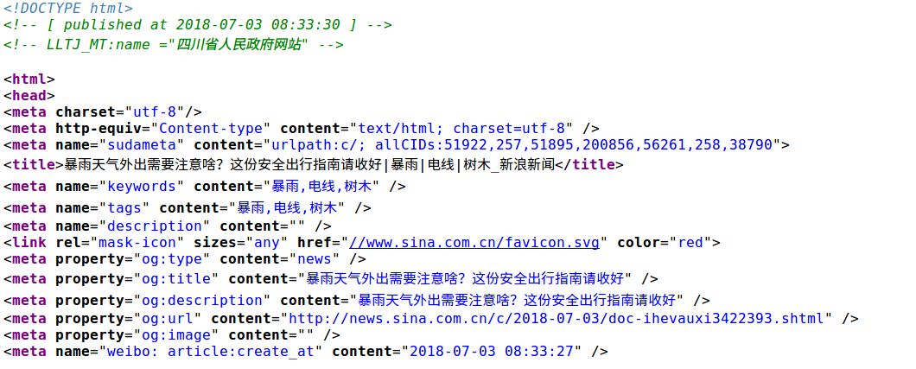
HTML
http://news.sina.com.cn/c/2018-07-03/doc-ihevauxi3422393.shtml

Slide 11
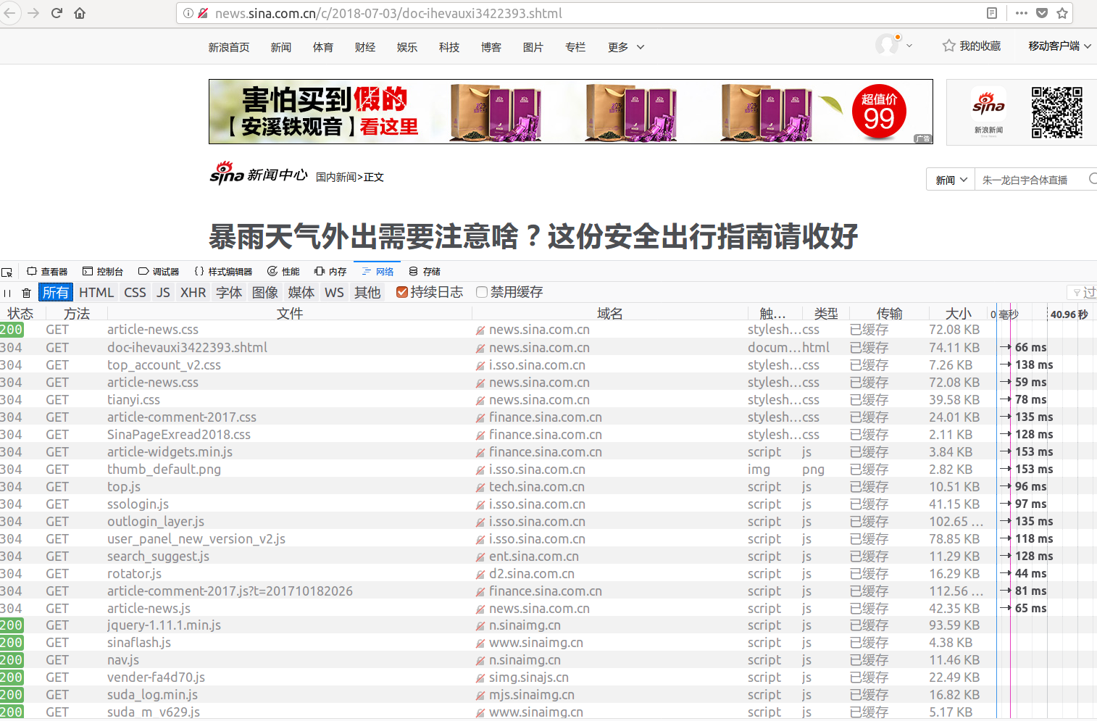
不只是一个HTML!

Slide 12
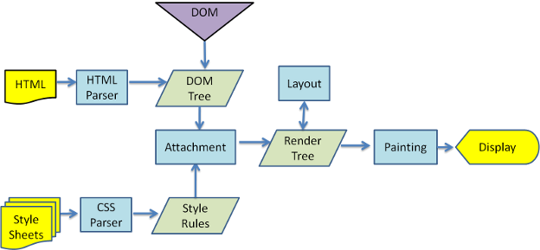
浏览器渲染过程
https://www.html5rocks.com/en/tutorials/internals/howbrowserswork/

Slide 13
JavaScript
http://www.webscrapingfordatascience.com/simplejavascript/
http://www.webscrapingfordatascience.com/complexjavascript/

Slide 14
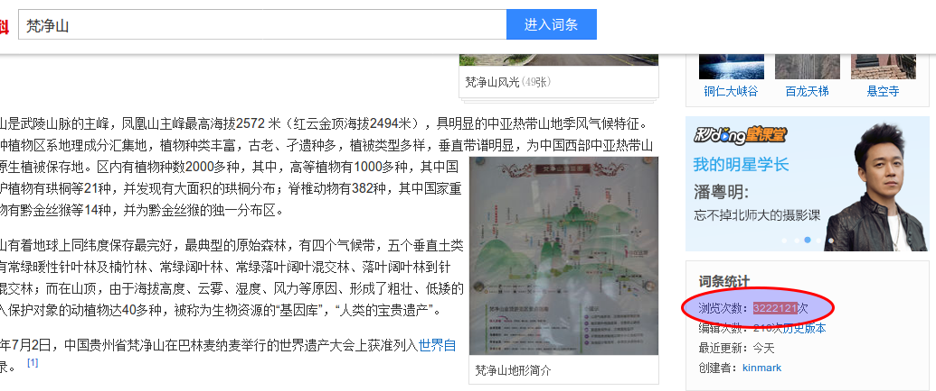
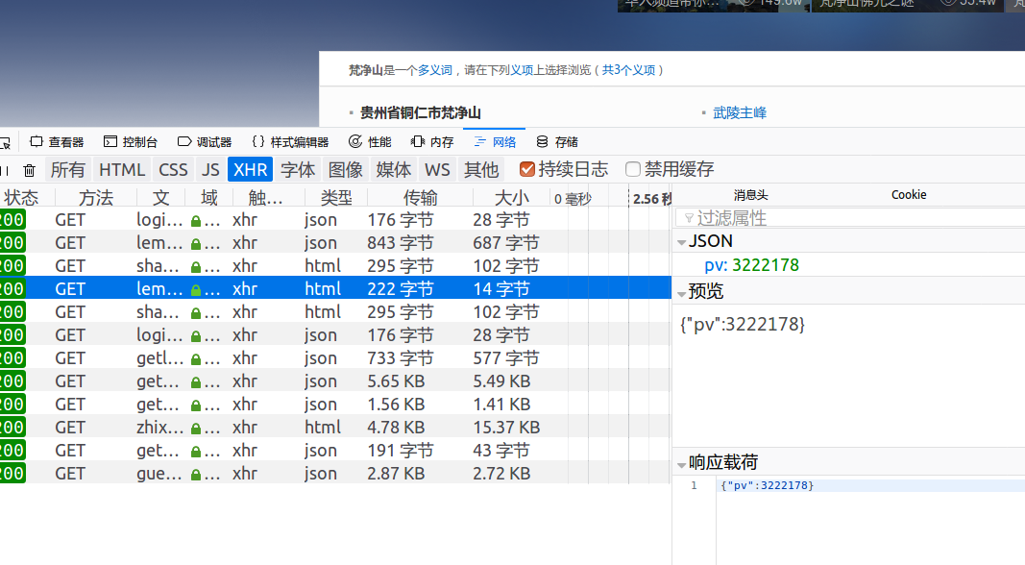
Ajax
Ajax ( "Asynchronous JavaScript And XML") is a set of Web development techniques using many Web technologies on the client side to create asynchronous Web applications
http://www.webscrapingfordatascience.com/jsonajax/

Slide 15
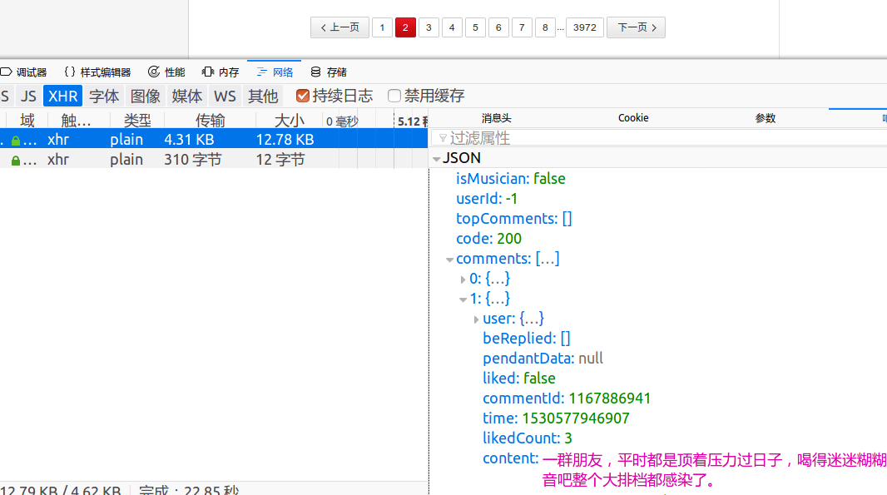
Ajax
https://music.163.com/#/song?id=168091

Slide 16

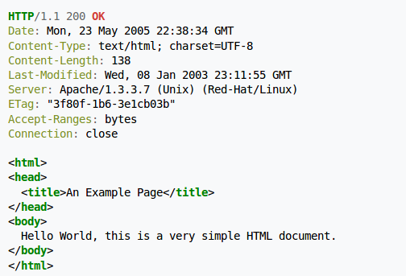
HTTP
Hypertext Transfer Protocol
The Hypertext Transfer Protocol (HTTP) is an application protocol for distributed, collaborative, and hypermedia information systems.[1] HTTP is the foundation of data communication for the World Wide Web.

Slide 17
HTTP Headers
请求
Referer
Cookie
User-Agent
Accept-Encoding
响应
Cache-Control/Expires
Last-Modified/If-Modified-Since
ETag/If-None-Match

Slide 18
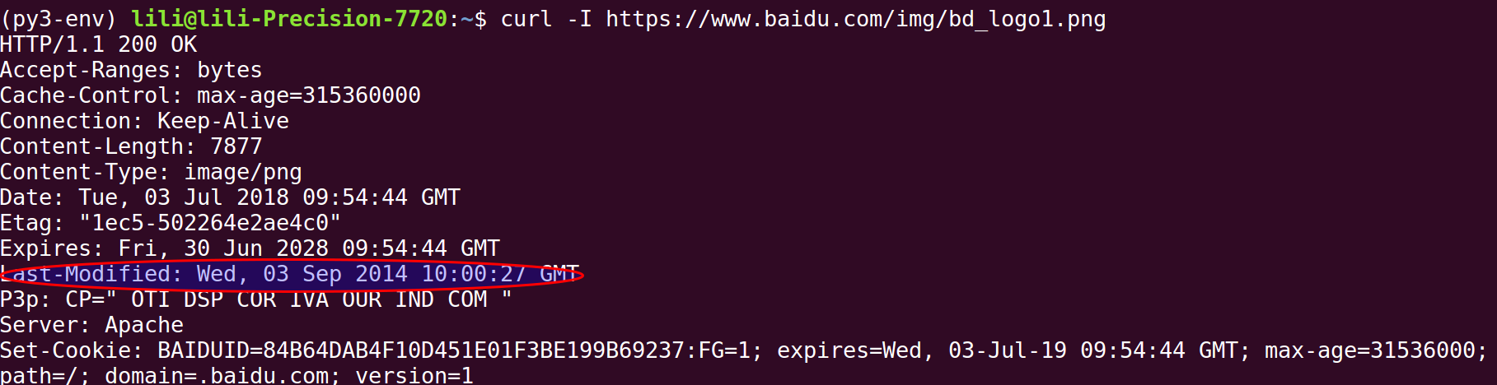
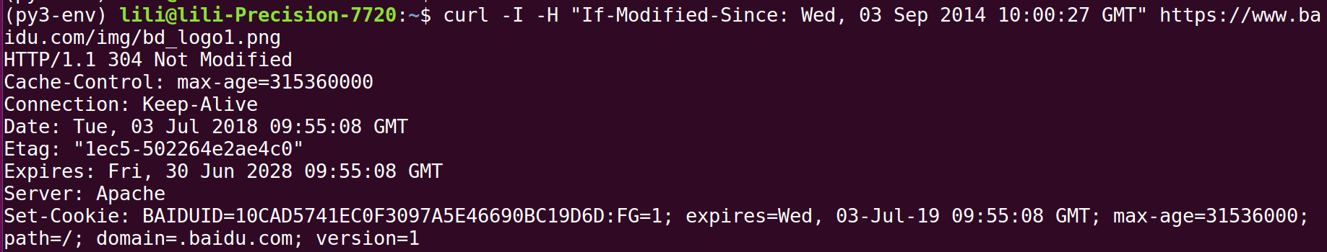
HTTP Header Example

Slide 19
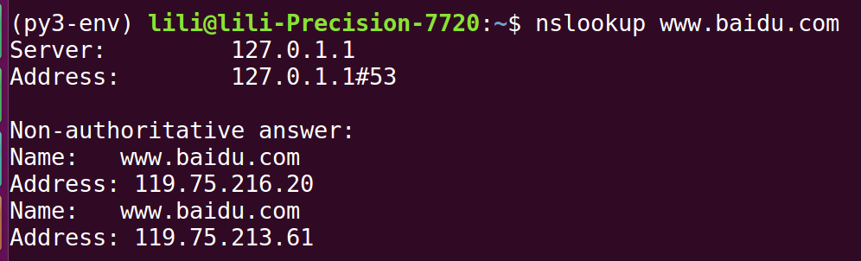
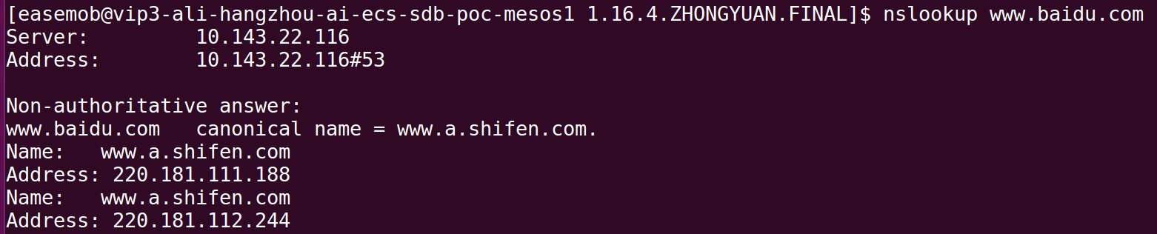
DNS
The Domain Name System (DNS) is a hierarchical decentralized naming system for computers, services, or other resources connected to the Internet or a private network.

Slide 20
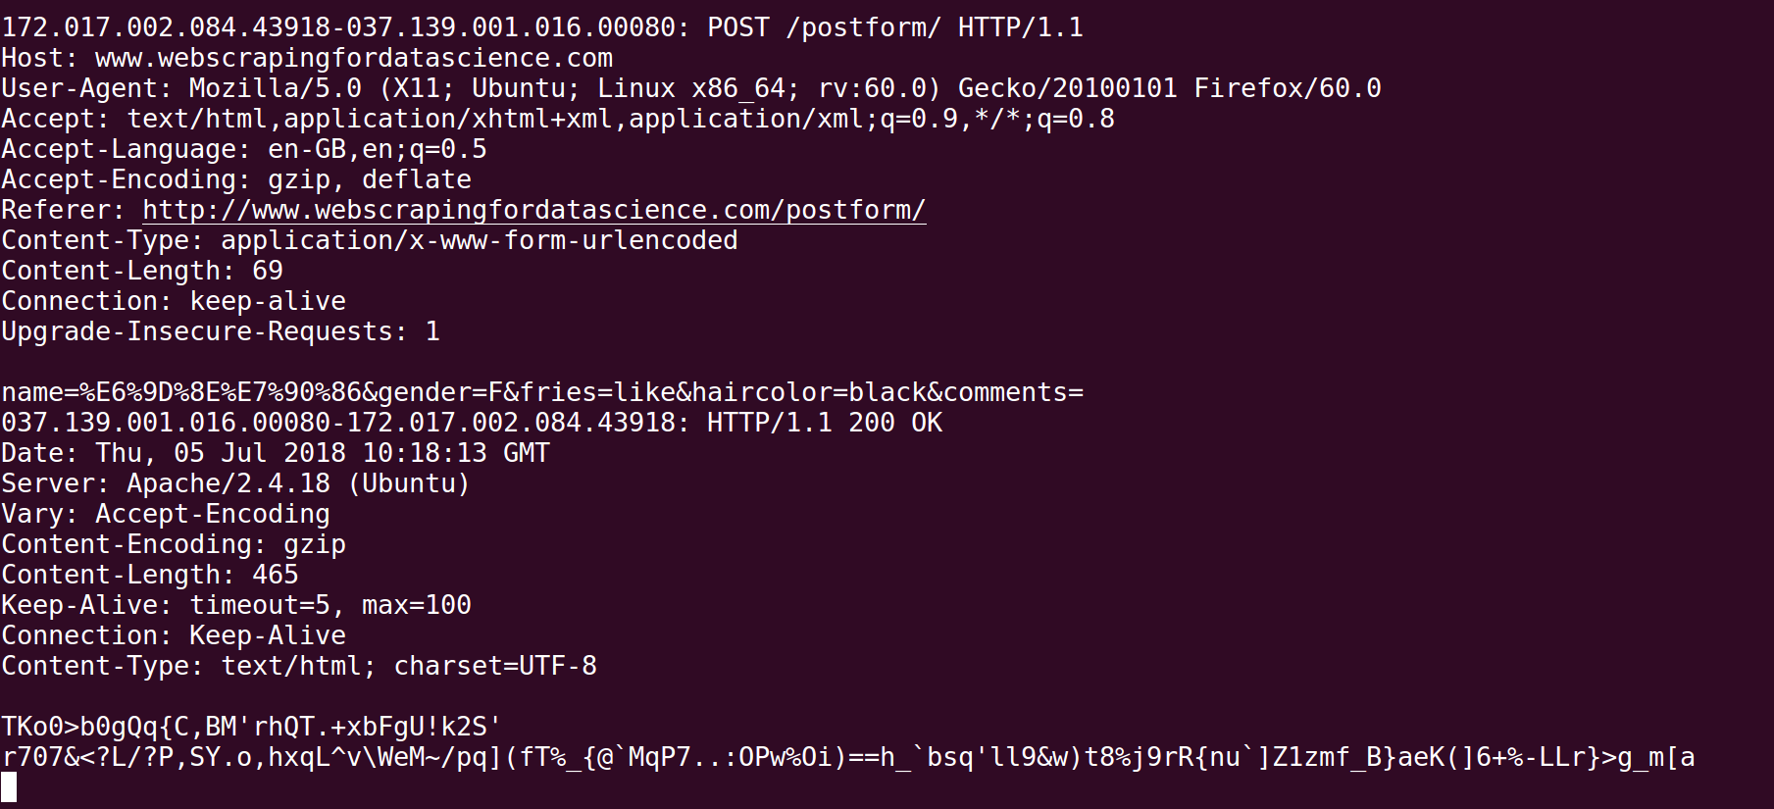
HTTP POST
http://www.webscrapingfordatascience.com/postform/
http://www.webscrapingfordatascience.com/basicform

Slide 21
重定向和验证
http://www.webscrapingfordatascience.com/redirect/
https://baike.baidu.com/item/不存在的词条
http://www.webscrapingfordatascience.com/authentication/

Slide 22
爬虫分类
通用爬虫
通用搜索引擎
垂直(Vertical)爬虫
垂直搜索引擎
定向爬虫
Web Scraping

Slide 23
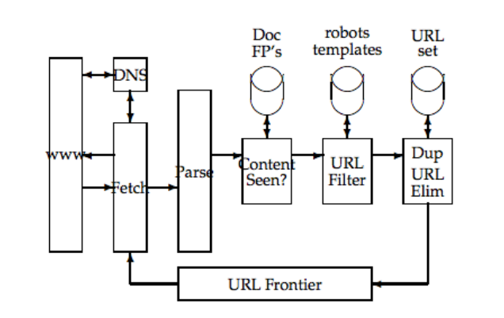
通用爬虫架构
URL frontier
DNS resolution
Fetching module
Parsing module
Duplicate elimination

Slide 24
通用爬虫的挑战
海量数据
Google索引了上千亿网页
实时
新的文章能在几分钟搜到
深度网络
社交媒体、自媒体
反作弊
爬虫陷阱

Slide 25
定向爬虫

Slide 26
反爬虫
robots.txt https://www.baidu.com/robots.txt
封ip/验证码
headers检验
登录
js "加密"

Slide 27
网页解析
抽取网页的重要数据
标题
正文
发表时间
方法
手写模板/规则
通用方法

Slide 28
XPath
https://www.w3schools.com/xml/xpath_intro.asp
https://doc.scrapy.org/en/xpath-tutorial/topics/xpath-tutorial.html

Slide 29
工具介绍
Firebug
Tcpflow
Xpath插件

Slide 30
练习
在终端打印百度首页的DOM树
递归遍历DOM树
抓取一个网站
使用介绍的框架
根据关键词抓取搜狗微信文章
Referer、速度控制
抓取https://music.163.com/#/song?id=168091 的所有评论
url前端加密

Slide 31
练习
通用的标题和正文抽取器
anchor text ratio
网页截图，超过一屏的截屏，某个元素(验证码)的截屏
AShot
抓取qunar明天北京到上海所有航班的票价
前端视觉混淆

