Slide 1
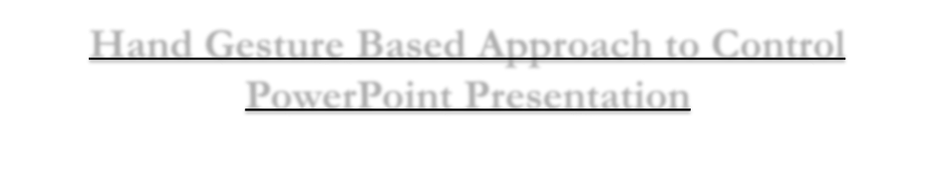
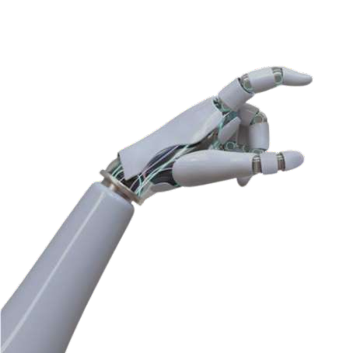

D.Y. Patil Academic Education Excellence Federation’s
Dr.D.Y.Patil Technical Campus
(Engineering and MCA)
(Approved by AICTE, DTE- Govt of Maharashtra, Affiliated to Savitribai Phule Pune University, Pune)
Sr.No.32/1/A/7, Near Talegaon Railway Station, A/P Varale, Talegaon Dabhade
Tal-Maval, Dist-Pune 410507
Ph. No.9920141406,9309228311,7666829653,9307909501
Website: www.dypatiltcs.com
Hand Gesture Based Approach to Control PowerPoint Presentation
Name : Rahul Bargal

Slide 2


CONTENTS
Introduction
Proposed System
Literature Survey
Objectives of projects
Proposed work with Methodology
Applications of Proposed System
Software and Hardware Platform Requirement
Conclusion
References

Slide 3

Introduction
Hand gesture control is a blessing of modern technology. Data-intensive applications are creating havoc in the world today with the advent of hand gesture control, we are not only interacting with the devices but also providing ease of use for the users. Hand gesture recognition systems gained significant importance with the machine learning evolution . In the present business scenario, hand gesture recognition has several applications like controlling PowerPoint presentation and ensuring the audience better understand the topic. With the advancements like human-computer interaction and media technologies processing of hand gesture tasks became simplified, in medicine, aviation, defense, multimedia, creative expression, and generally in all interactive systems.

Slide 4

Proposed System
The presented system for controlling PowerPoint presentations through hand gestures and machine learning offers an interface that is easy to use and entirely hands-free. It captures real- time video using an onboard camera that follows the hand gestures of the user, utilizing mechanisms like hand landmark detection. Such libraries as Media Pipe or OpenCV are employed to obtain critical points on the user's hand, such as the fingers, wrist, and knuckles. Based on these detected features, the gesture is classified by the trained machine learning model. The gesture can be predefined: a left or right swipe could move from slide to slide, making a fist could pause or stop the presentation, or some other measures may be used for extra controls, like volume adjustment.

Slide 5

Literature Survey
Paper No | Title Of Paper | Author name | Outcomes | Future scope/unaddre ssed challenges | Remark
1. | Real-Time Hand Gest- ure Recognition for Human-Computer Interaction | R. L. Murali, B. S. Manjunath, and K. R. Venugopal | Proposed a real- time hand gesture recognition system using computer vision and | Future improvements could include integrating more complex gestures, multi-hand recognition | A solid foundation for hand gesture recognition systems with potential for application in presentations.
2. | Gesture-Based Control of Presentation Slides using OpenCV | Charan et al. | Uses OpenCV to track hand movements for slide control. | Expands to other interactive applications. | Ensures accurate gesture recognition.
3. | Controlling PowerPoint Presentation using Hand Gestures in Real- Time | Rahul Sharma, Deepak Kumar | Controls slides and converts speech to text. | Potential for broader automation and AI integration. | Uses Python interface for control.

Slide 6

Objectives of Projects
Objective: Develop a hands-free system for controlling PowerPoint presentations using gesture recognition and machine learning.
Interaction Model: Enables seamless slide navigation, Previous, Next, and other controls
without a keyboard, mouse, or remote.
Technology Stack:
Computer Vision for real-time hand tracking.
Machine Learning Algorithms for gesture classification.
Gesture-to-Command Mapping for PowerPoint control.
Functionality:
Tracks hand movements in real-time.
Classifies gestures based on predefined actions.
Maps recognized gestures to corresponding PowerPoint commands.
Application Domains:
Professional Presentations – Hands-free interaction enhances efficiency.
Educational Use Cases – Provides an interactive teaching experience.
Remote Environments – Facilitates better accessibility in virtual settings.
Future Scope: Potential expansion into virtual environments and integration with smart
devices

Slide 7

Proposed work with methodology
Data Collection:
Creation of a dataset consisting of various hand gestures (e.g., swipe left, swipe right, fist, point).
Use of pre-existing datasets or manually labeled gesture data.
Gesture capture via camera for real-time processing.
Hand Tracking & Landmark Detection: Implemented using libraries like MediaPipe or OpenCV.
Feature Extraction:
Angles between fingers.
Distances between key hand landmarks.
Hand orientation.
Machine Learning Model:
Features extracted from hand tracking serve as input to the model.
Model selection based on complexity and dataset size:
Decision Trees and Support Vector Machines (SVMs) for simpler classification tasks.
Deep Learning (CNNs) for complex gesture recognition.
Training process ensures high accuracy in distinguishing gestures.

Slide 8
Applications of Proposed system
Education: Trainers can use gestures to control their presentations from a far without having to walk back to the computer or use a remote. Teaching will therefore be more personal, but the training will be seamless.
Business Presentations: In the corporate world, presenters are free to focus on communicating their message without interruptions to operate a keyboard or mouse. This considerably increases the professionalism and fluency of presentations.
Virtual or Remote Presentations: Presenters can use hand gestures to switch slides during the presentation while remaining engaged in the video call, which thus optimizes the interactive experience of online settings.

Slide 9

Software and hardware platform requirement
Software Requirements:
Operating System: Windows 10/11, Linux (Ubuntu), macOS
Programming Language: Python (preferred), Java, or C++
Libraries & Frameworks:
OpenCV (for computer vision)
NumPy (for numerical computations)
IDE (Integrated Development Environment): PyCharm, VS Code.
Hardware Requirements:
Processor: Intel Core i5/i7 or AMD Ryzen 5/7 (or higher)
RAM: Minimum 4GB (8GB recommended for smooth processing)
Camera: HD Webcam (Logitech C270 or above) for hand gesture recognition
Graphics Card: Integrated or Dedicated GPU (for better AI processing)

Slide 10

Conclusion
The gesture-controlled in PowerPoint system transitions from traditional input methods to modern, user-centric control. Using machine learning and computer vision, it accurately interprets hand gestures to automate presentation navigation, enhancing user experience. This system improves accessibility for work, education, virtual meetings, and individuals with movement impairments. It also lays the groundwork for advanced gestures, multi-hand detection, and broader device control, expanding its functionality across various environments.

Slide 11
References
X. Peng, T. Bhattacharya, J. Mao, T. Cao, C. Jiang, and X. Qin,Energy-efficient management of data centers using a renewable aware scheduler,” in 2022 IEEE International Conference on Networking,Architecture and Storage (NAS). IEEE, 2022, pp. 1–8.
Y. Wang, T. Bhattacharya, Y. Jiang, X. Qin, Y. Wang, Y. Liu, A. J. Saykin,and L. Chen, “A novel deep learning method for predictive modelling of microbiome data,” Briefings in Bioinformatics, vol. 22, no. 3, pbbaa073, 2021.
M. Meier, P. Streli, A. Fender, and C. Holz, “Tapid: Rapid touch interaction in virtual reality using wearable sensing,” in 2021 IEEE Virtual Reality and 3D User Interfaces (VR). IEEE, 2021, pp. 519–528.
A. R. Sarkar, G. Sanyal, and S. Majumder, “Hand gesture recognition systems: a survey,”
International Journal of Computer Applications,vol. 71, no. 15, 2013.
Z. Sun, Reducing the Gulfs in Human-Computer Communication: Exploring the Effects of Non- verbal Metaphors. Hong Kong University of Science and Technology (Hong Kong), 2021.

