Slide 1
Introduction to CI/CD Jenkins Workshop
Jayson Workman

Slide 2
What is CI/CD Definition
Continuous Integration (CI)
Continuous Integration primarily concentrates on improving the build and integration phases of the software release cycle, and is the fundamental element in most “continuous” practices
Continuous Delivery & Deployment (CD)
Both Continuous Delivery & Continuous Deployment extends CI by concentrating on the downstream deployment activities, with the key difference between “Delivery” and “Deployment", being: in deployment the process by which software is deployed to production is fully automated, whereas, in delivery there usually exists an extra hop to get into production

Slide 3
What is CI/CD Scope
Notes:
Three primary technical patterns for managing software that you should better famiarilize yourself in the workplace today

Slide 4
Benefits of CI/CD Importance
CI/CD establish a set of principles for automating the delivery of software which is critical to moving to a Cloud infrastructure
it provides guidance for enabling faster delivery of software at higher quality through a pipeline process
This is important because increased speed without increased quality will have a boomerang effect (“garbage-in-garbage-out”)
Isn’t centered around a particular tool rather many tools are necessary to establish a CI/CD pipeline
Critical to maximize the efficiency of the Cloud
infrastructure and software are assembled together
Dev+Ops (two different perspectives) must come together to provide a single process for managing software

Slide 5
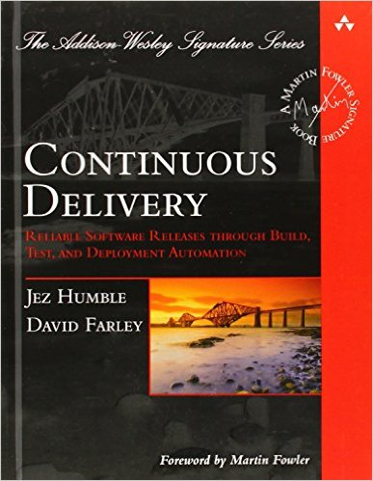
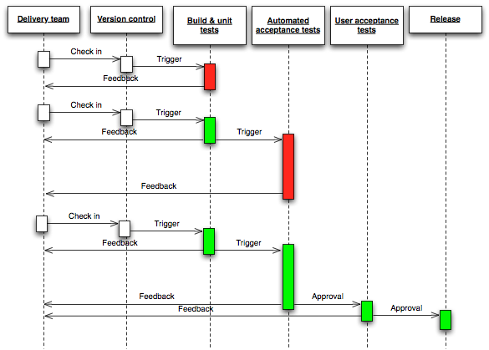
Benefits of CI/CD Feedback loops
“CI/CD is about closing
Feedback loops”
Borrowed from Continuous Delivery by Jez Humble & David Farley

Slide 6
How to apply CI/CD Guiding Principles
Make the software delivery process reliable and repeatable
Make software delivery a non-event (if something is hard to do, do it often until it becomes easy)
Version control everything!
Build quality into the pipeline (avoid garbage-in-garbage-out)
Make the pipeline transparent (visible to outsiders)
Capture pipeline metrics (continuously improve the process)
Make sure to capture all necessary steps in the pipeline (everyone involved in the SDLC should play a part)
Produce Immutable artifacts (any changes produce a new artifact)
Avoid environmental specific artifacts (keep environment specifics out of the artifact)

Slide 7
How to apply CI/CD CI/CD Pipeline
Pipeline can be thought of like a Conveyer Belt at a manufacturing plant
Packages “applications” go through an automated Conveyor Belt “process”
Along the way there are Quality Control stations “tests” that ensure what is being produced aligns with the original intent “specification/requirement”

Slide 8

Jenkins
Jenkins is a self-contained, open source automation server which can be used to automate all sorts of tasks related to building, testing, and delivering or deploying software.

Slide 9

CloudFormation
AWS CloudFormation provides a common language for you to describe and provision all the infrastructure resources in your cloud (AWS) environment.

Slide 10

GitHub
web-based hosting service for version control using Git (software defined infrastructure and application code)

Slide 11
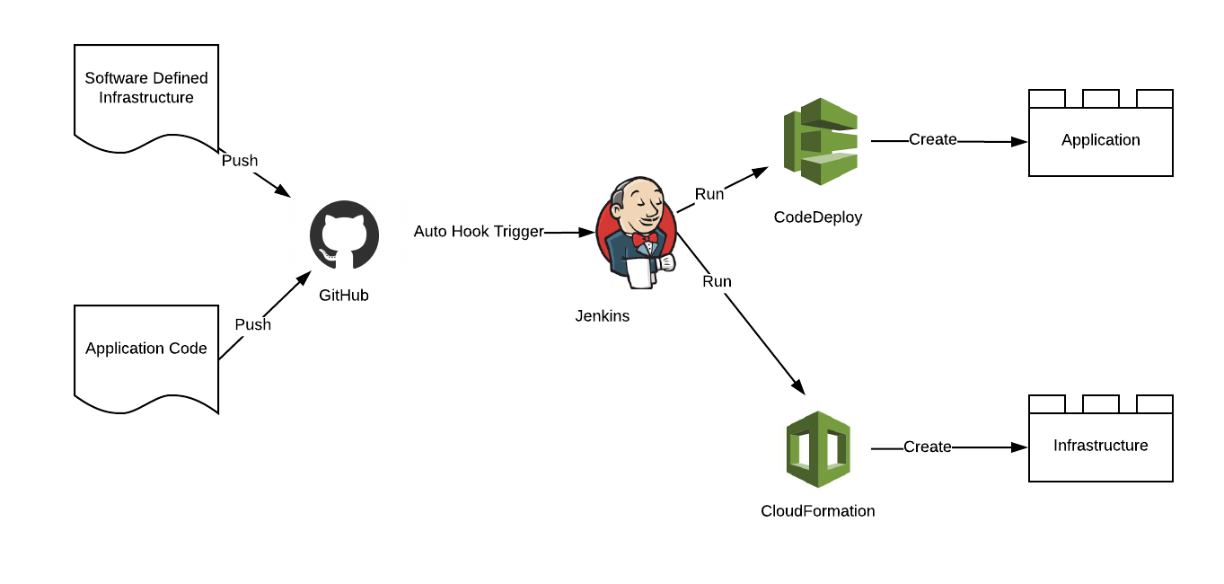
CI/CD Process Example

Slide 12
Thank You

