Slide 1
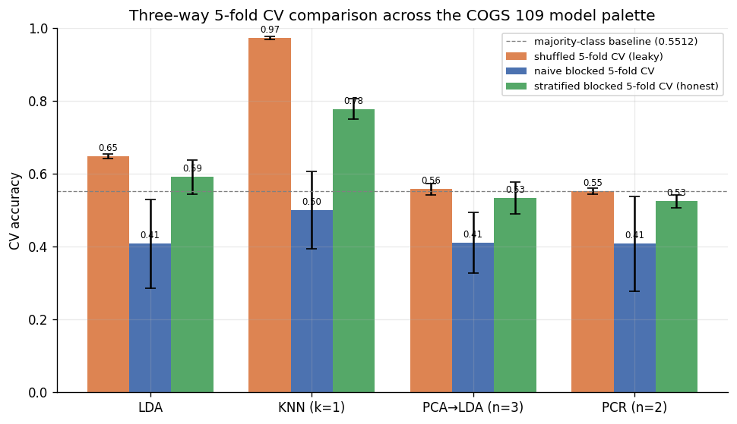
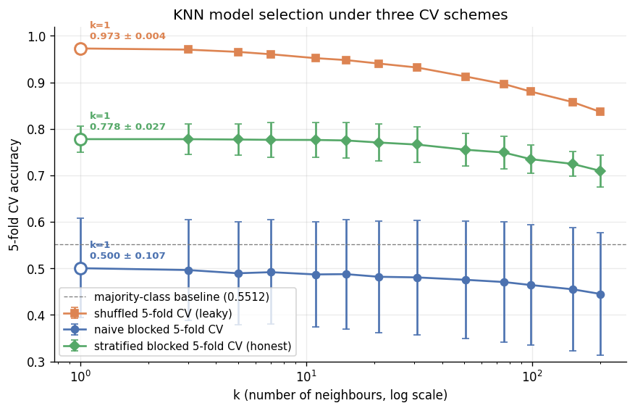
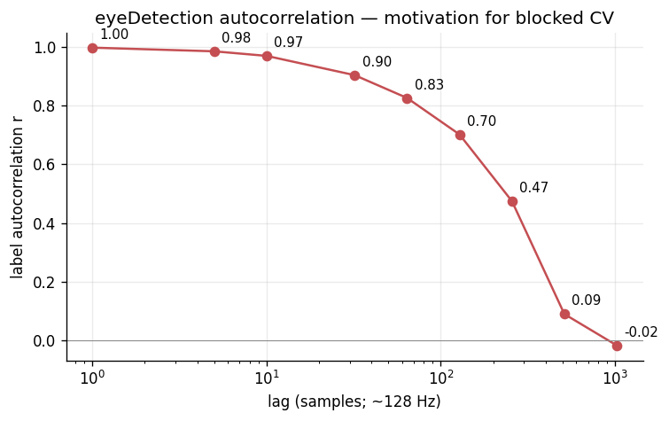
UC San Diego • Department of Cognitive Science
UC SAN DIEGO
COGS 109 — Spring 2026
Classification of EEG Eye-State via KNN: A Cross-Validation Honesty Study
Ivan Del Rio / Anish Kondamadugula COGS 109 • Mukamel • Spring 2026 University of California, San Diego
ABSTRACT
METHODS
RESULTS
We pick classification as our data-analysis approach, K-nearest neighbours (KNN) as our model, and a k-sweep minimising 5-fold CV error as our model-selection procedure. We then run that same procedure under three different CV schemes — shuffled, naive blocked, and stratified blocked — on the UCI #264 EEG Eye State recording. All three schemes pick k = 1, but the picked accuracies span 47 percentage points: 97.3% ± 0.4% (shuffled, leaky), 50.0% ± 10.7% (naive blocked), and 77.8% ± 2.7% (stratified blocked, honest). The 19.5 pp gap between the leaky and honest estimates is leakage attributable to scheme choice on this autocorrelated single-subject recording, not to model quality.
• Approach: classification (binary eyeDetection target).
• Model: K-nearest neighbours with Euclidean distance in z-scored 14-D channel space. Chosen because KNN's per-sample similarity decision rule is the COGS 109-palette model most sensitive to lag-1 autocorrelation.
• Model selection: sweep k over {1, 3, 5, 7, 11, 15, 21, 31, 51, 75, 99, 151, 201} (log-spaced); pick the k maximising mean 5-fold CV accuracy.
• CV scheme A — shuffled 5-fold (leaky baseline).
• CV scheme B — naive blocked 5-fold (5 contiguous time chunks).
• CV scheme C — stratified blocked 5-fold (100 short contiguous segments redistributed across folds to balance class proportion; honest).
• Preprocessing: drop 4 voltage outliers (>4 SD on any channel), chronological 80/20 split with a 64-sample seam gap, z-score on the training partition only.
CV scheme | Picked k | Mean accuracy ± std
Shuffled (leaky) | 1 | 0.9728 ± 0.0037
Naive blocked | 1 | 0.5004 ± 0.1068
Stratified blocked (honest) | 1 | 0.7778 ± 0.0274
SUPPORTING EVIDENCE
• We also evaluated three alternative classifiers (LDA, PCA→LDA, PCR-as-classifier) as sanity checks, sweeping their hyperparameters under the same three CV schemes.
• LDA leakage gap (shuffled minus stratified blocked): +5.6 pp.
• PCA→LDA (n=3) leakage gap: +2.4 pp.
• PCR-as-classifier (n=2) leakage gap: +2.8 pp.
• KNN's +19.5 pp gap is the outlier — consistent with KNN exploiting per-sample similarity while LDA / PCA→LDA / PCR average over many samples before deciding. See figure 14 + tables/03 for full numbers.
QUESTION
TAKE-HOME
Given an autocorrelated single-subject EEG recording and a KNN classifier, how does the choice of cross-validation scheme change the result of an otherwise-identical model-selection procedure?
Shuffled CV says we have a 97% classifier.
Honest stratified blocked CV says we have a 78% classifier.
The difference is leakage, not signal.
BACKGROUND
Fig. 3. Supporting figure — three-way CV comparison across LDA / KNN / PCA→LDA / PCR. KNN bar group has the largest leakage gap.
• UCI EEG Eye State dataset (Roesler, 2013) — id #264.
• 14,980 samples × 14 Emotiv channels (AF3, F7, F3, FC5, T7, P7, O1, O2, P8, T8, FC6, F4, F8, AF4), sampled at ~128 Hz over ~117 s.
• Single subject, binary eyeDetection label, 55.12% open / 44.88% closed.
• Only 24 contiguous label runs in the whole recording.
• Channel autocorrelation at lag 1 ≈ 0.997 — adjacent samples are nearly identical, so any uniformly-random CV split puts near-duplicates into both train and test.
HEADLINE FIGURE
CONCLUSIONS
• (1) The same KNN-k-sweep model-selection procedure picks k = 1 under all three CV schemes — but the accuracy at that k varies by 47 percentage points (50.0% naive blocked → 97.3% shuffled).
• (2) The honest accuracy at k = 1 (stratified blocked CV) is 77.8% ± 2.7% — well above the 55.12% majority-class baseline.
• (3) The 19.5 pp gap between the leaky and honest estimates is leakage attributable to scheme choice, not signal from a better model.
• (4) Alternative classifiers (LDA / PCA→LDA / PCR) confirm KNN is uniquely vulnerable — their leakage gaps are only 2–6 pp, as theory predicts for classifiers that do not depend on per-sample similarity.
REFERENCES
[1] Roesler, O. (2013). EEG Eye State Data Set. UCI ML Repository #264. https://archive.ics.uci.edu/dataset/264/eeg+eye+state
[2] Mukamel, R. (2026). COGS 109 — Modelling and Data Analysis Spring 2026 Study Guide. UC San Diego.
[3] James, G., Witten, D., Hastie, T., Tibshirani, R. (2021). An Introduction to Statistical Learning, 2nd ed. Springer.
[4] Bergmeir, C., Benítez, J. M. (2012). On the use of cross-validation for time series predictor evaluation. Information Sciences 191:192–213.
Fig. 2. KNN mean accuracy ± std-dev vs k (log scale) under three CV schemes — all three schemes pick k = 1 but report accuracies spanning 47 percentage points.
Fig. 1. Label autocorrelation across lags — motivates blocked CV.
Source code & full report: github.com/BariBariGood/cogs109-eeg-eye-state-classifier
COGS 109 — Modelling and Data Analysis — Spring 2026

