Slide 1
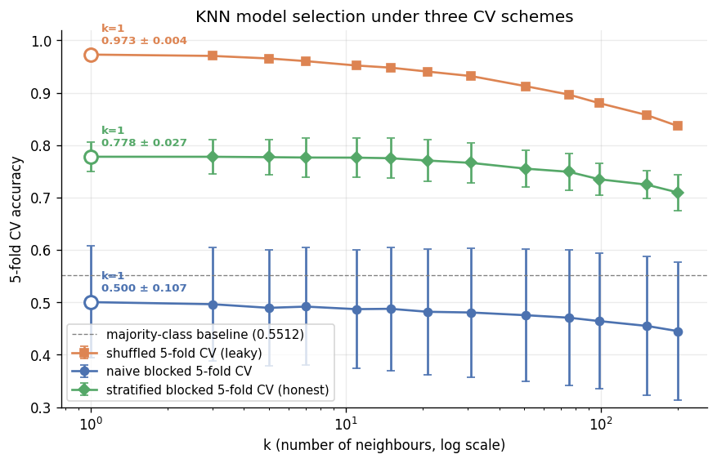
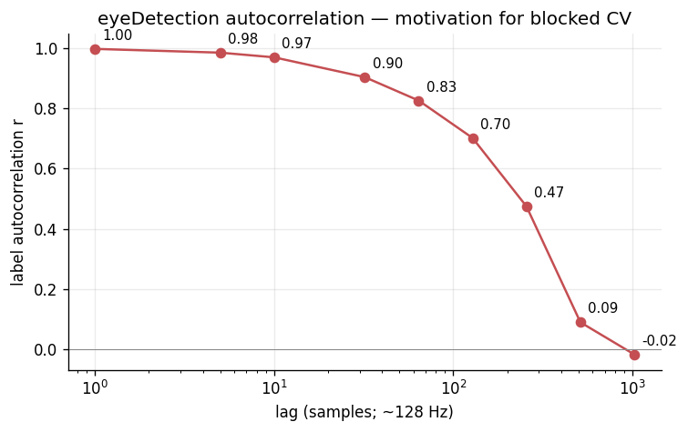
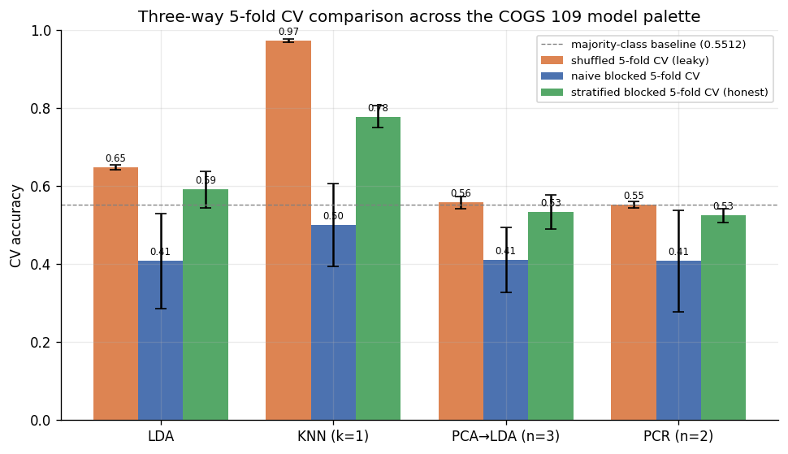
UC SAN DIEGO / DEPARTMENT OF COGNITIVE SCIENCE
Classification of EEG Eye-State via KNN: A Cross-Validation Honesty Study
Ivan Del Rio · Anish Kondamadugula | COGS 109 (Mukamel) · Spring 2026 | UC San Diego
THE QUESTION Given an autocorrelated single-subject EEG recording and a KNN classifier, how does the choice of cross-validation scheme change the result of an otherwise-identical model-selection procedure?
97%
78%
50%
shuffled / leaky
stratified blocked / honest
naive blocked / punitive
shuffled (leaky) 0.9728 ± 0.0037 • naive blocked 0.5004 ± 0.1068 • stratified blocked (honest) 0.7778 ± 0.0274 (all schemes pick k = 1)
“Shuffled CV says we have a 97% classifier. Honest stratified blocked CV says we have a 78% classifier. The difference is leakage, not signal.”
Shuffled 5-fold CV
Sits at 0.97 across every k. Looks dazzling, but the random shuffle leaks adjacent samples (lag-1 autocorr ≈ 0.997) into both train and test.
Stratified blocked CV
0.778 ± 0.027 at k=1 — honest, time-aware, well above the 0.5512 majority-class floor. This is the number to quote.
Naive blocked CV
0.500 ± 0.107: too punitive — 5 contiguous chunks let class proportion drift across folds, so the mean drops far below baseline.
The headline gap
0.973 − 0.778 = +19.5 percentage points. That gap is leakage attributable to scheme choice on an autocorrelated single-subject recording — not a better model.
Fig. 1. KNN mean accuracy ± std-dev vs k (log scale) under three CV schemes — all three pick k = 1, but the picked accuracies span 47 percentage points.
METHODS
CONCLUSIONS
SUPPORTING EVIDENCE
— Approach: classification (binary eyeDetection target).
— Model: K-nearest neighbours with Euclidean distance in z-scored 14-D channel space. Chosen because KNN's per-sample similarity decision rule is the COGS 109-palette model most sensitive to lag-1 autocorrelation.
— Model selection: sweep k over {1, 3, 5, 7, 11, 15, 21, 31, 51, 75, 99, 151, 201} (log-spaced); pick the k maximising mean 5-fold CV accuracy.
— CV scheme A — shuffled 5-fold (leaky baseline).
— CV scheme B — naive blocked 5-fold (5 contiguous time chunks).
— CV scheme C — stratified blocked 5-fold (100 short contiguous segments redistributed across folds to balance class proportion; honest).
— Preprocessing: drop 4 voltage outliers (>4 SD on any channel), chronological 80/20 split with a 64-sample seam gap, z-score on the training partition only.
— (1) The same KNN-k-sweep model-selection procedure picks k = 1 under all three CV schemes — but the accuracy at that k varies by 47 percentage points (50.0% naive blocked → 97.3% shuffled).
— (2) The honest accuracy at k = 1 (stratified blocked CV) is 77.8% ± 2.7% — well above the 55.12% majority-class baseline.
— (3) The 19.5 pp gap between the leaky and honest estimates is leakage attributable to scheme choice, not signal from a better model.
— (4) Alternative classifiers (LDA / PCA→LDA / PCR) confirm KNN is uniquely vulnerable — their leakage gaps are only 2–6 pp, as theory predicts for classifiers that do not depend on per-sample similarity.
— We also evaluated three alternative classifiers (LDA, PCA→LDA, PCR-as-classifier) as sanity checks, sweeping their hyperparameters under the same three CV schemes.
— LDA leakage gap (shuffled minus stratified blocked): +5.6 pp.
— PCA→LDA (n=3) leakage gap: +2.4 pp.
— PCR-as-classifier (n=2) leakage gap: +2.8 pp.
— KNN's +19.5 pp gap is the outlier — consistent with KNN exploiting per-sample similarity while LDA / PCA→LDA / PCR average over many samples before deciding. See figure 14 + tables/03 for full numbers.
REFERENCES
[1] Roesler, O. (2013). EEG Eye State Data Set. UCI ML Repository #264. https://archive.ics.uci.edu/dataset/264/eeg+eye+state
[2] Mukamel, R. (2026). COGS 109 — Modelling and Data Analysis Spring 2026 Study Guide. UC San Diego.
[3] James, G., Witten, D., Hastie, T., Tibshirani, R. (2021). An Introduction to Statistical Learning, 2nd ed. Springer.
[4] Bergmeir, C., Benítez, J. M. (2012). On the use of cross-validation for time series predictor evaluation. Information Sciences 191:192–213.
github.com/BariBariGood/cogs109-eeg-eye-state-classifier
COGS 109 — Modelling & Data Analysis — Spring 2026
Fig. 2. Label autocorrelation across lags — motivates blocked CV.
Fig. 3. Three-way CV comparison — KNN has the largest leakage gap.

