Slide 1
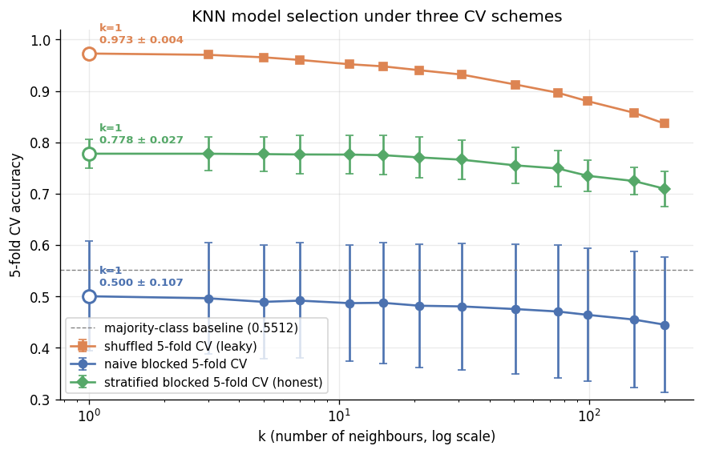
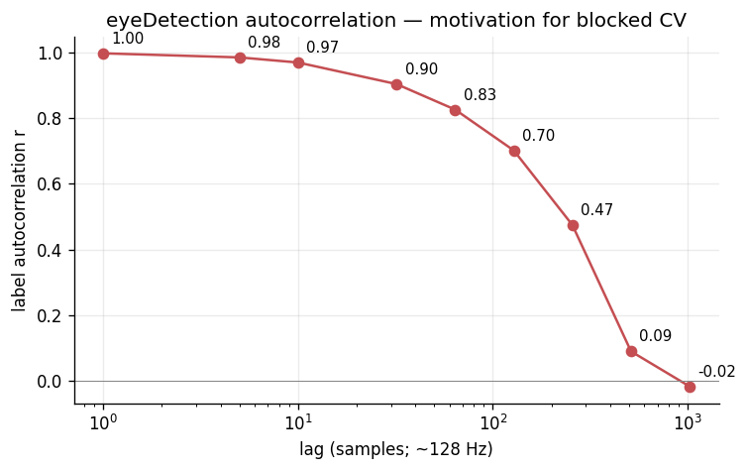
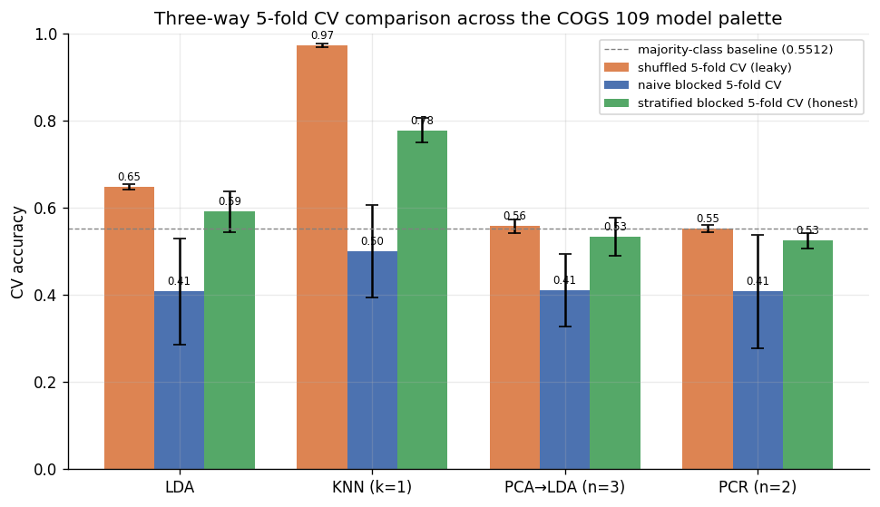
C O G S 1 0 9 · S P R I N G 2 0 2 6
Classification of EEG Eye-State via KNN: A Cross-Validation Honesty Study
Ivan Del Rio · Anish Kondamadugula | COGS 109 (Mukamel) · Spring 2026 | UC San Diego
How does the choice of cross-validation scheme change the result of an otherwise-identical KNN model-selection procedure?
KNN model selection under three CV schemes — all three pick k = 1.
78% honest.
97% leaky.
The difference is leakage.
M E T H O D S
C O N C L U S I O N S
KNN with Euclidean distance in z-scored 14-D channel space.
Sweep k over log-spaced {1…201}; pick k maximising mean 5-fold CV accuracy.
Three CV schemes: shuffled (leaky), naive blocked, stratified blocked (honest).
All three schemes pick k = 1, but reported accuracy spans 47 pp.
Honest accuracy: 77.8% ± 2.7% — well above the 55.12% baseline.
+19.5 pp gap is scheme-choice leakage, not signal. KNN is uniquely vulnerable.
R E F E R E N C E S
[1] Roesler, O. (2013). EEG Eye State Data Set. UCI ML Repository #264. https://archive.ics.uci.edu/dataset/264/eeg+eye+state
[2] Mukamel, R. (2026). COGS 109 — Modelling and Data Analysis Spring 2026 Study Guide. UC San Diego.
[3] James, G., Witten, D., Hastie, T., Tibshirani, R. (2021). An Introduction to Statistical Learning, 2nd ed. Springer.
[4] Bergmeir, C., Benítez, J. M. (2012). On the use of cross-validation for time series predictor evaluation. Information Sciences 191:192–213.
Autocorrelation across lags
Three-way CV comparison — LDA / KNN / PCA→LDA / PCR

