Slide 1

SOEN 6611 SOFTWARE MEASUREMENT MODELLING BIG DATA QUALITY
TEAM – 7
SIDDHARTHA NANDA 40200496
BARIQ ISHTIAQ MOHAMMED 40208194
RAJAT KUMAR 40201807
VIKYATH SRINIVASULU 40218245
TEAM LEADER
RAJAT KUMAR 40201807
EMAIL ID: rajat.kumar@mail.concordia.ca

Slide 2

INDEX
Summary (Steps 1-5)
Retrospection
a. What went well?
b. What could be changed to deliver better results?
c. What should we stop doing?
d. What still puzzles us?
Issues
a. Issue 1 – Completeness of data
b. Issue 2 – Availability of data for initial steps
c. Issue 3 - Small-scale volume and variety

Slide 3
INTRODUCTION
Step 1 and 2
What is Big Data Quality?
V’s control the Quality
Dataset chosen
Dataset 1 – Netflix Movies and TV Shows
https://www.kaggle.com/datasets/shivamb/netflix-shows
Dataset 2 - Netflix data with IMDB scores added https://www.kaggle.com/datasets/sarahjeeeze/imdbfile

Slide 4
BUSINESS GOALS
Step 1 and 2
Business goal: Improve Big Data Quality
Measurement Stakeholders
Business Sub-goal | Goal synopsis
Sub-goal 1 | Increasing the Volume of big data sets
Sub-goal 2 | Accelerate the Big Data set Velocity
Sub-goal 3 | Enhancing Variety in Big Data
Stakeholders
Product Owner/Project Manager
Developers/Data Scientist
Testers
Sales and Marketing Team
End Users

Slide 5
MEASUREMENT GOALS
Step 1 and 2
Measurement Goal | Description | Corresponding Business Goal
MG1 | The volume of data refers to the quantity of data available for processing the dataset. To choose a dataset with enough records so that a conclusive analytical application can be constructed on top of it. | Volume
MG2 | Although the dataset is always changing, the aim is to swiftly collect it and analyze it with ease by utilizing the organization's current infrastructure. | Velocity
MG3 | Datasets may be in many forms, but for our purposes, we should distinguish between them and choose the format that allows for easy procurement while maintaining quality. | Variety

Slide 6
GOAL QUESTION METRIC
Step 1 and 2
Product Owner
Q1: Is the volume of the big data collection large enough to support the development of a model?
Q2: Is the dataset updated frequently?
Q3: Is there any missing information in the dataset? What is the amount of difficulty in removing that data?
Q4: How simple is it to locate a recently modified dataset?
Q5: What is the current level of client satisfaction? Is this dataset going to influence user satisfaction?
Q6: Is the selected dataset connected or related data necessary for product development?

Slide 7
GOAL QUESTION METRIC
Step 1 and 2
Developers
Q1: Is there preprocessed data in a usable format?
Q2: Is there enough data for processing?
Q3: Is the data too large to manage, and can existing programming approaches handle it?
Q4: Does the algorithm take into account the fresh data stream?
Q5: Do we need to update our code to accommodate a new dataset?
Q6: Is it in sync or not?
Q7: Is the dataset well-structured?
Q8: How should various types of data be classified?

Slide 8
OPERATIONALIZED GOALS
Step 1 and 2
Volume:
Choose a dataset with high-quality Volume.
Velocity:
Improve the decision-making process by obtaining data more frequently and processing it more quickly.
Variety:
The goal of Variety is to identify and segregate data by classification and segmentation.

Slide 9

SUCCESS CRITERIA
STEP 3
VOLUME:
The percentage of data that can be preprocessed increases with the volume of the dataset and decreases with the decrease in volume.
VELOCITY:
An excessive discrepancy in the velocity of the dataset between time frames shows that the dataset is out of date.
The quantity of useful data that can be processed grows in proportion to the rise in volume over time, and vice versa.
VARIETY:
When the amount of data, number of records, and number of datasets rise in comparison to previously utilized datasets

Slide 10
BASE AND DERIVED MEASURES
STEP 3
Base Measures
Ndde : Number of Distinct Data Elements
Lbd : Length of Big Data (Number of Records
Nds : Number of Datasets
Time : Time Frame [T1 T2 T3]
Derived Measures
Mvol
Mvel
Mvar

Slide 11

MEASUREMT PLAN
STEP 4
Defined the labels
Frequency of Data collection(T1, T2, T3)
Time-Line (min 70, max 90 person hours
Procedure for collecting and recording data(Kaggle, Pandas Data-Frame)
Data Storage Strategy(memory)
Roles and responsibilities (Defined and Distributed)

Slide 12
PLAN OF TASKS AND ACTIVITIES
STEP 4
Several tasks have been identified
They may be traced back to their original labels
Captured the accountable stakeholders
Take note of the participants
Days are used to estimate the duration
Effort Estimated in Person Hours
Schedule: When to plan the usage of a certain task
Tools to be utilized
The reasoning for the
work done
Role | Responsibility | Student #
Product Owner/Project Manager | Identification of the scope and requirement Identification of resources | 4020####
# | Task | Trace | Responsible(who) | Participants(with whom) | Estimated duration (in days) | Estimated effort | Schedule(when) | Tool(with what) | Rationale
MT01 | Identify the interested stakeholders | MG01/MG02/MG06 | Product owner/Project manager |  | 3 Days | 24HRS | During the planning phase | Based on the survey | Party who will be dedicated to quality improvement

Slide 13
DATA COLLECTION GUIDE
STEP 4
Guide
People collecting the data (the stakeholders involved)
Data Collection (measures calculated and Data collected)
The significance of the collected data (how the collected data helps and its use cases)
Time of data collection (beginning, end, or throughout the time frames)
Data Collection Procedure(Base Measures)
The data was analyzed manually as well as with Python scripts.
Ndde,Lbd, and Nds measurements
Count all datasets manually at T1, T2, and T3.
The dataset is divided into three timeframes: T1, T2, and T3.

Slide 14

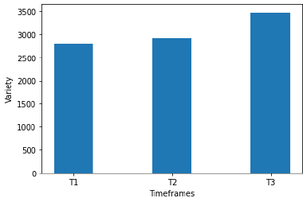
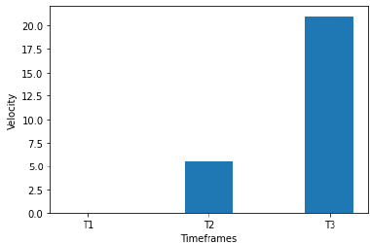
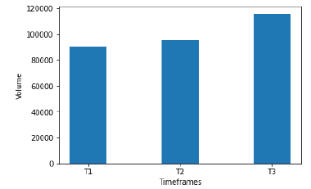
MEASURES : COLLECTED DATA VALUES
Data values collected before pre-processing:
Data Collected/ (Before Pre-processing) | T1 | T2 | T3
Ndde | 7076 | 7427 | 8816
Nds | 2 | 2 | 2
Lbd | 1306 | 1305 | 1605
Volume | 90492.9709 | 95500.5538 | 115541.6894
Velocity | 0 | 5.5336 | 20.985
Variety | 2794.666 | 2911.3333 | 3474.33333

Slide 15
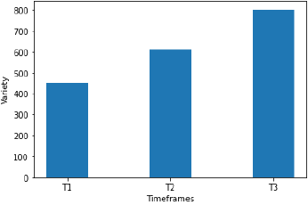
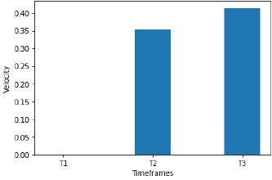
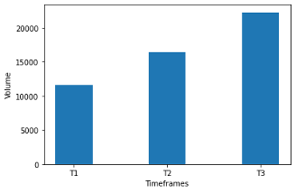
MEASURES : COLLECTED DATA VALUES
Data values collected after pre-processing:
Data Collected/ (Before Pre-processing) | T1 | T2 | T3
Ndde | 1146 | 1553 | 2029
Nds | 2 | 2 | 2
Lbd | 206 | 281 | 376
Volume | 11646.1004 | 16463.1078 | 22291.7163
Velocity | 0 | 35.404 | 41.361
Variety | 451.333 | 611.9999 | 802.3333

Slide 16
From T1 to T3, the volume of big data has been observed to increase gradually over time. It shows that there has been a substantial amount of data added to the dataset for the T2 and a considerable amount for the T3 timeframe. As stated in previous steps, increasing, or decreasing the value of varieties does not make them better or worse. It only gives information about the amount of Ndde, Lbd and Nds present in the dataset. It is evident from the indicator graph that there has gradual change over the three timeframes (T1, T2, and T3). However, each time frame has seen a slight increase over the previous one. The result of the machine learning algorithm usually requires more data for processing for accurate prediction but considering more data can be added to the dataset in the future and based on a visual analysis of three major quality characteristics, we can conclude that the data is suitable for machine learning algorithms.
CONCLUSION

Slide 17
RETROSPECTIVE ANALYSIS AND ISSUES
Retrospection
The process of looking back or examining past actions or decisions in order to self-reflect and offer suggestions for a better future.
The following questions might be used to elaborate on or expand the process retrospective for this project.
What went well?
What could be changed for better results?
What should we stop doing?
What have we learned?
What still puzzles us?

Slide 18
RETROSPECTIVE ANALYSIS
What went well?
In project’s point of view:
Understanding the main objective and identifying the requirements
Dividing the roles and responsibilities among the team members and learning collaboratively
Availability of ISO/IEC standards to map the requirements to real world standards
In business point of view:
Availability of a well-structured data set
Visualizing real-time data was easy due to URL availability
Derived measures had a good trend

Slide 19
RETROSPECTIVE ANALYSIS
What could be changed to deliver better results?
In project’s point of view:
Improved early quantitative model selection by prior topic/data review
Python-based data analytics expertise is shared among the team members
Defined threshold models for pre-processing decisions such whether to average over or delete null values
In business point of view:
Multiple data sets being available could greatly enhance outcomes and predictions
Including information from other Vs could be beneficial
A larger sample size of the data might be beneficial for producing better results
The absence of data gaps in the data set could have enhanced metrics like completeness and accuracy, among others

Slide 20
RETROSPECTIVE ANALYSIS
What should we stop doing?
In project’s point of view:
should never postpone learning something new
Abstraction to create metrics, such as the GQM process, should be topic-specific and need high-level comprehension
General agreement or secondary members can be assigned when one accountable member for a job is removed
In business point of view:
Time frame division of the data set should not be done but rather understand the data and find better frames
Unnecessary columns that do not add any meaning to the data set should not be added

Slide 21
RETROSPECTIVE ANALYSIS
What have we learned?
In project’s point of view:
We’ve learned to use collaboration tools like Google collab, Google Docs
Learning from our mistakes and repeating them in future
Any project requires a team and an individual alone cannot complete it
In business point of view:
Real-world abilities include data analytics, big data visualization, turning the data into insightful remarks, and many others

Slide 22
RETROSPECTIVE ANALYSIS
What still puzzles us?
In project’s point of view:
What to do if there are too many null records discovered. How, for instance, can a column with an excessive number of null entries be averaged when the data type is string?
What should be the Big Data V's definite values in order for ML algorithms to process them?
In business point of view:
In each frame, the data distribution for posts and comments was not altered but rather biased to one of them.
Ideal dataset, performance benchmarking metrics, and evaluation and conclusion-improving metrics

Slide 23
ISSUES
Issue 1: Availability of data for initial steps
Team had to create goals and queries in an abstract or high-level manner due to lack of topical reference
Once the dataset was ready, these objectives and questions are needed to be reviewed and changed as necessary
The team members had some uncertainty and a problem as a result of the delayed dataset availability
The problem was solved by making the questions general rather than topic-specific and by setting the metrics, but these were later altered to meet the requirements

Slide 24
ISSUES
Issue 2: Data completeness
The problem of null values being present was caused by the process of recording and evaluating records without null values
Furthermore, it was challenging to determine whether the comment bodies included too many special characters or were just unrelated to the topic at hand
These problems caused the first code and analysis model problems. However, the team decided on a workaround and continued with the procedure

Slide 25
ISSUES
Issue 3: Not many Outliers to capture variety
It was difficult to develop an effective and accurate model for capturing variety because of very few outliers.
Despite being a diverse dataset, the minimal variety was found during time frames causes the loss of solid trends.
This can be addressed by splitting the dataset at various time frames with incremental records.

