Slide 1

VHDL Basics
ECE 448 – FPGA and ASIC Design with VHDL 1

Slide 2
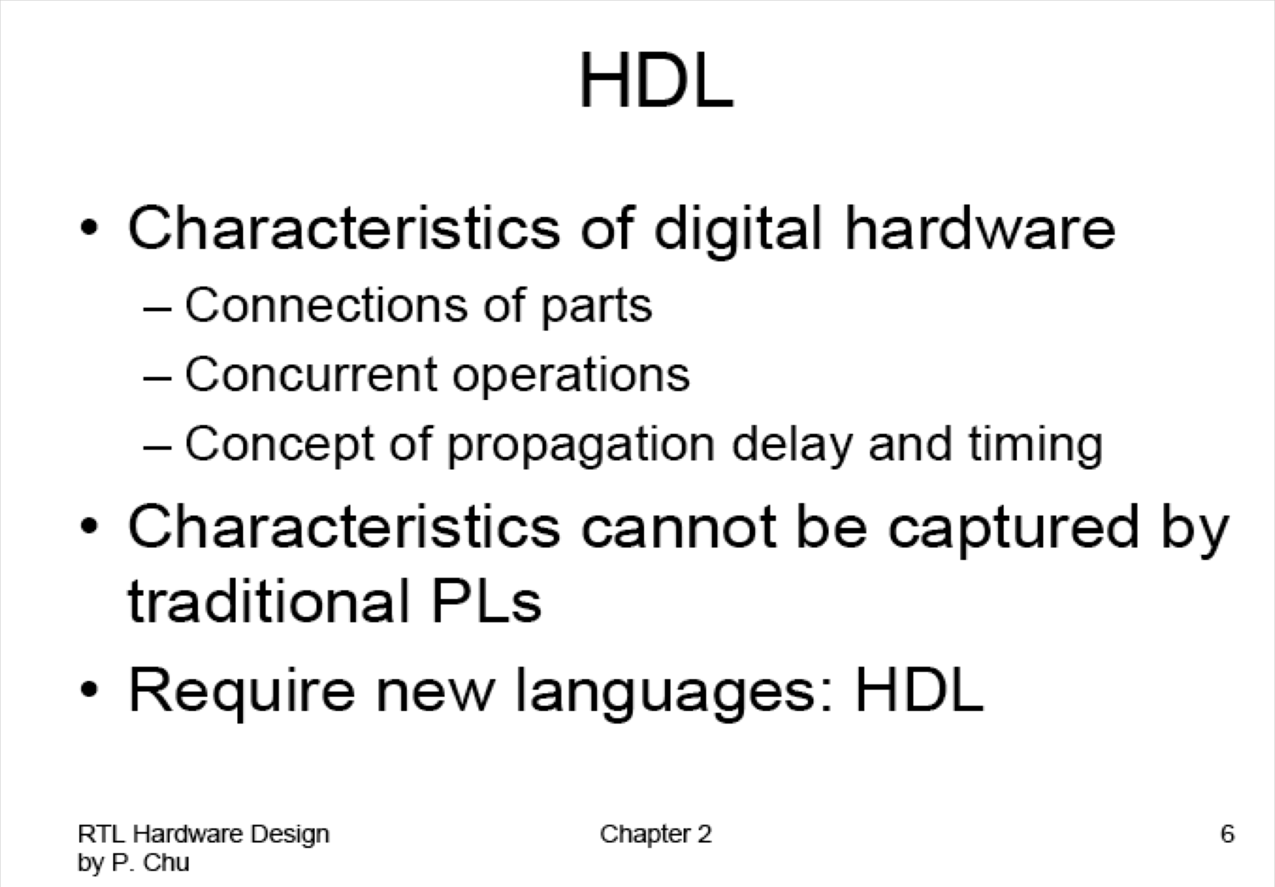

Slide 3
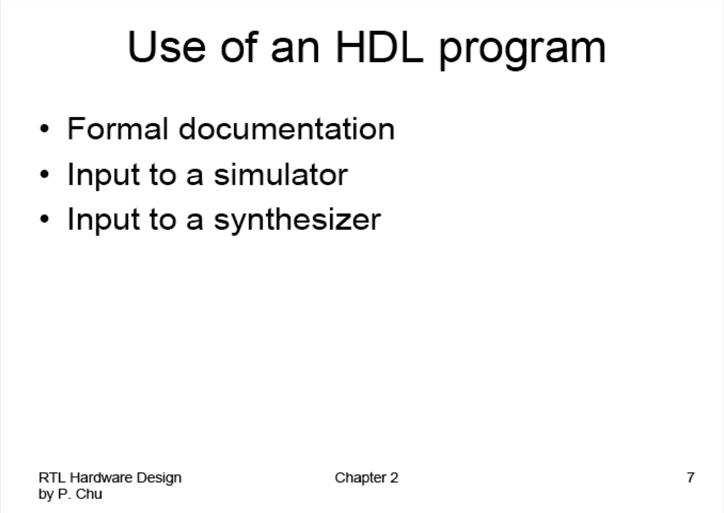

Slide 4
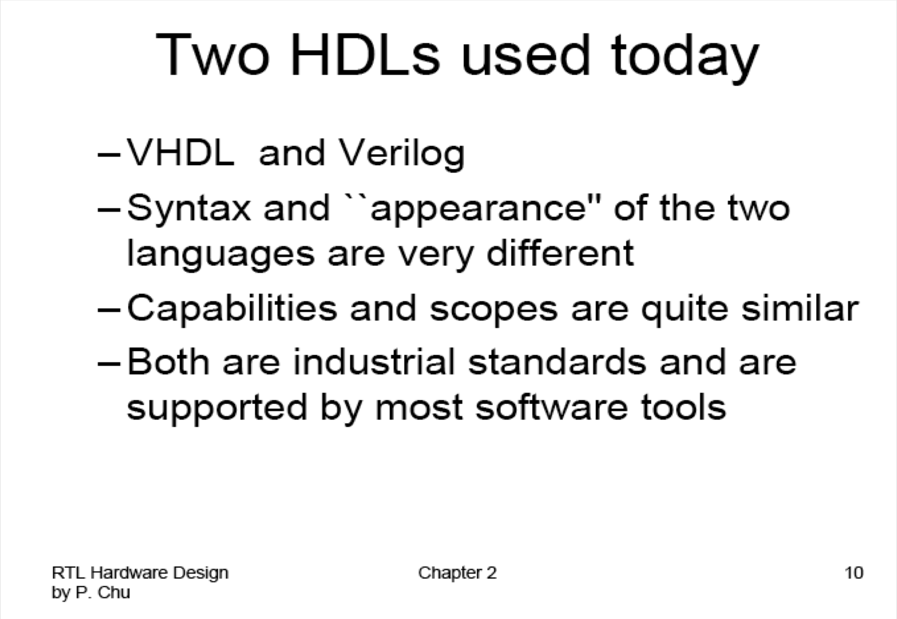

Slide 5
Features of VHDL
Technology/vendor independent
Portable
Reusable

Slide 6
VHDL Fundamentals
ECE 448 – FPGA and ASIC Design with VHDL 6

Slide 7
Naming and Labeling (1)
VHDL is case insensitive
Example:
Names or labels databus Databus DataBus DATABUS
are all equivalent

Slide 8
Naming and Labeling (2)
General rules of thumb (according to VHDL-87)
All names should start with an alphabet character (a-z or A-Z)
Use only alphabet characters (a-z or A-Z) digits (0-9) and underscore (_)
Do not use any punctuation or reserved characters within a name (!, ?, ., &, +, -, etc.)
Do not use two or more consecutive underscore characters ( ) within a name (e.g., Sel A is invalid)
All names and labels in a given entity and architecture must be unique

Slide 9
Valid or invalid?
7segment_display A87372477424
Adder/Subtractor
/reset
And_or_gate AND OR NOT
Kogge-Stone-Adder Ripple&Carry_Adder
My adder

Slide 10
Extended Identifiers
Allowed only in VHDL-93 and higher:
Enclosed in backslashes
May contain spaces and consecutive underscores
May contain punctuation and reserved characters within a name (!, ?, ., &, +, -, etc.)
VHDL keywords allowed
Case sensitive
Examples:
/rdy/ | /My design/ | /!a/
/RDY/ | /my design/ | /-a/

Slide 11
Free Format
VHDL is a “free format” language
No formatting conventions, such as spacing or indentation imposed by VHDL compilers. Space and carriage return treated the same way.
Example:
if (a=b) then
or
if (a=b) then
or
if (a =
b) then
are all equivalent
11

Slide 12
Comments
Comments in VHDL are indicated with a “double dash”, i.e., “--”
Comment indicator can be placed anywhere in the line
Any text that follows in the same line is treated as a comment
Carriage return terminates a comment
No method for commenting a block extending over a couple of lines
Examples:
-- main subcircuit
Data_in <= Data_bus; -- reading data from the input FIFO

Slide 13
Comments
Explain Function of Module to Other Designers
Explanatory, Not Just Restatement of Code
Locate Close to Code Described
Put near executable code, not just in a header

Slide 14
Design Entity
ECE 448 – FPGA and ASIC Design with VHDL 14

Slide 15
Example: NAND Gate
a | b | z
0 | 0 | 1
0 | 1 | 1
1 | 0 | 1
1 | 1 | 0
a
z
b

Slide 16
Example VHDL Code
3 sections to a piece of VHDL code
File extension for a VHDL file is .vhd
Name of the file should be the same as the entity name (nand_gate.vhd) [OpenCores Coding Guidelines]
LIBRARY ieee;
USE ieee.std_logic_1164.all;
LIBRARY DECLARATION
ENTITY nand_gate IS PORT(
a : IN STD_LOGIC; b : IN STD_LOGIC; z : OUT STD_LOGIC);
ENTITY DECLARATION
END nand_gate;
ARCHITECTURE model OF nand_gate IS BEGIN
z <= a NAND b;
END model;
ARCHITECTURE BODY

Slide 17
Tips & Hints
Place each entity in a different file.
The name of each file should be exactly the same as the name of an entity it contains.
These rules are not enforced by all tools
but are worth following in order to increase readability and portability of your designs

Slide 18
Tips & Hints
Place the declaration of each port, signal, constant, and variable
in a separate line
These rules are not enforced by all tools
but are worth following in order to increase readability and portability of your designs

Slide 19
STD_LOGIC Demystified
ECE 448 – FPGA and ASIC Design with VHDL 19

Slide 20
STD_LOGIC
LIBRARY ieee;
USE ieee.std_logic_1164.all;
ENTITY nand_gate IS PORT(
: IN STD_LOGIC;
: IN STD_LOGIC; z : OUT STD_LOGIC);
END nand_gate;
ARCHITECTURE dataflow OF nand_gate IS BEGIN
z <= a NAND b;
END dataflow;
What is STD_LOGIC you ask?

Slide 21
BIT versus STD_LOGIC
BIT type can only have a value of ‘0’ or ‘1’
STD_LOGIC can have nine values
’U’,’X’,‘0’,’1’,’Z’,’W’,’L’,’H’,’-’
Useful mainly for simulation
‘0’,’1’, and ‘Z’ are synthesizable (your codes should contain only these three values)

Slide 22
More on STD_LOGIC Meanings
Do not care.
Can be assigned to outputs for the case of invalid
inputs (may produce significant improvement in resource utilization after synthesis).
Must be used with great caution.
For example in VHDL, the direct comparison
'1’ = '-’
gives FALSE.
'-’
The "std_match" functions defined in the numeric_std package must be used to make this value work
as expected:
Example:
if (std_match(address, "-11---") then ...
elsif (std_match(address, "-01---") then ... else ...
end if;

Slide 23
Modeling Wires and Buses
ECE 448 – FPGA and ASIC Design with VHDL 23

Slide 24
Signals
SIGNAL a : STD_LOGIC;
 | a
 | ¹ wire
SIGNAL b : STD_LOGIC_VECTOR(7 DOWNTO 0);
 | b
 | 8 bus

Slide 25
Standard Logic Vectors
SIGNAL a: STD_LOGIC;
SIGNAL b: STD_LOGIC_VECTOR(3 DOWNTO 0); SIGNAL c: STD_LOGIC_VECTOR(3 DOWNTO 0); SIGNAL d: STD_LOGIC_VECTOR(15 DOWNTO 0); SIGNAL e: STD_LOGIC_VECTOR(8 DOWNTO 0);
……….
a <= ‘1’;
b <= ”0000”; c <= B”0000”;
d <= X”AF67”; e <= O”723”;
-- Binary base assumed by default
-- Binary base explicitly specified
-- Hexadecimal base
-- Octal base

Slide 26
Vectors and Concatenation
SIGNAL SIGNAL | a: b: | STD_LOGIC_VECTOR(3 DOWNTO 0); STD_LOGIC_VECTOR(3 DOWNTO 0);
SIGNAL | c, | d, e: STD_LOGIC_VECTOR(7 DOWNTO | 0);
<= <= | ”0000”; ”1111”;
c <= | a & b; | -- | c | = ”00001111”
d <= | ‘0’ & ”0001111”; | -- | d | <= ”00001111”
e <= | ‘0’ & ‘0’ & ‘0’ & ‘1’ & ‘1’; | ‘0’ | & | ‘1’ & ‘1’ &
 |  | -- | e | <= ”00001111”

Slide 27
VHDL Design Styles
ECE 448 – FPGA and ASIC Design with VHDL 27

Slide 28
VHDL Design Styles
VHDL Design Styles
Testbenches
dataflow
structural
behavioral (sequential)
Concurrent statements
Components and interconnects
Sequential statements
Registers
State machines
Decoders
Subset most suitable for synthesis

Slide 29
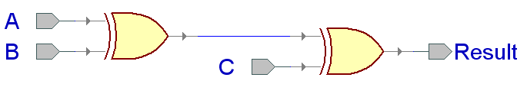
xor3 Example

Slide 30
Entity xor3_gate
LIBRARY ieee;
USE ieee.std_logic_1164.all;
ENTITY xor3_gate IS PORT(
A : IN STD_LOGIC;
B : IN STD_LOGIC; C : IN STD_LOGIC;
Result : OUT STD_LOGIC
);
end xor3_gate;

Slide 31
Dataflow Architecture (xor3_gate)
ARCHITECTURE dataflow OF xor3_gate IS SIGNAL U1_OUT: STD_LOGIC;
BEGIN
U1_OUT <= A XOR B;
Result <= U1_OUT XOR C;
END dataflow;
U1_OUT

Slide 32
Dataflow Description
Describes how data moves through the system and the various processing steps.
Dataflow uses series of concurrent statements to realize logic.
Dataflow is most useful style when series of Boolean equations can represent a logic → used to implement simple combinational logic
Dataflow code also called “concurrent” code
Concurrent statements are evaluated at the same time; thus, the order of these statements doesn’t matter
This is not true for sequential/behavioral statements
This order…
U1_out <= A XOR B;
Result <= U1_out XOR C;
Is the same as this order…
Result <= U1_out XOR C; U1_out <= A XOR B;

Slide 33
Structural Architecture in VHDL 93
xor2.vhd
LIBRARY ieee;
USE ieee.std_logic_1164.all;
ENTITY xor2 IS PORT(
I1 : IN STD_LOGIC;
I2 : IN STD_LOGIC; Y : OUT STD_LOGIC);
END xor2;
ARCHITECTURE dataflow OF xor2 IS BEGIN
Y <= I1 xor I2;
END dataflow;

Slide 34

Structural Architecture in VHDL 93
A B C
xor3_gate
ARCHITECTURE structural OF xor3_gate IS SIGNAL U1_OUT: STD_LOGIC;
Result
BEGIN
U1: entity work.xor2(dataflow)
PORT MAP (I1 => A,
I2 => B, Y => U1
I1 I2
U1_OUT
Y
I1 I2
_OUT);
Y
U2: entity work.xor2(dataflow)
PORT MAP (I1 => U1_OUT,
I2 => C,
Y => Result);
END structural;
PORT NAME
LOCAL WIRE NAME

Slide 35
Behavioral Architecture (xor3 gate)
ARCHITECTURE behavioral OF xor3 IS BEGIN
xor3_behave: PROCESS (A, B, C)
BEGIN
IF ((A XOR B XOR C) = '1') THEN
Result <= '1';
ELSE
Result <= '0';
END IF;
END PROCESS xor3_behave;
END behavioral;

Slide 36
Behavioral Description
It accurately models what happens on the inputs and outputs of the black box (no matter what is inside and how it works).
This style uses PROCESS statements in VHDL.

Slide 37
Arithmetic Operators in VHDL (1)
To use basic arithmetic operations involving std_logic_vectors you need to include the following library packages:
LIBRARY ieee;
USE ieee.std_logic_1164.all;
USE ieee.std_logic_unsigned.all;
or
USE ieee.std_logic_signed.all;

Slide 38
Arithmetic Operators in VHDL (2)
You can use standard +, - operators to perform addition and subtraction:
signal A : STD_LOGIC_VECTOR(3 downto 0); signal B : STD_LOGIC_VECTOR(3 downto 0); signal C : STD_LOGIC_VECTOR(3 downto 0);
……
C <= A + B;

Slide 39
Different ways of performing the same operation
signal count: std_logic_vector(7 downto 0);
You can use:
count <= count + “00000001”;
or
count <= count + 1;
or
count <= count + ‘1’;

Slide 40
Different declarations for the same operator
Declarations in the package ieee.std_logic_unsigned:
function “+” ( L: std_logic_vector;
R:std_logic_vector) return std_logic_vector;
function “+” ( L: std_logic_vector;
R: integer)
return std_logic_vector;
function “+” ( L: std_logic_vector;
R:std_logic)
return std_logic_vector;

Slide 41
Operator overloading
Operator overloading allows different argument types for a given operation (function)
The VHDL tools resolve which of these functions to select based on the types of the inputs
This selection is transparent to the user as long as the function has been defined for
the given argument types.

