Slide 1

Data Flow Modeling of Combinational Logic

Slide 2
Register Transfer Level (RTL) Design Description
Current Topic
…
Combinational
Logic
Combinational
Logic
Registers

Slide 3
Data-Flow VHDL
Concurrent Statements
concurrent signal assignment (⇐)
conditional concurrent signal assignment
(when-else)
selected concurrent signal assignment
(with-select-when)

Slide 4
Data-flow VHDL: Example
x
y
s
cin
cout

Slide 5
Data-flow VHDL: Example (1)
LIBRARY ieee ;
USE ieee.std_logic_1164.all ;
ENTITY fulladd IS
PORT ( x : IN STD_LOGIC ;
y : IN STD_LOGIC ;
cin : IN STD_LOGIC ;
s : OUT STD_LOGIC ;
cout : OUT STD_LOGIC ) ;
END fulladd ;

Slide 6
Data-flow VHDL: Example (2)
ARCHITECTURE dataflow OF fulladd IS
BEGIN
s <= x XOR y XOR cin ;
cout <= (x AND y) OR (cin AND x) OR (cin AND y) ;
END dataflow ;
equivalent to
ARCHITECTURE dataflow OF fulladd IS
BEGIN
cout <= (x AND y) OR (cin AND x) OR (cin AND y) ;
s <= x XOR y XOR cin ;
END dataflow ;

Slide 7
Logic Operators
Logic operators
Logic operators precedence
and or nand nor xor not xnor
only in VHDL-93
or later
Highest
not
and or nand nor xor xnor
Lowest
Notes:
No order precedents

Slide 8
No Implied Precedence
Wanted: y = ab + cd
Incorrect
y <= a and b or c and d ;
equivalent to
y <= ((a and b) or c) and d ;
equivalent to
y = (ab + c)d
Correct
y <= (a and b) or (c and d) ;
Notes:
No order precedents

Slide 9
Signal assignment statement with a closed feedback loop
A signal appears in both sides of a concurrent assignment statement
E.g., q <= ((not q) and (not en)) or (d and en);
Syntactically correct
Form a closed feedback loop
Should be avoided

Slide 10
Data-Flow VHDL
Concurrent Statements
concurrent signal assignment (⇐)
conditional concurrent signal assignment
(when-else)
selected concurrent signal assignment
(with-select-when)

Slide 11
Conditional concurrent signal assignment
When - Else
target_signal <= value1 when condition1 else
value2 when condition2 else
. . .
valueN-1 when conditionN-1 else
valueN;

Slide 12
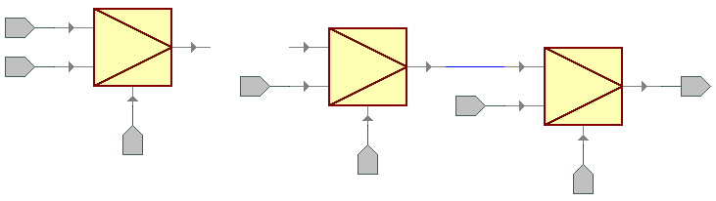
Most often implied structure
When - Else
target_signal <= value1 when condition1 else
value2 when condition2 else
. . .
valueN-1 when conditionN-1 else
valueN;
Value N
0
1
…
.…
0
1
Value N-1
0
1
Target Signal
Value 2
Value 1
Condition N-1
Condition 2
Condition 1

Slide 13
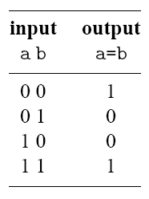
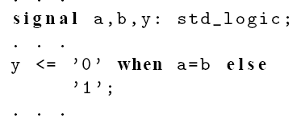
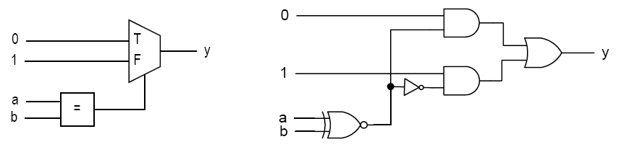
Example

Slide 14
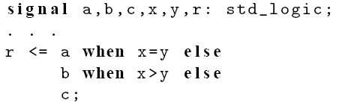
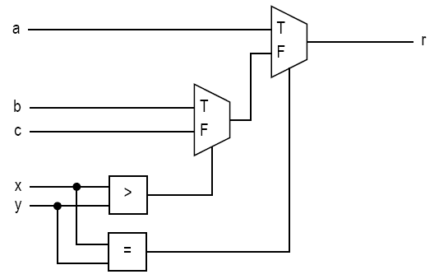
Example

Slide 15
Signed and Unsigned Types
Behave exactly like
STD_LOGIC_VECTOR
plus, they determine whether a given vector
should be treated as a signed or unsigned number.
Require
USE ieee.numeric_std.all;

Slide 16
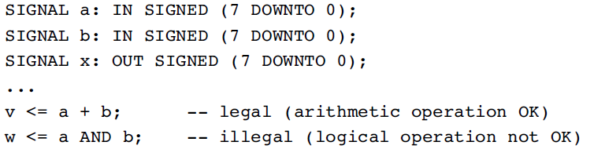
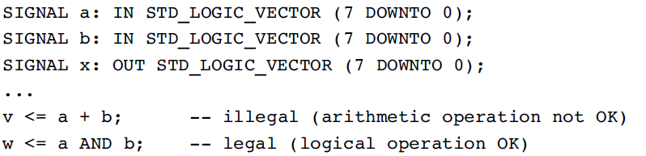
Signed, Unsigned, STD_LOGIC_VECTOR
Despite their syntax, SIGNED and UNSIGNED data types are intended mainly for arithmetic operations. On the other hand, logical operations are not allowed.

Slide 17
Operators
Relational operators
Can be used with std_logic_vector, signed, and unsigned
Logic and relational operators precedence
= /= < <= > >=
Highest
not
= /= < <= > >=
and or nand nor xor xnor
Lowest
Notes:
No order precedents

Slide 18
Priority of logic and relational operators
compare a = bc
Incorrect
… when a = b and c else …
equivalent to
… when (a = b) and c else …
Correct
… when a = (b and c) else …
Notes:
No order precedents

Slide 19
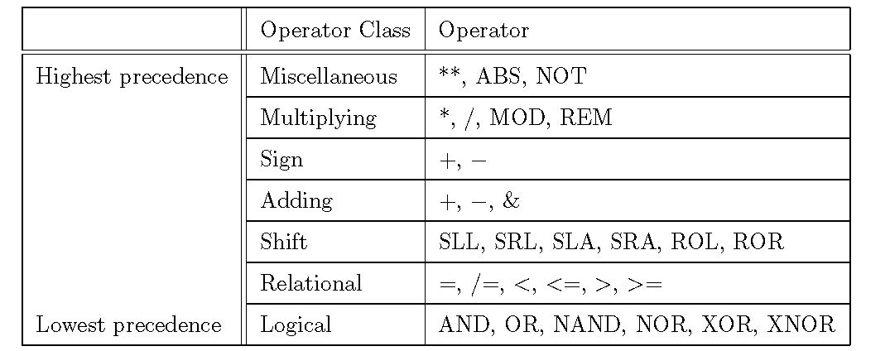
VHDL operators

Slide 20
Data-Flow VHDL
Concurrent Statements
concurrent signal assignment (⇐)
conditional concurrent signal assignment
(when-else)
selected concurrent signal assignment
(with-select-when)

Slide 21
Selected concurrent signal assignment
With –Select-When
with choice_expression select
target_signal <= expression1 when choices_1,
expression2 when choices_2,
. . .
expressionN when choices_N;

Slide 22
Most Often Implied Structure
With –Select-When
with choice_expression select
target_signal <= expression1 when choices_1,
expression2 when choices_2,
. . .
expressionN when choices_N;
expression1
choices_1
expression2
choices_2
target_signal
expressionN
choices_N
choice expression

Slide 23
Allowed formats of choices_k
WHEN value
WHEN value_1 | value_2 | .... | value N
WHEN OTHERS

Slide 24
Allowed formats of choice_k - example
WITH sel SELECT
y <= a WHEN "000",
c WHEN "001" | "111",
d WHEN OTHERS;

Slide 25
Syntax
select_expression
Discrete type or 1-D array
With finite possible values
choice_i
A value of the data type
Choices must be
mutually exclusive
all inclusive
others can be used as last choice_i

Slide 26
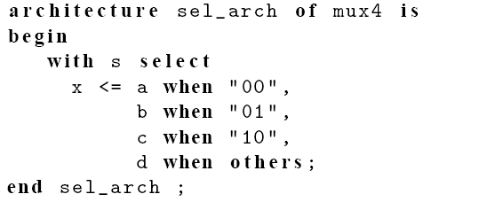
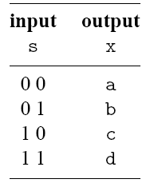
E.g., 4-to-1 mux

Slide 27
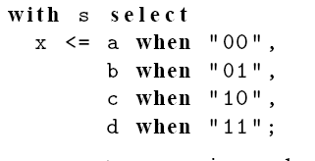
Question
Can “11” be used to replace others?

Slide 28
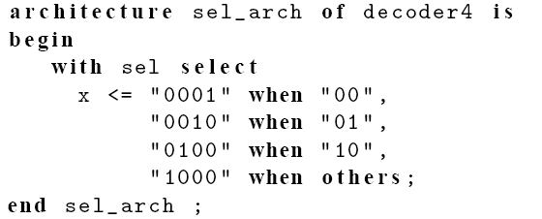
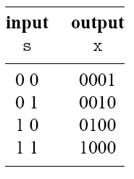
E.g., 2-to-2² binary decoder

Slide 29
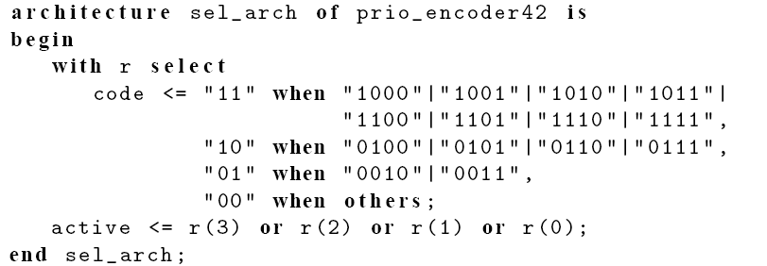
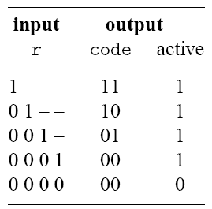
E.g., 4-to-2 priority encoder

Slide 30
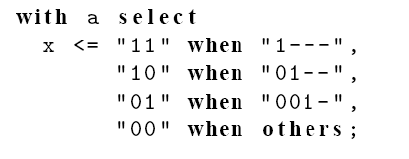
Question
Can we use ‘-’?

Slide 31
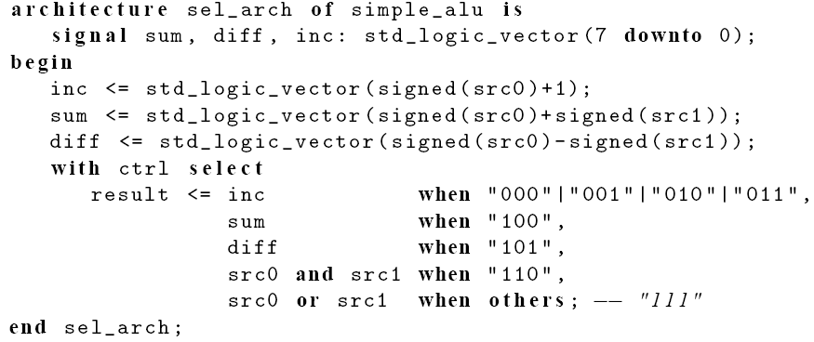
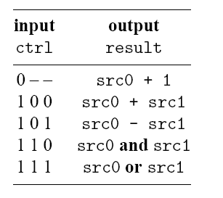
E.g., simple ALU

Slide 32
Comparison
"when-else" should be used when:
there is only one condition (and thus, only one else), as in the 2-to-1 MUX
conditions are independent of each other (e.g., they test values of different signals)
conditions reflect priority (as in priority encoder); one with the highest priority need to be tested first.

Slide 33
Comparison
"with-select-when" should be used when there is:
more than one condition
conditions are closely related to each other (e.g., represent different ranges of values of the same signal)
all conditions have the same priority (as in the 4-to-1 MUX).

Slide 34
Behavioral Modeling of Sequential-Circuit Building Blocks

Slide 35
VHDL Design Styles
VHDL Design
Styles
dataflow
structural
behavioral
Concurrent
statements
Components and
interconnects
Sequential statements
Registers
Shift registers
Counters
State machines
synthesizable
and more
if you are careful

Slide 36
Processes in VHDL
Processes Describe Sequential Behavior
Processes in VHDL Are Very Powerful Statements
Allow to define an arbitrary behavior that may be difficult to represent by a real circuit
Not every process can be synthesized
Use Processes with Caution in the Code to Be Synthesized
Use Processes Freely in Testbenches

Slide 37
Anatomy of a Process
OPTIONAL
[label:] PROCESS [(sensitivity list)]
[declaration part]
BEGIN
statement part
END PROCESS [label];

Slide 38
PROCESS with a SENSITIVITY LIST
List of signals to which the process is sensitive.
Whenever there is an event on any of the signals in the sensitivity list, the process fires.
Every time the process fires, it will run in its entirety.
WAIT statements are NOT ALLOWED in a processes with SENSITIVITY LIST.
label: process (sensitivity list)
declaration part
begin
statement part
end process;

Slide 39
Component Equivalent of a Process
clk
y
w
priority: PROCESS (clk)
BEGIN
IF w(3) = '1' THEN
y <= "11" ;
ELSIF w(2) = '1' THEN
y <= "10" ;
ELSIF w(1) = c THEN
y <= a and b;
ELSE
z <= "00" ;
END IF ;
END PROCESS ;
a
priority
z
b
c
All signals which appear on the left of signal assignment statement (<=) are outputs e.g. y, z
All signals which appear on the right of signal assignment statement (<=) or in logic expressions are inputs e.g. w, a, b, c
All signals which appear in the sensitivity list are inputs e.g. clk
Note that not all inputs need to be included in the sensitivity list

Slide 40
Registers

Slide 41
D latch
Graphical symbol
Truth table
Clock
D
Q(t+1)
D
Q
Q(t)
0
–
Clock
1
0
0
1
1
1
Timing diagram
t
1
t
2
t
3
t
4
Clock
D
Q
Time

Slide 42
D flip-flop
Graphical symbol
Truth table
Clk
D
Q(t+1)
D
Q
0
↑
0
Clock
↑
1
1
0
–
Q(t)
1
–
Q(t)
Timing diagram
t
1
t
2
t
3
t
4
Clock
D
Q
Time

Slide 43
D latch
LIBRARY ieee ;
USE ieee.std_logic_1164.all ;
ENTITY latch IS
PORT ( D, Clock : IN STD_LOGIC ;
Q : OUT STD_LOGIC) ;
END latch ;
ARCHITECTURE behavioral OF latch IS
BEGIN
PROCESS ( D, Clock )
BEGIN
IF Clock = '1' THEN
Q <= D ;
END IF ;
END PROCESS ;
END behavioral;
D
Q
Clock

Slide 44
D flip-flop
LIBRARY ieee ;
USE ieee.std_logic_1164.all ;
ENTITY flipflop IS
PORT ( D, Clock : IN STD_LOGIC ;
Q : OUT STD_LOGIC) ;
END flipflop ;
ARCHITECTURE behavioral OF flipflop IS
BEGIN
PROCESS ( Clock )
BEGIN
IF Clock'EVENT AND Clock = '1' THEN
Q <= D ;
END IF ;
END PROCESS ;
END behavioral ;
D
Q
Clock

Slide 45
D flip-flop
LIBRARY ieee ;
USE ieee.std_logic_1164.all ;
ENTITY flipflop IS
PORT ( D, Clock : IN STD_LOGIC ;
Q : OUT STD_LOGIC) ;
END flipflop ;
ARCHITECTURE behavioral2 OF flipflop IS
BEGIN
PROCESS ( Clock )
BEGIN
IF rising_edge(Clock) THEN
Q <= D ;
END IF ;
END PROCESS ;
END behavioral2;
D
Q
Clock

Slide 46
D flip-flop with asynchronous reset
LIBRARY ieee ;
USE ieee.std_logic_1164.all ;
ENTITY flipflop_ar IS
PORT ( D, Resetn, Clock : IN STD_LOGIC ;
Q : OUT STD_LOGIC) ;
END flipflop_ar ;
ARCHITECTURE behavioral OF flipflop_ar IS
BEGIN
PROCESS ( Resetn, Clock )
BEGIN
IF Resetn = '0' THEN
Q <= '0' ;
ELSIF rising_edge(Clock) THEN
Q <= D ;
END IF ;
END PROCESS ;
END behavioral ;
D
Q
Clock
Resetn

Slide 47
D flip-flop with synchronous reset
LIBRARY ieee ;
USE ieee.std_logic_1164.all ;
ENTITY flipflop_sr IS
PORT ( D, Resetn, Clock : IN STD_LOGIC ;
Q : OUT STD_LOGIC) ;
END flipflop_sr ;
ARCHITECTURE behavioral OF flipflop_sr IS
BEGIN
PROCESS(Clock)
BEGIN
IF rising_edge(Clock) THEN
IF Resetn = '0' THEN
Q <= '0' ;
ELSE
Q <= D ;
END IF ;
END IF;
END PROCESS ;
END behavioral ;
D
Q
Clock
Resetn

Slide 48
Asychronous vs. Synchronous
In the IF loop, asynchronous items are
Before the rising_edge(Clock) statement
In the IF loop, synchronous items are
After the rising_edge(Clock) statement

Slide 49
8-bit register with asynchronous reset
LIBRARY ieee ;
USE ieee.std_logic_1164.all ;
ENTITY reg8 IS
PORT ( D : IN STD_LOGIC_VECTOR(7 DOWNTO 0) ;
Resetn, Clock : IN STD_LOGIC ;
Q : OUT STD_LOGIC_VECTOR(7 DOWNTO 0) ) ;
END reg8 ;
ARCHITECTURE behavioral OF reg8 IS
BEGIN
PROCESS ( Resetn, Clock )
BEGIN
IF Resetn = '0' THEN
Q <= "00000000" ;
ELSIF rising_edge(Clock) THEN
Q <= D ;
END IF ;
END PROCESS ;
END behavioral ;`
8
Resetn
8
D
Q
Clock
reg8

Slide 50
Use of OTHERS
OTHERS stand for any index value that has
not been previously mentioned.
Q <= “00000001” can be written as Q <= (0 => ‘1’, OTHERS => ‘0’)
Q <= “10000001” can be written as Q <= (7 => ‘1’, 0 => ‘1’, OTHERS => ‘0’)
or Q <= (7 | 0 => ‘1’, OTHERS => ‘0’)
Q <= “00011110” can be written as Q <= (4 downto 1=> ‘1’, OTHERS => ‘0’)

Slide 51
Counters

Slide 52
2-bit up-counter with synchronous reset
LIBRARY ieee ;
USE ieee.std_logic_1164.all ;
USE ieee.std_logic_unsigned.all ;
ENTITY upcount IS
PORT ( Clear, Clock : IN STD_LOGIC ;
Q : OUT STD_LOGIC_VECTOR(1 DOWNTO 0) ) ;
END upcount ;
ARCHITECTURE behavioral OF upcount IS
SIGNAL Count : std_logic_vector(1 DOWNTO 0);
BEGIN
upcount: PROCESS ( Clock )
BEGIN
IF rising_edge(Clock) THEN
IF Clear = '1' THEN
Count <= "00" ;
ELSE
Count <= Count + 1 ;
END IF ;
END IF;
END PROCESS;
Q <= Count;
END behavioral;
Clear
2
Q
upcount
Clock

Slide 53
4-bit up-counter with asynchronous reset (1)
LIBRARY ieee ;
USE ieee.std_logic_1164.all ;
USE ieee.std_logic_unsigned.all ;
ENTITY upcount_ar IS
PORT ( Clock, Resetn, Enable : IN STD_LOGIC ;
Q : OUT STD_LOGIC_VECTOR (3 DOWNTO 0)) ;
END upcount_ar ;
Enable
4
Q
Clock
upcount
Resetn

Slide 54
4-bit up-counter with asynchronous reset (2)
ARCHITECTURE behavioral OF upcount _ar IS
SIGNAL Count : STD_LOGIC_VECTOR (3 DOWNTO 0) ;
BEGIN
PROCESS ( Clock, Resetn )
BEGIN
IF Resetn = '0' THEN
Count <= "0000" ;
ELSIF rising_edge(Clock) THEN
IF Enable = '1' THEN
Count <= Count + 1 ;
END IF ;
END IF ;
END PROCESS ;
Q <= Count ;
END behavioral ;
Enable
4
Q
Clock
upcount
Resetn

Slide 55
Shift Registers

Slide 56
Shift register
Q(3)
Q(2)
Q(1)
Q(0)
Sin
D
Q
D
Q
D
Q
D
Q
Clock
Enable

Slide 57
Shift Register With Parallel Load
Load
D(3)
D(2)
D(1)
D(0)
Sin
D
Q
D
Q
D
Q
D
Q
Clock
Enable
Q(3)
Q(2)
Q(1)
Q(0)

Slide 58
4-bit shift register with parallel load (1)
LIBRARY ieee ;
USE ieee.std_logic_1164.all ;
ENTITY shift4 IS
PORT ( D : IN STD_LOGIC_VECTOR(3 DOWNTO 0) ;
Enable : IN STD_LOGIC ;
Load : IN STD_LOGIC ;
Sin : IN STD_LOGIC ;
Clock : IN STD_LOGIC ;
Q : OUT STD_LOGIC_VECTOR(3 DOWNTO 0) ) ;
END shift4 ;
4
Enable
4
D
Q
Load
Sin
shift4
Clock

Slide 59
4-bit shift register with parallel load (2)
ARCHITECTURE behavioral OF shift4 IS
SIGNAL Qt : STD_LOGIC_VECTOR(3 DOWNTO 0);
BEGIN
PROCESS (Clock)
BEGIN
IF rising_edge(Clock) THEN
IF Enable = ‘1’ THEN
IF Load = '1' THEN
Qt <= D ;
ELSE
Qt <= Sin & Qt(3 downto 1); END IF ;
END IF;
END IF ;
END PROCESS ;
Q <= Qt;
END behavioral ;
4
Enable
4
D
Q
Load
Sin
shift4
Clock

Slide 60
Circuit built of medium scale components
s(0)
r(0)
p(0)
En
0
r(1)
1
w
q(1)
Enable
p(1)
0
y
w
y
1
3
1
z(3)
t(3)
r(2)
w
q(0)
p(2)
1
y
w
y
0
0
2
r(3)
w
z(2)
t(2)
2
ena
D
Q
z
y
w
1
3
z(1)
t(1)
r(4)
p(3)
priority
y
0
En
0
z(0)
t(0)
dec2to4
regne
r(5)
1
Clk
Clock
s(1)

Slide 61
Structural description – example (1)
LIBRARY ieee ;
USE ieee.std_logic_1164.all ;
ENTITY priority_resolver IS
PORT (r : IN STD_LOGIC_VECTOR(5 DOWNTO 0) ;
s : IN STD_LOGIC_VECTOR(1 DOWNTO 0) ;
clk : IN STD_LOGIC;
en : IN STD_LOGIC;
t : OUT STD_LOGIC_VECTOR(3 DOWNTO 0) ) ;
END priority_resolver;
ARCHITECTURE structural OF priority_resolver IS
SIGNAL p : STD_LOGIC_VECTOR (3 DOWNTO 0) ;
SIGNAL q : STD_LOGIC_VECTOR (1 DOWNTO 0) ;
SIGNAL z : STD_LOGIC_VECTOR (3 DOWNTO 0) ;
SIGNAL ena : STD_LOGIC ;

Slide 62
Structural description – example (2)
BEGIN
u1: work.mux2to1(dataflow)
PORT MAP (w0 => r(0) ,
w1 => r(1),
s => s(0),
f => p(0));
p(1) <= r(2);
p(2) <= r(3);
u2: work.mux2to1(dataflow)
PORT MAP (w0 => r(4) ,
w1 => r(5),
s => s(1),
f => p(3));
u3: work.priority(dataflow)
PORT MAP (w => p,
y => q,
z => ena);

Slide 63
Structural description – example (3)
u4: work.dec2to4 (dataflow)
PORT MAP (w => q,
En => ena,
y => z);
u5: work.regne(behavioral)
PORT MAP (D => z ,
Enable => En ,
Clock => Clk,
Q => t );
END structural;

Slide 64
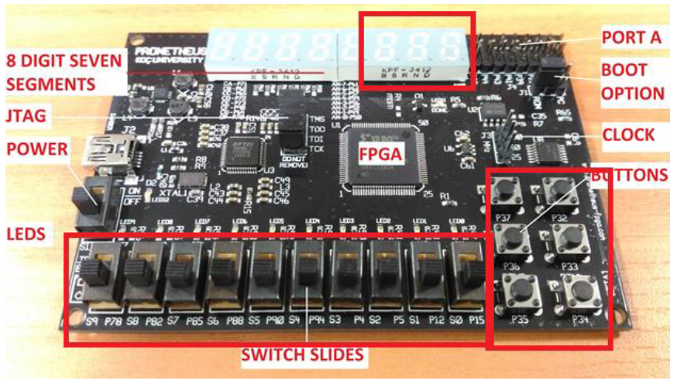
FPGA Board
Inputs: Switches and Push Buttons
Outputs: SSDs and LEDs

Slide 65
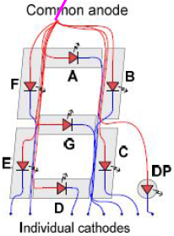
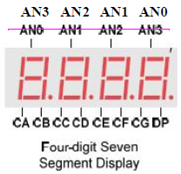
Seven Segment Display (SSD)
Common Anode vs. Common Cathode
Reduce number of pins
Common anode is active low
Digit Mutliplexing:
Each SSD has separate common anode pin
Multiple SSDs share the same Cathode pins
For example, the a cathode of the four SSDs are connected together to form a single output called CA (Cathode a)
12 pins instead of 36
Select each SSD sequentially (setting AN0=0, then AN1=0, and so on)
Do this “fast enough” to create the illusion that all SSDs are lit constantly

Slide 66
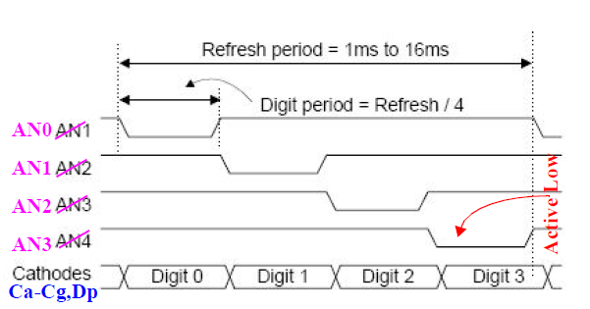
SSD Multiplexing
We use a 2-bit counter (00, 01, 10, 11) and a 2x4 decoder to generate the 4 SSD enables (00 => AN0 active, 01 => AN1 active, etc.).
We use the same counter bits as select lines to a 4x1 mux to “steer” the proper Ca-Cg to the enabled SSD.

Slide 67
Clock Division (1)
The counter value should change every 1ms to 16ms (i.e. 60Hz to 1000Hz)
Clock frequency from board (MCLK) is 100 MHz
Given the following architecture:
DIVCLK[0] is 50 MHz, DIVCLK[1] is 25 MHz, and so on
All outputs have 50% duty cycle
signal DIVCLK : STD_LOGIC_VECTOR(31 DOWNTO 0) := X"00000000";
DIV_PROCESS: PROCESS(MCLK)
BEGIN
IF rising_edge (MCLK) THEN
DIVCLK <= DIVCLK + 1;
END IF;
END PROCESS;

Slide 68
Clock Division: Arbitrary Frequency
Target Frequency is 100 Hz → Cycle Time = 0.01 second
Original Frequency is 100 MHz → Cycle Time = 0.01 µsecond
# of original cycles = 0.01 second / 0.01 µsecond = 1000000 cycles
CLK_PROCESS: PROCESS(MCLK)
BEGIN
IF RISING_EDGE(MCLK) THEN
IF(COUNTER < "11110100001000111111") THEN
COUNTER <= COUNTER + 1;
ELSE
COUNTER <= "00000000000000000000";
END IF;
END IF;
END PROCESS;
HUNDREDHZCLOCK <= '0' WHEN COUNTER < "01111010000100100000" ELSE '1';

Slide 69
Detour Sign Example
Design a system that receives 2-bit input from switches and displays the following words on the SSDs:
Input = “00” → SSDs <= StOP
Input = “01” → SSDs <= LeFt
Input = “10” → SSDs <= rIte
Input = “11” → Nothing is displayed (SSDs are OFF)
Multiple SSDs constantly:
Four characters in each case → 2-bit counter is needed
Clock divider is needed (100 Hz Frequency)

Slide 70
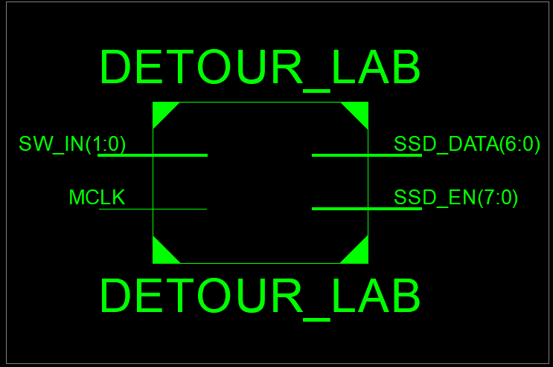
Block Diagram of Detour Sign

Slide 71
Detour Sign Design Components
One possible implementation:
Clock divider Entity
2-bit Counter Entity
4-to-1 MUX Entity
Choose the 1st character (S, L, r, nothing) according to input switches
Choose the 2nd character (t, e, I, nothing) according to input switches
Choose the 3rd character (O, F, t, nothing) according to input switches
Choose the 4th character (P, t, e, nothing) according to input switches
SSD Driver to determine which character and enable the correct SSD

Slide 72
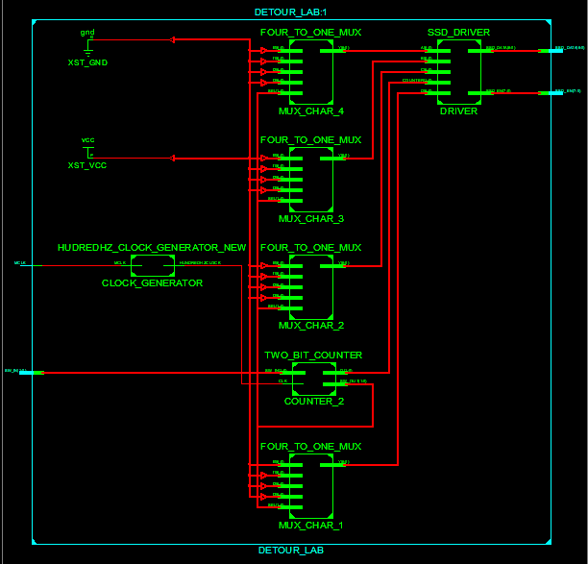

Slide 73
Clock Divider VHDL Code (1)
entity HUDREDHZ_CLOCK_GENERATOR_NEW is
Port ( MCLK : in STD_LOGIC;
HUNDREDHZCLOCK : out STD_LOGIC);
end HUDREDHZ_CLOCK_GENERATOR_NEW;
architecture Behavioral of HUDREDHZ_CLOCK_GENERATOR_NEW is
SIGNAL COUNTER : STD_LOGIC_VECTOR(19 DOWNTO 0) := "00000000000000000000";
begin
CLK_PROCESS: PROCESS(MCLK)
BEGIN

Slide 74
Clock Divider VHDL Code (2)
IF(MCLK'EVENT AND MCLK = '1') THEN
IF(COUNTER < "11110100001000111111") THEN
COUNTER <= COUNTER + 1;
ELSE
COUNTER <= "00000000000000000000";
END IF;
END IF;
END PROCESS;
HUNDREDHZCLOCK <= '0' WHEN COUNTER < "01111010000100100000" ELSE '1';
end Behavioral;

Slide 75
Two-bit Counter VHDL Code (1)
ENTITY TWO_BIT_COUNTER IS
PORT ( SW_IN : IN STD_LOGIC_VECTOR (1 DOWNTO 0);
CLK : IN STD_LOGIC;
SW_OUT : OUT STD_LOGIC_VECTOR(1 DOWNTO 0);
Q : OUT STD_LOGIC_VECTOR (1 DOWNTO 0));
END TWO_BIT_COUNTER;
ARCHITECTURE BEHAVIORAL OF TWO_BIT_COUNTER IS
SIGNAL COUNTER : STD_LOGIC_VECTOR(1 DOWNTO 0) := "00";
SIGNAL SW_REG : STD_LOGIC_VECTOR(1 DOWNTO 0) := "00";
BEGIN

Slide 76
Two-bit Counter VHDL Code (2)
PROCESS_COUNT : PROCESS(CLK)
BEGIN
IF RISING_EDGE(CLK) THEN
COUNTER <= COUNTER + 1;
IF COUNTER = "11" THEN
SW_REG <= SW_IN;
END IF;
END IF;
END PROCESS;
SW_OUT <= SW_REG;
Q <= COUNTER;
END BEHAVIORAL;

Slide 77
Four-to-One MUX VHDL Code (1)
ENTITY FOUR_TO_ONE_MUX IS
PORT ( I0 : IN STD_LOGIC_VECTOR (6 DOWNTO 0);
I1 : IN STD_LOGIC_VECTOR (6 DOWNTO 0);
I2 : IN STD_LOGIC_VECTOR (6 DOWNTO 0);
I3 : IN STD_LOGIC_VECTOR (6 DOWNTO 0);
SEL : IN STD_LOGIC_VECTOR (1 DOWNTO 0);
Y : OUT STD_LOGIC_VECTOR (6 DOWNTO 0));
END FOUR_TO_ONE_MUX;
ARCHITECTURE BEHAVIORAL OF FOUR_TO_ONE_MUX IS
BEGIN

Slide 78
Four-to-One MUX VHDL Code (2)
WITH SEL SELECT Y <=
I0 WHEN "00",
I1 WHEN "01",
I2 WHEN "10",
I3 WHEN OTHERS;
END BEHAVIORAL;

Slide 79
SSD Driver VHDL Code (1)
ENTITY SSD_DRIVER IS
PORT ( A : IN STD_LOGIC_VECTOR (6 DOWNTO 0);
B : IN STD_LOGIC_VECTOR (6 DOWNTO 0);
C : IN STD_LOGIC_VECTOR (6 DOWNTO 0);
D : IN STD_LOGIC_VECTOR (6 DOWNTO 0);
COUNTER : IN STD_LOGIC_VECTOR (1 DOWNTO 0);
SSD_DATA : OUT STD_LOGIC_VECTOR(6 DOWNTO 0);
SSD_EN : OUT STD_LOGIC_VECTOR (7 DOWNTO 0));
END SSD_DRIVER;
ARCHITECTURE BEHAVIORAL OF SSD_DRIVER IS
BEGIN

Slide 80
SSD Driver VHDL Code (2)
WITH COUNTER SELECT SSD_DATA <=
D WHEN "00",
C WHEN "01",
B WHEN "10",
A WHEN OTHERS;
WITH COUNTER SELECT SSD_EN <=
"11110111" WHEN "00",
"11111011" WHEN "01",
"11111101" WHEN "10",
"11111110" WHEN "11",
"11111111" WHEN OTHERS;
END BEHAVIORAL;

Slide 81
Top Design VHDL Code (1)
ENTITY DETOUR_LAB IS
PORT ( SW_IN : IN STD_LOGIC_VECTOR (1 DOWNTO 0);
MCLK : IN STD_LOGIC;
SSD_DATA : OUT STD_LOGIC_VECTOR (6 DOWNTO 0);
SSD_EN : OUT STD_LOGIC_VECTOR (7 DOWNTO 0));
END DETOUR_LAB;
ARCHITECTURE BEHAVIORAL OF DETOUR_LAB IS
SIGNAL WIRE_HUNDREDHZ_CLOCK : STD_LOGIC;
SIGNAL WIRE_SEVSEG_DATA : STD_LOGIC_VECTOR(3 DOWNTO 0);
SIGNAL WIRE_SW_OUT : STD_LOGIC_VECTOR(1 DOWNTO 0);
SIGNAL WIRE_Q : STD_LOGIC_VECTOR(1 DOWNTO 0);
SIGNAL WIRE_CHAR_1 : STD_LOGIC_VECTOR(6 DOWNTO 0);
SIGNAL WIRE_CHAR_2 : STD_LOGIC_VECTOR(6 DOWNTO 0);

Slide 82
Top Design VHDL Code (2)
SIGNAL WIRE_CHAR_3 : STD_LOGIC_VECTOR(6 DOWNTO 0);
SIGNAL WIRE_CHAR_4 : STD_LOGIC_VECTOR(6 DOWNTO 0);
BEGIN
CLOCK_GENERATOR : ENTITY WORK.HUDREDHZ_CLOCK_GENERATOR_NEW PORT MAP(
MCLK => MCLK,
HUNDREDHZCLOCK => WIRE_HUNDREDHZ_CLOCK);
COUNTER_2 : ENTITY WORK.TWO_BIT_COUNTER PORT MAP(
SW_IN => SW_IN,
CLK => WIRE_HUNDREDHZ_CLOCK,
SW_OUT => WIRE_SW_OUT,
Q => WIRE_Q);

Slide 83
Top Design VHDL Code (3)
MUX_CHAR_1 : ENTITY WORK.FOUR_TO_ONE_MUX PORT MAP(
I0 => "0010010", I1 => "1000111", I2 => "0101111",
I3 => "1111111", SEL => WIRE_SW_OUT, Y => WIRE_CHAR_1);
MUX_CHAR_2 : ENTITY WORK.FOUR_TO_ONE_MUX PORT MAP(
I0 => "0000111", I1 => "0000100", I2 => "1001111",
I3 => "1111111", SEL => WIRE_SW_OUT, Y => WIRE_CHAR_2);
MUX_CHAR_3 : ENTITY WORK.FOUR_TO_ONE_MUX PORT MAP(
I0 => "1000000", I1 => "0001110", I2 => "0000111",
I3 => "1111111", SEL => WIRE_SW_OUT, Y => WIRE_CHAR_3);
MUX_CHAR_4 : ENTITY WORK.FOUR_TO_ONE_MUX PORT MAP(
I0 => "0001100", I1 => "0000111", I2 => "0000100",
I3 => "1111111", SEL => WIRE_SW_OUT, Y => WIRE_CHAR_4);

Slide 84
Top Design VHDL Code (3)
DRIVER : ENTITY WORK.SSD_DRIVER PORT MAP(
A => WIRE_CHAR_4,
B => WIRE_CHAR_3,
C => WIRE_CHAR_2,
D => WIRE_CHAR_1,
COUNTER => WIRE_Q,
SSD_DATA => SSD_DATA,
SSD_EN => SSD_EN);
END BEHAVIORAL;

Slide 85
Test Bench VHDL Code (1)
ENTITY DETOUR_LAB_TB IS
END DETOUR_LAB_TB;
ARCHITECTURE BEHAVIORAL OF DETOUR_LAB_TB IS
SIGNAL SW_IN_TB : STD_LOGIC_VECTOR(1 DOWNTO 0) := "00";
SIGNAL MCLK_TB : STD_LOGIC := '0';
SIGNAL SSD_DATA_TB : STD_LOGIC_VECTOR(6 DOWNTO 0);
SIGNAL SSD_EN_TB : STD_LOGIC_VECTOR(7 DOWNTO 0);
BEGIN
DETOUT_LAB_U1 : ENTITY WORK.DETOUR_LAB(BEHAVIORAL) PORT MAP( SW_IN => SW_IN_TB, MCLK => MCLK_TB,
SSD_DATA => SSD_DATA_TB, SSD_EN => SSD_EN_TB);

Slide 86
Test Bench VHDL Code (2)
CLK_PROCESS : PROCESS
BEGIN
WAIT FOR 10ns;
MCLK_TB <= NOT(MCLK_TB);
END PROCESS CLK_PROCESS;
INPUT_PROCESS : PROCESS
BEGIN
WAIT FOR 0.1sec;
SW_IN_TB <= "01";
WAIT FOR 0.1sec;
SW_IN_TB <= "10";
WAIT FOR 0.1sec;
SW_IN_TB <= "11";
WAIT FOR 0.1sec;
SW_IN_TB <= "00";
END PROCESS INPUT_PROCESS;
END BEHAVIORAL;

Slide 87
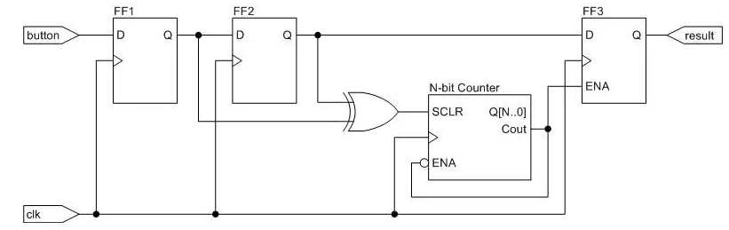
Push Buttons as Inputs
Debouncer Circuit:
Counter time ≈ 15 ms

Slide 88
?

