Slide 1
CMPE 211 PROJECT
HIRING ROBOT
KARYA TÜFEKCİ 117200082
BERKE TEVİK 117200043
BARIŞ TONBUL 117200054
IŞILSU TOPANOĞLU 117200076

Slide 2
Hırıng robot
Our project works like it takes datas from a text file these datas represent a person’s social skills ,algorithm ,gpa, age and if the person hired or not by the order.The properties that matters is social skills and knowledge the other properties doesn’t lead a person to hired.When we take the data we need to normalize the properties since we need all the value to effect equally.When a person applied for a job the program takes its social skills and algorithm calculate its Euclidian distance from the datas one by one then we sort the distances from lower to higher then takes the nearest 5 person and look for if they are hired or not if more than half of the persons are hired than the person is also hired.

Slide 3


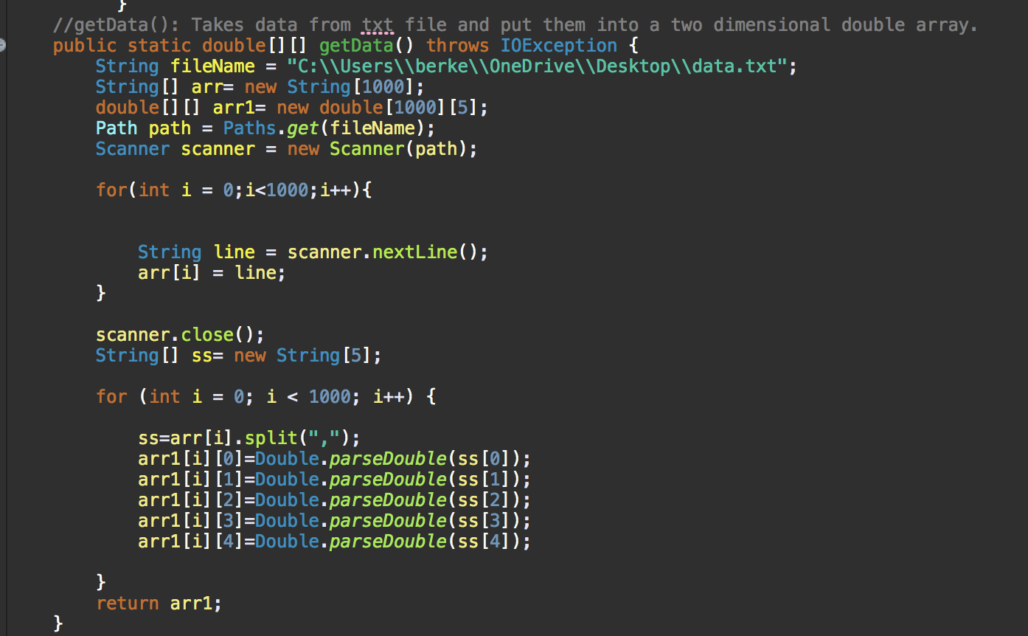
Getting data method
This is the method which provides getting the datas from the text field and returning them into 2 dimensional array

Slide 4
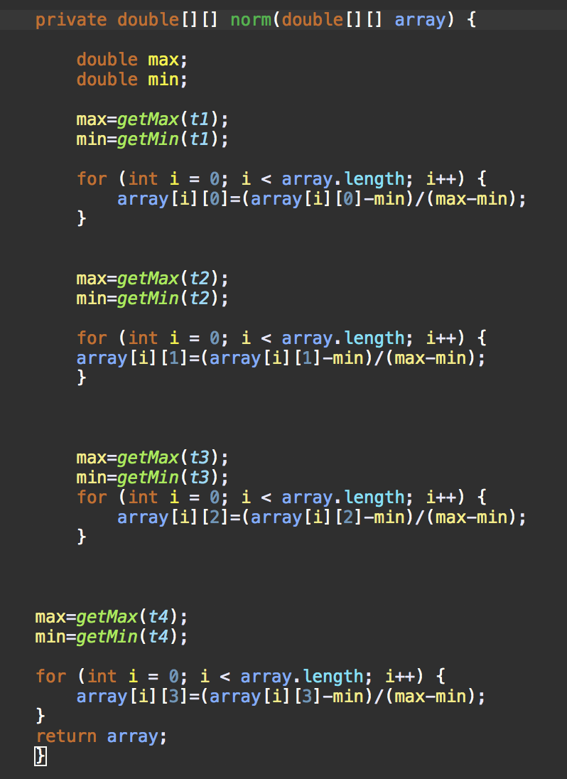
Normalizing method
This method provides us all the values in the array to effect equally.It takes 2 dimensional double array and find the first two columns’ maximum and minimum numbers with two helper method than makes the calculations.

Slide 5
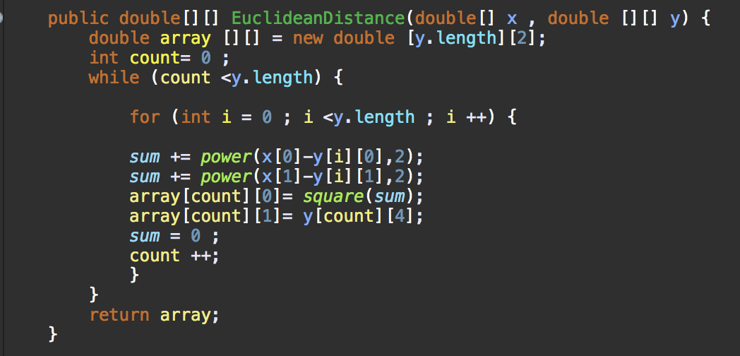
EUCLİDEAN DİSTANCE METHOD
This method calculates the euclidean distances between candidates and datas.It takes first two properties of candidates and datas then makes the calculation.

Slide 6
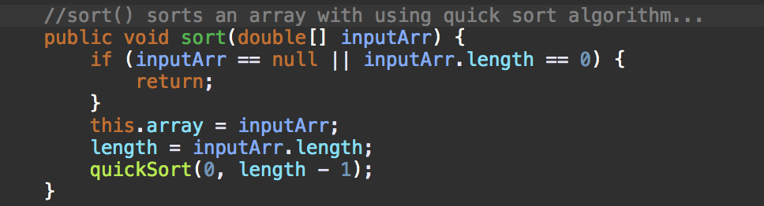
Sort method
This method sorts the algorithm to lower to higher by using helper quick sort class.

Slide 7
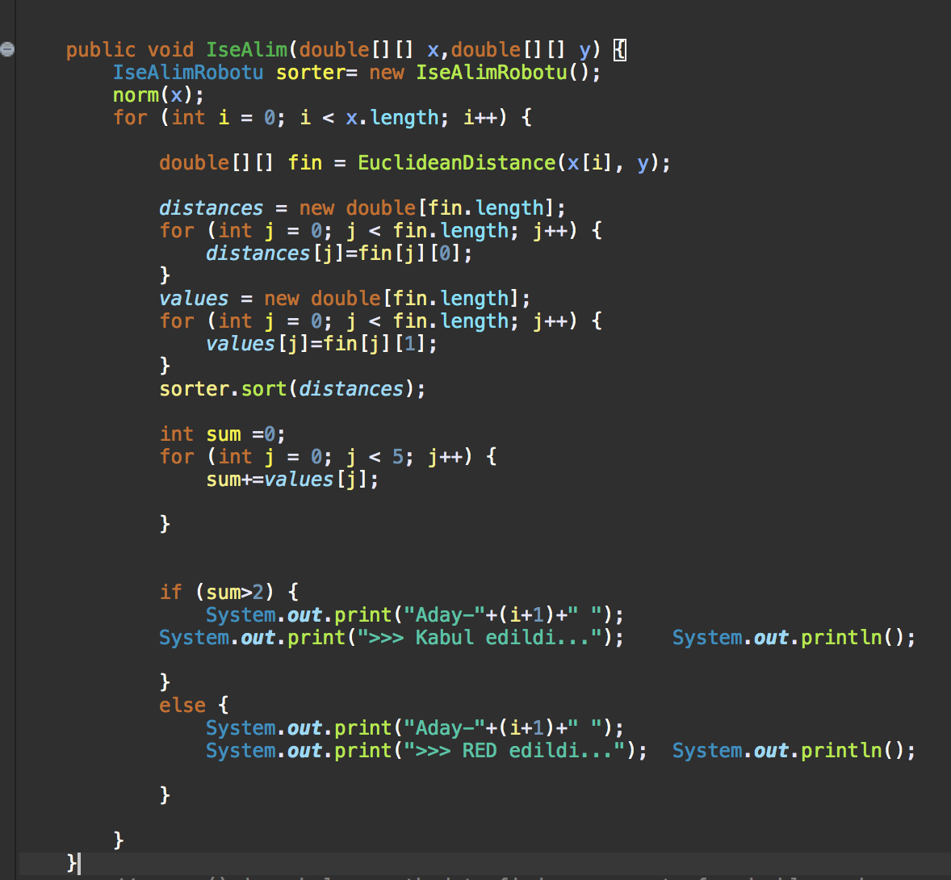
Hiring method
This method looks for when the Euclidean distance calculate the half of nearest 5 persons are hired or not if more than 2 persons are hired then new candidate get hired.

