Slide 1
Modelling of US Adult Census Data to Predict Income
BARIŞ UMUT KÜRÜN

Slide 2
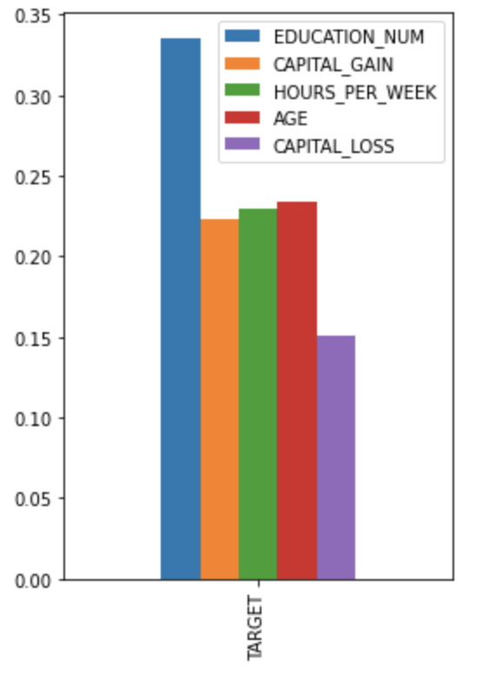
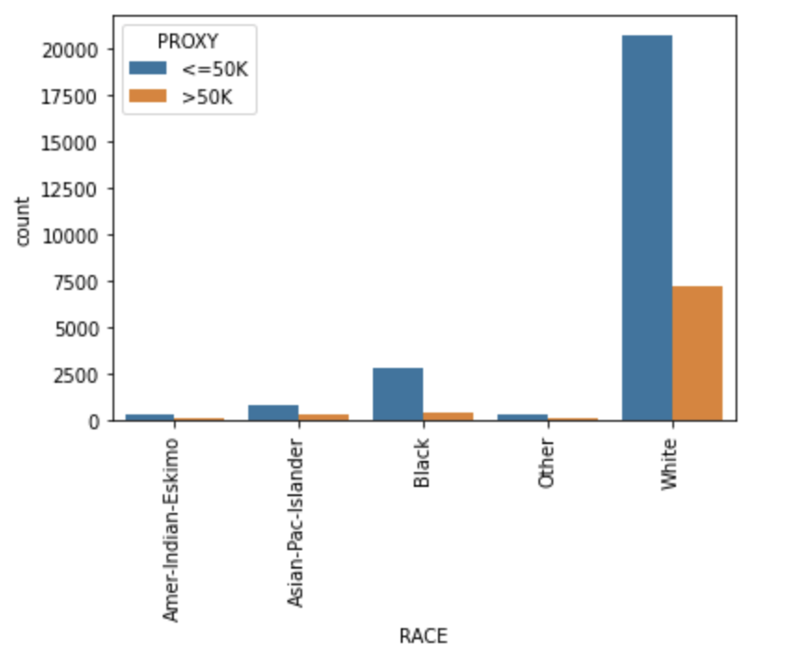
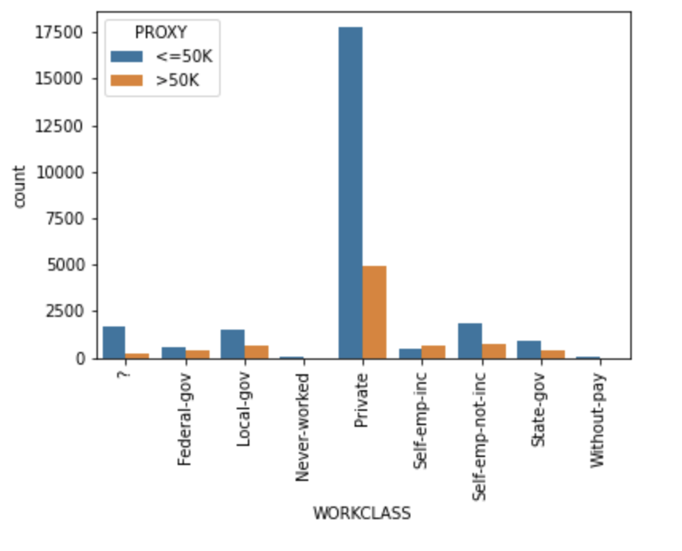
DATA PREPERATION STEPS
- Data is exported to Jupyter Lab to analyze with Python.
- Related .csv file is read with ”;” seperation
- Numerical and non-numerical columns are identified.
- Correlation of numerical columns with target are examined.
- Categorical columns are examined with data visualization.
- Null values are examined which were “?” for this dataset.

Slide 3
THE METHOD USED FOR DEVELOPING THE PREDICTIVE MODEL
- Test and train sets are builded.
- Skewness of the numerical columns are examined to transform and normalize the values accordingly.
- For categorical columns ”dummies” are created.
- Different supervised machine learning algorithms are performed namely;
Linear Regression
Random Forest
XGBoost

Slide 4
INTERPRETATION OF THE MODEL OUTPUTS: SELECTED FEATURES AND MODEL PERFORMANCE
- Accurancy scores for all three models are found to be:
Linear Regression: 81.62 %
Random Forest: 80.64 %
XGBoost: 81.35 %

Slide 5
MODEL VALIDATION METHOD
Dimensionalty reduction can perfected with different reductions.
Iterating modelling parameters can be done to fine-tune models
Model Validation methods can be done as such with:
Cross-validation-score.
Kfold.

