Slide 1


MIMO Techniques in 5/6G
F-js851-3*
Kaiyuan Bao (kb784)
Supervisor: Prof. Albert Guillen i Fabregas, Alexander Hamilton (Nokia)

Slide 2
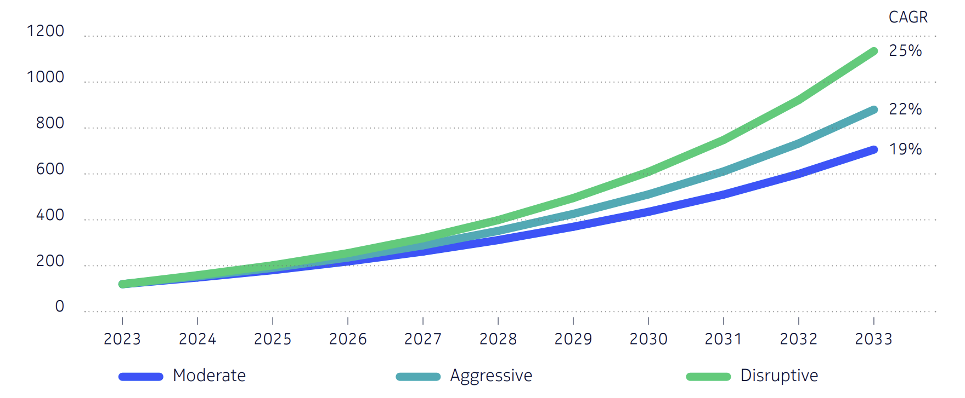
Background & Motivation
Rapid growth in mobile traffic
Emerging applications demand higher capacity, reliability and lower latency
5G New Radio (5G NR) defines three major service categories (eMBB, mMTC, URLLC)
MIMO is a key enabler to meet these performance requirements
Enhanced Mobile Broadband
eMBB
5G
mMTC
Massive Machine-Type Communications
URLLC
Ultra-Reliable and Low Latency Communications
Consumer Mobile Traffic Forecast (EB/month)
5G NR Service Categories

Slide 3

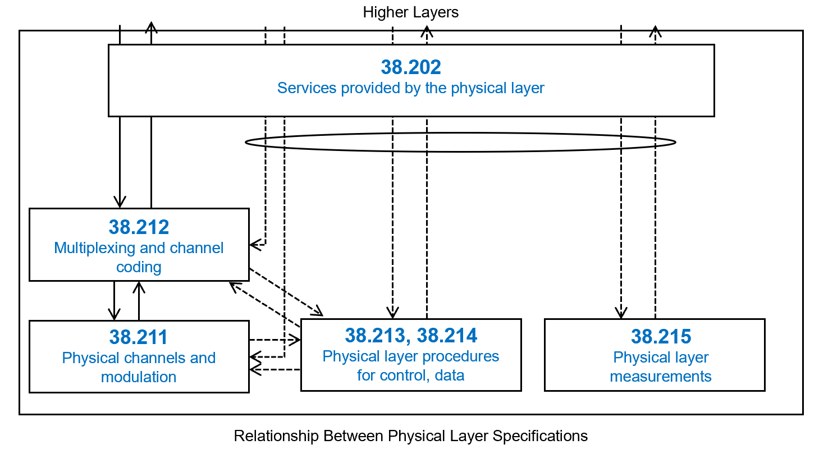
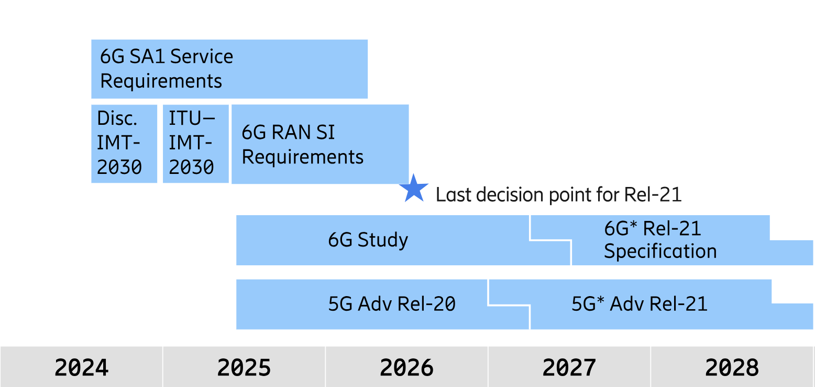
3GPP
3GPP (3rd Generation Parnership Project) develops mobile telecommunication standards
5G NR specifications belong to the 38-series TS
This project follows a 3GPP-aligned framework, enabling insights relevant to standardization
3GPP Roadmap
Relationship Between Physical Layer Specifications
Source: Ericsson 6G standardization – an overview of timeline and high-level technology principles, ETSI TS 138 201

Slide 4
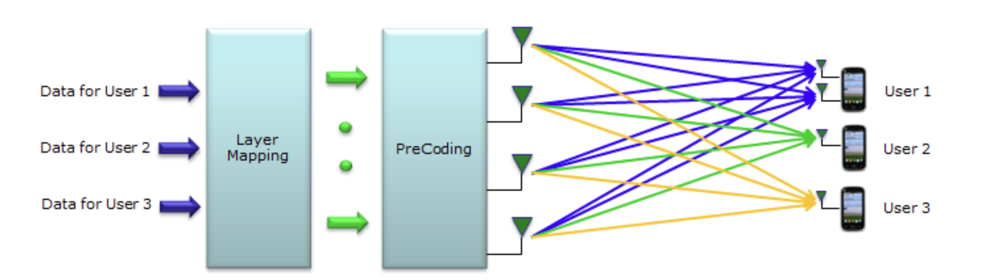
Multiple-Input and Multiple-Output (MIMO)
Multiple antennas at transmitter/receiver
Multi-antenna technologies:
Beamforming – increases signal quality by spatially focusing power
Spatial multiplexing – transmits multiple streams to increase throughput
Null forming – reduces interference by suppressing gain in undesired directions
5G NR strengthens MIMO by scaling antenna arrays (Massive MIMO), supporting both single-user MIMO and multi-user MIMO
High Level View of Multi-User MIMO (MU-MIMO)

Slide 5
Key MIMO Factors
Antenna configuration (Tx × Rx): 4×4 / 8×8
Rank / Layers: 1 / 2 / 4 / 8
Channel State Information (CSI): PMI / CQI / RI
Retransmission (HARQ): on / off
Codewords: single / dual
Channel models: TDL / CDL

Slide 6
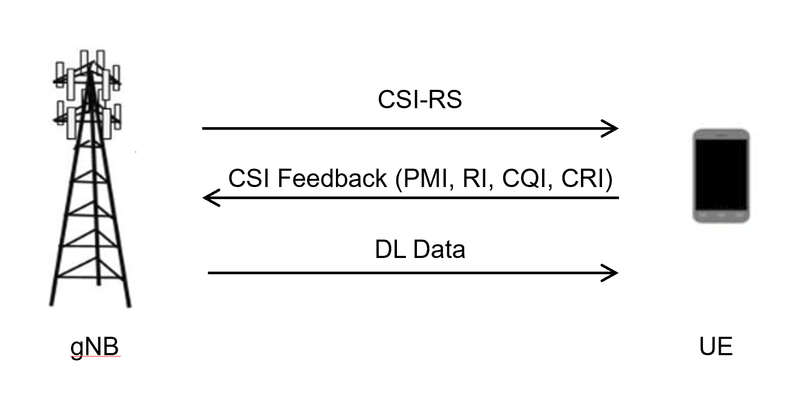
Channel State Information (CSI)
The UE estimates the downlink channel and reports CSI to the gNB
CSI consists of:
Precoder Matrix Indicator (PMI): preferred precoding matrix
Rank Indicator (RI): recommended number of layers (rank)
Channel Quality Indicator (CQI): recommended modulation and coding
Strongly impacts throughput, BLER, and inter-layer interference
CSI Between gNB (Base Station) and UE (User Equipment)

Slide 7
Goal
Objectives
Conduct performance analysis within a 3GPP-aligned framework
Investigate the impact of antenna configuration, rank/layers, CSI feedback, HARQ and channel models
Provide insights to support future 3GPP standardization discussions
Methodology
Utilize MATLAB 5G Toolbox to implement simulation
Produce systematic Throughput (%) vs SNR and BLER vs. SNR curves
Scope
Focus on downlink MIMO transmission
Rank 1-8, antenna configurations 4x4 and 8x8
TDL and CDL channel models

Slide 8
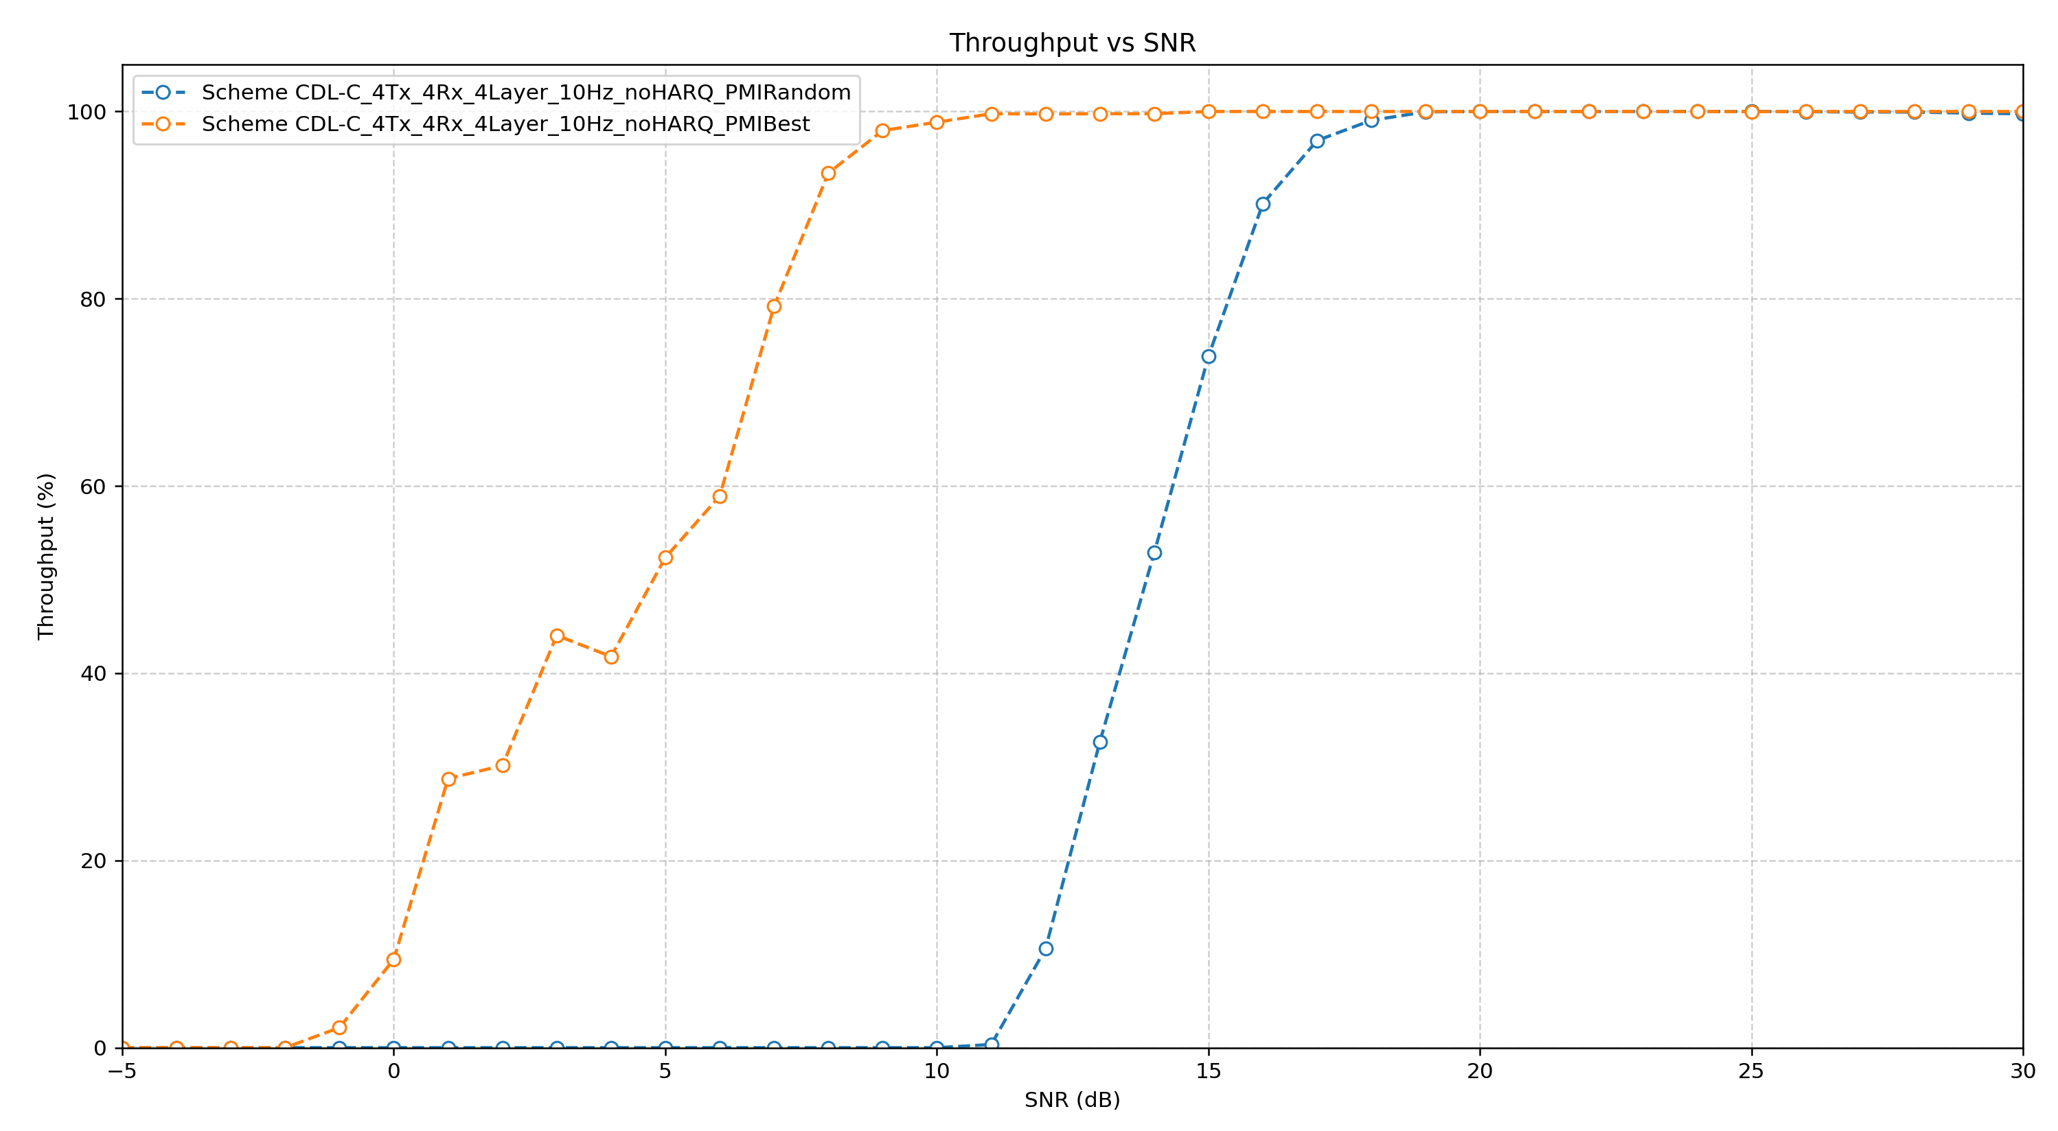
Initial Result
Impact of PMI Selection on Throughput in a 4×4 CDL-C Scenario
Notes:
Clustered Delay Line, Tapped Delay Line Physical Downlink Shared Channel pdsch pdcch pusch pucch. Monotonic function. Es/N0

Slide 9
Higher Layers
38.202 Services provided by the physical layer
38.212
Multiplexing and channel coding
38.211
Physical channels and modulation
38.213, 38.214 Physical layer procedures for control, data
38.215
Physical layer measurements
Relationship Between Physical Layer Specifications
Notes:
38.211, 38.212 the key 211 mimo codework/modulation 212: channel coding and codeword mapping。
38.101 – 4： ref demodulation performance requirement (baseband)

Slide 10
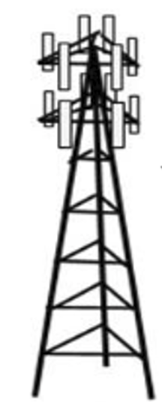

CSI-RS
CSI Feedback (PMI, RI, CQI, CRI)
DL Data
gNB (Base Station)
UE (User Equipment)

