Slide 1


CSI-Feedback-Driven Link Adaptation in 5G NR Downlink MIMO: A Link Level Simulation Study
MIMO Techniques in 5/6G (F-js851-3*)
Kaiyuan Bao (kb784)
Supervisor: Prof. Albert Guillen i Fabregas, Alexander Hamilton (Nokia)

Slide 2
Project Objectives
Construct a 3GPP-aligned MATLAB 5G NR downlink MIMO link-level simulation model
Study how CSI feedback affects rank, precoding, and MCS selection
Evaluate throughput under different MIMO configurations, mobility levels, and CSI reporting periods
Identify the trade-off between CSI freshness, throughput gain, and feedback overhead
Provide insight for future 5/6G adaptive CSI reporting design

Slide 3
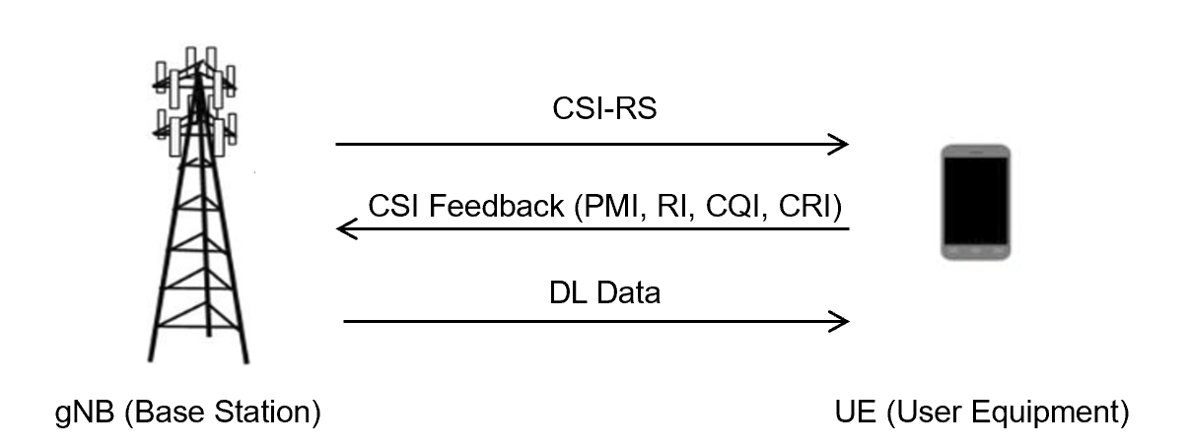
Channel State Information (CSI)
UE estimates the downlink channel using CSI-RS and reports CSI to the gNB
CSI feedback supports link adaptation:
Precoding Matrix Indicator (PMI): preferred precoding matrix
Rank Indicator (RI): recommended number of layers (rank)
Channel Quality Indicator (CQI): recommended modulation and coding
CSI reporting must be fast enough to track channel variation
Figure 1: CSI reporting and downlink transmission

Slide 4
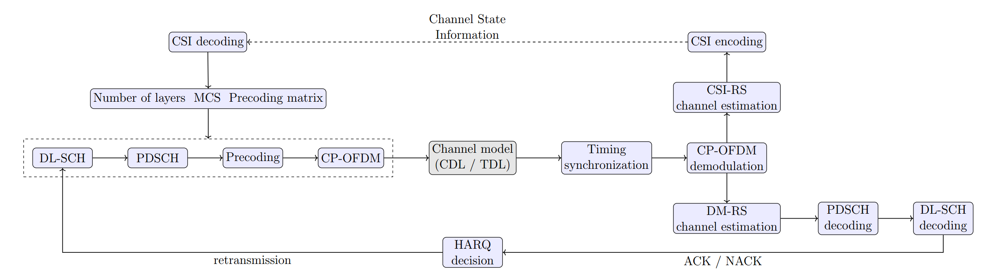
Simulation Framework
Figure 2: Overview of the CSI-based downlink transmission and feedback framework
CSI based feedback with adaptive RI / PMI / CQI
Baseline: 3.5 GHz, 40 MHz BW, 30 kHz SCS, 4Tx 4Rx, CDL-C channel
Performance metric: delivered PDSCH throughput in Mbps
SNR range: -5 to 25 dB, with 1500 10-ms frames per SNR point

Slide 5
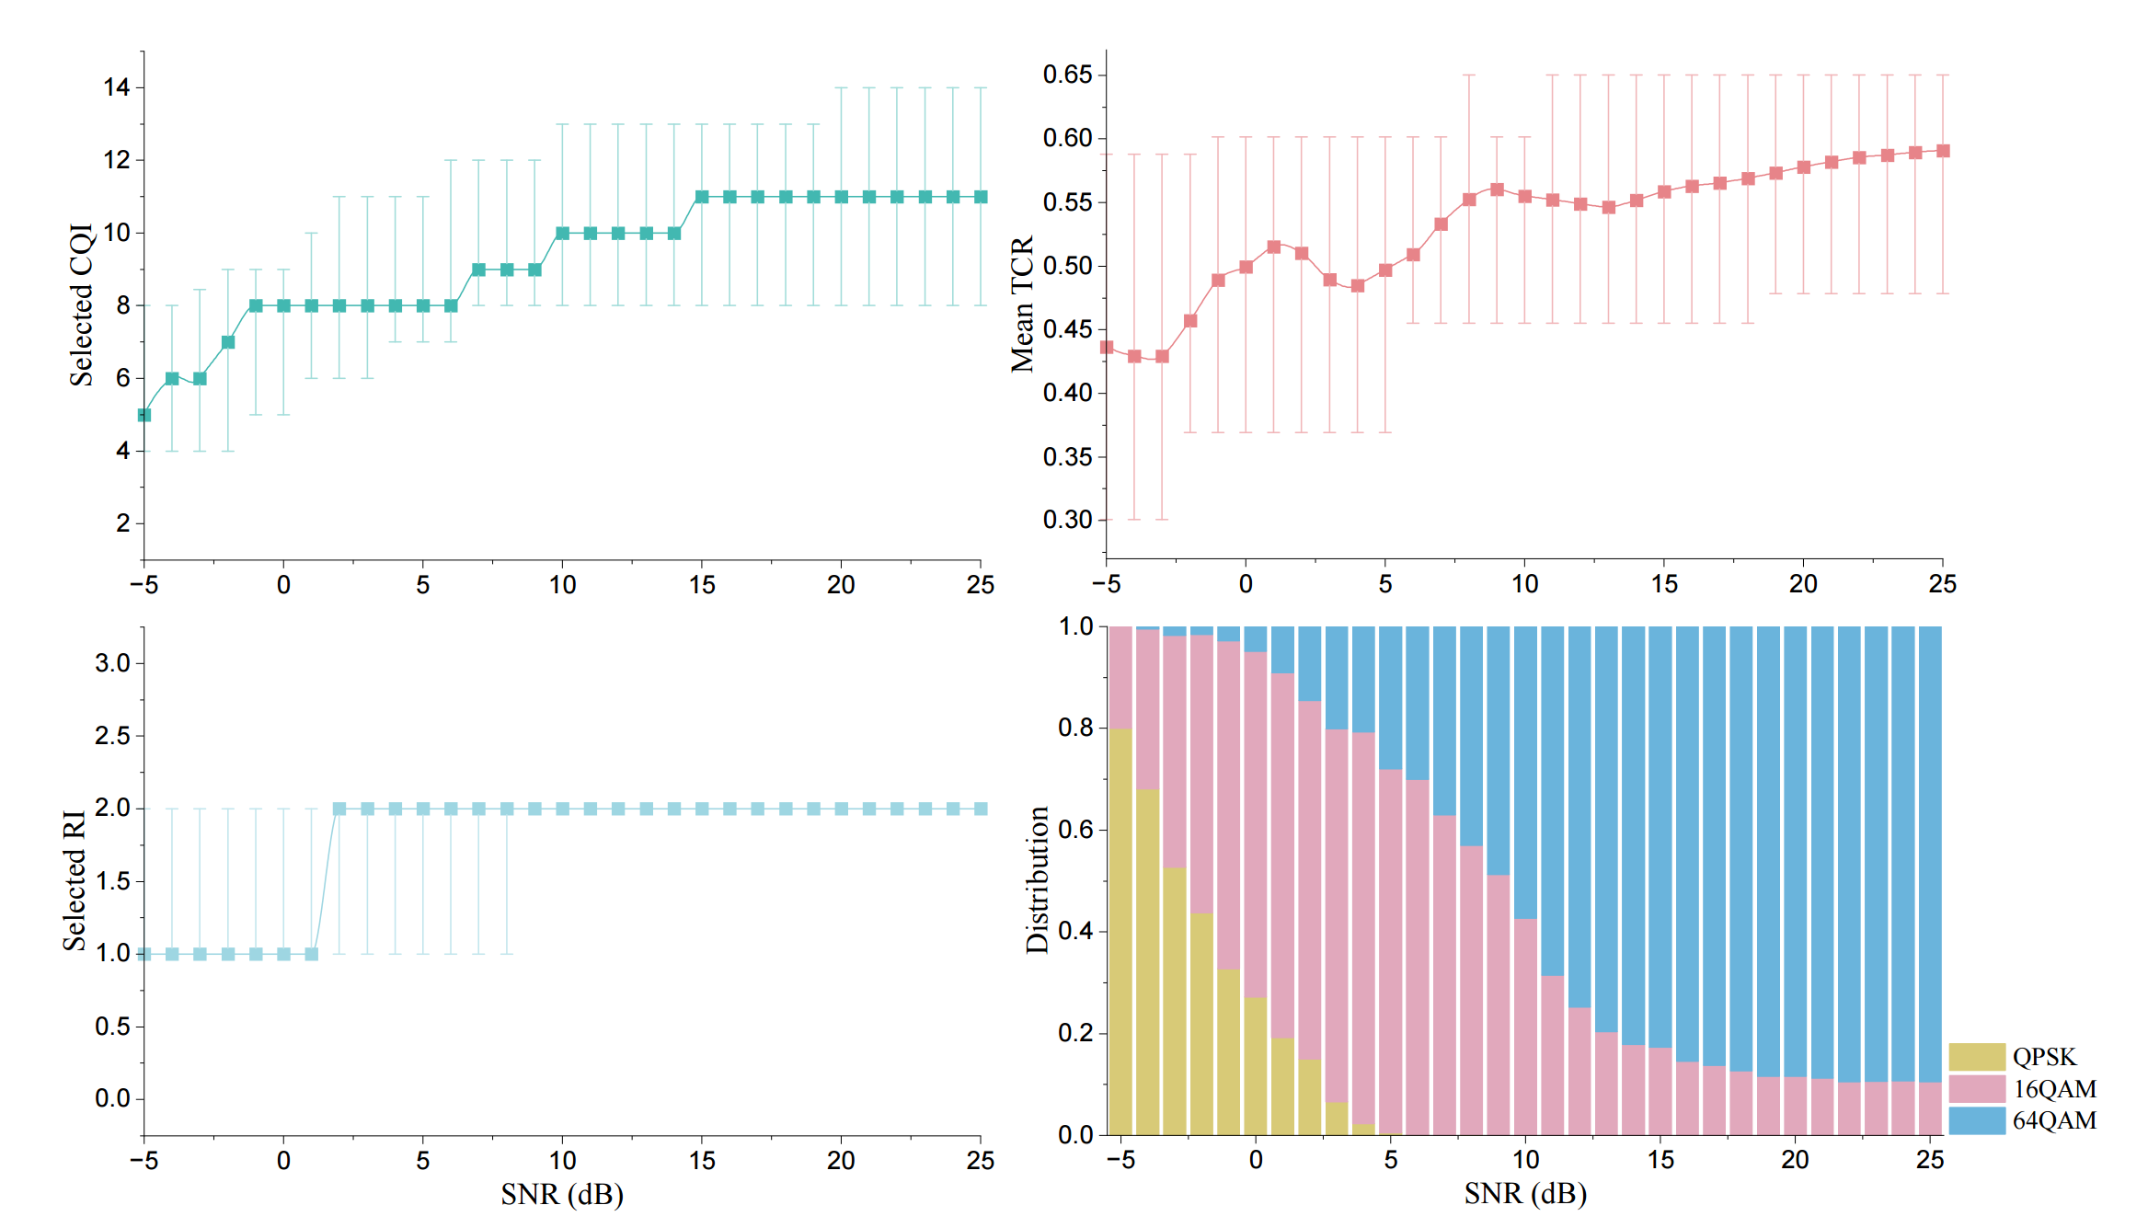
Baseline Link Adaptation
Figure 3: CSI-driven link adaptation behaviour across SNR

Slide 6
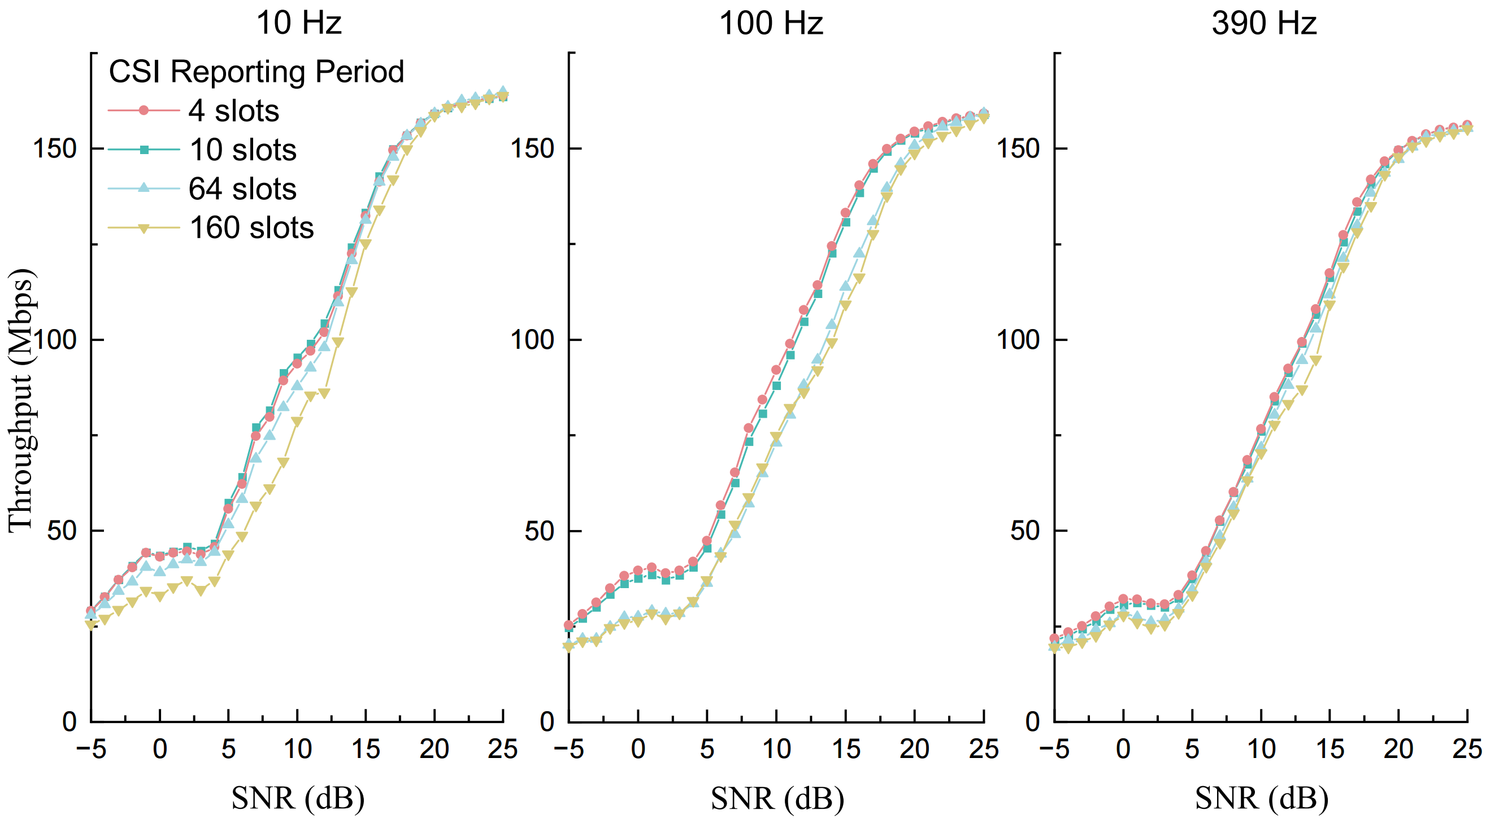
CSI Reporting Periodicity
Figure 4: Downlink throughput performance under different CSI reporting periods

Slide 7
Contributions and Future Work
Contribution:
Built a 3GPP-aligned simulation framework for CSI-driven downlink MIMO
Quantified throughput trends under MIMO configuration, mobility, and CSI reporting-period changes
Identified the scenario-dependent benefits of CSI reporting and discussed the trade-off
Future work:
Develop adaptive CSI reporting-period selection algorithms
Explore AI-native CSI management for future 6G systems
Extend the simulation with HARQ and more realistic system assumptions

Slide 8
Thank You!

Slide 9
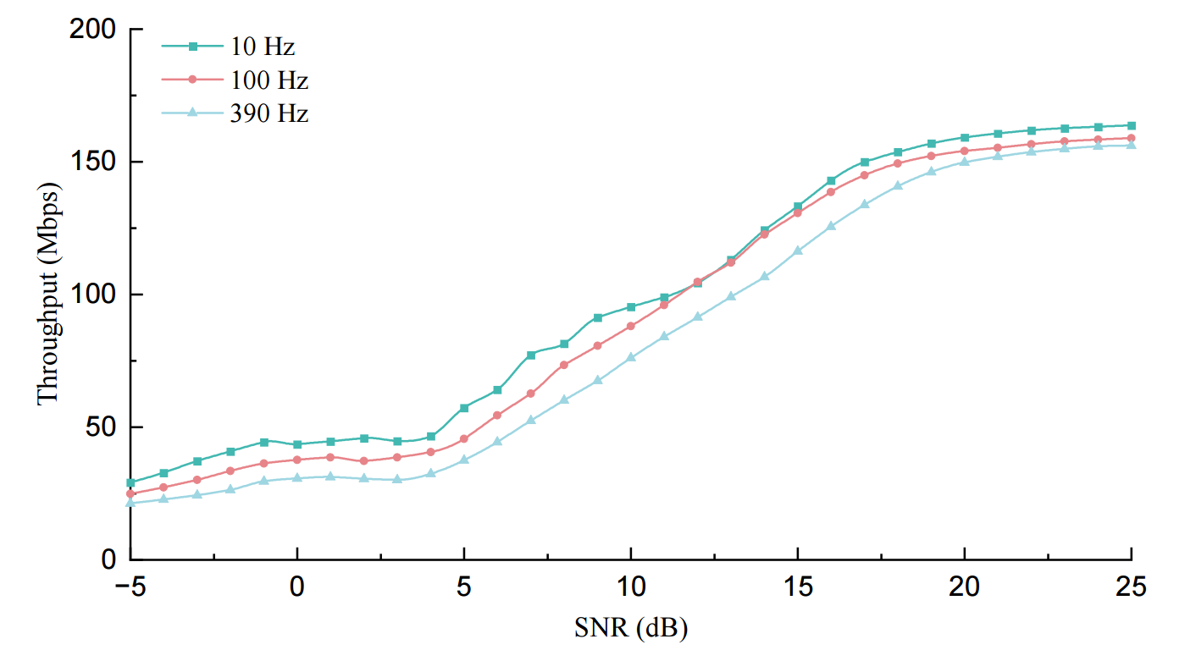
Appendix

Slide 10
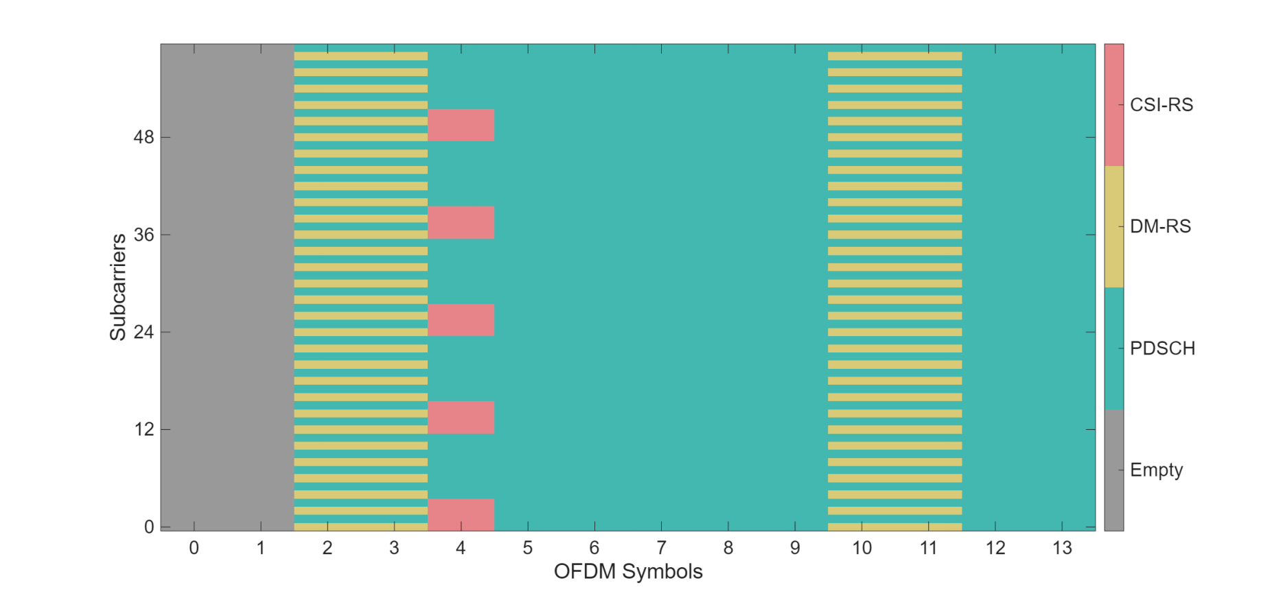
Appendix

Slide 11
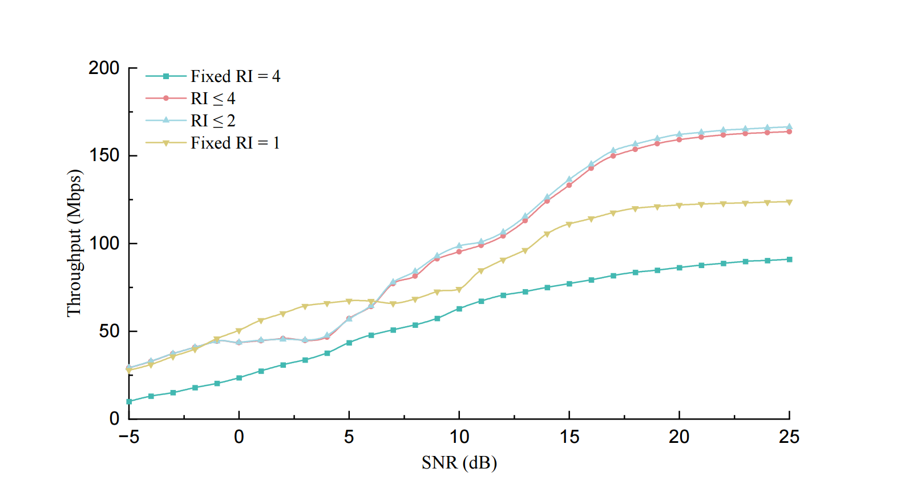
Appendix

Slide 12
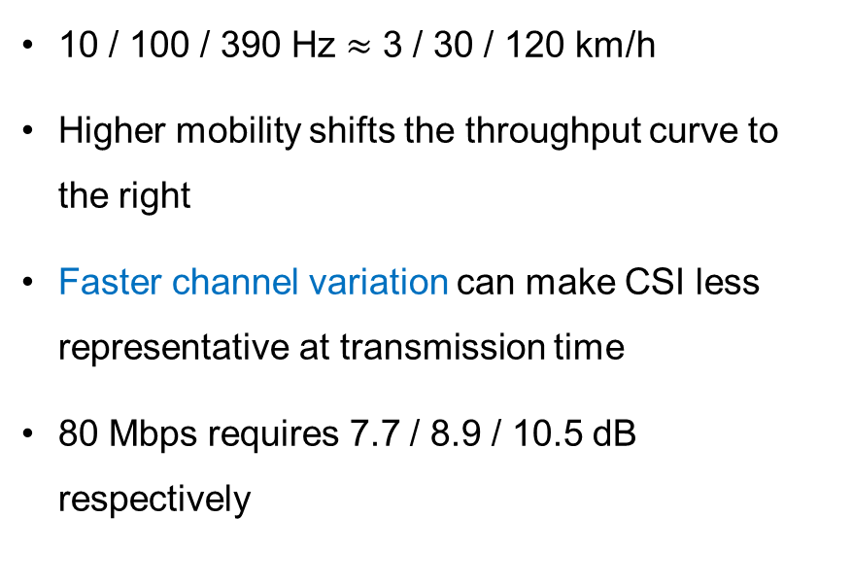
Impact of Mobility on Throughput
10 / 100 / 390 Hz $≈$ 3 / 30 / 120 km/h
Higher mobility shifts the throughput curve to the right
Faster channel variation can make CSI less representative at transmission time
80 Mbps requires 7.7 / 8.9 / 10.5 dB respectively
Figure 3: Throughput vs SNR under different Doppler shifts

Slide 13
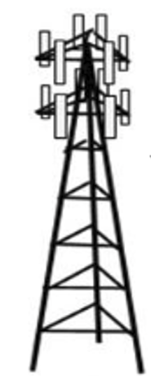

CSI-RS
CSI Feedback (PMI, RI, CQI, CRI)
DL Data
gNB (Base Station)
UE (User Equipment)

