Slide 1
TRAVEL PLANNER AGENT
IBM PROJECT
Presented By:
BARIYA SHAIKH
GENBA SOPANRAO MOZE COLLEGE OF ENGINEERING
BACHELOR OF ENGINEERING -IT

Slide 2
OUTLINE
Problem Statement
Proposed System/Solution
System Development Approach
Algorithm & Deployment
Result (Output Image)
Conclusion
Future Scope
References

Slide 3
Problem Statement
Planning a trip involves several challenges, such as searching for destinations, transportation, accommodations, and activities. This process is time-consuming and often overwhelming due to the vast amount of information available. A Travel Planner Agent is needed to simplify this process by using AI to generate personalized itineraries, provide real-time recommendations, and ensure a smooth travel experience while considering user preferences, budget, and constraints.

Slide 4
Proposed Solution
Data Collection
Gather historical and real-time data on destinations, accommodations, and transport options.
Integrate IBM Weather Company APIs for weather updates.
Use Google Maps API for location, routes, and travel time.
Collect user preferences like budget, duration, travel style, and activities.
Preprocessing
Clean and organize travel-related data for easy access.
Extract key features such as cost, location ratings, weather conditions, and transport availability.
Categorize activities and destinations based on user preferences.
AI Model
Using IBM Granite Foundation Models and Watson Assistant, the system:
Interprets natural language queries from users.
Generates personalized itineraries including travel, stay, and activities.
Optimizes plans using weather, time, and cost constraints.
Provides real-time suggestions for modifications.

Slide 5
Proposed Solution
Deployment
Hosted on IBM Cloud Lite for easy scalability.
Integrated chatbot interface with IBM Watson Assistant for smooth user interaction.
Accessible across devices with fast and reliable responses.
Evaluation
Continuous feedback collection from users.
Metrics: travel plan accuracy, personalization level, and user satisfaction.
Real-world testing with different user groups (individual travelers, agencies, corporates).
Result
Efficient and Optimized Travel Plans generated in minutes.
Reduced planning time from hours to minutes.
Enhanced satisfaction with tailored itineraries.
Dynamic adaptability for real-time changes during trips.

Slide 6
System Approach
System Requirements
Frontend: React.js for building an interactive user interface
Backend: Node.js with Express.js for handling requests
Database: MongoDB / IBM Cloud DB for storing user input and generated itineraries
Cloud Platform: IBM Cloud Lite for hosting and scalability
AI Services: IBM Granite AI models with RAG for data retrieval and itinerary generation
Libraries Required
Frontend: Tailwind CSS (for styling), Axios (for API calls)
Backend: Express.js, Mongoose (for database integration)
AI/NLP: IBM Watson SDK, LangChain (for RAG orchestration)
Utility: JSON handling libraries, dotenv for environment management

Slide 7
Algorithm & Deployment
Selection
Uses RAG (Retrieval-Augmented Generation) with IBM Granite AI for accurate and context-aware itineraries.
Data Input
User Preferences: Budget, dates, destination type, activities.
External Sources: IBM Weather APIs (weather), Google Maps API (routes), accommodation & travel databases, review platforms.
Training Process
Fine-tuned on travel datasets.
Generation Process
Retrieves and filters data based on user input.
Generates a day-wise optimized itinerary with transport, stay, and activities.
Balances budget, comfort, and time efficiency.
Provides real-time adjustments if conditions change.

Slide 8
Algorithm & Deployment
Deployment
Frontend: React.js
Backend: Node.js with Express.js
Database: MongoDB / IBM Cloud DB
Hosting: IBM Cloud Lite

Slide 9
Result
Efficient and Optimized Travel Plans generated in minutes.
Reduced planning time from hours to minutes.
Enhanced satisfaction with tailored itineraries.
Dynamic adaptability for real-time changes during trips.

Slide 10
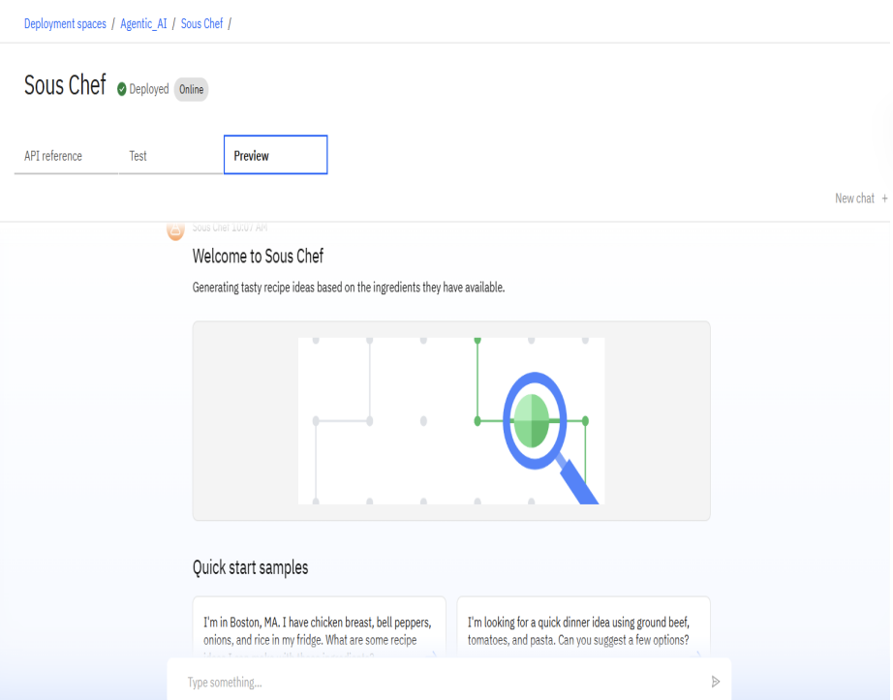
Result

Slide 11
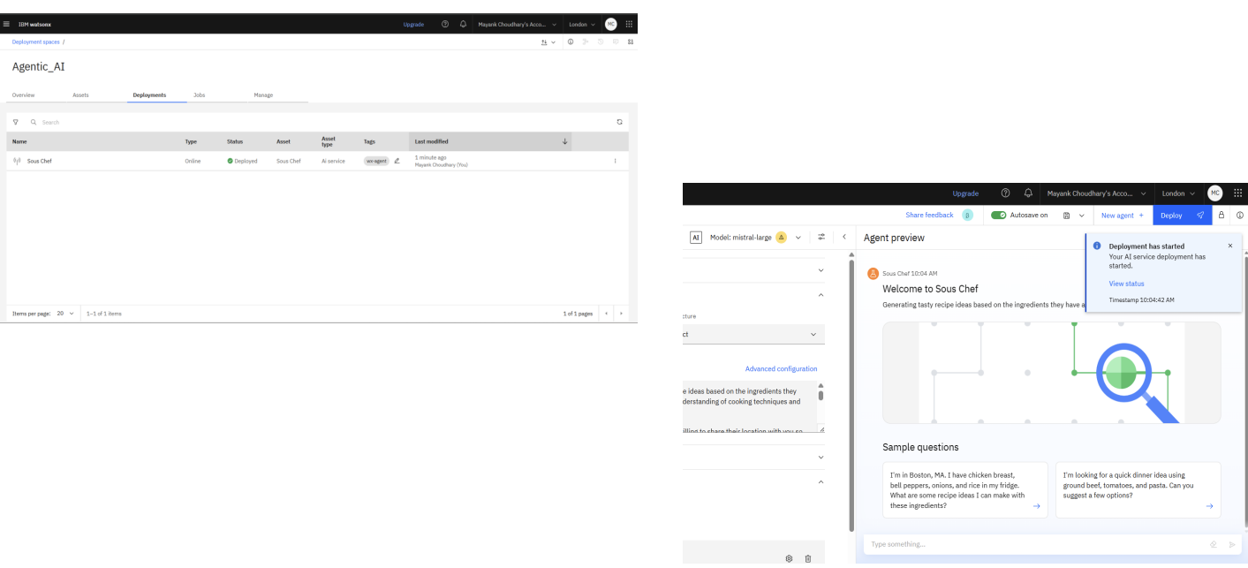
Result

Slide 12
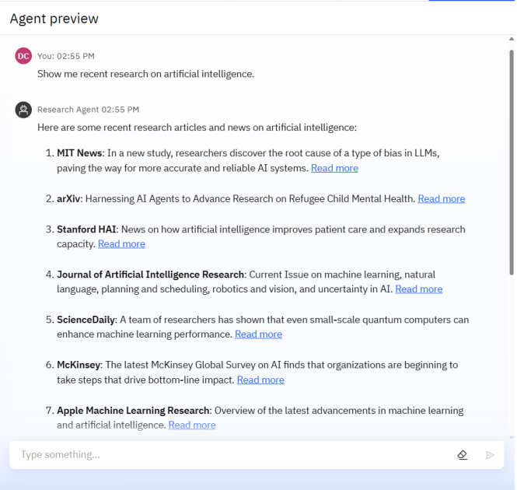
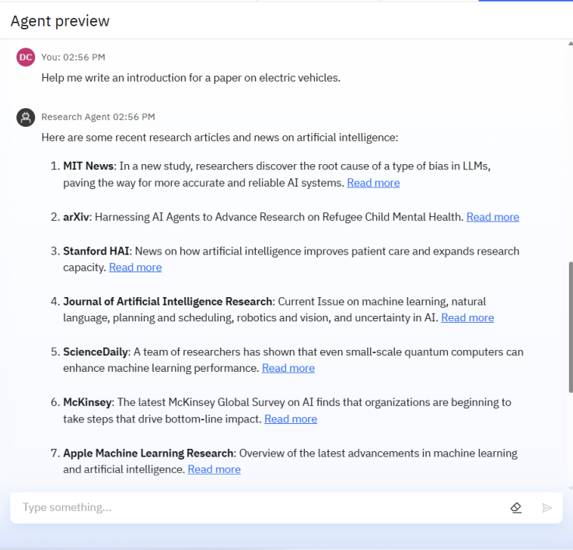
Result

Slide 13
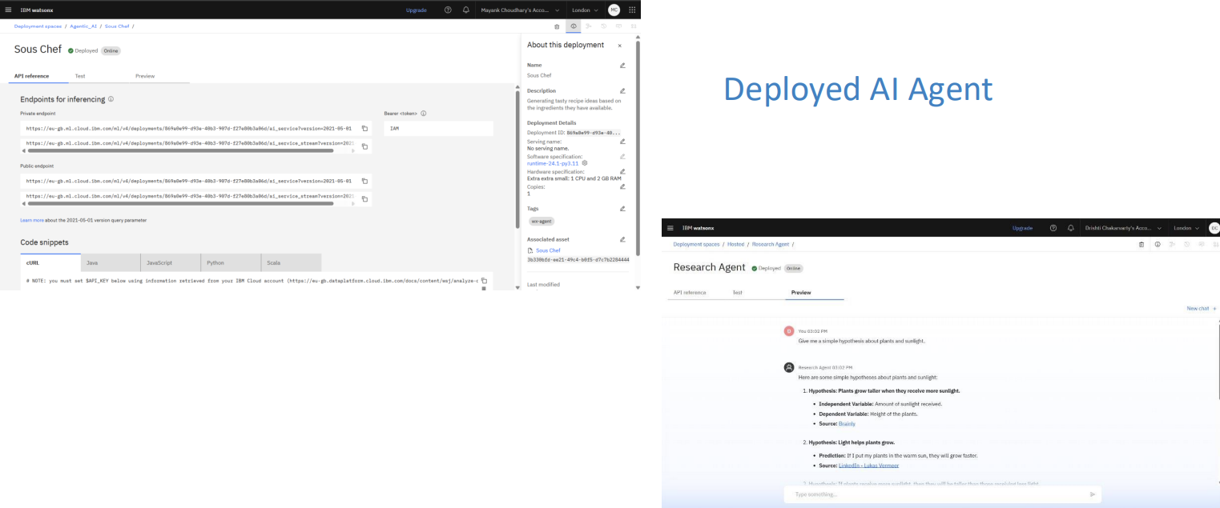
Result

Slide 14
Conclusion
The AI-powered Travel Planner Agent successfully automates the process of trip planning. It provides travelers with optimized, personalized, and adaptable itineraries, improving overall efficiency and travel satisfaction. The system not only saves time but also ensures better decision-making by considering real-time data and user preferences.

Slide 15
Future scope
Multilingual support for global travelers.
Voice-activated assistant for hands-free planning.
Integration with AR/VR for immersive previews of destinations.
Budget optimization using financial AI tools.
Expansion into business travel management and concierge services.
Collaboration features for group travel planning.

Slide 16
References
GitHub Link: https://github.com/Bariyashaikh/IBM_skillbuild_inetrnship
IBM Watson Assistant Documentation: https://cloud.ibm.com/docs/watson-assistant
IBM Cloud Object Storage Guide: https://cloud.ibm.com/docs/cloud-object-storage
IBM Watsonx.ai Studio Overview: https://cloud.ibm.com/docs/watsonx-ai

Slide 17
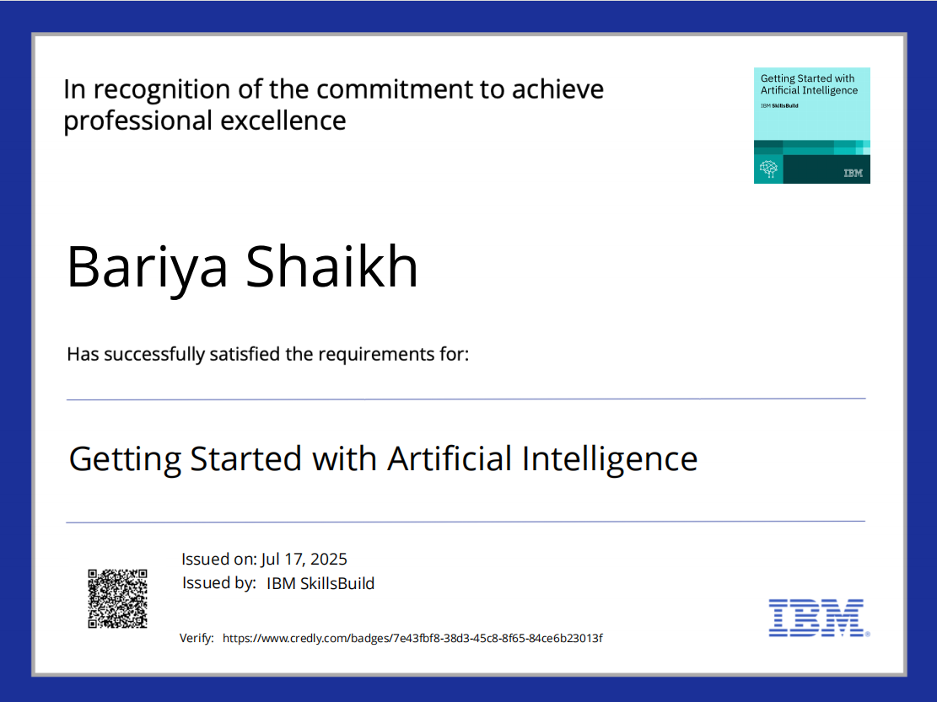
IBM Certifications

Slide 18
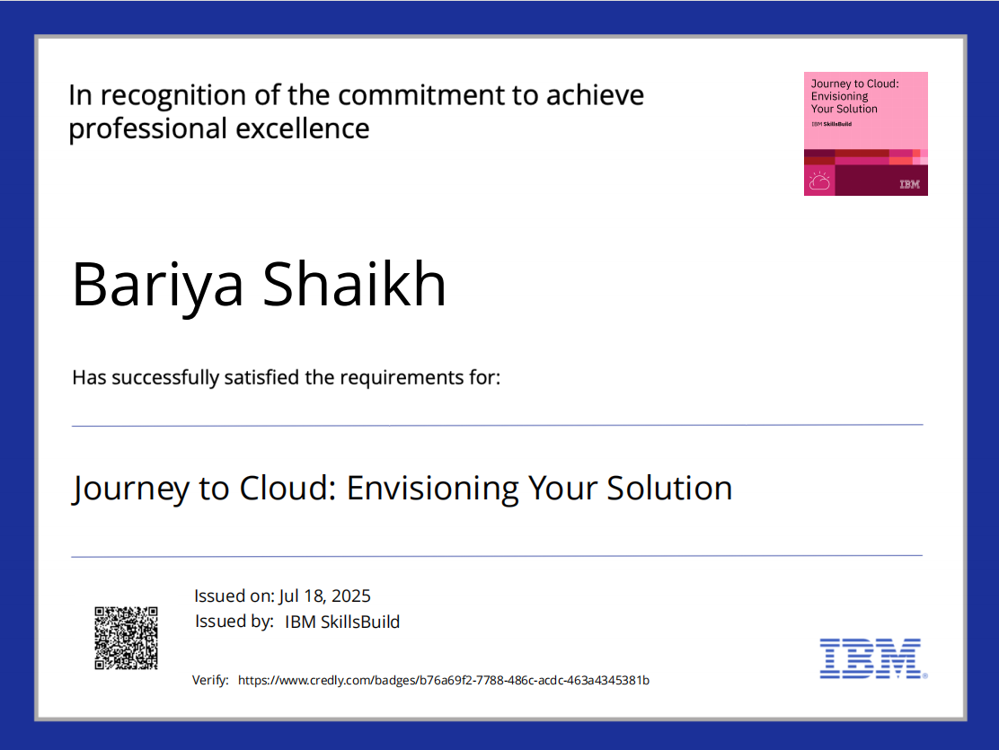
IBM Certifications

Slide 19
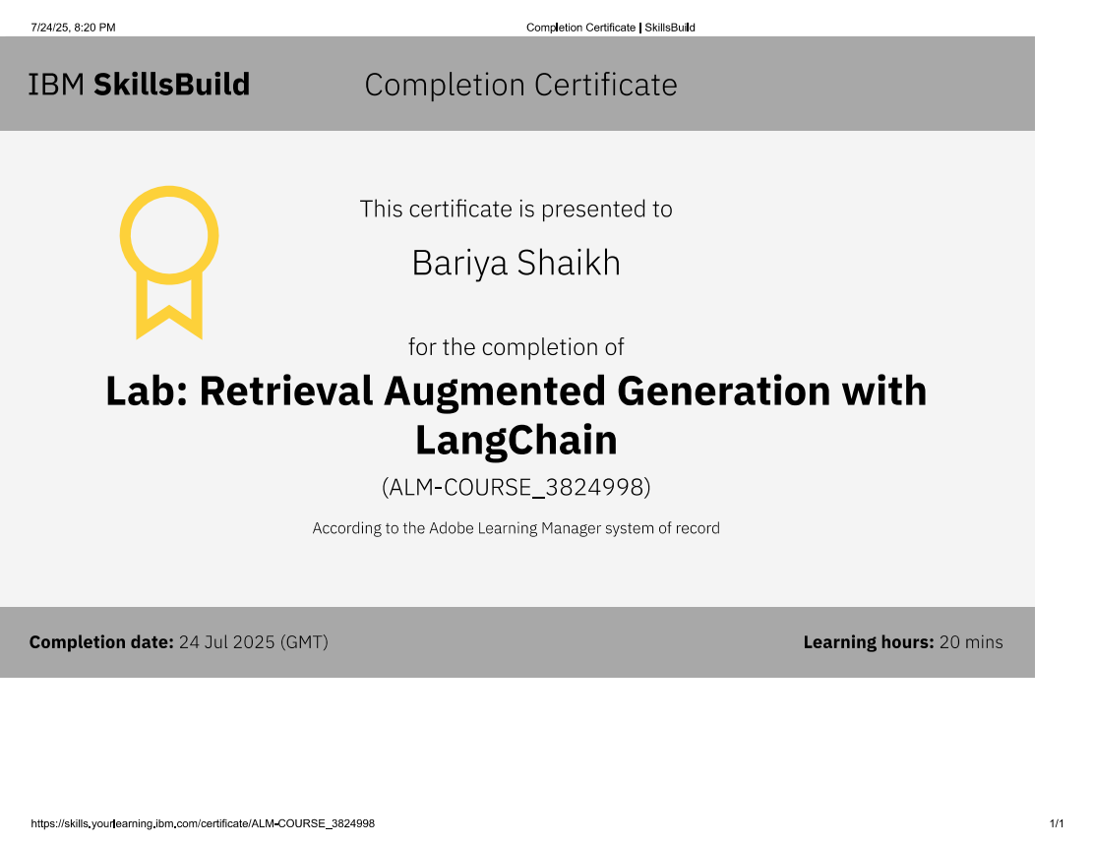
IBM Certifications

Slide 20
THANK YOU

