Slide 1
SECURE DATA HIDING IN IMAGES USING STEGNOGRAPHY
CAPSTONE PROJECT
Student Name :E BARKAVI
College Name : PRINCE DR K VASUDEVAN COLLAGE OF ENGINEERING AND TECHNOLOGY
Department : B.E.CSE

Slide 2
OUTLINE
Problem Statement
Technology used
Wow factor
End users
Result
Conclusion
Git-hub Link
Future scope

Slide 3
Problem Statement
Steganography is the practice of hiding secret messages within digital media to ensure secure communication. Unlike cryptography, which encrypts messages, steganography conceals their existence.
This project implements image-based steganography, embedding secret text within an image and retrieving it using a passcode.

Slide 4
Technology used
Programming Language: Python Libraries & Tools:
OpenCV: Image processing and manipulation
OS Library: File handling and automation
Concepts Utilized:
ASCII Encoding & Mapping for text representation
Pixel Manipulation to embed secret messages

Slide 5
Wow factors
Invisible Secret Message: The text is seamlessly hidden within image pixels without altering the image's visible appearance.
Passcode-Protected Retrieval: The message is only accessible when the correct passcode is provided.
Efficient Encoding & Decoding: Utilizes ASCII mapping and pixel manipulation to store and extract messages.
Undetectable Alterations: The changes in pixel values are minimal, making it difficult for unauthorized users to identify hidden data.

Slide 6
End users
Cybersecurity Professionals: Secure data communication
Forensic Investigators: Embedding forensic marks in digital evidence
Content Creators: Digital watermarking for copyright protection
General Users: Safe transmission of sensitive messages

Slide 7
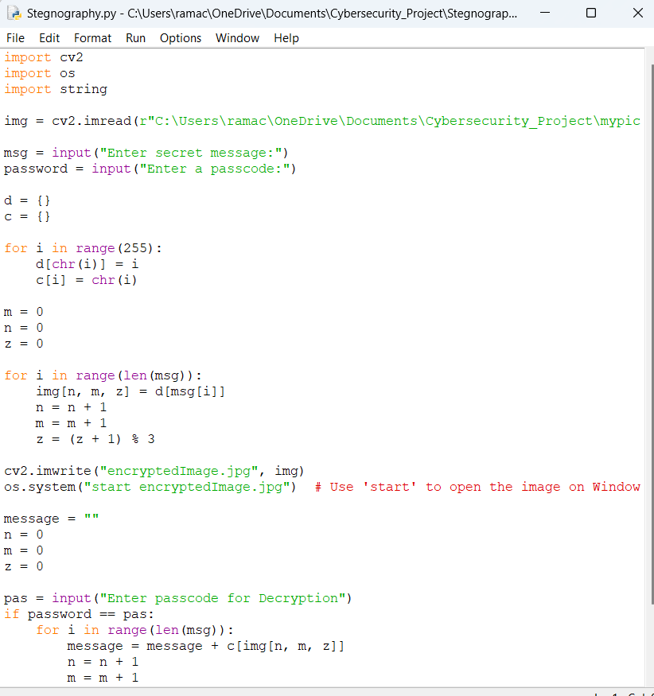
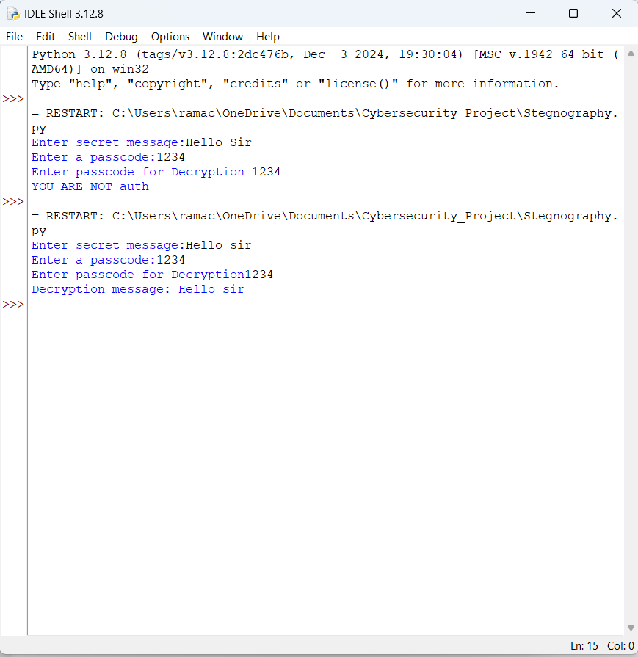
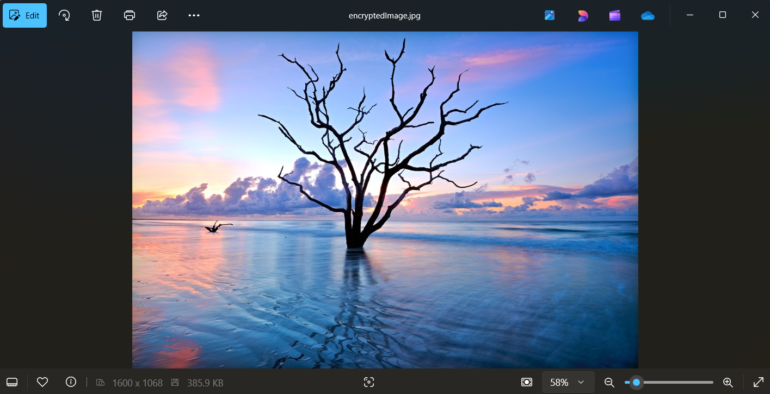
Results
Successfully implemented image steganography using Python
Text is hidden inside an image and retrieved only with a correct passcode
The hidden message remains undetectable to normal users
Code
Output
Encrypted image

Slide 8
Conclusion
Steganography is a secure method of hiding messages within digital media, ensuring confidential communication. This project successfully implements image-based steganography using Python, OpenCV, and ASCII encoding to embed and retrieve hidden messages with passcode protection. The approach enhances data security and privacy, making it useful for cybersecurity, digital watermarking, and forensic applications. The message remains undetectable, providing a discreet and efficient communication method. Future improvements can include advanced encoding techniques, encryption, and multimedia support for enhanced security.

Slide 9
GitHub Link
https://github.com/Barkavikannan/Stenography_Project.git
Steganography Project - Image-Based Message Hiding

Slide 10
Future scope(optional)
Next Steps & Possible Improvements: 🔹 Advanced Encoding Techniques – To improve security and reduce detection risk. 🔹 Pre-Encryption Mechanism – Encrypt the text before embedding it into the image. 🔹 Support for Larger Messages – Optimize storage for longer messages. 🔹 Graphical User Interface (GUI) – Build a user-friendly application for easy encryption/decryption. 🔹 Integration with Video & Audio Files – Extend functionality beyond images.

Slide 11
THANK YOU

