Slide 1
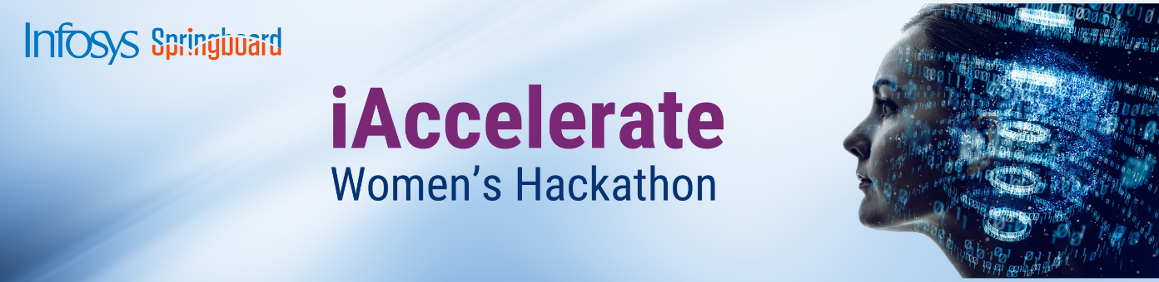
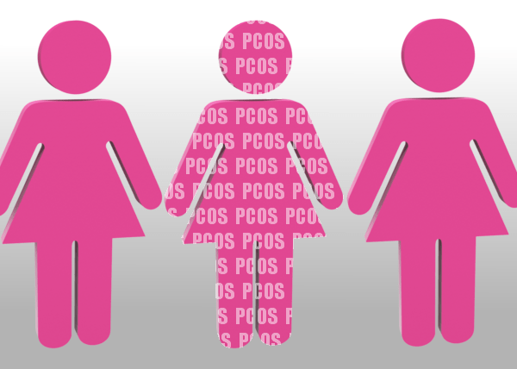

Theme 1: Health & Wellness
PCOS Clustering & Personalized Healthcare Recommendations
Submitted by : Barkha Kumari
barkhak628@gmail.com
Github.com/BarkhaKumari-1/
A Machine Learning-Based Solution

Slide 2
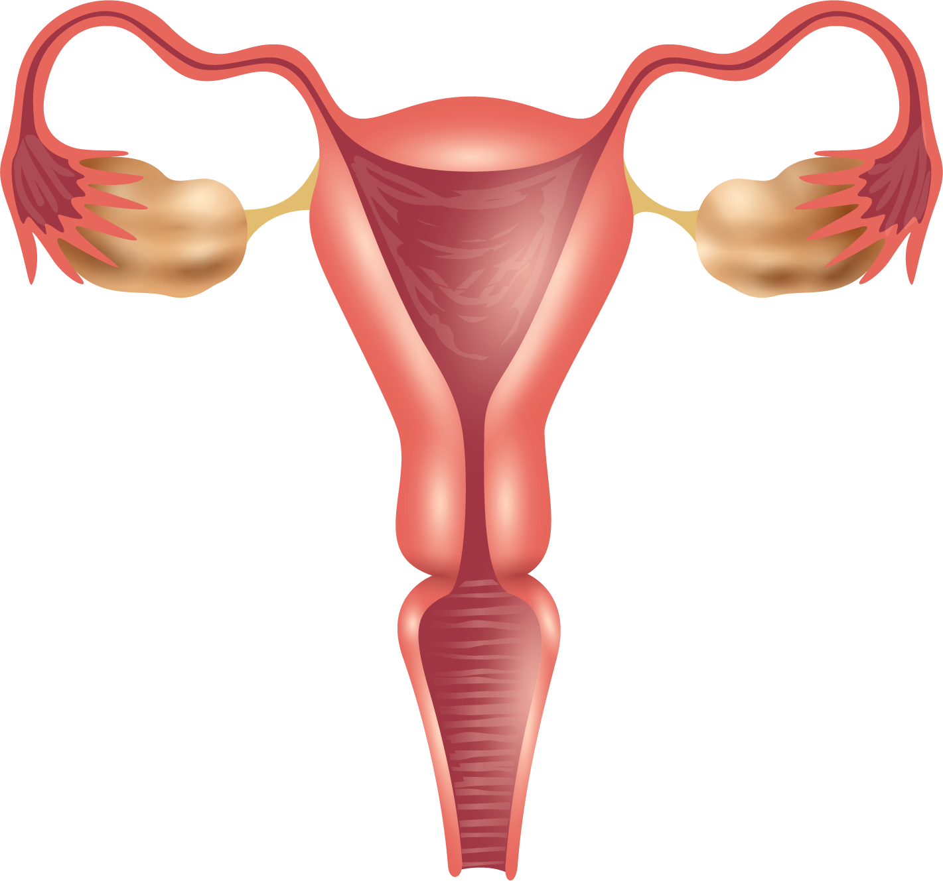

POLYCYSTIC OVARY SYNDROME (PCOS)
Women Scenario :-
According to the Rashtriya Kishor SwathyaKaryakram study, around 18 % of women in India, predominantly from the Eastern regions, experience this syndrome, with approximately 70 % of cases remaining undiagnosed and according to data from the World Health Organization (WHO), approximately 116 million women worldwide, accounting for 3.4 % of the global female population, are impacted by PCOS

Slide 3
POLYCYSTIC OVARY DIAGNOSIS
NORMAL OVARY
POLYCYSTIC OVARY
Venus has a beautiful name and very high temperatures
Mercury is the closest planet to the Sun and the smallest one

Slide 4
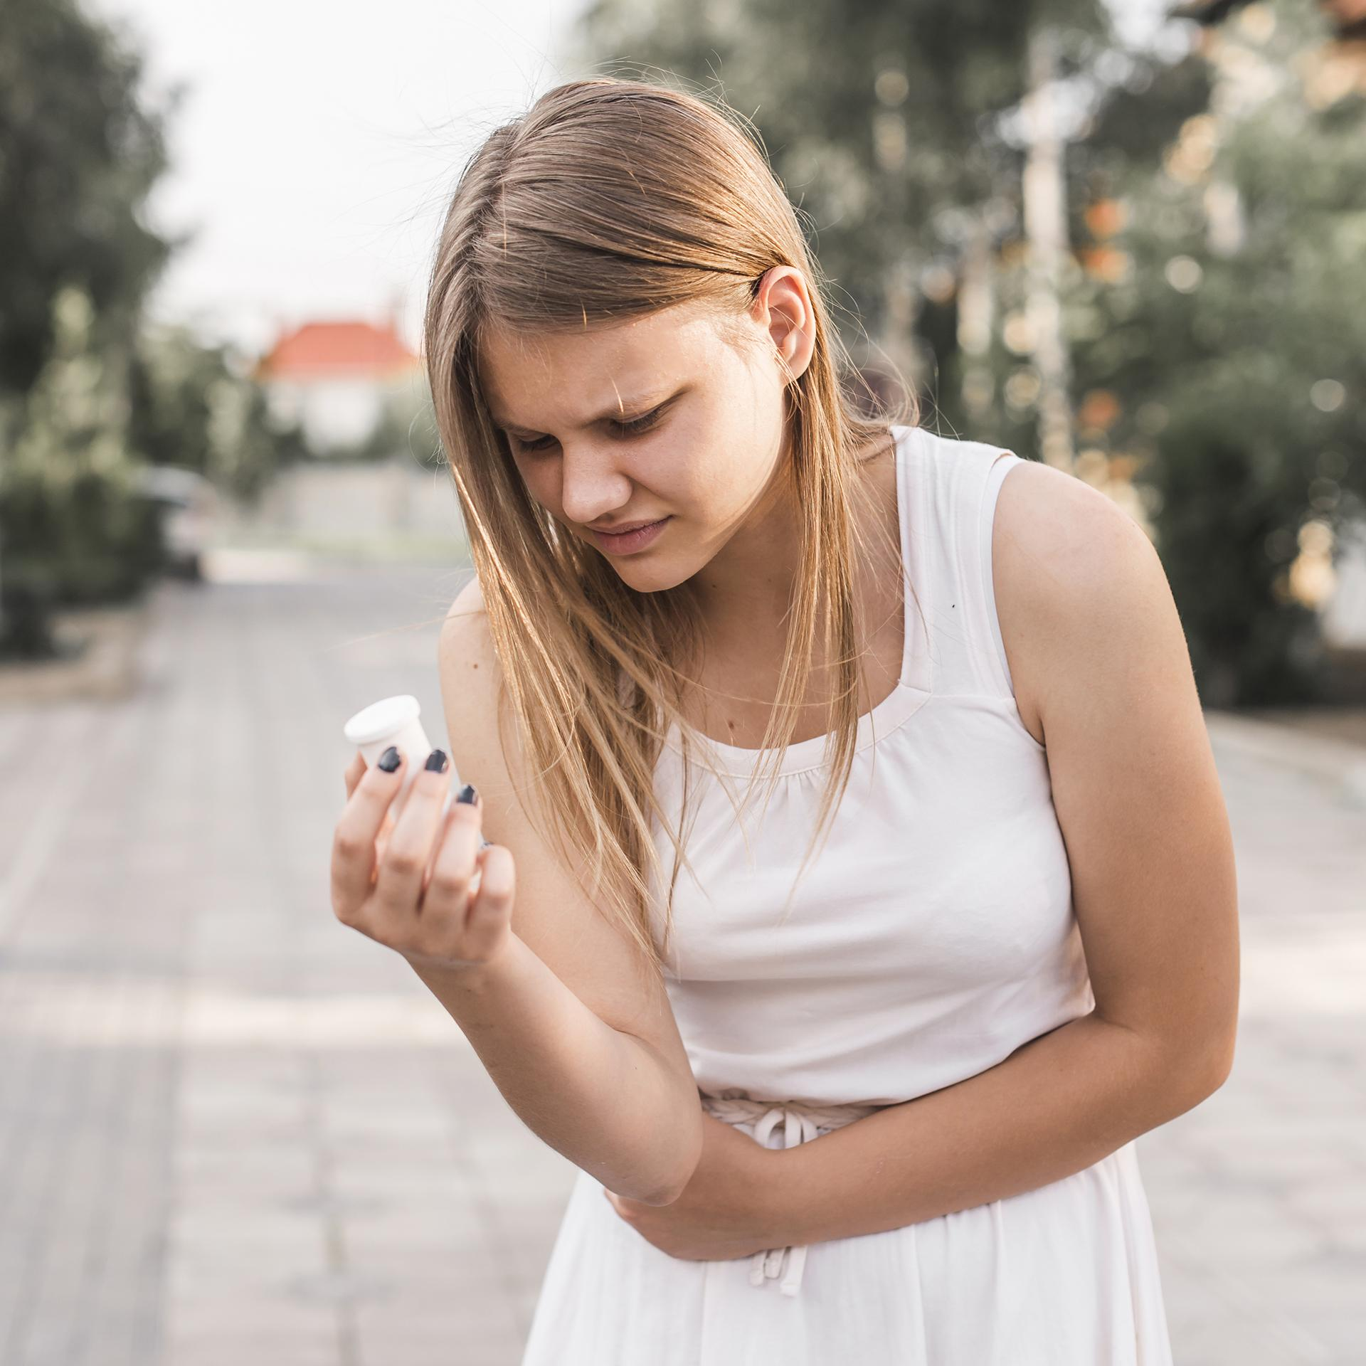
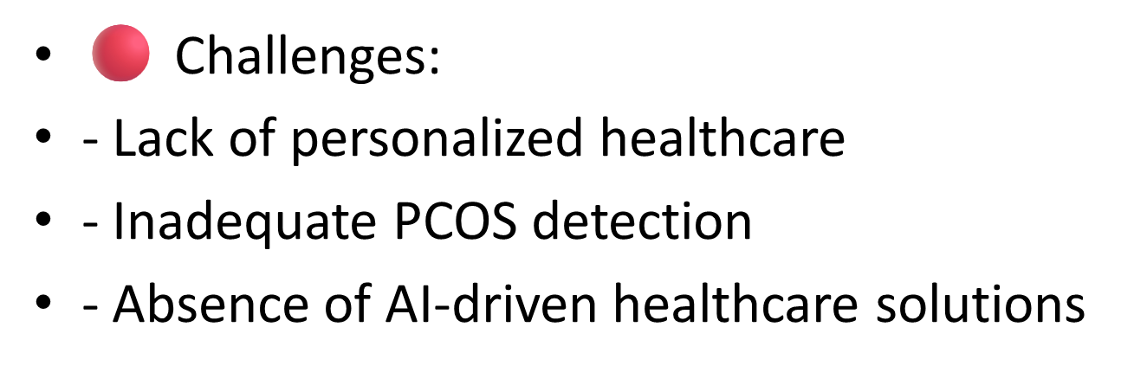
PROBLEM STATEMENT:
Women have diverse health needs, and generic healthcare approaches fail to provide personalized solutions.

Slide 5
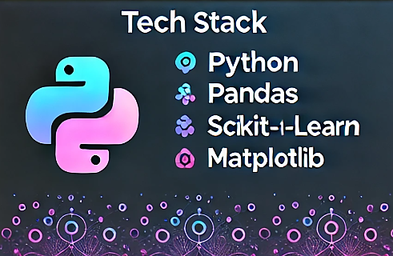
INNOVATION & UNIQUE APPROACH
✅ Our Solution:
-Data-driven segmentation using Hierarchical Clustering & GMM
- Predictive insights for personalized healthcare recommendations
- Machine Learning-powered recommendations
🔬 Tech Stack: Python, Pandas, Scikit-learn, Matplotlib

Slide 6
IMPLEMENTATION & FEASIBILITY
1️⃣ Data Collection: PCOS dataset
2️⃣ Preprocessing: Feature selection & encoding
3️⃣ Clustering: Hierarchical Clustering & GMM
4️⃣ Evaluation: Silhouette Score
5️⃣ Results: Personalized recommendations

Slide 7
THOUGHT PROCESS & LEARNINGS
01
02
🔹 What Inspired This Project?
- The need for AI-powered, personalized healthcare solutions
- The gap in PCOS diagnosis & treatment
🔹 Challenges Faced & Solutions:
✅ Data Preprocessing: Handled missing values
✅ Model Optimization: Tuned clusters using silhouette scores
✅ Interpretability: Mapped clusters to recommendations

Slide 8
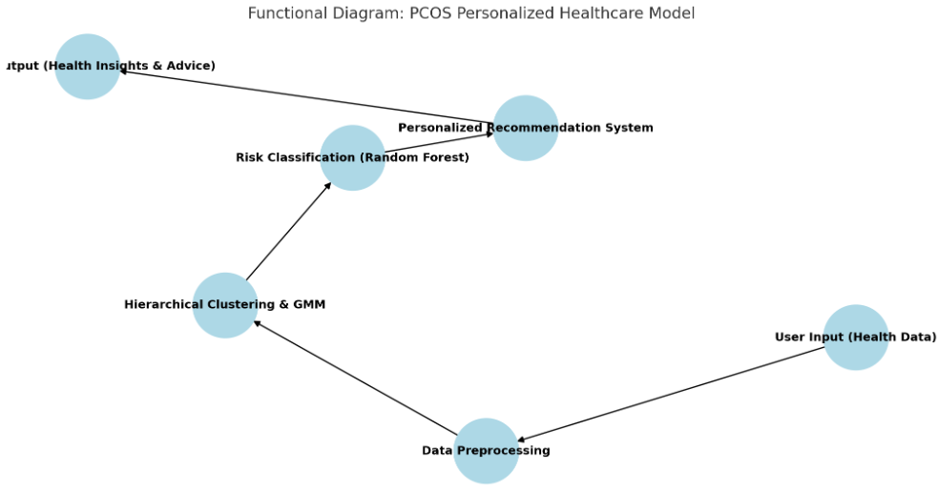
FUNCTIONAL DIAGRAM

Slide 9
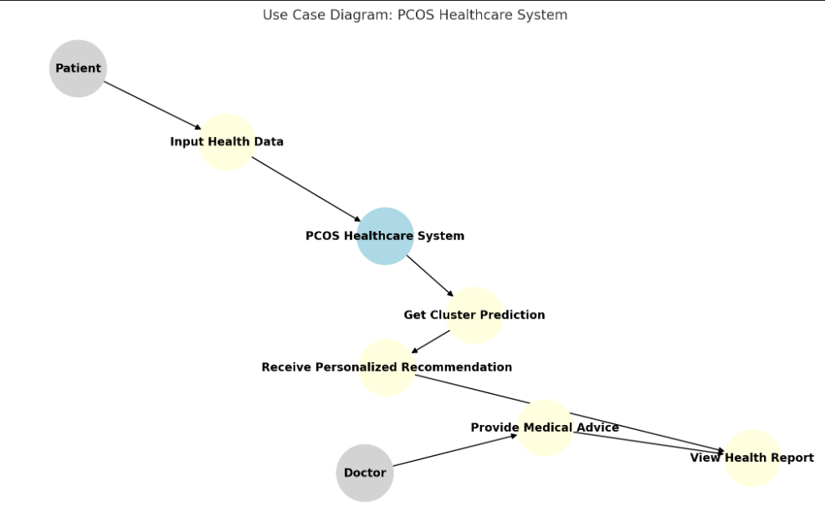
USECASE DIAGRAM

Slide 10
CODE: DISEASE
GitHub: https://github.com/BarkhaKumari-1/PCOS-Detection-ML

Slide 11
Future Enhancements
🚀 Next Steps:
- Expand dataset for broader female health conditions
- Integrate Deep Learning for better feature extraction
- Develop a Web App for user-friendly health assessment
- Collaborate with healthcare providers for real-world testing

Slide 12
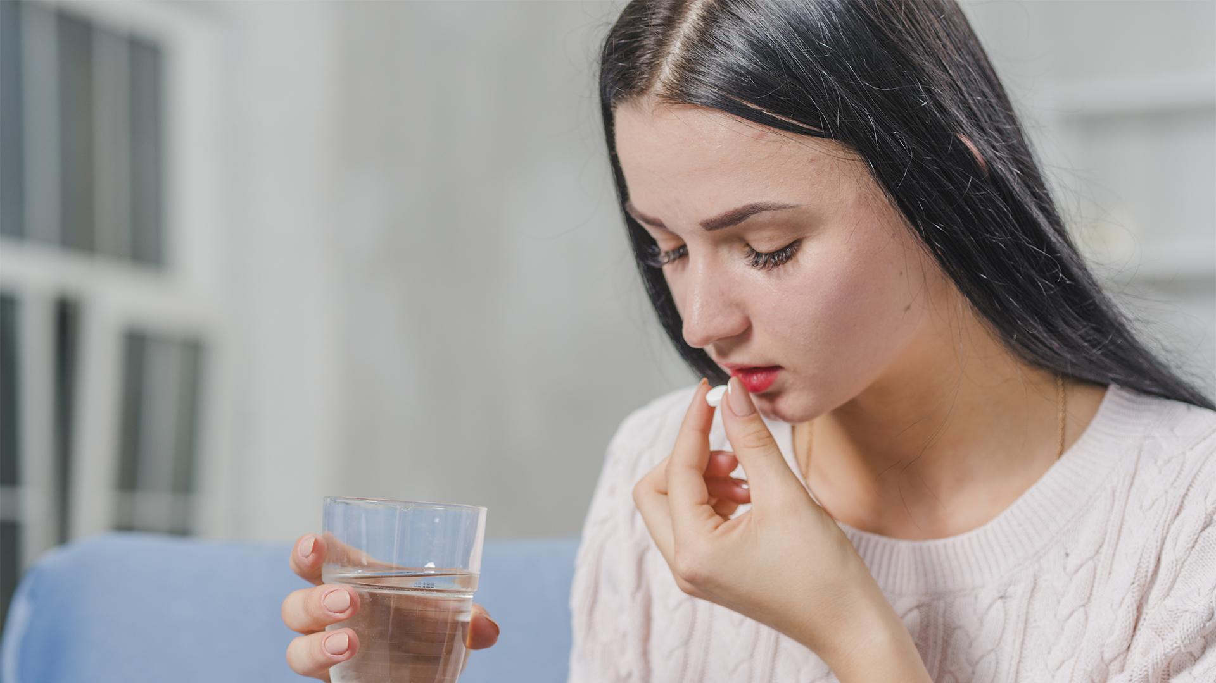
💙
Join Us in Revolutionizing Women’s Healthcare!
Thank You Infosys Springboard for incredible platform

