Slide 1
A foundational library for formally-verified Network-on-Chip generation
Garvit Chhabra
29.01.2025

Slide 2
Motivation

Slide 3
Motivation
Incident | Year | Monetary Loss | Cause
Crowdstrike outage¹ | 2024 | $10 billion | Read-out-of-bounds memory error in driver
https://www.crowdstrike.com/wp-content/uploads/2024/08/Channel-File-291-Incident-Root-Cause-Analysis-08.06.2024.pdf
Notes:
Verification is also necessary for hardware; Intel Pentinum floating point fiasco costed them 475mil$ in 1994. Even though companies like Intel and Airbus invest in verification these incidents still happen. Recently a microcode error in Intels 12th and 13th generation CPUs led to instability and performance degradation.

Slide 4
Motivation
Incident | Year | Monetary Loss | Cause
Crowdstrike outage¹ | 2024 | $10 billion | Read-out-of-bounds memory error in driver
Intel Pentinum Floating Point Division Bug² | 1994 | $475 million≈ $868 million (2023) | Missing values in a lookup table used for floating-point division
https://www.crowdstrike.com/wp-content/uploads/2024/08/Channel-File-291-Incident-Root-Cause-Analysis-08.06.2024.pdf
2. https://en.wikipedia.org/wiki/Pentium_FDIV_bug
Notes:
Verification is also necessary for hardware; Intel Pentinum floating point fiasco costed them 475mil$ in 1994. Even though companies like Intel and Airbus invest in verification these incidents still happen. Recently a microcode error in Intels 12th and 13th generation CPUs led to instability and performance degradation.

Slide 5
Verification Gap
Productivity
Difficult to obtain complete coverage
Can’t verify complex properties
Can verify only static implementations
Available Silicon Gates
Simulation and Assertion-based Verification
Gates Designed / min
Verification Gap
Gates Verified / min
1980
1990
2000
2010
Time
L. Rizzatti. High-Level Synthesis to Design in the New Millennium. IEEE Tech Forum.
Notes:
Even though verification is being done are we doing enough
Lets visualize it this way.
The number of gates were increasing at a good pace because of moores law
Although the no. of gates designed/min didn’t keep the same pace but it was quite close
But when you compare it with the number of gates verified we see this enormous verification gap.
This is due to

Slide 6
Verification Gap
Productivity
Provides exhaustive coverage
Can verify complex properties
Verify parametric implementations
Available Silicon Gates
Theorem Prover-based Verification using Kôika¹
Gates Designed / min
Gates Verified / min
1980
1990
2000
2010
Time
¹Thomas Bourgeat,et al. The essence of Bluespec: a core language for rule-based hardware design. In Proceedings of the 41st ACM SIGPLAN Conference on Programming Language Design and Implementation (PLDI 2020). Association for Computing Machinery, New York, NY, USA.
Notes:
In this thesis we utilise a novel approach using Koika a language embedded in Coq theorem prover.
Lets get to the second part of our thesis which is a network on chip

Slide 7
System-on-Chips (SoCs)
CPU
CPU
DRAM Ctrl
DRAM Ctrl
GPU
GPU
IP
Intellectual Property
Notes:
A soc integrates different cores specialized in different

Slide 8
Network-on-Chip (NoC)
CPU
CPU
DRAM Ctrl
TCU
TCU
TCU
R
R
DRAM Ctrl
GPU
GPU
IP
Intellectual Property
TCU
TCU
TCU
R
Router
R
R
Channel
TCU
Trusted Communication Unit
Notes:
These cores are connected to each other via a network on chip which is a bunch of routers and wires connected together.
The cores communicate with the NoC via a network interface like the TCU, which was developed at BI.

Slide 9
Goal of the thesis
R
R
R
IP
IP
R
R
R
R
R
R
R
IP
2 × 2
IP
IP
IP
IP
R
R
R
R
R
R
M × N
1 × 3
Notes:
As we said in the title we want as a goal of this thesis we want to develop a library capable of generating formally verified nocs of any given size.
As mentioned before the benefit of using a theorem prover is that properties can be proven for a parametric system, so whatever properties we prove over

Slide 10
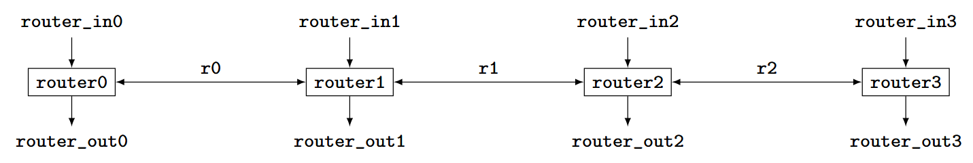
Simple pipeline in Kôika
Notes:
To simplify the problem we first focused on a 1D pipeline NoC, as shown here. Lets start building this circuit

Slide 11
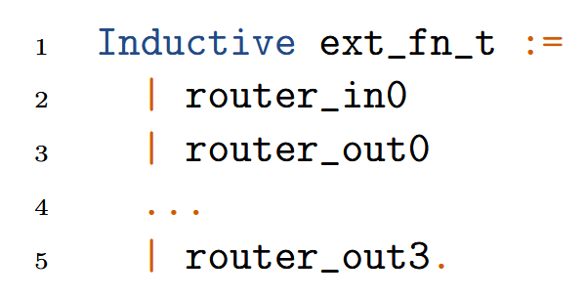
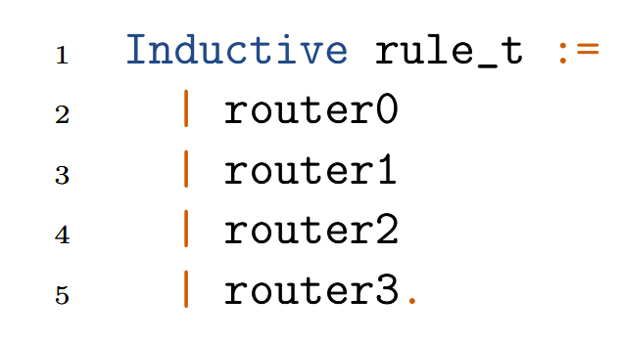
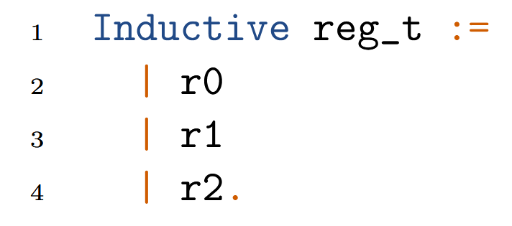
Components of circuit as Inductive Types
Notes:
An inductive type allows the creation of new terms of its type from constants and functions (like enums)
This is a simple 4 stage pipeline it consists of 3 channel registers, 4 routers, and each router has two interfaces one for input one for output
One thing that needs to be noted here is the routers are stored as rules. So koika falls in the category of rule based hardware description languages (Kami and bluespec). The concurrent blocks of the circuit (always block in Verilog) are represented by rules.

Slide 12
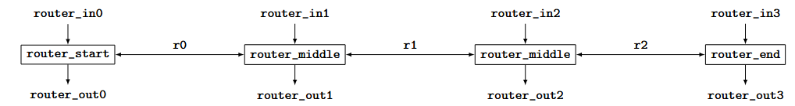
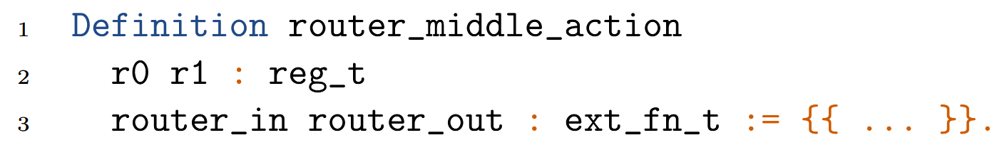
Functionality of the circuit
Action
Notes:
Because we want to eventually build a n stage pipeline, we cant write n dedicated router functions for each router. To circumvent this problem we can classify our routers of pipeline into 3 types
Routers placed at the start and end and routers placed in the middle.
The functionality of routers is defined using something known as actions. Actions can only communicate with each other via registers. Since we want to use one action for all middle routers we make our actions polymorphic on the registers, external functions and the address of the router. Then we map the actions to our rules. Here you can see how the same router middle action is configured for two different routers

Slide 13
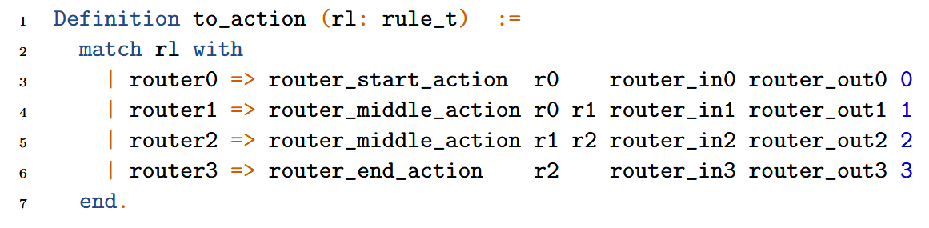
Mapping functionality to rules
Mapping rules to actions
Notes:
Because we want to eventually build a n stage pipeline, we cant write n dedicated router functions for each router. To circumvent this problem we can classify our routers of pipeline into 3 types
Routers placed at the start and end and routers placed in the middle.
The functionality of routers is defined using something known as actions. Actions can only communicate with each other via registers. Since we want to use one action for all middle routers we make our actions polymorphic on the registers, external functions and the address of the router. Then we map the actions to our rules. Here you can see how the same router middle action is configured for two different routers

Slide 14
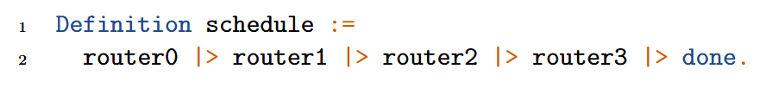
Scheduling Rules
Rules are independently executed according to One rule at a time (ORAAT) semantics.
Ensures no data races occur in design.
Notes:
Now the last part of the design is to create a schedule. Koika follows something known as One rule at a time semantics, as the name suggests these rules are executed sequentially, This kind of model is followed to make sure that no race conditions occur. According to this router0 then 1.
It must be noted that in hardware these blocks are still executed concurrently.
Its just to ensure correctness

Slide 15
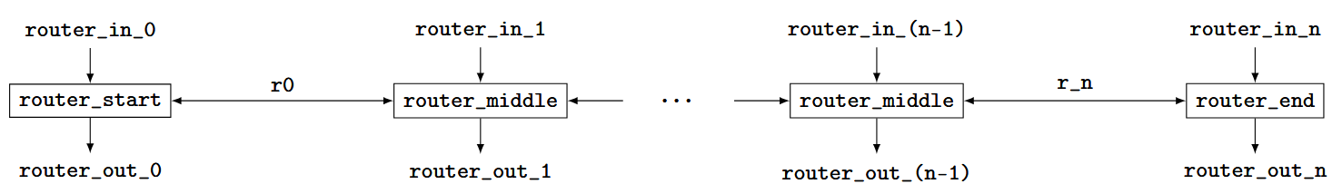

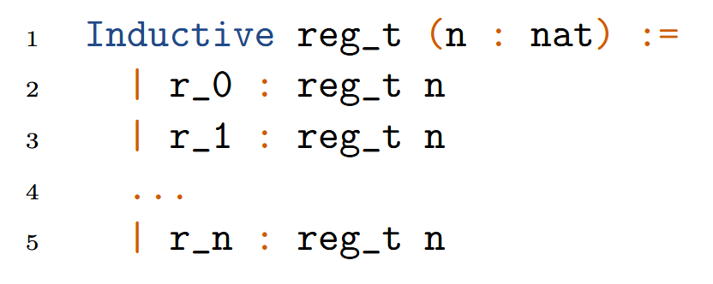
N-stage Pipeline NoC
Kôika needs an upper bound to be established for every
program for successful compilation to Verilog.

Slide 16





Approaches
Notes:
During this thesis we tried to solve this problem using two different approaches which we will be discussing first is using metaprogramming

Slide 17
Meta-programming

Slide 18
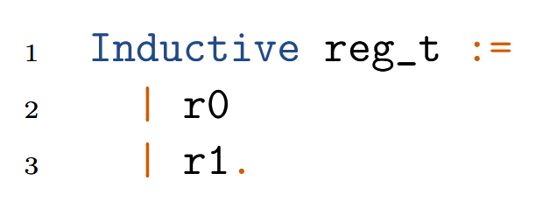
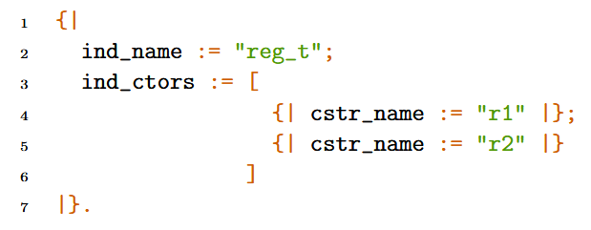
Meta-programming
Meta-programming enables writing programs in a meta-language (reified syntax) that can produce or manipulate programs written in an object language (concrete syntax).​
MetaCoq¹ is a framework for meta-programming and reasoning about Coq itself.
Concrete Syntax
Reified Syntax
¹Matthieu Sozeau, et al. The MetaCoq Project. Journal of Automated Reasoning June 2020.
Notes:
MP is a paradigm
Here we divide our language into two types of syntax
syntax of Coq as entered by the user which we just saw is referred to as Concrete syntax
Meta programming allows us to write represent the same terms we saw as data structures, how these structures look and why do we need them we’ll discuss that shortly
But one thing we can do with metacoq is we can convert these syntax from one form to another

Slide 19
Inductive types using MetaCoq
Concrete Syntax
Reified Syntax
Notes:
Here we can see our the inductive type reg_t.
On the right now we have this as the reified syntax
It’s a record which is a data structure and this data structure contains some data about our inductive type
One thing I want you to notice is that the data about the type is stored as strings here, and the constructors are stored as a list.

Slide 20
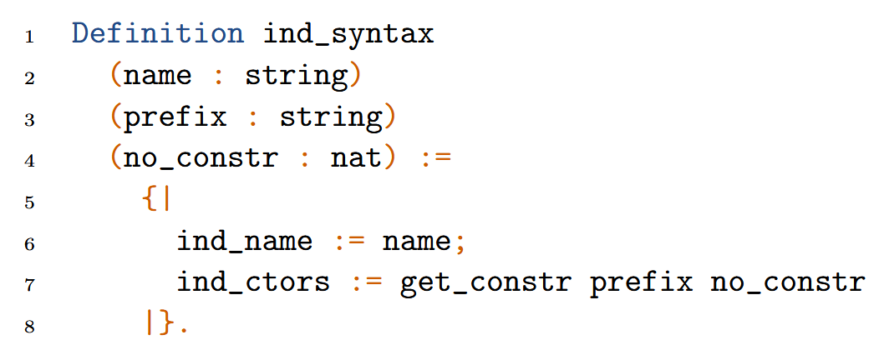
Inductive types using MetaCoq
Concrete Syntax
Reified Syntax
n=2
Notes:
So what if I wrap this in a function which generates this data structure. And we let this function have some arguments, now we can use this same function for all inductive data types.
To make the constructors we can write another function. Since the constructors are name r1,r2 so on we can generate them using a simple string operation.
And once we have obtain the required data structure we can convert it into actual coq syntax.

Slide 21
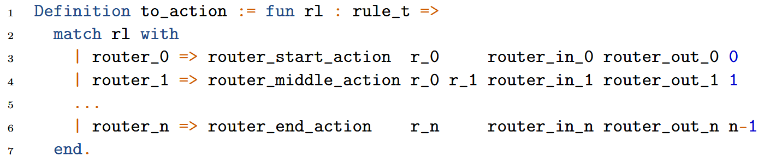
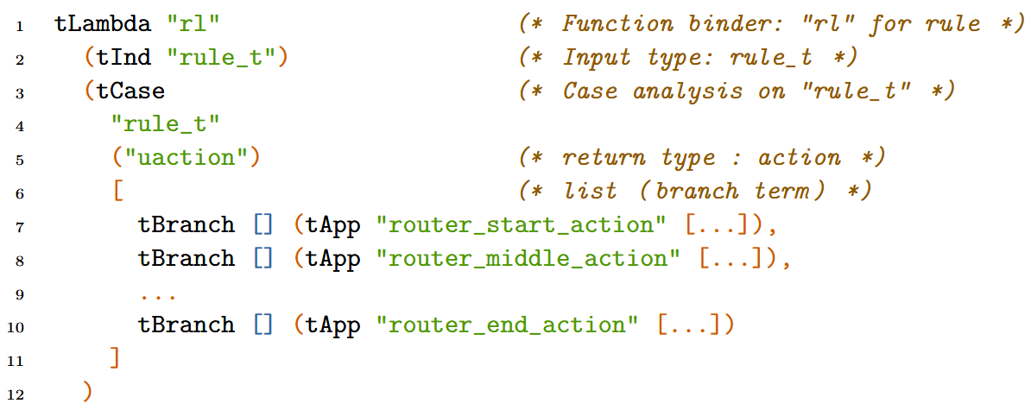
Functions using MetaCoq
Concrete Syntax
Reified Syntax
Notes:
Similarly we can write functions in reified language as well
The fun rl here is represented by tlambda, for those who haven’t worked with coq the fun keyword in coq is used to represent a lambda function and tInd rule t is the input
tCase is used to represent the whole match statement with rule t as the type on which match is performed and uaction being the type which is returned
tBranches are used to write the syntax for the branches
Basically any term written in coq can be represented in a reified version

Slide 22
Functions using MetaCoq
Concrete Syntax
Reified Syntax
Notes:
Similarly we can write functions in reified language as well
The fun rl here is represented by tlambda, for those who haven’t worked with coq the fun keyword in coq is used to represent a lambda function and tInd rule t is the input
tCase is used to represent the whole match statement with rule t as the type on which match is performed and uaction being the type which is returned
tBranches are used to write the syntax for the branches
Basically any term written in coq can be represented in a reified version

Slide 23
Functions using MetaCoq
Concrete Syntax
Reified Syntax
Notes:
Similarly we can write functions in reified language as well
The fun rl here is represented by tlambda, for those who haven’t worked with coq the fun keyword in coq is used to represent a lambda function and tInd rule t is the input
tCase is used to represent the whole match statement with rule t as the type on which match is performed and uaction being the type which is returned
tBranches are used to write the syntax for the branches
Basically any term written in coq can be represented in a reified version

Slide 24
Functions using MetaCoq
Concrete Syntax
Reified Syntax
Notes:
Similarly we can write functions in reified language as well
The fun rl here is represented by tlambda, for those who haven’t worked with coq the fun keyword in coq is used to represent a lambda function and tInd rule t is the input
tCase is used to represent the whole match statement with rule t as the type on which match is performed and uaction being the type which is returned
tBranches are used to write the syntax for the branches
Basically any term written in coq can be represented in a reified version

Slide 25
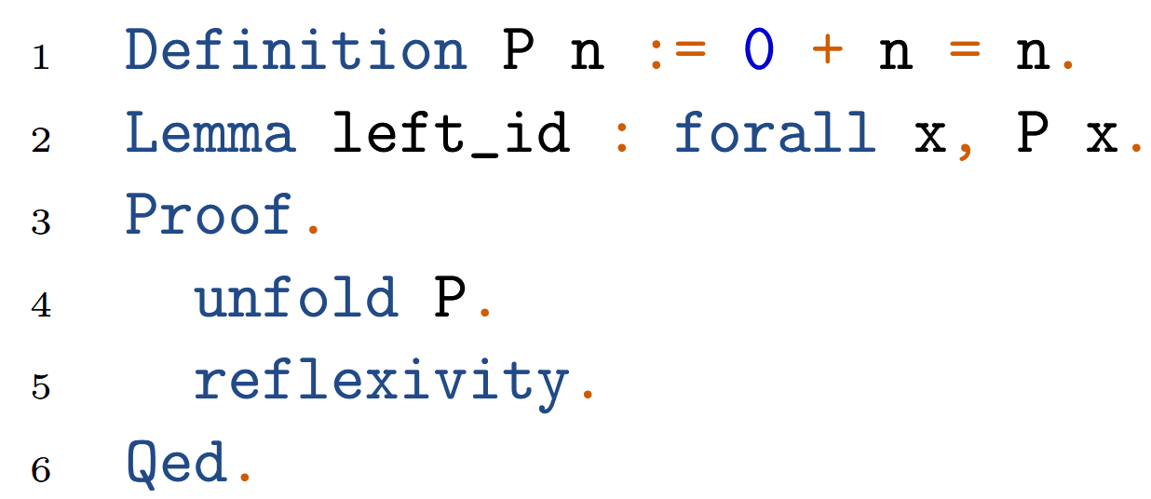
Proving Properties of Generated Code
Left Identity of Addition:
Notes:
Proof terms needs to be built manually.
The automation provided by Coq tactics needs to be abandoned.

Slide 26
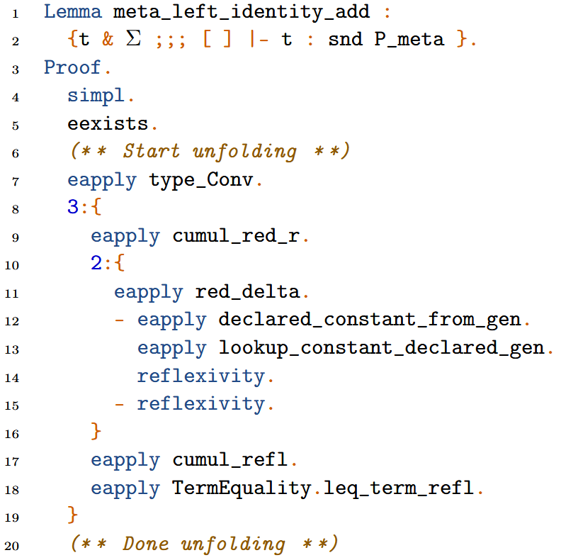
Proving Properties of Generated Code
Coq
MetaCoq

Slide 27
Proving Properties of Generated Code
Coq
MetaCoq

Slide 28
Dependent Programming

Slide 29
Dependent Types
Dependent types - Types that can be parameterized by values.
Example: Fin.t n represents a type of finite values constrained to the range [0, n-1].
Fin.t can be used to define types and functions with the size as a parameter while ensuring type-safety and correctness.
Fin.t n
0 1 2 n-1
FS (FS F1)
F1
FS F1
Fin.t 3
Notes:
So as I said while talking about challenges koika and coq needs inductive types to be bounded to ensure successful compilation.
Coq actually does provide us a way to define bounded types. Which is by using dependent types
dependent types, which are types that can be parameterized by values
The concept of dependent programming is tightly connected with dependent types,

Slide 30
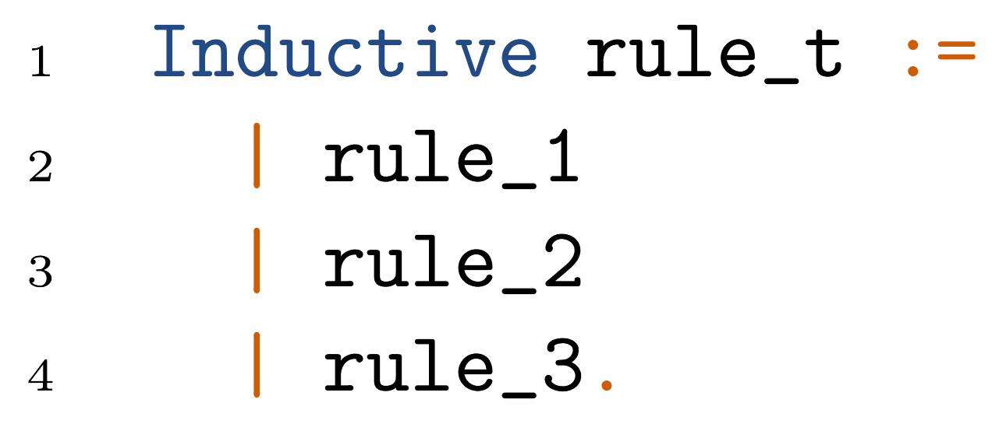
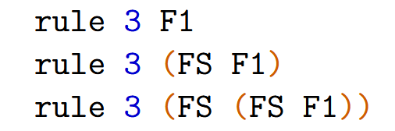
Inductive Types using Dependent Types
Rules
Notes:
This is a more advanced use of inductive types, in previous case we had constants rule1, rule2, to represent terms of the inductive type, here we use a function rule to represent the terms of our types. This function takes a finite type, x_dim which is the index of our pipeline returns a rule name t indexed by x_dim.

Slide 31
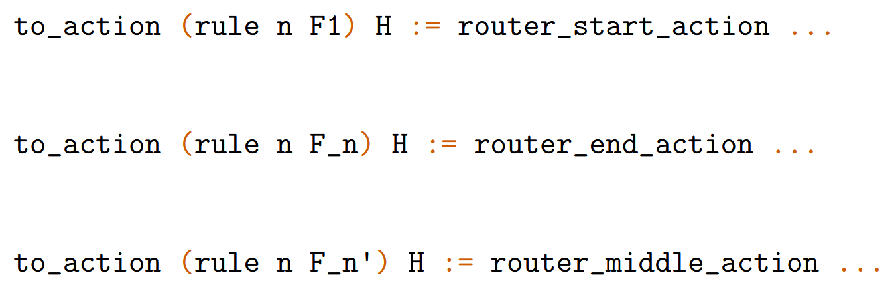

Functions using Dependent Programming
Matthieu Sozeau. “Equations: A Dependent Pattern-Matching Compiler”. In: Interactive Theorem Proving. Ed. Berlin, Heidelberg: Springer Berlin Heidelberg, 2010, pp. 419–434.

Slide 32
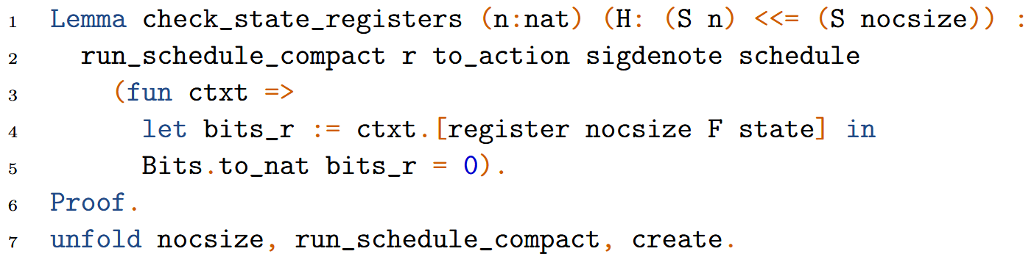
Proving Properties of NoC using dependent programming

Slide 33
Proving Properties of NoC using dependent programming

Slide 34


Approaches

Slide 35
Comparison

Slide 36

Comparison
Aspect | Meta-programming | Dependent Programming
Design
Proving Properties
Notes:
Existing tools in koika for type checking are compatible with this approach

Slide 37

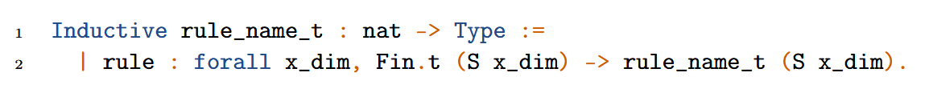
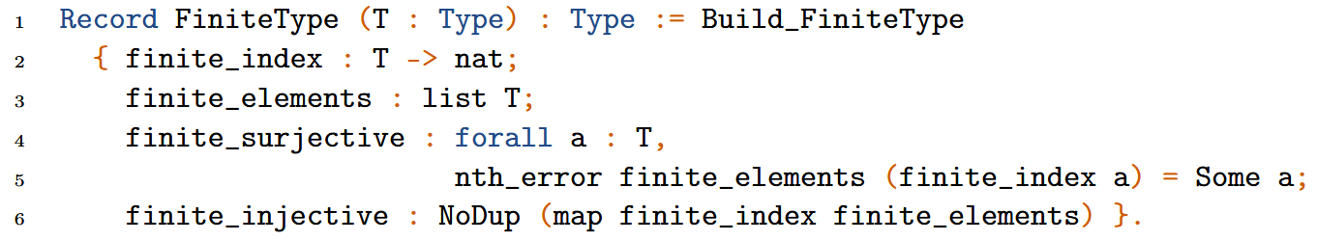
Comparison
Aspect | Meta-programming | Dependent Programming
Design
Proving Properties
Notes:
To ensure that the components are finite or bounded koika requires the types to be an instance of this typeclass
Koika can automatically resolve the type class of the simple inductive types but not of this
So we have to manually create the members of the

Slide 38

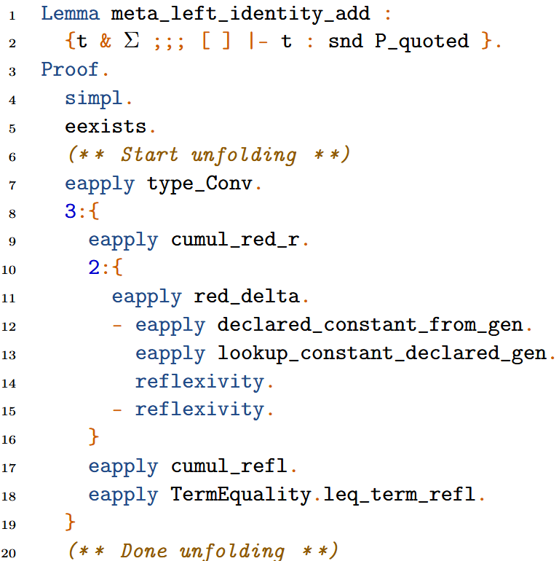
Comparison
Aspect | Meta-programming | Dependent Programming
Design
Proving Properties

Slide 39
Comparison
Aspect | Meta-programming | Dependent Programming
Design
Proving Properties
Notes:
Since dependent programming is an intrinsic part of coq tactics can be used in proofs and

Slide 40
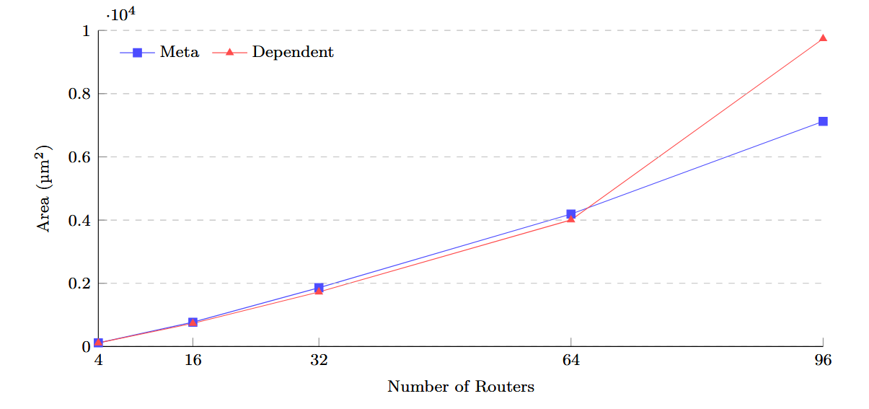
Synthesis Results

Slide 41
Related Work
Abstract Formal Model
GeNoC presented by Schmaltz et al.
Aethereal protocol in PVS by Gebremichael et al.
Implementation
Focus of this thesis
Verilog
Julien Schmaltz and Dominique Borrione. “A Generic Network on Chip Model”.
In: Theorem Proving in Higher Order Logics. Berlin Heidelberg, 2005.
Gebremichael, B., et al. “Deadlock Prevention in the Æthereal Protocol”
Correct Hardware Design and Verification Methods. CHARME 2005. Lecture Notes in Computer Science, Springer.
Notes:
GeNoC, a formal model and systematic approach to validation of communication architectures at a high level of abstraction.

Slide 42
Future Work
Abstract Formal Model
GeNoC presented by Schmaltz et al.
Aethereal protocol in PVS by Gebremichael et al.
Implementation
Future Work
Verilog
Julien Schmaltz and Dominique Borrione. “A Generic Network on Chip Model”.
In: Theorem Proving in Higher Order Logics. Berlin Heidelberg, 2005.
Gebremichael, B., et al. “Deadlock Prevention in the Æthereal Protocol”
Correct Hardware Design and Verification Methods. CHARME 2005. Lecture Notes in Computer Science, Springer.
Notes:
GeNoC, a formal model and systematic approach to validation of communication architectures at a high level of abstraction.

Slide 43
Future Work
Upgrade the NoC
Prove complex properties
Future Work
Verify other scalable components
Notes:
Extend existing work to 2D Mesh NoC, and then to other topologies, routing algorithms, switching schemes.
Prove complex properties such as functional correctness, deadlock freedom, or timing side-channel resilience.
The techniques developed in this thesis could be applied to the formal verification of other scalable hardware components, such as multipliers or memory controllers.

Slide 44
Questions?

Slide 45
References
Thomas Bourgeat, Clément Pit-Claudel, Adam Chlipala, and Arvind. 2020. The essence of Bluespec: a core language for rule-based hardware design. In Proceedings of the 41st ACM SIGPLAN Conference on Programming Language Design and Implementation (PLDI 2020). Association for Computing Machinery, New York, NY, USA, 243–257. https://doi.org/10.1145/3385412.3385965
Matthieu Sozeau et al. “The MetaCoq Project”. In: J. Autom. Reason. 64.5 (June 2020), pp. 947–999. issn: 0168-7433. doi: 10.1007/s10817-019-09540-0. url: https://doi.org/10.1007/s10817-019-09540-0.
Matthieu Sozeau. “Equations: A Dependent Pattern-Matching Compiler”. In: Interactive Theorem Proving. Ed. by Matt Kaufmann and Lawrence C. Paulson. Berlin, Heidelberg: Springer Berlin Heidelberg, 2010, pp. 419–434. isbn: 978-3- 642-14052-5.
Gebremichael, B., Vaandrager, F., Zhang, M., Goossens, K., Rijpkema, E., Rădulescu, A. (2005). Deadlock Prevention in the Æthereal Protocol. In: Borrione, D., Paul, W. (eds) Correct Hardware Design and Verification Methods. CHARME 2005. Lecture Notes in Computer Science, vol 3725. Springer, Berlin, Heidelberg. https://doi.org/10.1007/11560548_28.
Julien Schmaltz and Dominique Borrione. “A Generic Network on Chip Model”. In: Theorem Proving in Higher Order Logics. Ed. by Joe Hurd and Tom Melham. Berlin, Heidelberg: Springer Berlin Heidelberg, 2005, pp. 310–325. isbn: 978-3-540-31820-0.
L. Rizzatti. High-Level Synthesis to Design in the New Millennium. IEEE Tech Forum. Accessed: 06.01.2025. 2002. url: https://californiaconsultants.org/wp-content/uploads/2014/05/200205.pdf

