Slide 1
Formal Verification of Network On Chips
Garvit Chhabra
Barkhausen Institut, July 24th 2024

Slide 2
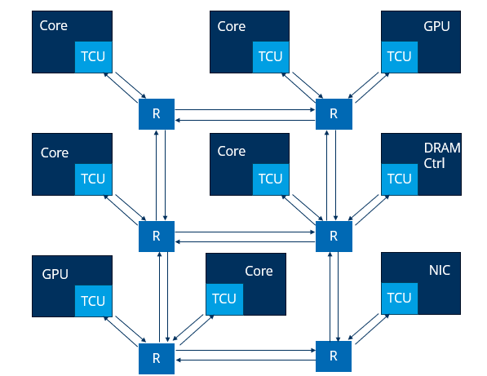
What is a NoC?
R
Router
TCU
Trusted Communication Unit
TCU
IP
Intellectual Property
Channel
Notes:
Modern day chips are built using various different building blocks also known as Ips. A Network on chip is a communication system that is capable of connecting a multitude of IP blocks and routes data packets between them.​
Here we have shown the M3 MPSoC, but we can see some components that are present in all NoC implementations. TCU is used to provide a network interface to the NoC and to isolate the core.
Routers are responsible for routing the data packets to the correct destination with channels acting as the medium for the packets to travel in.
​

Slide 3
Verification of NoC - Simulation
Check Results
Stimuli
Design Under Test (DUT)
Monitor
Difficult to obtain complete coverage
Corner cases or complex properties are hard to verify
Requires a static implementation of NoC
Notes:
The NoC paradigm introduces new challenges to the world of verification.
Traditionally in hardware design simulation is the golden standard that is used for verification.
In simulation various testcases are written and provided as stimuli to the design. The responses to the stimuli are then recorded and checked to see if they meet the required specification
But there are certain disadvantages to this approach

Slide 4
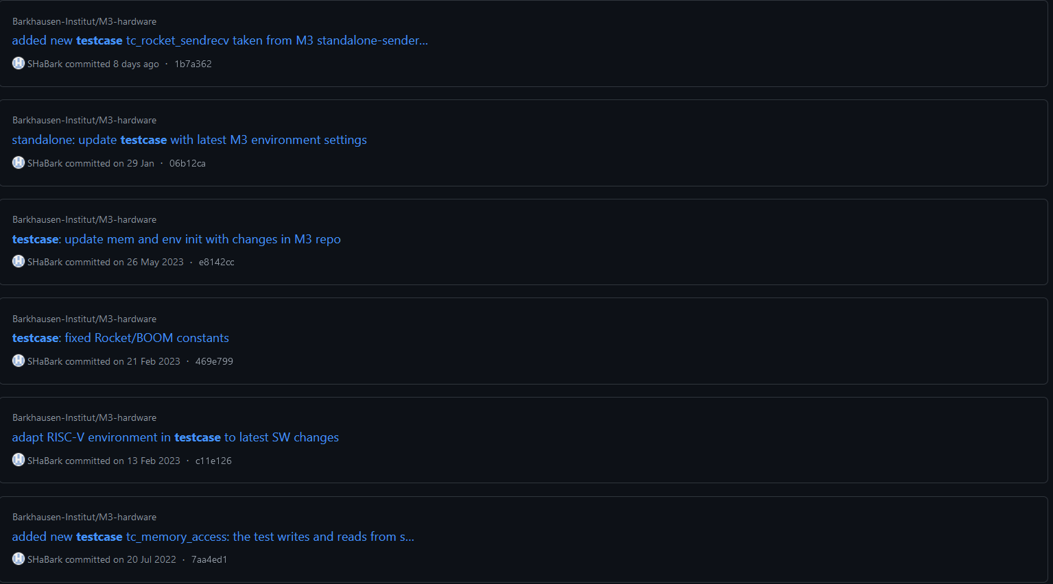
Notes:
People worked in hw design or are working on the M3 MPSoC will be familiar with these issues, as various commits made to the github repository involve the addition or modification of testcases. Including the most recent commit which was made just 8 days ago.
To alleviate this issue formal verification can be used

Slide 5
Formal Verification using Theorem Provers
Theorem Proving uses logical deduction to show that a system satisfies its specification.
Gebremichael et al. presented the formal specification of the Aethereal protocol using the PVS specification language.
1. Capable of exhaustive coverage
2. Proved absence of deadlocks – Complex properties can be proven
3. Arbitrary number of master and slave devices - Highly parameterized designs can be used
Schmaltz et al. presented GeNoC, a formal model and systematic approach to validation of communication architectures at a high level of abstraction.
Gebremichael, B., Vaandrager, F., Zhang, M., Goossens, K., Rijpkema, E., Rădulescu, A. (2005). Deadlock Prevention in the Æthereal Protocol. In: Borrione, D., Paul, W. (eds) Correct Hardware Design and Verification Methods. CHARME 2005. Lecture Notes in Computer Science,. Springer.
Notes:
Another approach to formal verification of hardware is by using theorem proving
As far as verification of communication protocols is concerned only two works are present.

Slide 6
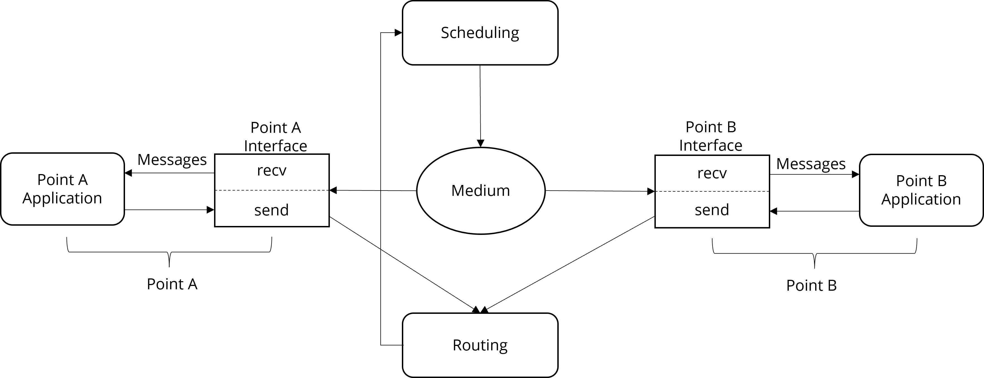
GeNoC - A Generic Model for NoCs
In GeNoC, the model has 3 important aspects:
Interfaces
Routing
Scheduling
Frame
Julien Schmaltz and Dominique Borrione. 2008. A functional formalization of on chip communications. Form. Asp. Comput. 20, 3 (May 2008),
Notes:
GeNoC is an abstract framework which can be used to verify different instantiations of NoCs. The GeNoC model breaks the communication system into three parts and defines properties that each must define

Slide 7
GeNoC
1. Interfaces - Responsible for encapsulating messages into a frame (send) and extracting messages from frame (recv).
Frame
Notes:
The first thing is the application sends the message to the interface which packages the message with data that will be required during the transfer
One basic property of an interface should be that unpacking and packing of the message should not lead to any modification of the message contents.

Slide 8
GeNoC
2. Routing - Computes all the possible routes allowed by the unitary moves from source to destination.
Frame
Notes:
Next the packaged message or frame is sent to the routing function where the routing algorithm computes a list of routes that the frame could take to travel from the source to the destination
All routes should terminate.
All routes should contain at least 2 nodes.

Slide 9
GeNoC
3. Scheduling - Manages conflicts, and generates a list of possible simultaneous communications and a list of delayed communications according to the invariant.
Frame
Notes:
In the end the list of routes is sent to a scheduling function, which decides depending on the availability of resources which route should be taken.
Each run of scheduling consumes at one attempt.
If no attempts are left the delayed communications are aborted.

Slide 10
Proposal
Implement a NoC with mesh topology using Coq.
Formally verify fundamental properties like Functional Correctness of the NoC.
The NoC should be configurable in terms of its size and routing.
Notes:
Now that we have seen existing work in this field lets discuss our proposal for the thesis

Slide 11

Koika
Embedded Domain Specific Language (DSL) in Coq for hardware design and verification.
One Rule At A Time (ORAAT) semantics, but preserves the notion of concurrency.
Formally Proven Compiler.
Allows scheduling of rules for cycle-accurate semantics.
Thomas Bourgeat, Clément Pit-Claudel, Adam Chlipala, and Arvind. 2020. The essence of Bluespec: a core language for rule-based hardware design. In Proceedings of the 41st ACM SIGPLAN Conference on Programming Language Design and Implementation (PLDI 2020). Association for Computing Machinery, New York, NY, USA.
Notes:
Koika code can be compiled into Verilog code and be used for describinh Hardware

Slide 12
NoC Implementations
Stateful
Stateless
Tile
Tile
Tile
Tile
1
R2
R3
1
R2
R3
Tile
Tile
0
R0
R1
R0
R1
0
Tile
Tile
Tile
Tile
0
1
0
1
Buffer
R
Router
Notes:
We plan on implementing two types of NoCs
A stateful version in which a combination of routers and buffers are used. So the router directs the packet to a buffer first then to the next router
This allows us to manage traffic quite conveniently
In a stateless router we directly route the packets between routers
Once the design is done we have to verify some properties for our NoCs

Slide 13
XY Routing algorithm
XY_Routing_Algorithm(from, to):
if from==to
then send(Tile)
else while from.X!=to.X
if from.X < to.X
from.X = send(R(X+1))
else
from.X = send(R(X-1))
else while from.Y!=to.Y
if from.Y < to.Y
from.Y = send(R(Y+1))
else
from.Y = send(R(Y-1))
Tile
Router
Router
Router
Router
Router
Router
Router
Router
Router
Tile

Slide 14
NoC Properties
NoC
Router
Buffer
Notes:
Generally in theorem proving we divide big theorems into smaller theorems or lemmas.
We will have a similar approach here break the router in terms of Routers and NoCs

Slide 15
Router
Router
(x,y)
N
W
E
S
$$Router: Packet →(Dir, Packet)$$
Notes:
As discussed previously a router routes the packet to its destination. We have 4 directions in which the packets have to be directed and the address of the router in the mesh
A router is could be modelled as a function which takes a packet as the input and returns a tuple consisting of the direction and the packet content

Slide 16

Router Properties
Router should have a valid address (where M & N are dimensions of the mesh)
$∀ r:Router,$
$$r.x<M−1 ∧ r.y<N−1$$
No modifications to the packet entering the router
$∀ p1,p2 : Packet,$
$$\left( \text{__ },p2\right)=Router p1 →p2=p1$$
Consistent Behaviour
$∀ d1,d2 :Dir, p:Packet,$
$$Router p=\left( \text{d}\text{1 },p\right)→Router p=\left(d2,p\right) →d1=d2$$

Slide 17
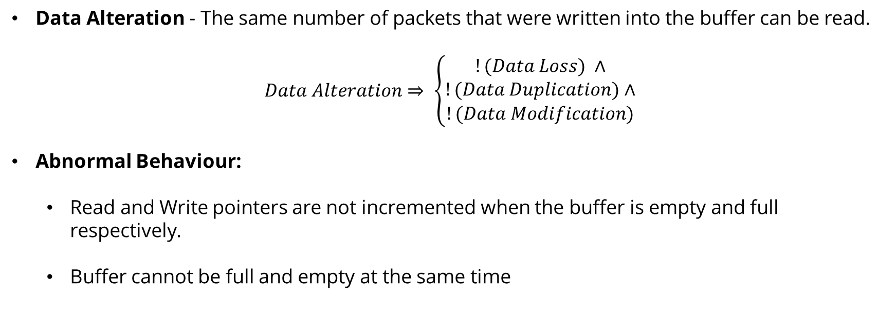
Buffer Properties
Data Alteration - The same number of packets that were written into the buffer can be read.
$$Data Alteration⇒ \left\{\begin{aligned}!(Data Loss) ∧ \\ !(Data Duplication)∧ \\ !(Data Modification)\end{aligned}\right.$$
Abnormal Behaviour:
Read and Write pointers are not incremented when the buffer is empty and full respectively.
Buffer cannot be full and empty at the same time
Read Ptr
Write Ptr
P | P | P
Notes:
No. Of hops
Correctness - reaches correct destination

Slide 18
Functional Correctness
Functional correctness is a property stating that if a packet is moving through the network it follows a correct path between connected resources, its contents are not modified and if it is consumed, it is consumed at its desired destination
Notes:
Functional Correctness -
Follows a correct path
Contents are not modified
If it is consumed, it is consumed at the correct destination

Slide 19
Outlook - Security Properties
AES
Router
Router
Router
S
Infected Core
Router
Router
Router
Router
Router
Router
D
A
Memory
Timing Side-Channel Analysis

Slide 20

Security Properties
Timing SCA resilience - Communication delay should be independent of amount of traffic
Time between two issued grants is always constant
$$Timing SCA Resilience⇒ \left\{\begin{aligned}∀req, ∆T_{req}=constant ∧ \\ !(Router Abnormal Behaviour)∧ \\ !(Buffer Abnormal Behaviour)\end{aligned}\right.$$
J. Sepulveda, D. Aboul-Hassan, G. Sigl, B. Becker and M. Sauer, "Towards the formal verification of security properties of a Network-on-Chip router," 2018 IEEE 23rd European Test Symposium (ETS), Bremen, Germany, 2018, pp. 1-6
Notes:
The time between two issue grants is always constant

Slide 21
QUESTIONS?

Slide 22
References
Gebremichael, B., Vaandrager, F., Zhang, M., Goossens, K., Rijpkema, E., Rădulescu, A. (2005). Deadlock Prevention in the Æthereal Protocol. In: Borrione, D., Paul, W. (eds) Correct Hardware Design and Verification Methods. CHARME 2005. Lecture Notes in Computer Science, vol 3725. Springer, Berlin, Heidelberg. https://doi.org/10.1007/11560548_28.
Chatterjee, S., Kishinevsky, M. (2010). Automatic Generation of Inductive Invariants from High-Level Microarchitectural Models of Communication Fabrics. In: Touili, T., Cook, B., Jackson, P. (eds) Computer Aided Verification. CAV 2010. Lecture Notes in Computer Science, vol 6174. Springer, Berlin, Heidelberg. https://doi.org/10.1007/978-3-642-14295-6_29.
D. Borrione, A. Helmy, L. Pierre and J. Schmaltz, "A Generic Model for Formally Verifying NoC Communication Architectures: A Case Study," First International Symposium on Networks-on-Chip (NOCS'07), Princeton, NJ, USA, 2007, pp. 127-136, doi: 10.1109/NOCS.2007.1.
J. Sepulveda, D. Aboul-Hassan, G. Sigl, B. Becker and M. Sauer, "Towards the formal verification of security properties of a Network-on-Chip router," 2018 IEEE 23rd European Test Symposium (ETS), Bremen, Germany, 2018, pp. 1-6, doi: 10.1109/ETS.2018.8400692.
A. Roychoudhury, T. Mitra and S. R. Karri, "Using formal techniques to debug the AMBA system-on-chip bus protocol," 2003 Design, Automation and Test in Europe Conference and Exhibition, Munich, Germany, 2003, pp. 828-833, doi: 10.1109/DATE.2003.1253709.
Thomas Bourgeat, Clément Pit-Claudel, Adam Chlipala, and Arvind. 2020. The essence of Bluespec: a core language for rule-based hardware design. In Proceedings of the 41st ACM SIGPLAN Conference on Programming Language Design and Implementation (PLDI 2020). Association for Computing Machinery, New York, NY, USA, 243–257. https://doi.org/10.1145/3385412.3385965

Slide 23
Appendix - Formal Verification using Model Checkers
A model checker systematically explores the state space of a model to ensure that it adheres to a specified set of properties.
Model checkers have been extensively used in verification of communication systems,
e.g. Roychoudhury et al. used the Cadence SMV model checker to debug an implementation of the AMBA AHB protocol.
Salient features of model checkers:
Provide exhaustive coverage.
Incorporating nontrivial instances of the protocol leads to state space explosion.
A model checker can only analyze a static model.
A. Roychoudhury, T. Mitra and S. R. Karri, "Using formal techniques to debug the AMBA system-on-chip bus protocol," 2003 Design, Automation and Test in Europe Conference and Exhibition, Munich, Germany, 2003, pp. 828-833, doi: 10.1109/DATE.2003.1253709.
Notes:
A common approach to formal verification of hardware is by using model checkers
A model checker systematically explores the state space of a model to ensure that it adheres to a specified set of properties

Slide 24
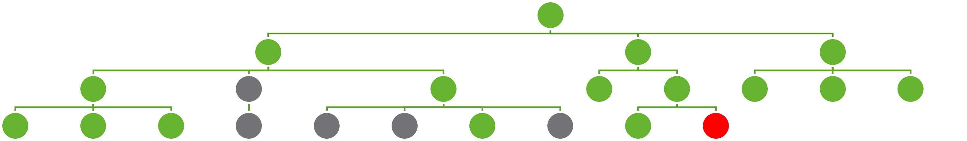
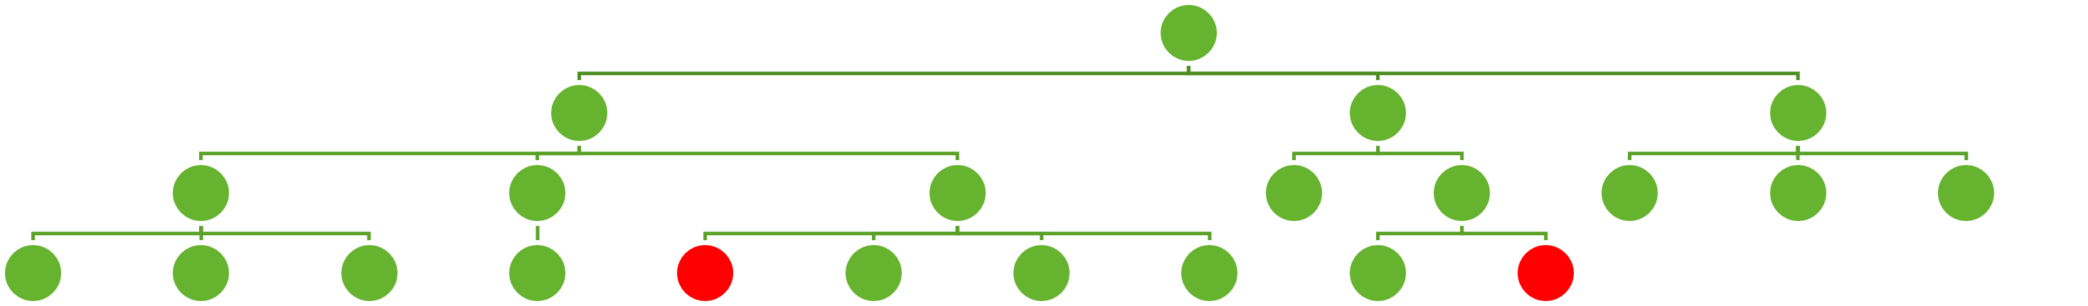
Appendix - Verification of NoCs
Simulation
Hard to obtain complete coverage
Corner cases are hard to debug
Requires a static NoC implementation
Formal Verification
Provides exhaustive coverage​
Can verify complex temporal and safety properties​
Highly parameterized designs can be used (only theorem provers) ​
Notes:
An inherent disadvantage of simulation is the difficulty to obtain full coverage. Corner cases are hard to find and debug
The NoC paradigm introduces new challenges to the world of SoC designers

Slide 25

Appendix - Route Properties
No. of hops
$∀ s,d, \#hops ≥ \left|d.x−s.x\right|+\left|d.y−s.y\right|$
Valid Route
$$validRoute\left(l(s,d)\right)⇒, \left\{\begin{aligned}l\left[0\right]=s \\ l\left[M+N−1\right]=\text{d} \\ l\left[i\right]!=l\left[i+1\right]\end{aligned}\right.$$

Slide 26
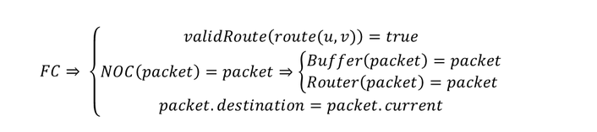
Appendix – Additional Properties
$$recv\left(send\left(msg\right)\right)=msg$$

