Slide 1
Rosaparks.App
Empowering the wronged;
Enabling the witness;
Teaching the uninformed.
Powered by Microsoft Azure™

Slide 2
What is it?

Slide 3

rosaparks.app
Rosaparks.app is an application that allows every individual to learn how to better behave in situations where people are victims of discrimination.

Slide 4

For who?

Slide 5
iNDIVIDUALS: Victims, Observers and bullies
We teach individuals:
Victims need to learn how to behave appropriately when being discriminated. They also need a safespace in which they can talk freely with people who understand them.
Observers need to learn how to be proactive when they witness discrimination.
Bullies need to understand the impact of their wrongdoings.
Please note that in our communications we will never call victims « victims » because of the negative connotations that may be associated to the word. We will prefer the term « wronged ».
Likewise, calling people « bullies » only gets in the path of their learning, as it may make them reluctant to learning. We will then assume the best and consider that they are not bullies, they are just « uninformed ».

Slide 6
For NGOs and associations
No great win was ever achieved alone. We realize that we cannot be alone in our fight against discrimination, and so we welcome the contributions of partnering associations and NGOS who chose to fight with us.
We strongly encourage NGOs and Associations to share their content, and their online courses, on our platform. We will also reward their contributions by helping them reach our userbase, publicising their works and events, and sometimes even sharing a part of our profits in a Netflix-like business model (we’re still working on that at the moment).

Slide 7
Companies
Thankfully, companies are nowadays under great pressure to face discrimination issues. That is for various reaons: legal ones, need for a diversified talent pool, public image… This leads HR departments of big companies to often pay for sensitivization seminars. In Europe and in the US, the prices they pay are often negotiated in a case-by-case basis [1], and may reach a thousand of euros for a single online seminar [2-4].
Providing a convenient solution with a decent pricing may be a profitable positioning into this market, and should provide the money needed to operate «RosaParks.app ».
Sources:
[1] https://ifm-business.de/firmen/seminare/personalmanagement/anti-rassismus-strategien/ (Negotiation in a case by case basis, Germany)
[2] https://www.diversitycampus.eu/en/contact/ (1285€ for online seminar, 1428€ for real life seminar, Germany)
[3] https://living-diversity.de/images/PDF_Sexismus-am-Arbeitsplatz-02_2020.pdf (350€ for one, 420€ for companies, Germany)
[4] https://courseforsexualharassment.com/ (25 to 40$ per person for a few hours < 3, United States. Labelled « the lowest price » )

Slide 8
How?
User Experience

Slide 9
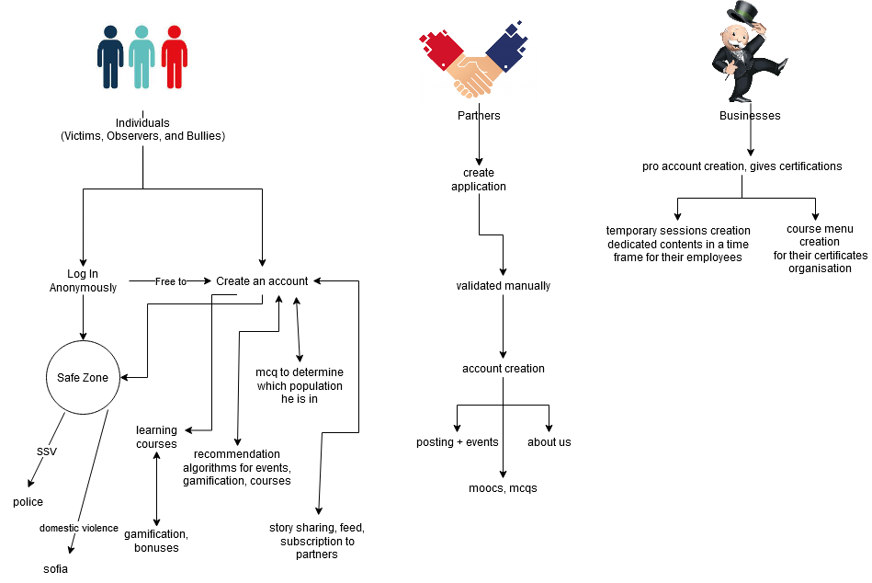
User experience flowchart

Slide 10
Anonymous safe zone for individuals
A safezone is an online chatroom in which 2 to 10 people may attend (parameterable). In every safezone, there is one « expert ».
An « expert » is either a professional psychologist, an employee, a volunteer from a trusted partner, or a qualified trusted user.
A user is deemed « qualified » and « trusted » if:
They were not reported and found guilty of toxic behaviour,
They successfully completed a chosen listed of courses on our platform,
Their application was cleared by 5 randomly selected experts, and, if there is less than 100 experts in total, they also had a real life meeting with a RosaParks.app employee.
People can connect to a Safe Zone without the need of an account.
Every exchange on the Safe Zone is encrypted in a peer-to-peer manner with an AES 256 encryption.
A « report » button is available on the Safe Zone to prevent experts or other users to abuse a given user. If that were to happen, the device of the user who reported the conversation would quit the chatroom, and send the decrypted and then re-encrypted logs of the chat to our servers for moderational purposes.
An « ask for more help » button is available on the Safe Zone. Clicking on that button would redirect the user to the either the national suicide hotline or a psychologist, depending on the configuration of the server and the help available in the user’s country.

Slide 11
Online classes (moocs)
We incentivize partnering associations and ONGs to put content online. The content can be in any form, but some of it will be organized in a structured manner to form courses.
These online classes provide value to companies who would rather pay for a flexible, possibly out-of-business hours formation to their employees (notably those that got reported for discriminating behavior). They are accessible for free for every individual, but we won’t provide them certificates.
Paying companies do not directly create an account under the name of their employees, instead they create anonymous temporary sessions so that we cannot store compromising information on employees who are taking the formation for disciplinary reasons.

Slide 12
The feed: “My name, MY STORY” & PARTNER EVENTS
The feed is a social-media like cocoon in which people only see content published by people they purposefully chose to follow, and the announcement of our carefully chosen partner associations.

Slide 13
Our choice of technologies
Backend in Python Django, and we know that it is slow language and a sub-optimal framework, however it is also extremely easy to both learn and use, which means we won’t need to pay highly skilled engineers.
The database is in PostgresSQL. It is one of the first database engines that every developer learns, and so it shouldn’t be difficult nor expensive to find people to maintain it if needed. Please keep in mind that this may not be the best choice of million of users over a big number of geographically distinct places.
The frontend is in React.js, this may contrast with our previous choices, as React.js developers may be more expensive than others, but it offers the advantage of being easily convertible into mobile applications, over all mobile operating systems, without the need of paying a different team of developers to handle the mobile and the web applications.
For cloud technologies, we chose to use straighforward plug-and-play tools from the Microsoft Azure Cloud. There are also many other cost-related advantages in which we will dive deeper in the three slides following the next one.

Slide 14
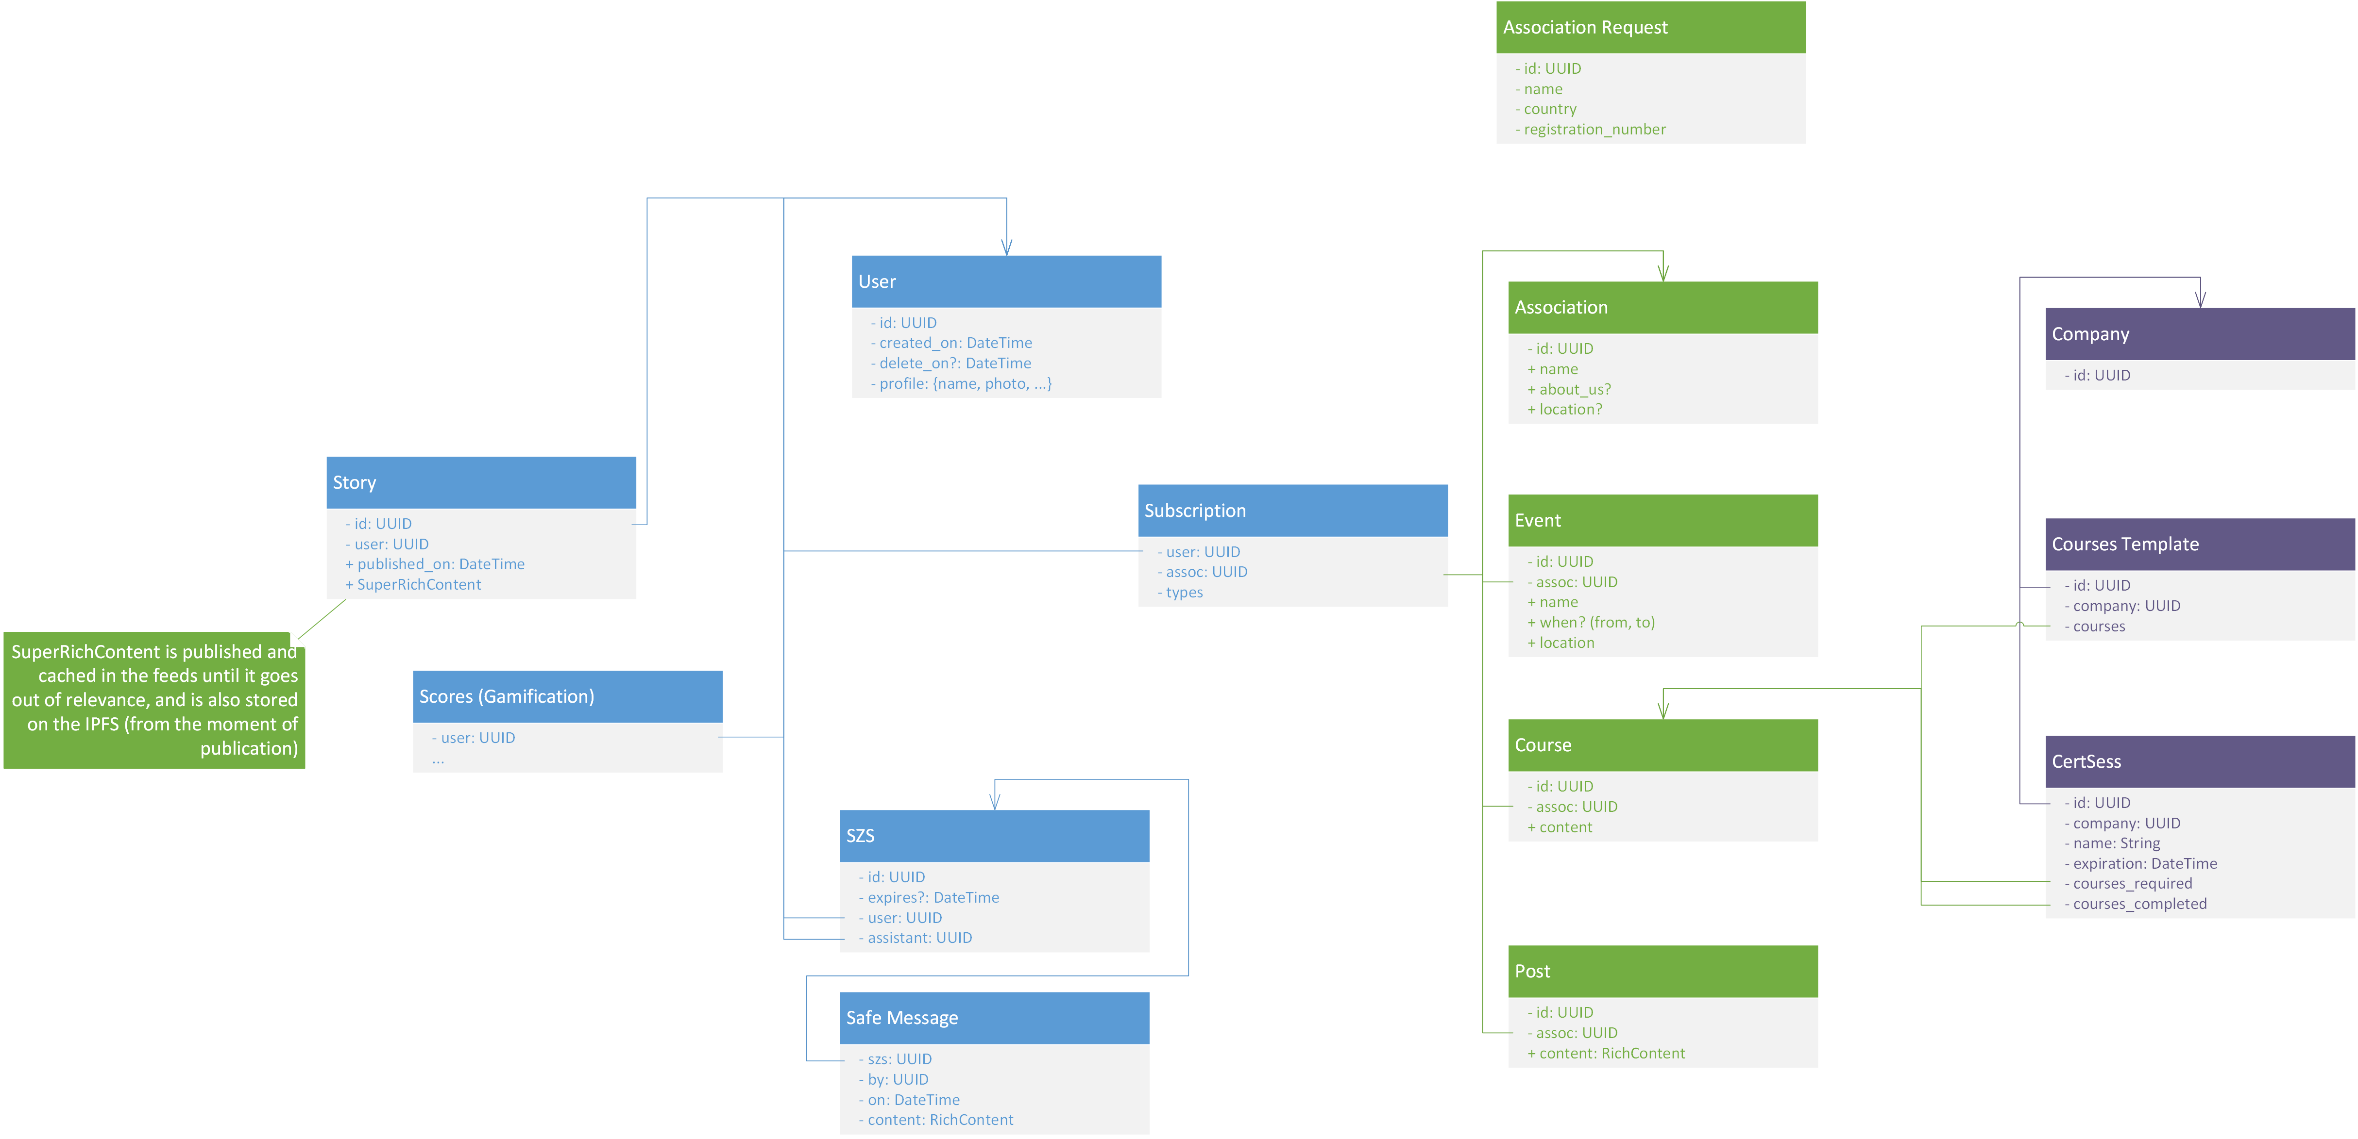
Software architecture: CURRENT DATABASE UML

Slide 15
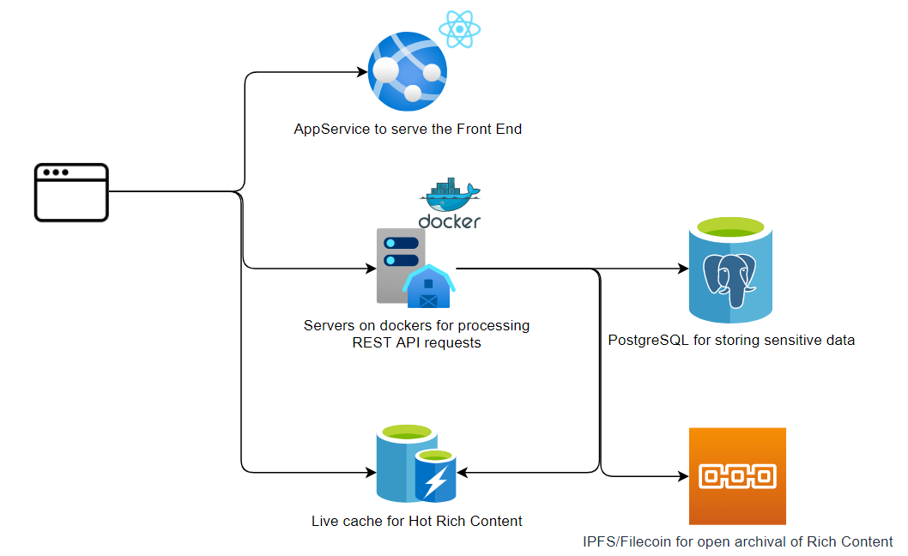
Our cloud architecture

Slide 16
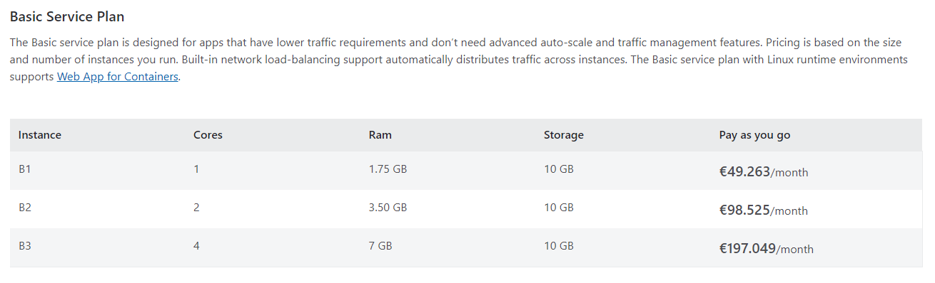
Technical costs
We chose every element of our tech stack with cost minimization in mind. Moreover, we adopted an approach that offers the benefits of only making us pay for what we use (thanks to the Microsoft Azure Cloud), and of being easy to shutdown if we were to decide that the project should stop (for whatever reasons).
We estimate that to be capable of sustaining the load of 2000 concurrent users, with our current tech stack, we would need 3 B1 instances from Microsoft Azure, which is 49.263 *3 = 147.789€ / month.

Slide 17
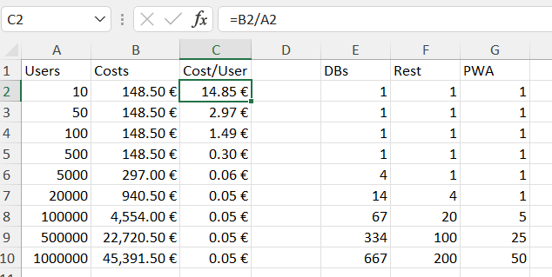
Technical costs: SCALING UP WITH EASE
The cost per user goes exponentially down with the number of users!

Slide 18
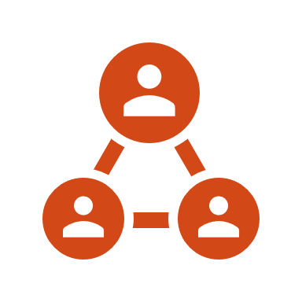
Using fileCOIN: For friends and profit
In order to give back to the community, the entirety of rich content produced by the users of the Rosa project will be open sourced on a decentralized blockchain – Filecoin. As a hyper-competitive storage solution, with inherent security and persistence, it is perfect for cheap and durable storage of massive amounts of data whose purpose is ultimately to be openly available. It also make it so we can archive old data on the blockchain instead of deleting it, knowing that the volunteers will be rewarded in crypto currency without costing us any money.

Slide 19
Proof-of-CONCEPT: you can find all of our CODE here:
Our Github organization for the hackathon: https://github.com/Barmanjoke
Our front-end code: https://github.com/Barmanjoke/Rosa-Front-end
We had to fork and modify an existing React Component to make the SafeZone: https://github.com/Barmanjoke/react-chatbox-component
Our back-end API server: https://github.com/Barmanjoke/Rosa-Back-Central
We tested data vizualisation tools for fun : https://github.com/Barmanjoke/Rosa-Back-Game

Slide 20
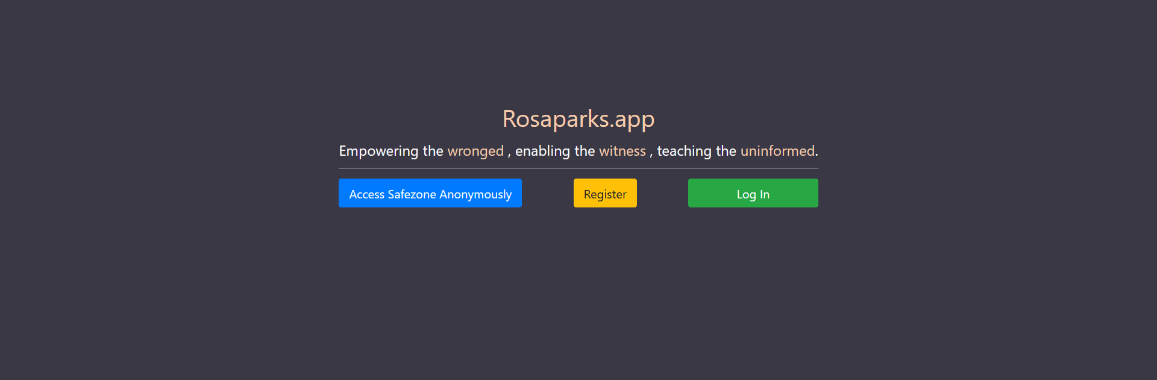
Proof-of-CONCEPT: current Look of our front end

Slide 21
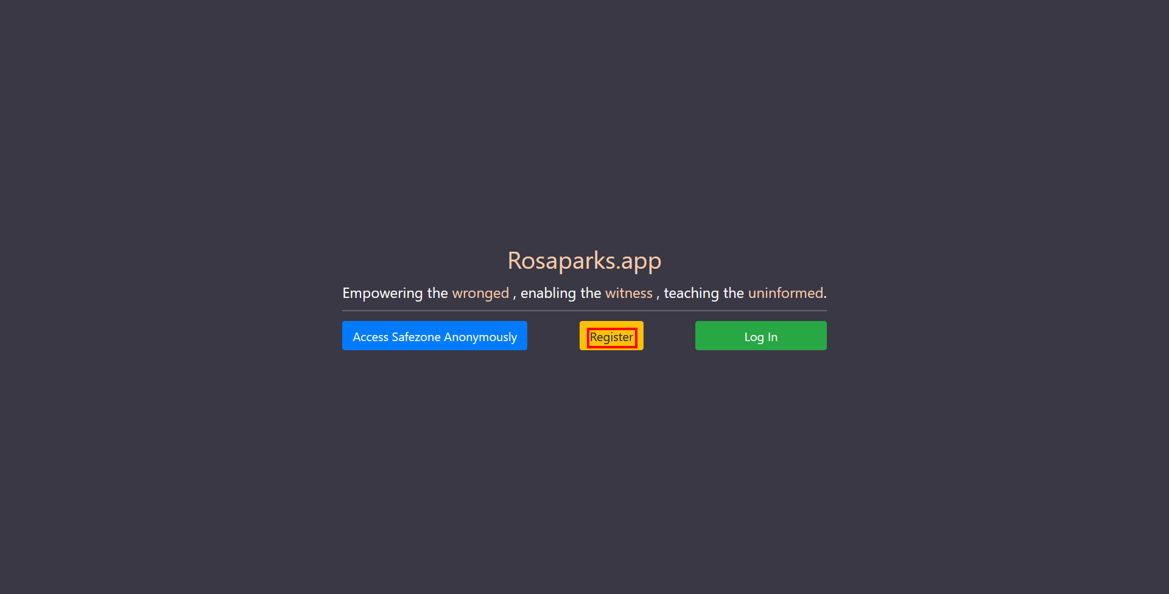

Slide 22
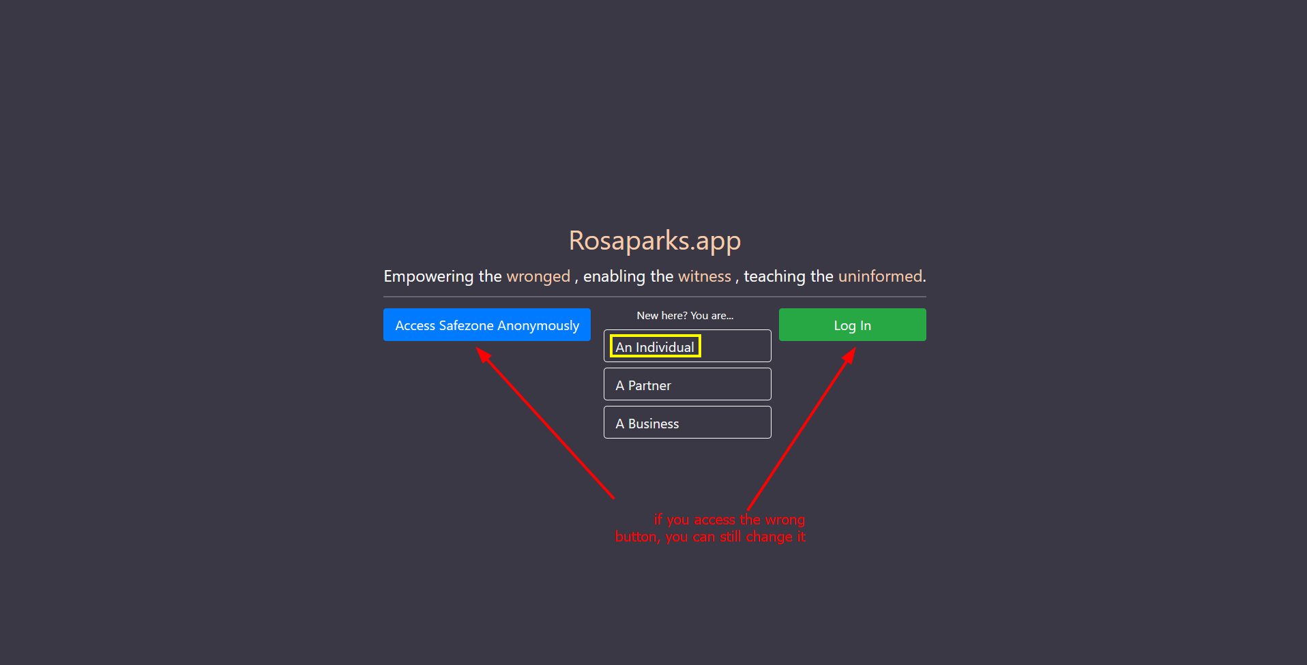

Slide 23
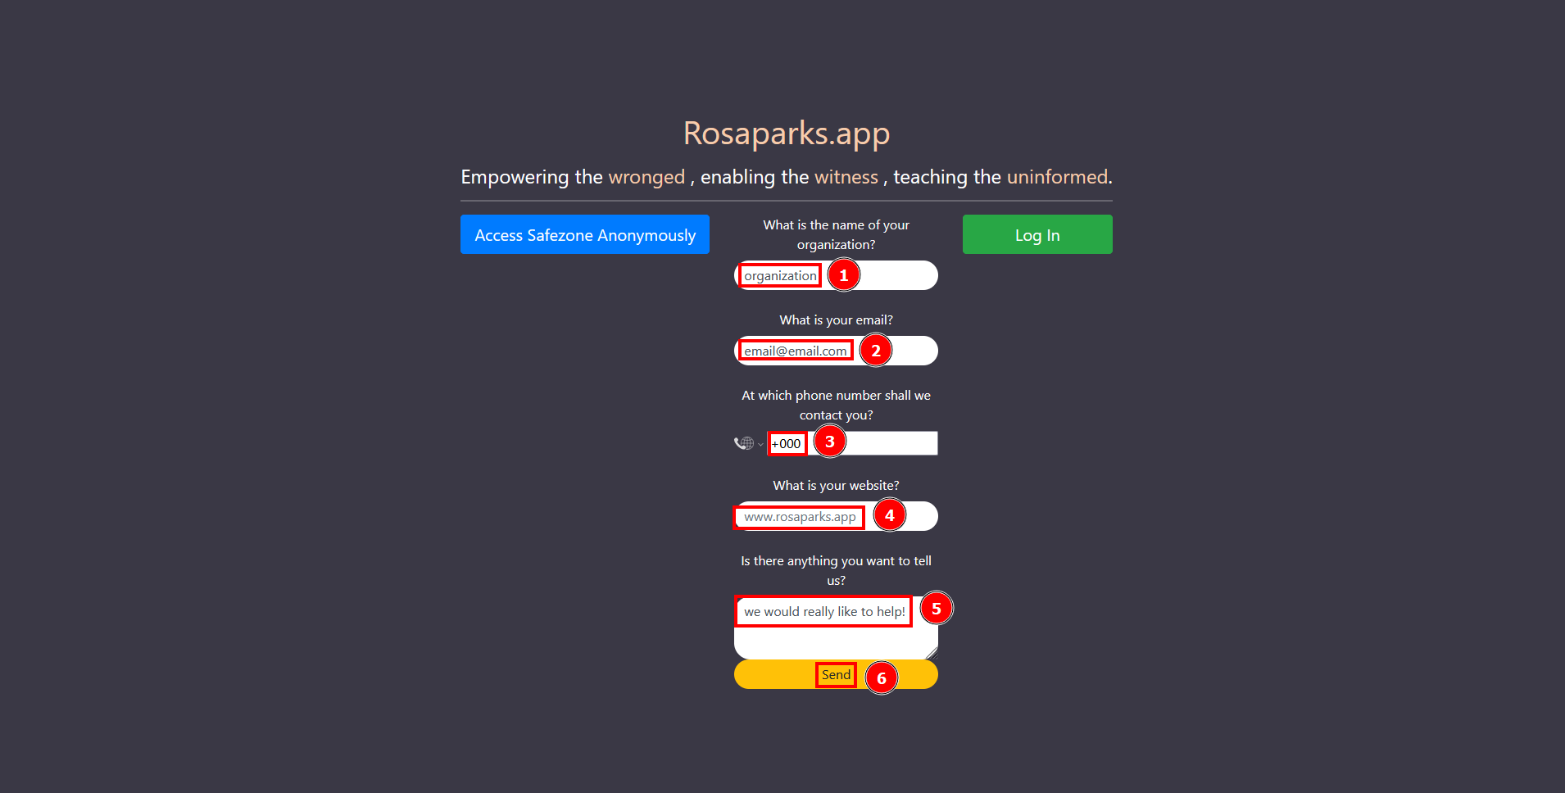

Slide 24
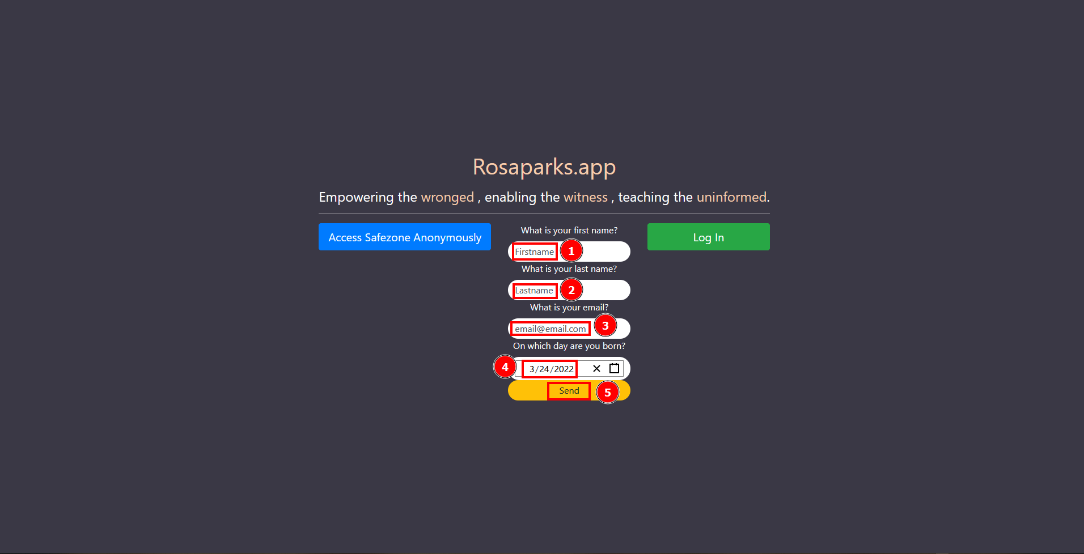

Slide 25
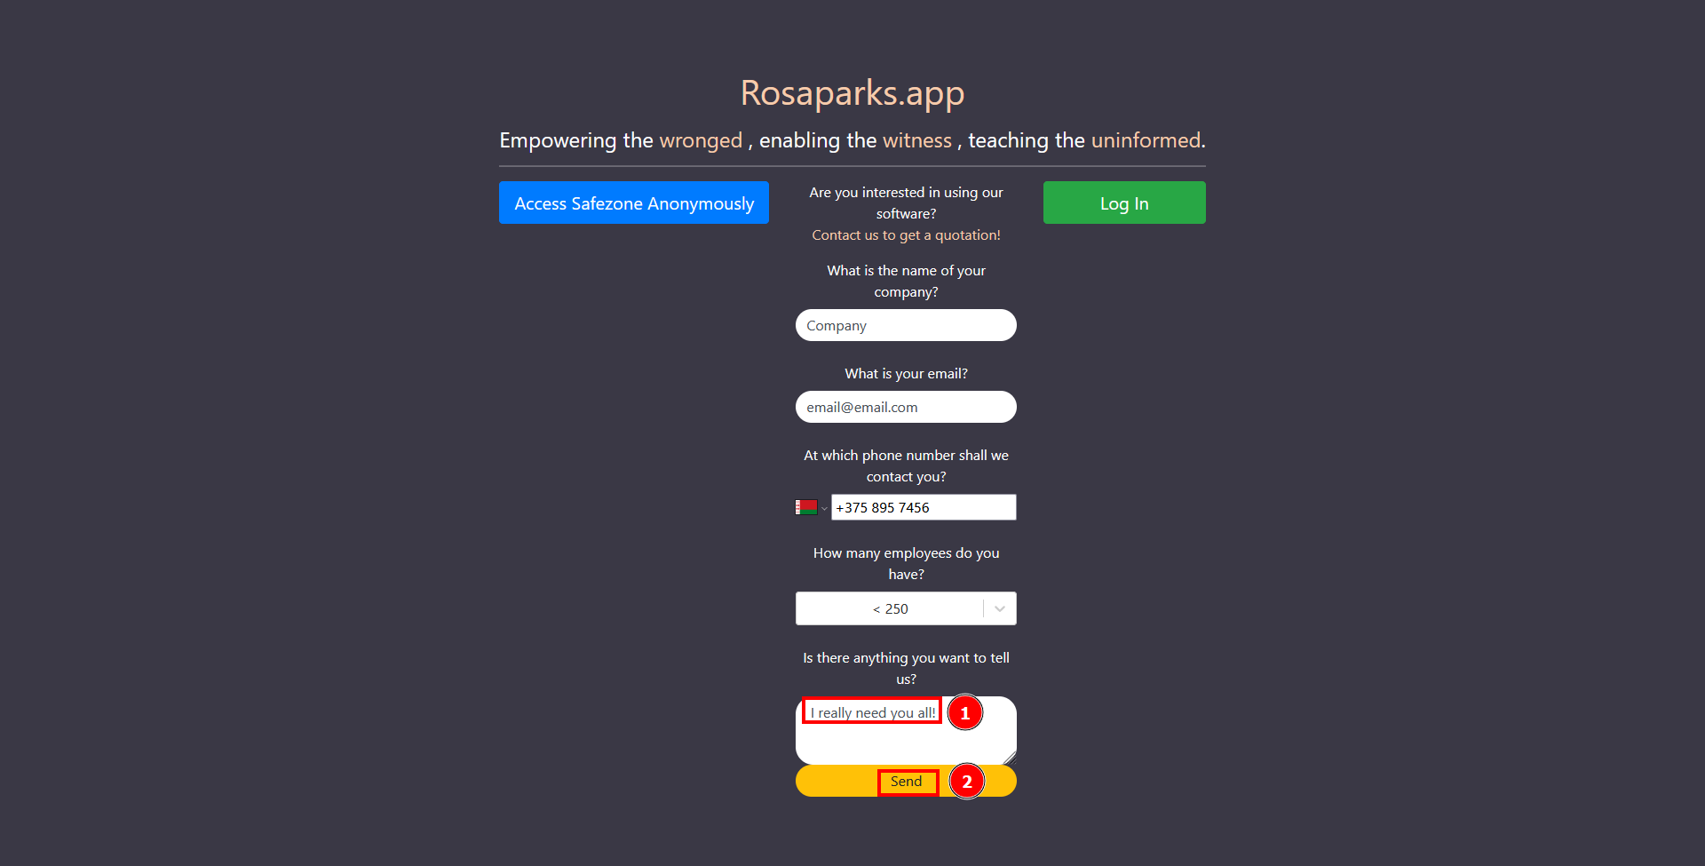

Slide 26
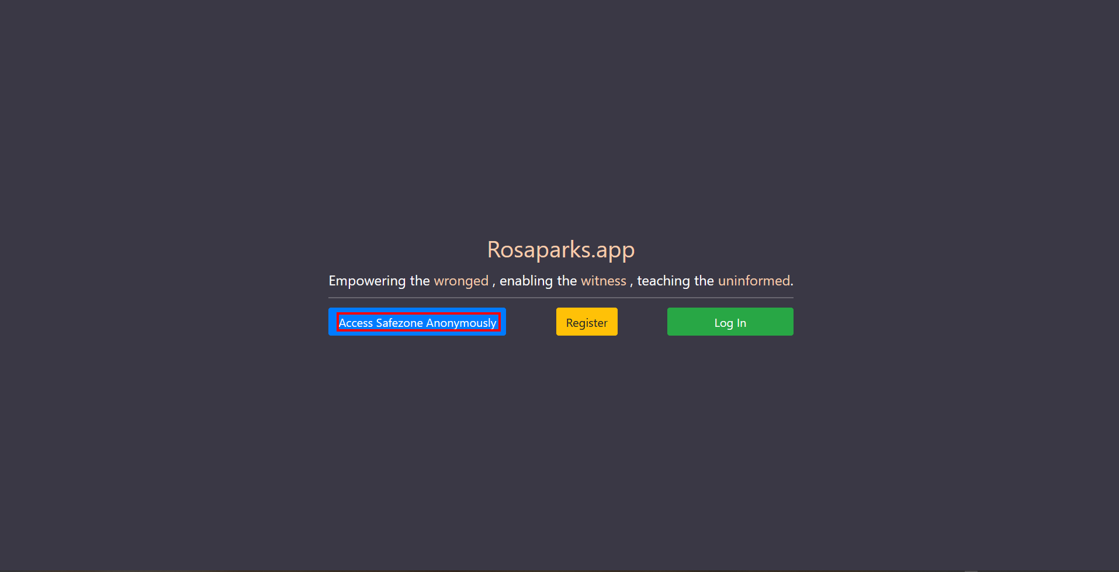

Slide 27
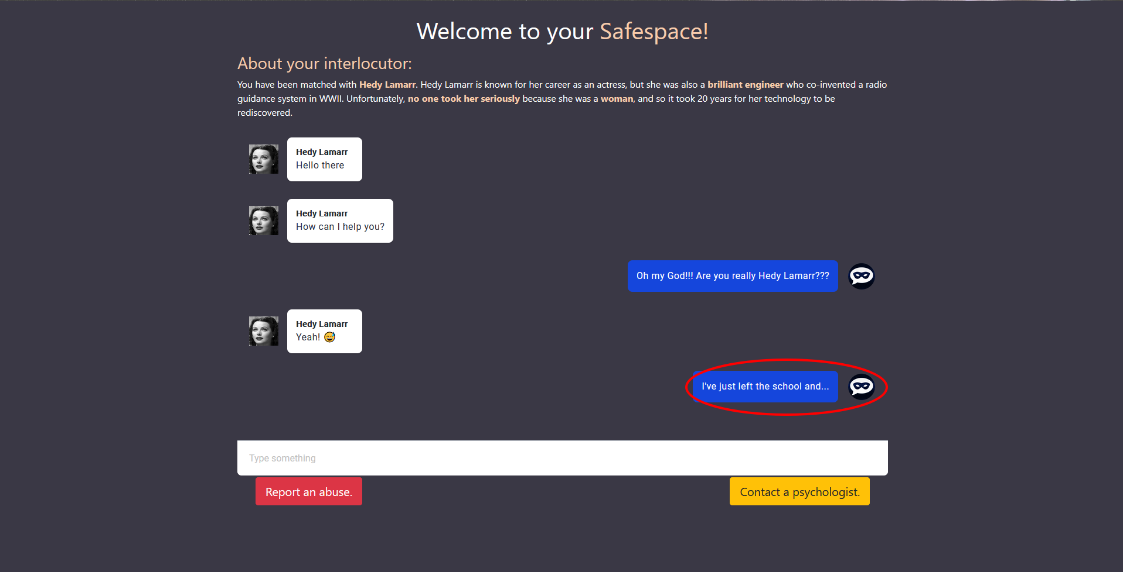

Slide 28
That’s it for now! More coming later on ^_^ !

