Slide 1
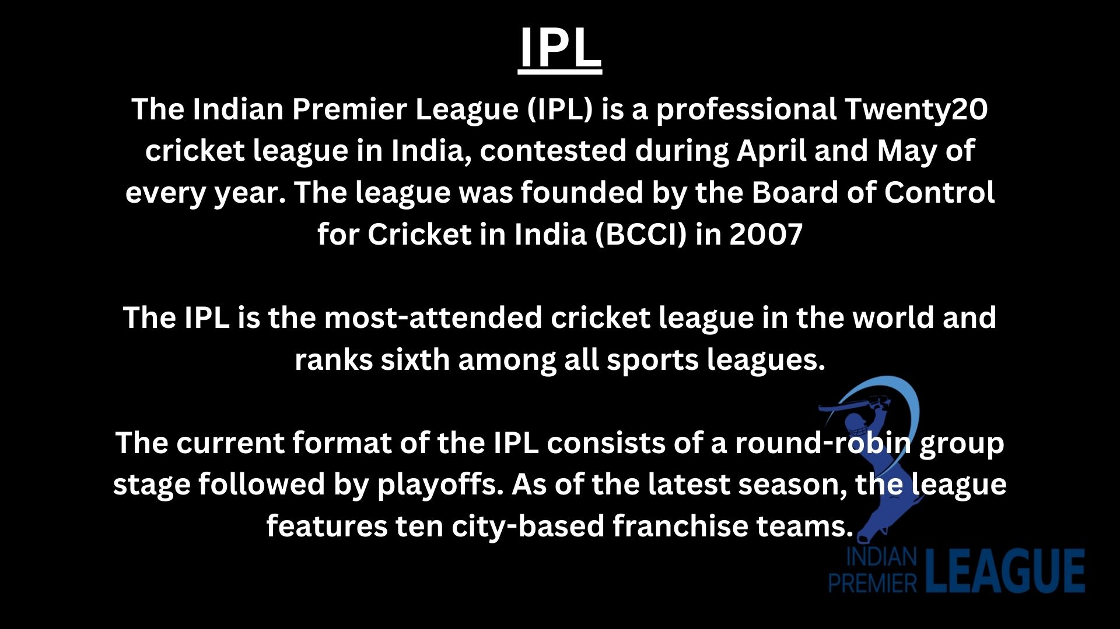

Slide 2
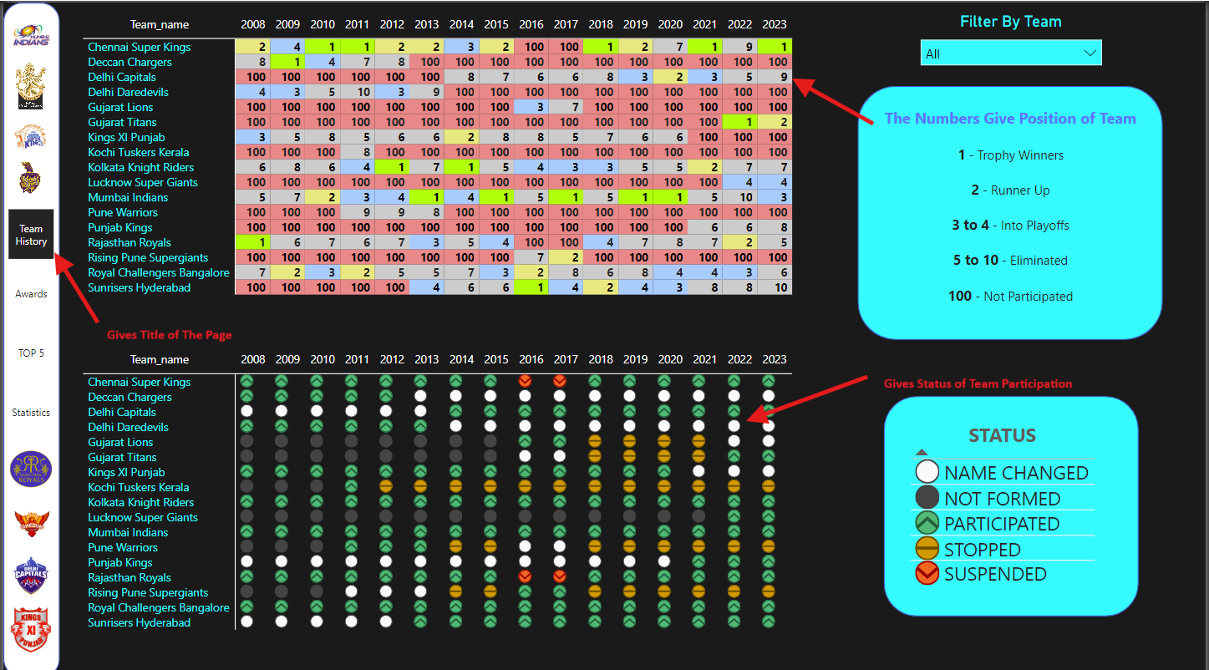
This Page Provides the Timeline of All teams from 2008-2023,gives performance and participation status

Slide 3
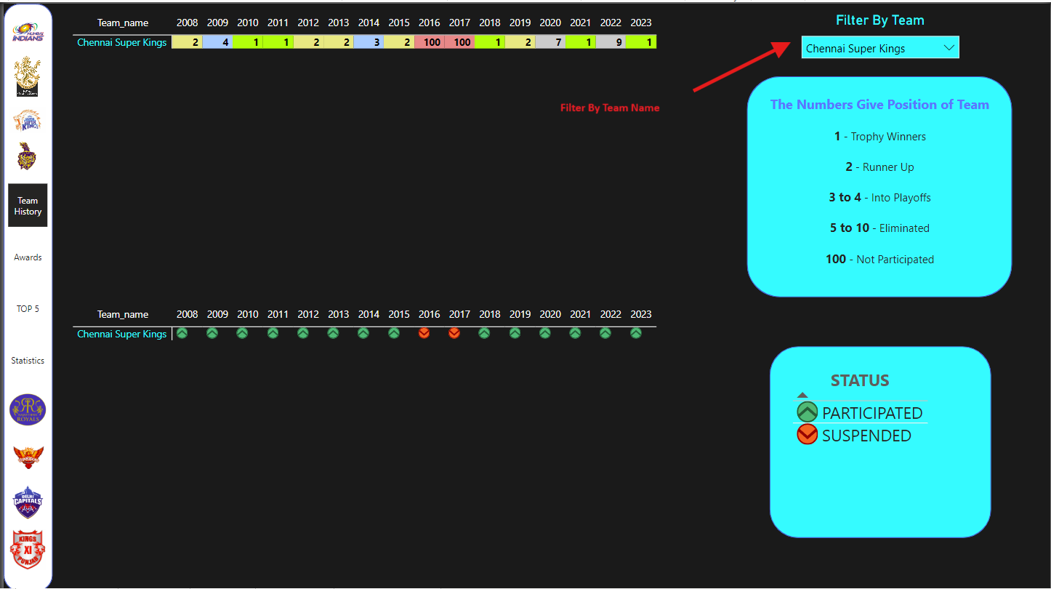

Slide 4
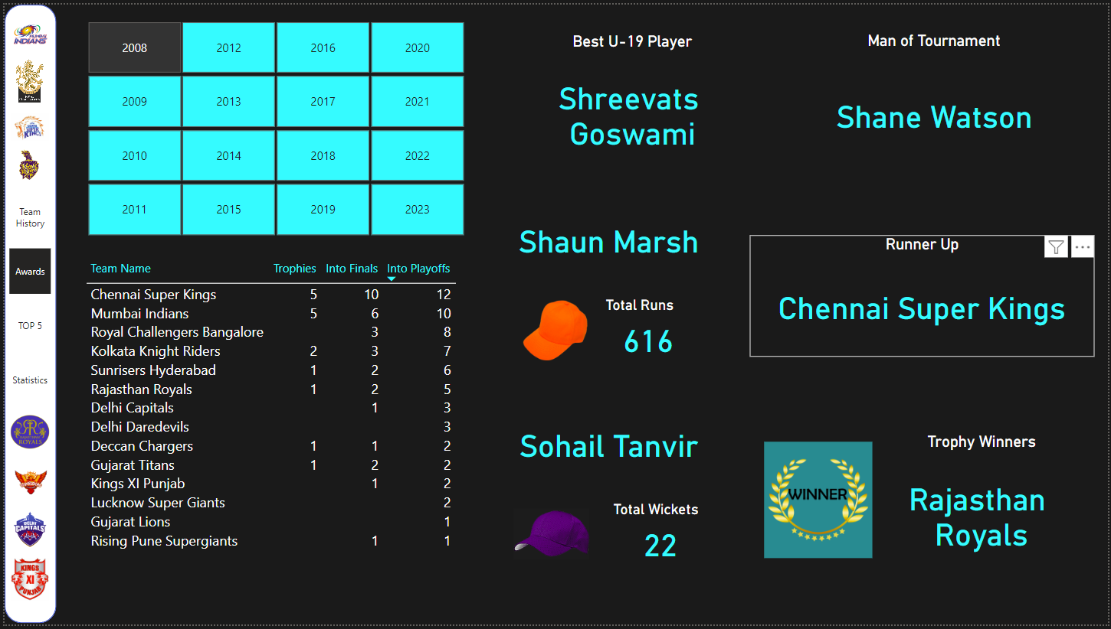
This Page Provides the Achievements and Awards for all seasons from 2008-2023,

Slide 5
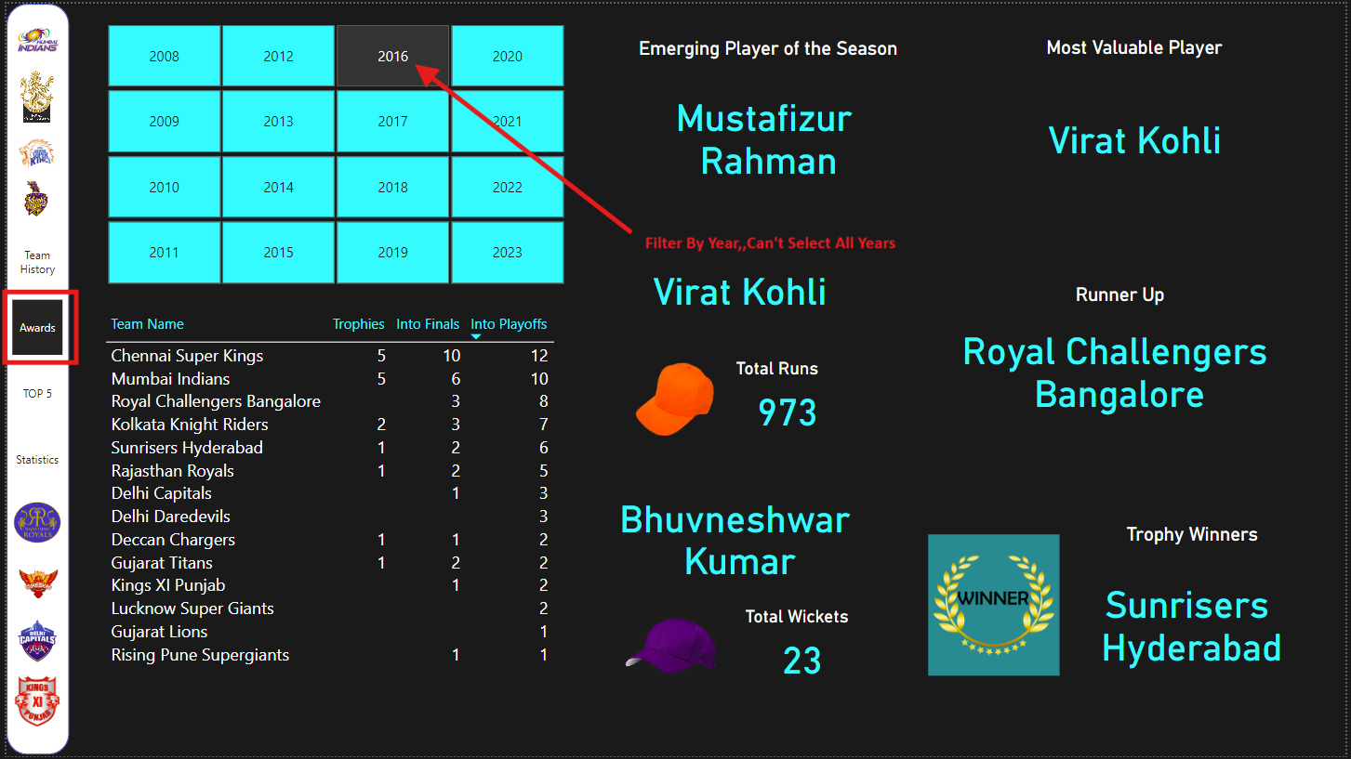

Slide 6
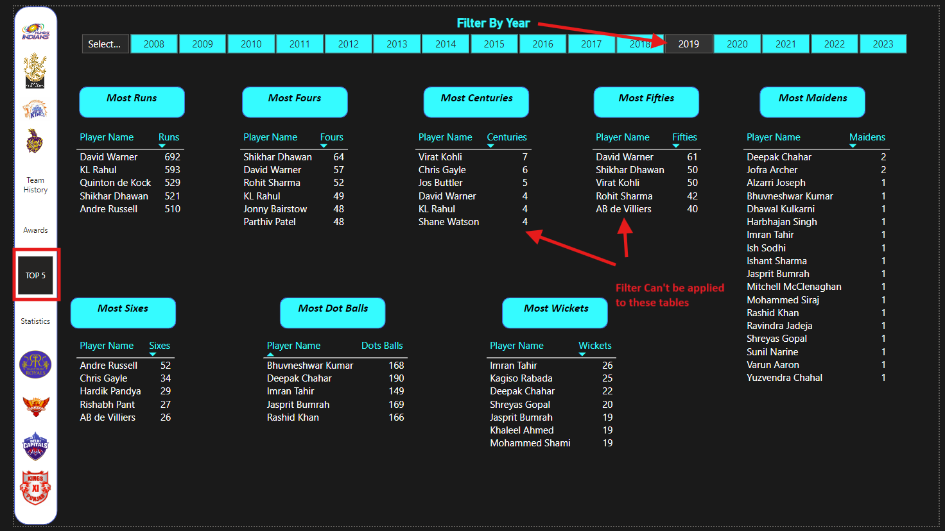
This Page Provides the TOP 5 in every field ,give data of all seasons and filter for individual year

Slide 7
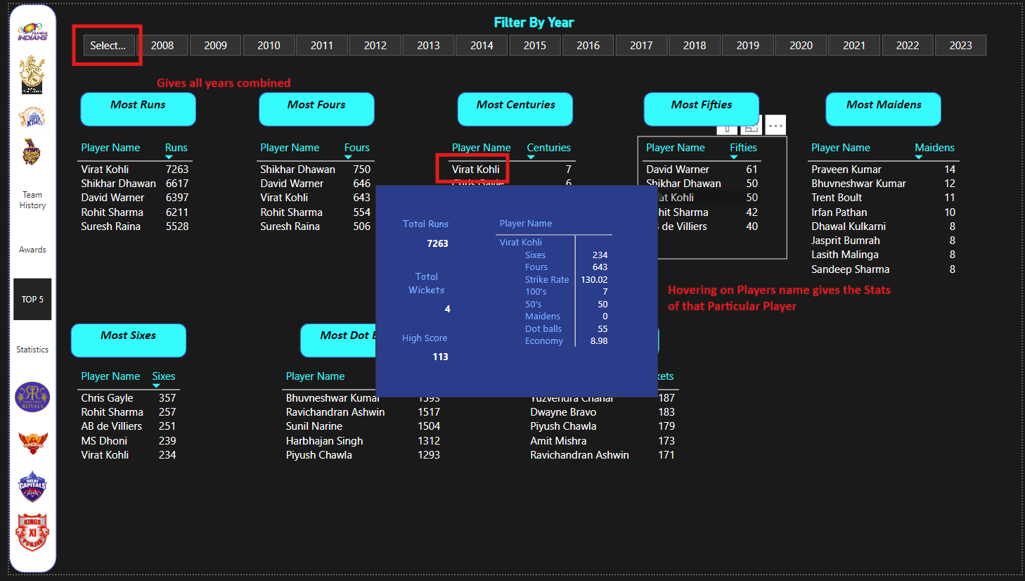

Slide 8
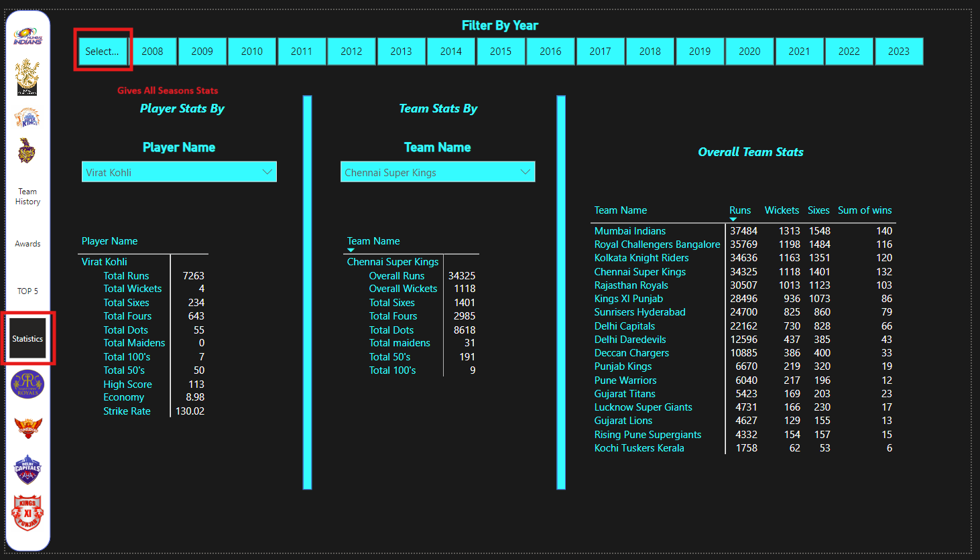
This Page Provides the Stats of Each individual player and Each individual Team , For All seasons and individual year

Slide 9
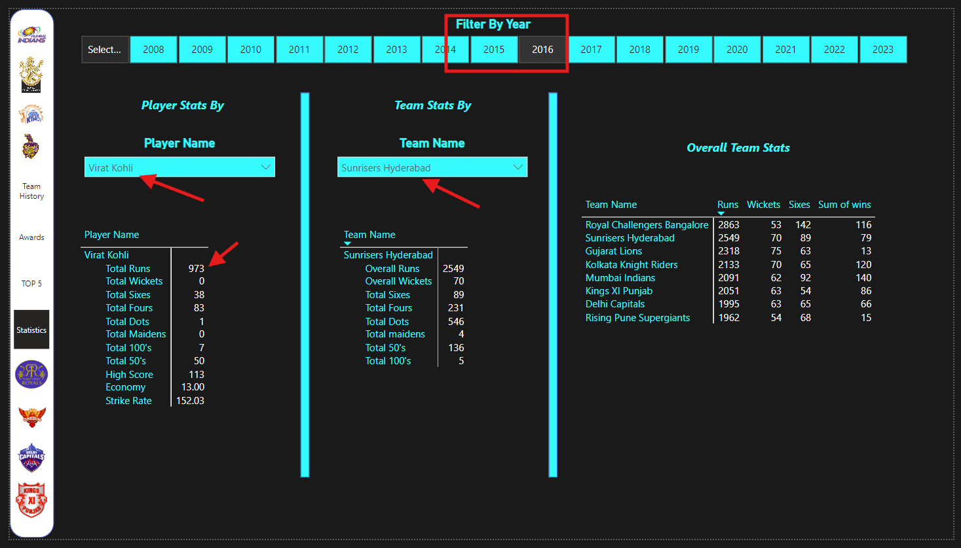

Slide 10
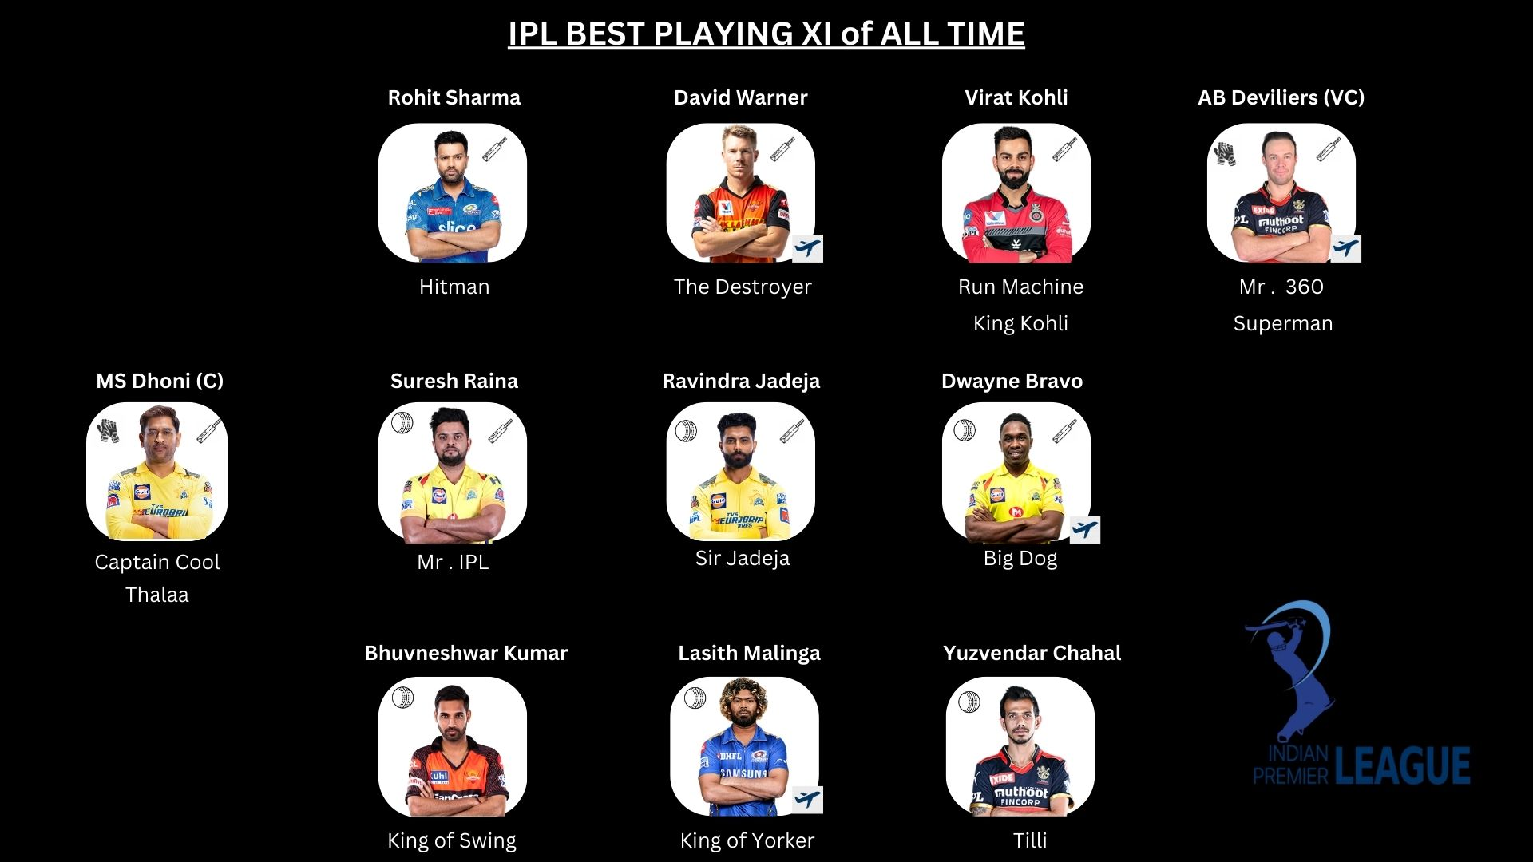
Based on Stats, I selected best playing XI of all time. Considering all rules for selection of most effective team.
Team includes 4 foreigners, 2 Openers, 2 Top order Batsmen, 1 WK Batsmen and Finisher, 3 All Rounders, 3 Spinners, 3 Pacers

