Slide 1

Track reconstruction for LHCb
machine learning – comparing sklearn and pyTorch
www.agh.edu.pl
Notes:
<numer>

Slide 2
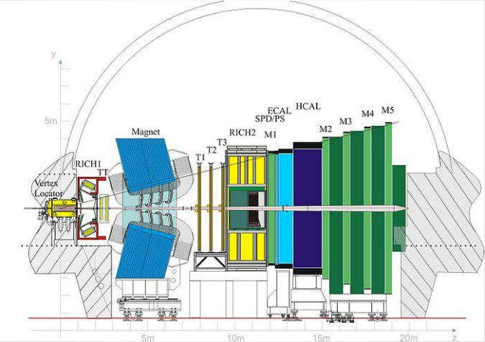
Data we got to analyze:
We got over 2 million data samples from LHCb experiment to work with.
This data resembles particles
that was created and spotted
by inner detector and labeled
depending on if they were
detected in further detector
Or if they where ”ghosts”.
Our project was to create machine learning algorithm that will be able to separate them under this criterium.
www.agh.edu.pl
Notes:
<numer>

Slide 3
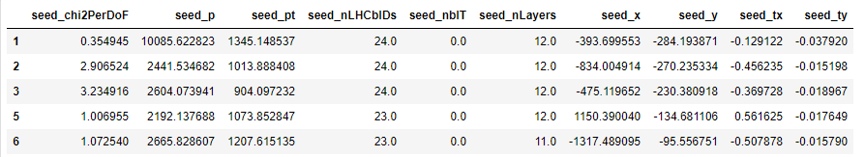
Data analysis:
Data we got was in tabular form and there was 10 features to base our models on:
At first to get a clear look we prepare histogram for every feature and split them by label.
(blue is True value, and orange is for False for feature is_downstream_reconstructible)
www.agh.edu.pl
Notes:
<numer>

Slide 4
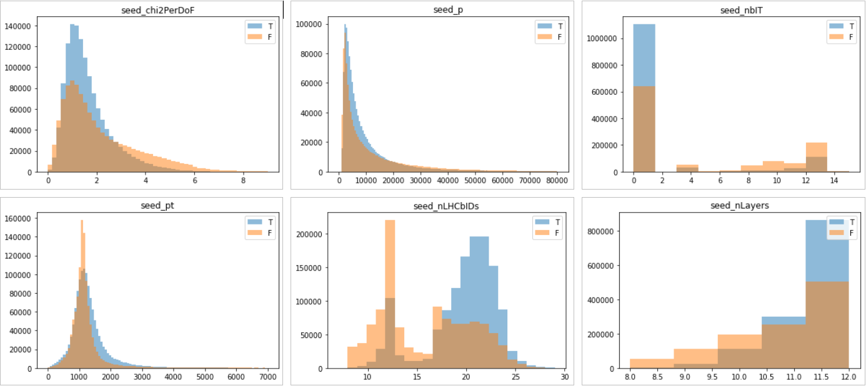
Data analysis:

Slide 5
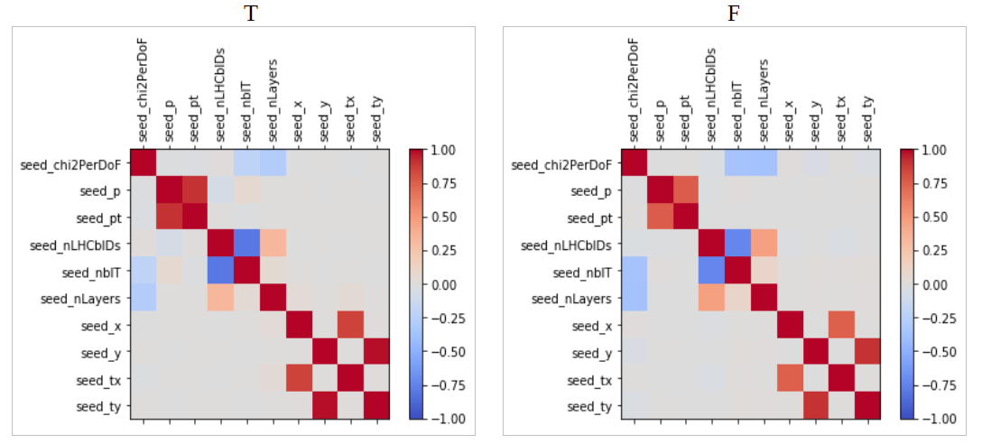
Data analysis:
Then we create chart of correlation between features, in case if we want to try reduce number of features.
We can see that most correlated are features sead_p-sead_pt
and pairs sead_x, sead_y with coresponding sead_tx and sead_ty
also we can see that sead_nLHCbIDs and sead_nbIT are negatively correlated

Slide 6
SKLEARN models:
At first we tried to make some easy models using sklearn library to better understand our data and to get more knowledge on binary classification in practice
we tried:
- Support Vector Machine (SVM)
- Naive Bayes Classifier
- K Nearest Neighbors Classifier (KNN)
- Logistic Regression
- Random Forest Classifier

Slide 7
Support Vector Machine (SVN)
Constructs a hyperplane or set of hyperplanes in a high dimensional space, which can be used for classification or regression. Good separation is achieved by the hyperplane that has the largest distance(margin) to the nearest training-data point of any class.
The larger the margin, the lower the generalization error of the classifier.

Slide 8
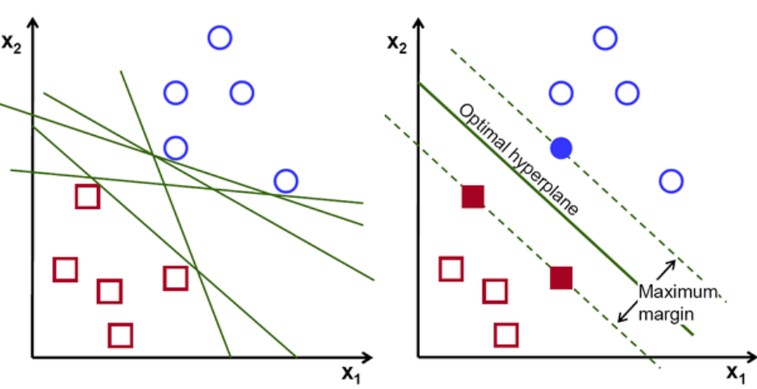
Support Vector Machine (SVN)

Slide 9
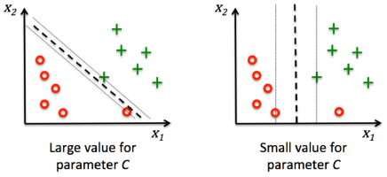
SVM – C (penalty parameter)
Trades off misclassification of training examples against simplicity of the decision surface. A low C makes the decision surface smooth, while a high C aims at classifying all training examples correctly.

Slide 10
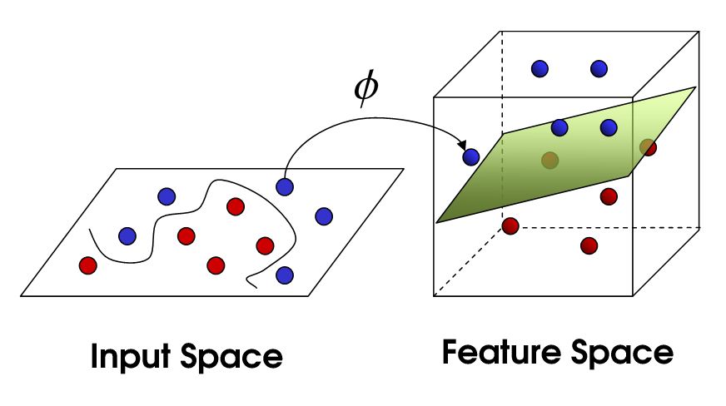
SVM – Kernel trick
Every scalar product is replaced by a nonlinear kernel function. This allows the algorithm to fit the
max-margin hyperplane in a transformed feature space. The transformation may be nonlinear and the transformed space high-dimensional. The classifier is a hyperplane in the transformed feature space, it may be nonlinear in the original input space.

Slide 11




Common Kernel Functions
Linear
Polynomial
Radial Basis Function
Sigmoid

Slide 12
SVM - advanteges
Effective in high dimensional spaces.
Still effective in cases where number of dimensions is greater than the number of samples.
Uses a subset of training points in the decision function (called support vectors), so it is also memory efficient.
Versatile: different Kernel functions can be specified for the decision function. Common kernels are provided, but it is also possible to specify custom kernels.

Slide 13
SVM - disadvantages
If the number of features is much greater than the number of samples, avoid over-fitting in choosing Kernel functions and regularization term is crucial.
SVMs do not directly provide probability estimates, these are calculated using an expensive five-fold cross-validation (see Scores and probabilities, below).

Slide 14
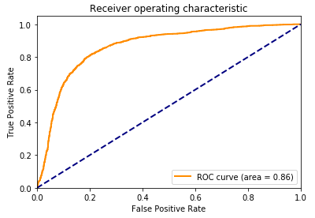
Our results with SVM
We usually get score of ~80% accuracy with this model and auc 0.86.
We try NuSVC model, dropping some features to get better score also to make training faster. Tuning by guessing gave us 80% score and auc 0.86.

Slide 15
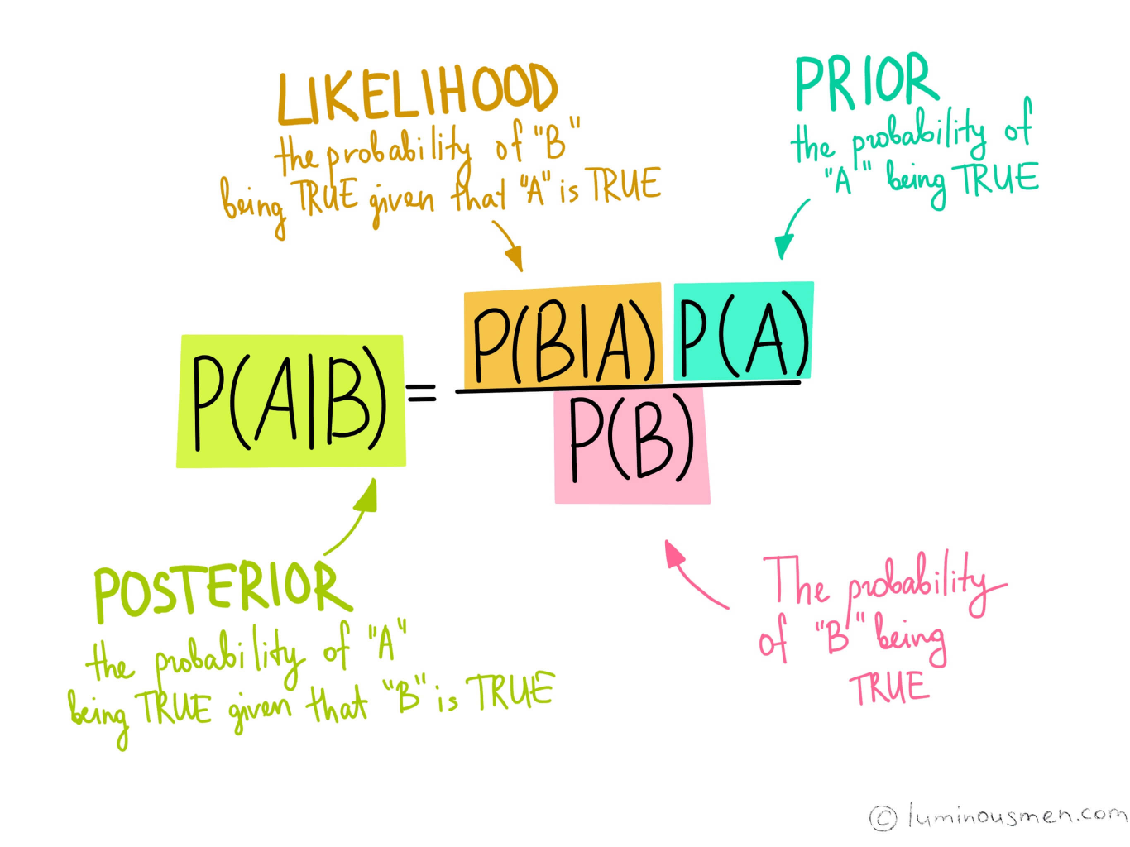
Naive Bayes Classifier

Slide 16
Principles
Based on Bayes’ theorem
Assumes that features are independent (that why is called naive)
Require reasonable data set (with removed all dependent features)
Works without any trainings, only calculates probability

Slide 17
Advantages
Simple to understand / implement
Very fast (because there's no training)
Works well with small data sets (small amount of data)
Fast with huge data sets
Works with continuous and discrete data
Works even if assumption of indepedent features is not met

Slide 18
Disadvantages
Low accuracy
Cannot modify dependencies beetwen features (cannot train model though epochs)
It is required to modify data if continous (for example Gaussian kernel)
It is required to have well prepared data (to meet assumptions) if we want better results

Slide 19
Hyperparameters
Lack of hyperparameters
Most important thing is to choose proper kernel for prepared data set
Hyperparametrs affect only kernels (smoothing in gaussian for example)

Slide 20
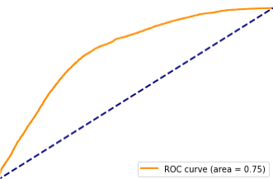
Our results
For independent features
Accuracy Score : 0.69
Precision Score : 0.667
Recall Score : 0.85
F1 Score : 0.747
Auc: 0.75

Slide 21
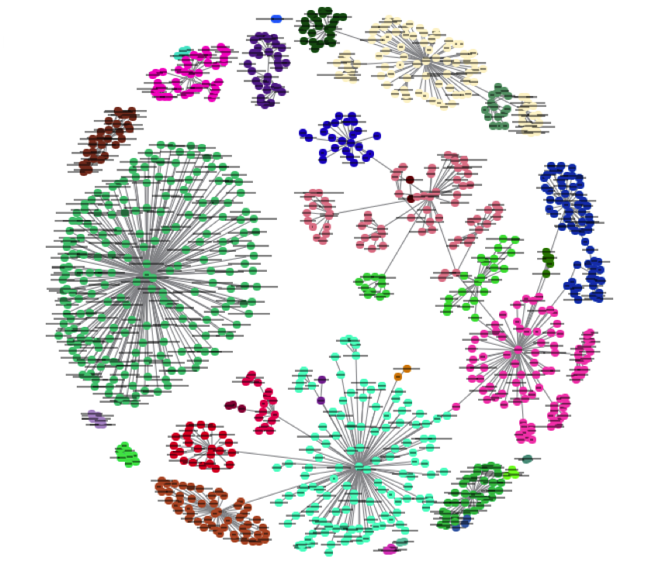
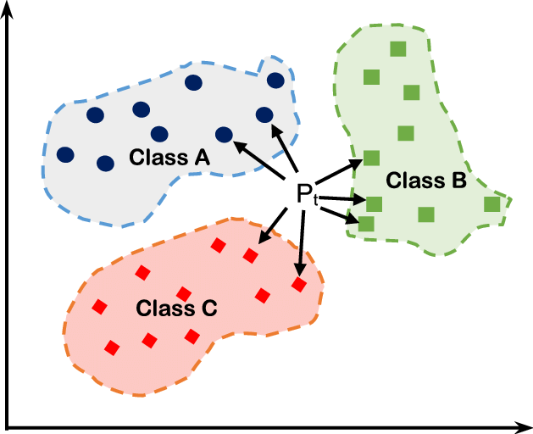
K Nearest Neighbours Classifier (KNN)

Slide 22
Principles
It is recommended to normalize data set
The main problem is to create structre to store points
Based on calculating distance between points
This classifier is lazy-learner, which means there's no training, as I mentioned earlier the main difficulty is to store data set in efficient and helpful way to classify new points

Slide 23
Advantages
It is easy to understand
There is no hard assumptions
There is no training steps
Only one crucial hyperparameter
Can be also used in regression
Distance criteria can be choosen

Slide 24
Disadvantages
Very slow with building logical structre of points and calculating points distance each prediction
More features means more dimensions
For better results it is required to normalize data set
It is hard to choose optimal number of neighbours
Sensivity on not normalized data set

Slide 25
Hyperparameters
Metric - how distance between points is calculated
- Euclidean
- Hamming
- Manhattan
- Minkowski
Neighbors - number of nearest neighbours taken to make classify decision
Type of logical structure of data set

Slide 26
Structure types which can be used
Ball Tree
K-D Tree
Preparing those structures optimizes calculating process
or even Brute Force (without preparing logical structure)
- calculates distance to all other points each prediction (very slow)

Slide 27
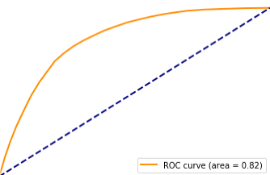
Our results for KNN
For normalized values of features :
Accuracy Score : 0.75
Precision Score : 0.75
Recall Score : 0.81
F1 Score : 0.78
Auc : 0.82

Slide 28
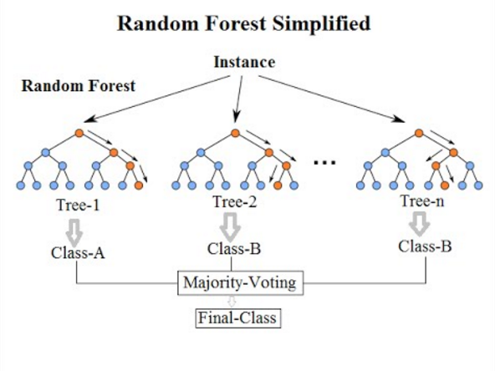
Random Forest Clasifier

Slide 29
Principles
Random Forest Classifier base on assumption that combined strength of weak learners is better then force of one strong learner.
In case of random forest, by week learner we mean small decision tree with limited number of features.

Slide 30
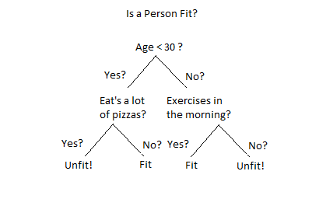
Decision tree
With decision trees we can make easy assumption of almost anything if we ask enough questions in right order

Slide 31
Random Forest
Why forest?
Based on our principle that combined guess from week learners is better then prediction of one strong learner with this model we are creating lots of decision trees, that are not related to each other.
We are ending with lots of different trees like in forest.
Why random?
Random in name of that model results from the way of building new trees.
Each tree is built from scratch and gets random amount of features and samples to work with.

Slide 32
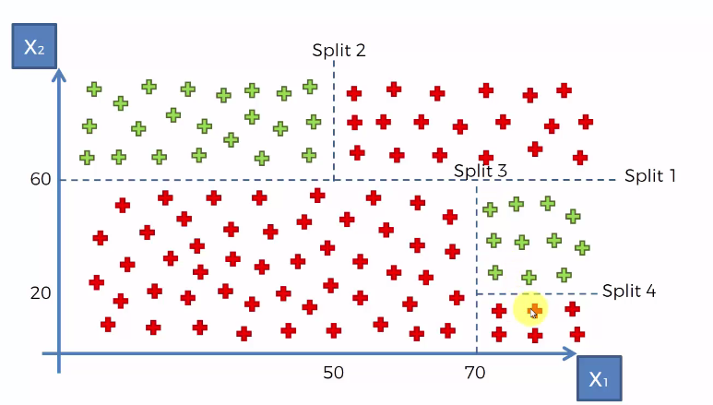
Growing tree
Building tree is based on splitting our data set based on asked questions.
Every iteration looks similar. We looking for best split of our data based on chosen feature. We are finding it by using entropy or information gain criterion.
Tree is constructed from nodes and leaves each split is creating two new nodes (children) from which will grow new nodes. If node is pure (have samples only from one class) or other stopping criterium is fulfilled node become leave.

Slide 33
Splitting data
This term means that we are trying to split our data in two halves to separate objects with different classes.
After doing that we can calculate combined impurity of those halves and if its lower from impurity of their parent node we can tell that the split is successful
Repeating this process for all features gives us best split for this node.
If after split impurity is 0 (samples are separated)
or created nodes fulfills specified criterion, this nodes become leaves.

Slide 34
Hyperparameters
Random forest classifier provided by sklearn have handful of hyperparameters to tinker with, but most impactful are n_estimators and max_depth.
n_estimators – number of created treas. The more trees we have the better prediction.
max_depth – this parameter limits heights of our trees. Its determine how week our week learners are.

Slide 35
Advantages
Easy to understand and to toy with.
Can take mixed kinds of data
(discrete, continuous and categorical)
we don’t need to preprocess them.
Giving really good predictions compared to its simplicity.
Don’t have problems with overfitting like simple decision tree.
Can give pretty good results even with small number of samples.

Slide 36
Dissadventages
Process of constructing random forest is time and resource consuming.
We can train model with relative small number of samples however, quickly reach a point where more samples will not improve the accuracy.
The big number trees and random nature of trees don’t give clear picture of relationships hidden in input data.

Slide 37
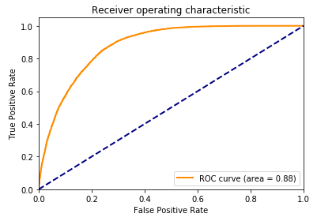
Results using random forest:
With:
max_depth: 20, n_estimators: 1000
Accuracy Score : 0.81
Precision Score : 0.82
Recall Score : 0.80
F1 Score : 0.81
Auc : 0.88

Slide 38
PyTorch – deep learning
Why pytorch?
Deep learning is based on neural networks with multiple hidden layers with activation function on each of theme.
We knew that to set waits on our model we need to calculate derivatives for loss function for each of our sample.
PyTorch is excellent in calculating them and provide easy tools to use high computing power of CUDA to make it even faster.

Slide 39
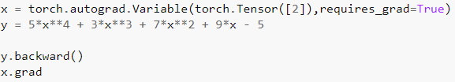
Main advantages of using pytorch:
Fast and easy calculation of derivatives:
Easy use of CUDA:
Tensors from pytorch are stored in exact same way as numpy arrays so converting one int another takes milliseconds and don’t depend on array size.
Pytorch provide tools to create easy linear models or relay complicated ones where we are setting every step and layer.

Slide 40


How to create simple model in pytorch
We need to create class that inherits nn.Module
Then define __init__ method like this:
The last step is to define forward method:
And in that simple way we created simple deep learning model with one hidden layer.
We need to remember to match output dimension of layers with input dimension of next one.

Slide 41

Teaching our model
First step would be to preproces and prepare data. We can use sklearn normalize and split our data set to training and validation parts:
Next we need to choose loss function and optimizer, in our case it was nn.BCELoss and optim.Adam
Last thing to do is to create learning loop for our model.

Slide 42
Learning loop
Basic learning loop contain 5 steps:
optimizer.zero_grad()
we need to have certainty that gradients of our samples are 0 when starting new propagation.
pred = model(features)
make predictions using our model.
loss = loss_fun(pred, targets)
compare predictions to targets and calculate error using our loss function.
loss.backward()
backpropagate our loss to calculate gradients.
optimation.step()
optimize weights of our model.

Slide 43
Batch size
Batch size determine how often we optimize our model in one epoch.
Basically we split our data set on equal parts and apply on them our 5 steps.
Stochastic-batch: batch size is equal to 1
not recommended, the smaller the batch the less accurate the estimate of the gradient.
Batch-mode: when batch size is equal to len(data)
makes your model slow, only one optimization per epoch also not practical in big data sets.
Mini-batch: preferable to have batch higher then amount of features, also we need to take in account size of data set, and make it in range of 0.5% to 2% in case of really big data sets.
With batch size we should aim to make each epoch easier to digest by our hardwere but I noticed that if the batch size is too small like 0,001% data set can stack at the beginning of learning.

Slide 44
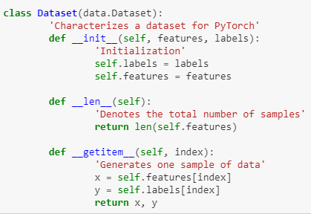
Data loader
To pass data to our data set in batches with ease, we can use DataLoader provided by pytorch.
Dataloder will automatically split our data and shuffle them for optimal learning.
At first we need to create simple class that will store our data set end will have method that let data set iterate on it to get tuple of features and target for single sample. Like this:
Then we can easily make our dataloader:

Slide 45
Our model and results:
We created model that takes 4 hyperparameters while initializing:
n_hidden: that determine number of hidden layers,
first_hiden: that is number of neuron in first hidden layer,
center_hidden: number of neurons in center,
last_hidden: number of neurons in last hidden layer.
Number of neurons in between of given layers is determine by linear function draw between them.

Slide 46
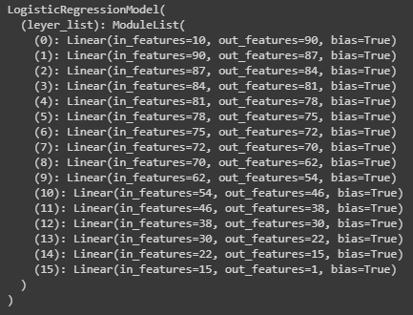
Best result:
With hyperparameters:
epochs = 150
batch_size = 20000
lr_rate = 0.01
n_hiden = 14
first_hiden = 90
center_hiden = 70
last_hiden = 15
The shape of model looks like this:
And we got this results:
train accuracy: 88,8%
test accuracy: 88,8%
train loss: 0.276
test loss: 0.279
acu: 0.95

Slide 47
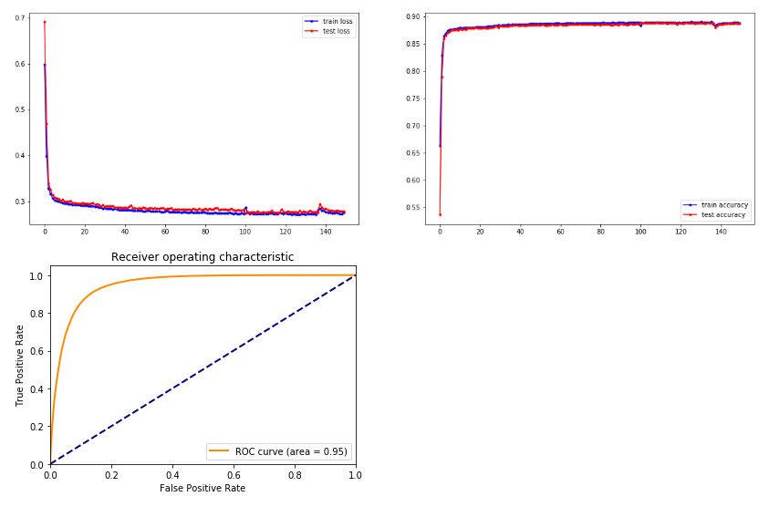
Results

Slide 48
Project created by:
Kamil Hałat
Dawid Gwiżdż
Miłosz Filus
Michał Piwowarczyk
With help of:
Adam Dendek
GitHub: PITE-PyTorch

