Slide 1
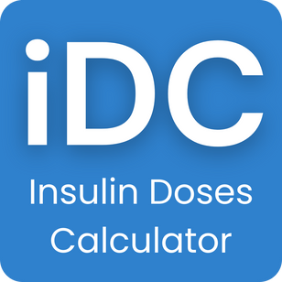
Insulin Doses Calculator
  Usage, Engagement & Early Adoption Summary
  For Clinical & Medical Specialists
  Reporting Period: 5–12 January

Slide 2
Purpose of the Platform
• Digital tool supporting insulin dose calculations
• Designed for clarity, speed, and repeat use
• Supports – does not replace – clinical judgement
• Built with performance, privacy, and safety in mind

Slide 3
Audience & Use Case
• Individuals managing insulin dosing
• Repeated daily calculator use
• Utility-focused, not content browsing
• Indicates intentional, problem-solving behaviour

Slide 4
Weekly Usage Snapshot
• 522 unique users in 7 days
• 7,800 total interactions
• ~15 interactions per user
• Consistent daily usage pattern

Slide 5
Engagement Quality
• High repeat interaction per visit
• Low bounce behaviour
• Suggests trust and usefulness
• Above-average engagement for early-stage health tools

Slide 6
Performance & Reliability
• 49% of content delivered instantly
• Fast page load times
• Lightweight data usage
• Optimised for mobile and low-bandwidth environments

Slide 7
Privacy & Data Handling
• No unnecessary personal data collected
• No advertising or behavioral tracking
• GDPR-aligned minimal data approach
• Designed for trust and safety

Slide 8
Discoverability & SEO Signals
• Organic user discovery already occurring
• Positive engagement signals to search engines
• Early trust formation phase
• Sustainable long-term visibility expected

Slide 9
Growth Trajectory
  3 Months: 3,000–3,500 users/month (expected)
  6 Months: 4,500–6,000 users/month (expected)
  Steady, trust-led growth pattern

Slide 10
Why This Matters Clinically
• Demonstrates real-world patient adoption
• Shows repeat engagement and reliance
• Potential adjunct support tool
• Foundation for clinical feedback and validation

Slide 11
Positioning Statement
• Not diagnostic
• Not a replacement for medical advice
• Supportive digital aid
• Designed with clinical responsibility

Slide 12
Discussion & Next Steps
• Clinical validation pathways
• Safety messaging refinement
• Professional oversight opportunities
• Collaboration and governance models

