Slide 1
IBM Applied Data Science Capstone by Coursera
Opening a New Shopping Mall in Kolkata, India
By: Barnendra Mohan Chaudhuri
January 2020

Slide 2
Business Problem
Location of the shopping mall is one of the most important decisions that will determine whether the mall will be a success or a failure
Objective: To analyse and select the best locations in the city of Kolkata, India to open a new shopping mall
This project is timely as the city is currently suffering from a disproportionate distribution of shopping malls which leads over-congestion is some parts of the city, traffic management issues and adequate public transportation issues
Business question
In the city of Kolkata, India, if a property developer is looking to open a new shopping mall, where would you recommend that they open it?

Slide 3
Data
Data required
List of neighbourhoods in Kolkata
Latitude and longitude coordinates of the neighbourhoods
Venue data, particularly data related to shopping malls
Sources of data
Wikipedia page for Kolkata neighbourhoods (https://en.wikipedia.org/wiki/Category:Neighbourhoods_in_Kolkata)
Open Cage Geocoder package for latitude and longitude coordinates
Foursquare API for venue data

Slide 4
Me thodology
Web scraping Wikipedia page for neighbourhoods list
Get latitude and longitude coordinates using OpenCage Geocoder
Use Foursquare API to get venue data
Group data by neighbourhood and taking the mean of the frequency of occurrence of each venue category
Filter venue category by Shopping Mall
Perform clustering on the data by using k-means clustering
Visualize the clusters in a map using Folium

Slide 5
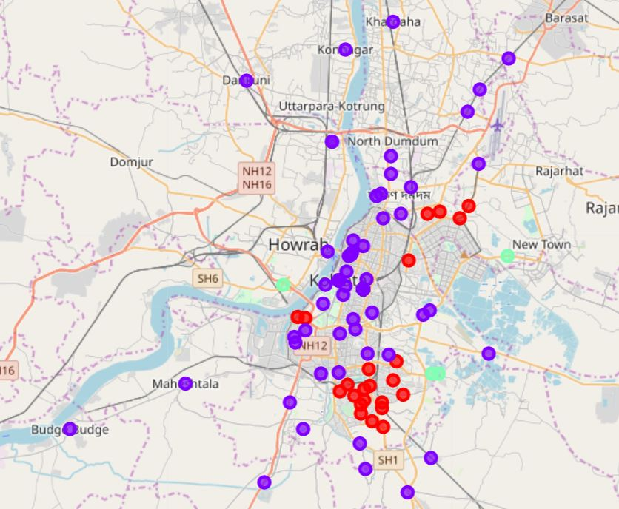
Results
Categorized the neighbourhoods into 3 clusters :
Cluster 0: Neighbourhoods with moderate number of shopping malls (red color dots)
Cluster 1: Neighbourhoods with low number to no existence of shopping malls (purple color dots)
Cluster 2: Neighbourhoods with high concentration of shopping malls (mint green color dots)

Slide 6
Discussion
Shopping malls are highly concentrated in 4 neighborhoods which form cluster 2. They are Anandapur, Bidhannagar, Jetia, Kasba
Moderate concentration of shopping malls in cluster 0 comprising of 23 neighborhoods
Cluster 1 has very low number to no shopping mall in the neighbourhoods. This cluster comprise about 171 neighborhoods

Slide 7
Recommendations
Open new shopping malls in neighbourhoods in cluster 1 with little to no competition
Can also open in neighbourhoods in cluster 0 with moderate competition if have unique selling propositions to stand out from the competition
Avoid neighbourhoods in cluster 2, already high concentration of shopping malls and intense competition

Slide 8
Conclusion
Answer to business question: The neighbourhoods in cluster 1 are the most preferred locations to open a new shopping mall
Findings of this project will help the relevant stakeholders to capitalize on the opportunities on high potential locations while avoiding overcrowded areas in their decisions to open a new shopping mall
This will also help alleviate the traffic management and public transportation issues currently being faced by the city authorities

Slide 9
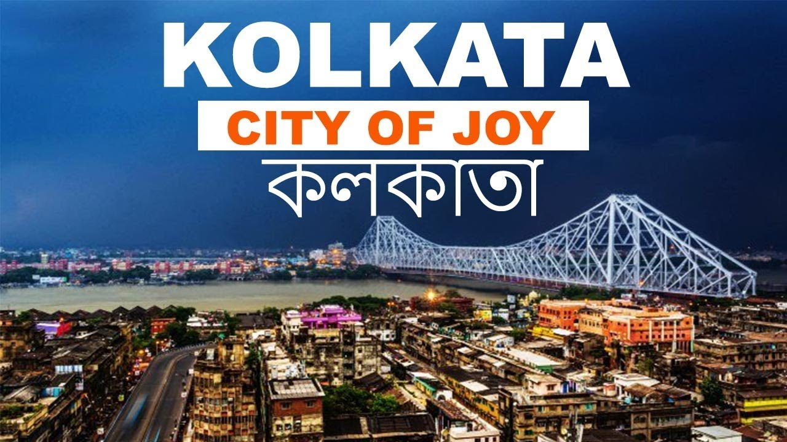
Thank you!

