Slide 1
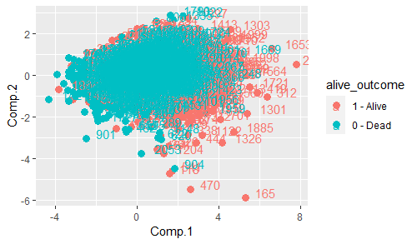
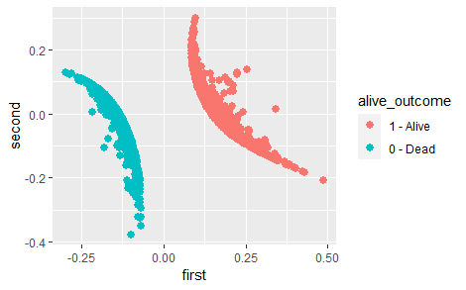
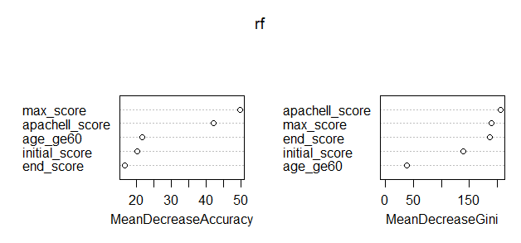
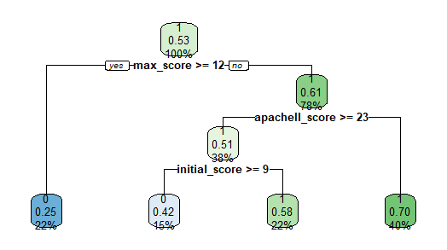
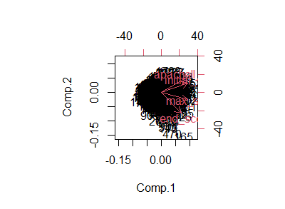
A model for evaluating physician performance
Xiao Yang, Panxi Chen
Department of Mathematics and Statistics, Carleton University; Department of Statistics, University of Michigan Ann arbor
Abstract
Conclusion
Since the last century, many efforts have been spent developing the ability of a health care system, focusing on patients in the intensive care unit (ICU).
Traditionally, physicians participate in 360 evaluations by answering questions scoring from 1 to 5, but this method fails to incorporate patient information and thus can be biased. Assessment of physicians performance depends on various factors such as professional knowledge level and behavior competence, therefore, we seek to develop a new model that includes patient information to evaluate physician performance.
We modified the 360 evaluation data set, filtering all incomplete rows and separate all evaluation questions to behavioral questions and professional questions, each yielding an average score for every physician. In the doctor data, we combine characters of doctor and 360 evaluation, and select overall score, evaluation rank, position, and summarize score from 360 evaluation to technical, non technical and overall scores. In the patient data frame, ax/initial/end score for each physician by each patient are included along with the alive outcome, Apache II score and whether the patient is over 60.
We are mainly interested in the minimum, maximum and ending SOFA score of a given patient as they reflect the severity to reduce bias. Next we incorporate the Apache II, SOFA scores into this data frame. We now have a patient and a physician data frame at disposal.
We proceed to apply machine learning techniques to predict whether a patient can survive, assigning different physicians. The output is a single value of 0 or 1, indicating death or alive after the treatment.
The result of KNN prediction is extremely bad, only with an accuracy around 0.411. Such low accuracy may be the consequence of the non-linearity of high-dimensionality of the data. Using the variable ’alive outcome’, the classification tree shows 4 splits while the CP is set to default as 0.01. The optimal size of the tree based on smallest ’x error’ shows up to 71% patients are predicted to be alive. The classification tree yields an overall training error of 0:31893, and test error of 0:34515. From projections of data, ’Alive’ has more outliers, while ’Dead’ are more tied together.
The bi-plot shows Apache II score and initial score are more correlated with smaller angle, which can be seen as a cluster. Perform MDS and plot the resulting projection into 2-d, so the two dimensions can preserve the real distance, then we can see which doctors are similar or dissimilar easily, with alive outcome noted by different color. From the plot, the two outcomes are clearly separated.
We developed a machine learning model that predicts whether a given patient will survive, assigning to a particular physician. From our analysis, we can conclude whether a patient is alive after treatment can significantly affect the score of the physician.
In particular, the ’alive outcome’ variable is the most influential factor to a physicians’ score, but most of the time, we can only forecast with a 70% correct rate.
As a result, the reserve of professional knowledge is not the same as being able to articulate clearly. Future work will include analysis of categorical variables to refine our model.
Objectives
The primary objective is to assign each physician an ‘effective’ 360 score that separately considers a physician’s professional ability and behavioral competence.
Further, we apply machine learning to predict whether a given ICU patient can survive under a specific physician.
By assessing each physician’s score and results in predicted death rates, we obtain a new model and summarize which of the factors may affect a physician’s success more.
Methods
Results
By exploration data analysis, whether the patient is over 60 may affect the death rate. We split the patient data (after data cleaning) and sample 80% of it as training data with the rest of them as test data.
A naive KNN yields the best k equals to 4 with accuracy 0:89. Classification tree approach gives us the optimal size of 3 with the smallest error 0.7646 with 3 splits. Random forest model shows that the most important variable is maximum SOFA score, which indicates the peak severity, followed by Apache II score. End score is also very important for Gini.
The scores of patients who are finally dead are more concentrated while the scores from alive patients are unstable and have outliers, indicated by PCA. We take the first two principle components which explain about 89% data. From its bi-plot, we can see that the Apache II score is correlated to initial SOFA score, and maximum/end SOFA score do not have a correlation with Apache II score. Finally,
by DMS we found that the scores of physicians have no overlap by separation of whether alive or not.
Acknowledgement
Panxi implement the methods and provided insightful analysis of model output, while Xiao provides the main idea, with model framework, and is responsible for the rest work of paper. Both have equal contribution.

