Slide 1

Netflix Data: Cleaning, Analysis and Visualization
Using Python & Power BI
- BARNEY SOPHIA

Slide 2
Objective
Import and clean the Netflix dataset using Pandas in Python and Power BI.
Analyze data trends and distributions using summary statistics and visualizations in Python.
Create charts like bar charts and pie charts with Matplotlib and Seaborn.
Build dynamic dashboard with Power BI for exploring the data.
Extract key trends and patterns, such as top and release year trends.

Slide 3
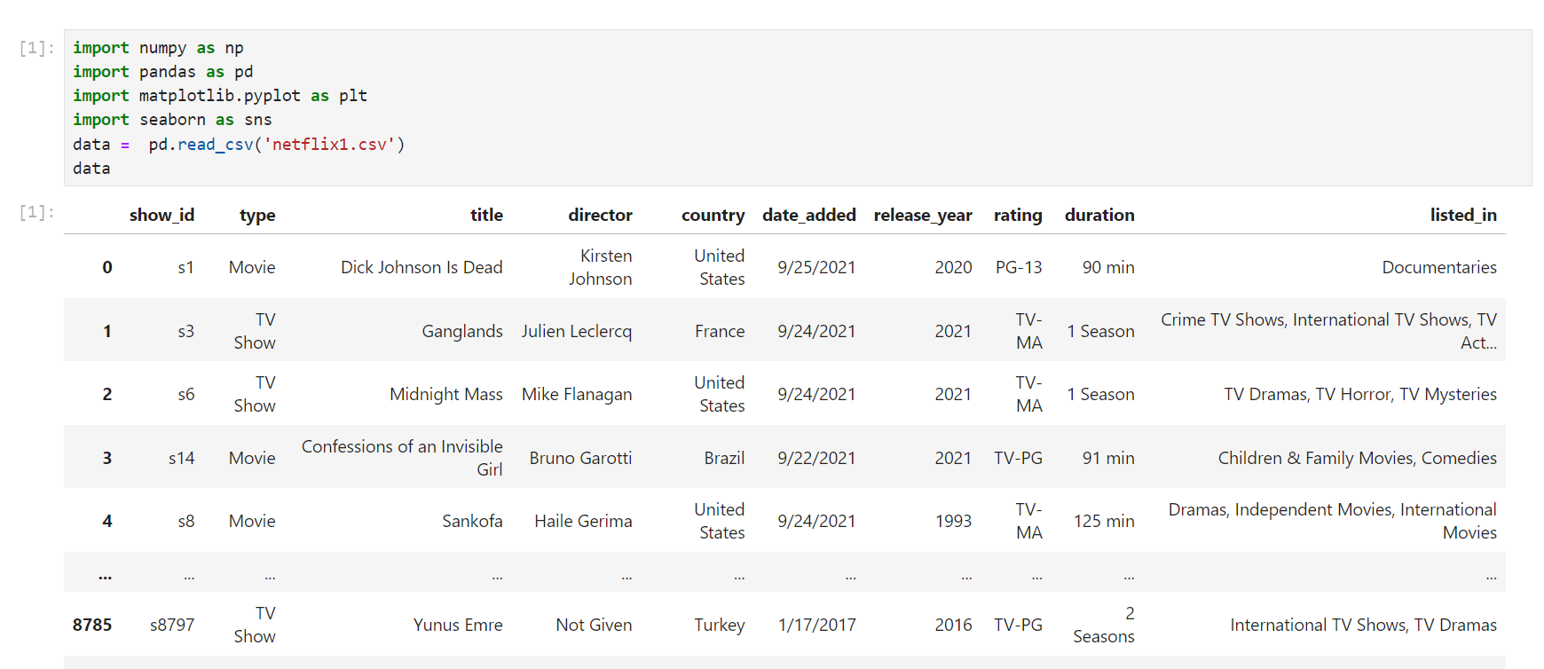
Importing Libraries and Modules

Slide 4
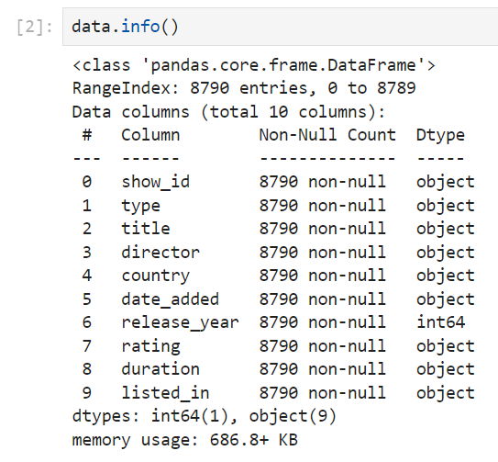
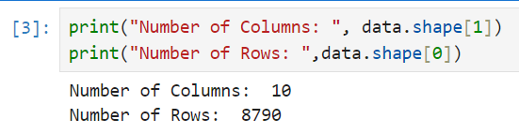
Checking the Info

Slide 5
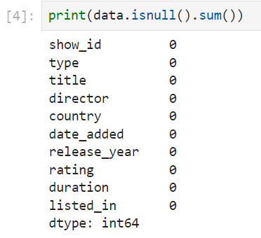
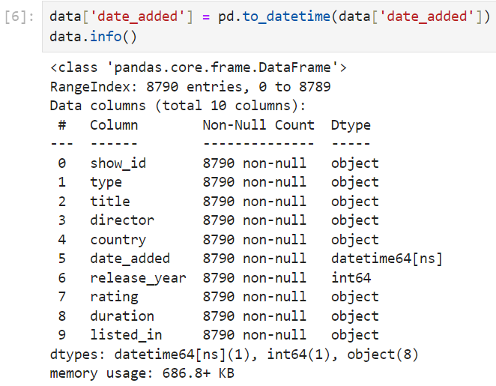
DATA CLEANING
Checking FOR null values
Converted 'date added‘ DTYPE
DETECT Duplicates

Slide 6
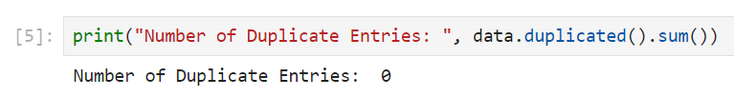
Checking for Duplicate Values

Slide 7
DATA VISUALIZATION

Slide 8
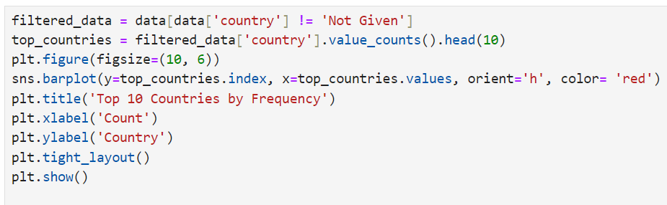
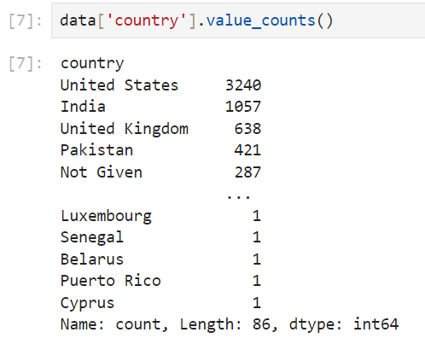
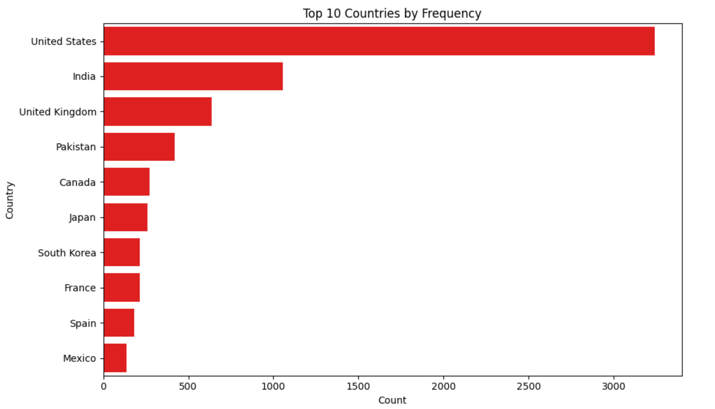
Top 10 Countries by users

Slide 9
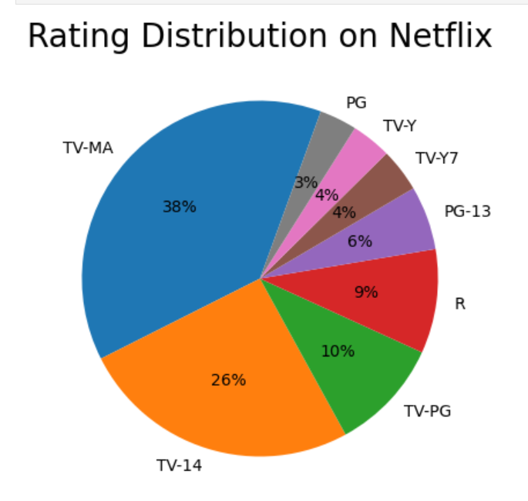
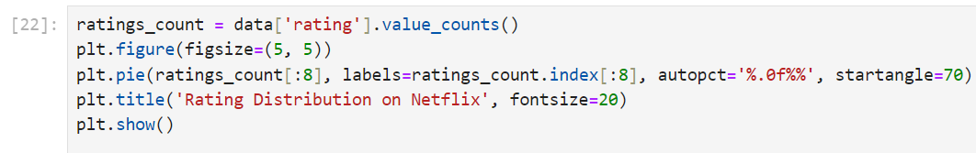
Rating on Netflix

Slide 10
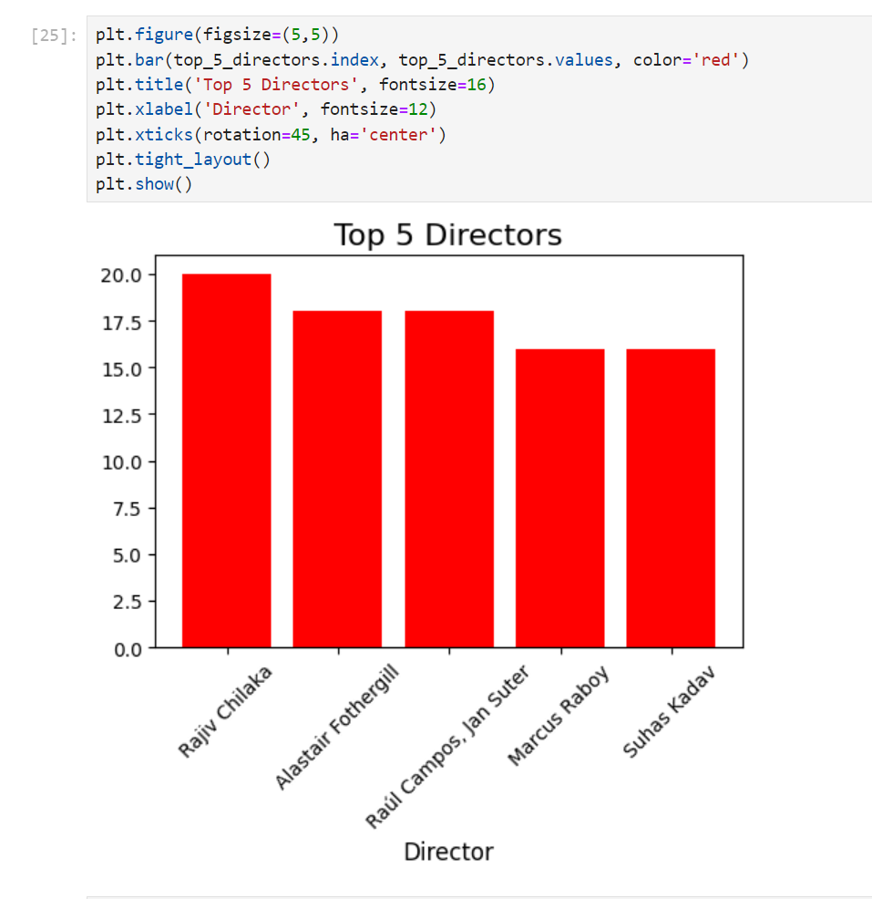
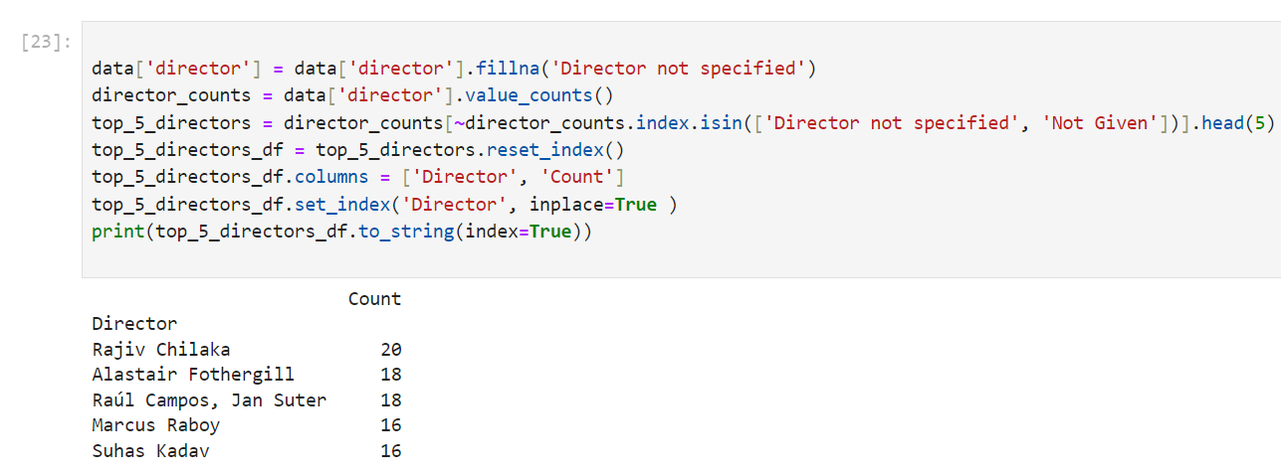
Top 5 Directors

Slide 11
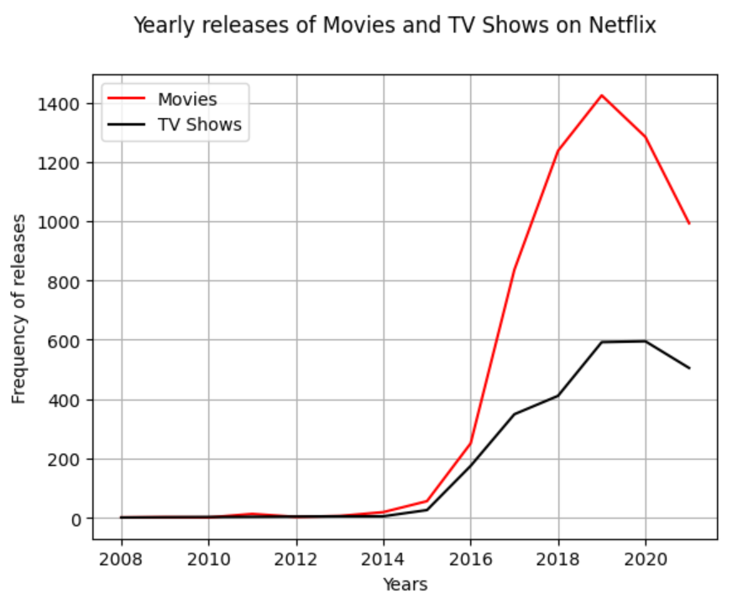
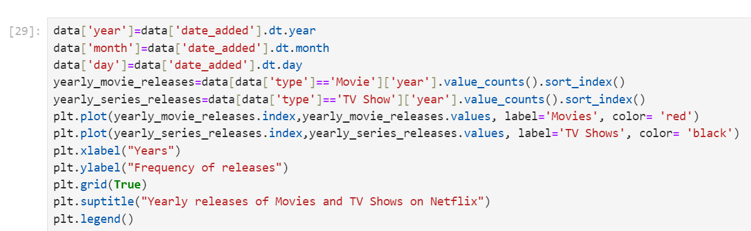
Yearly Releases of Shows

Slide 12
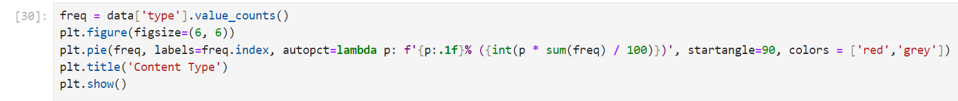
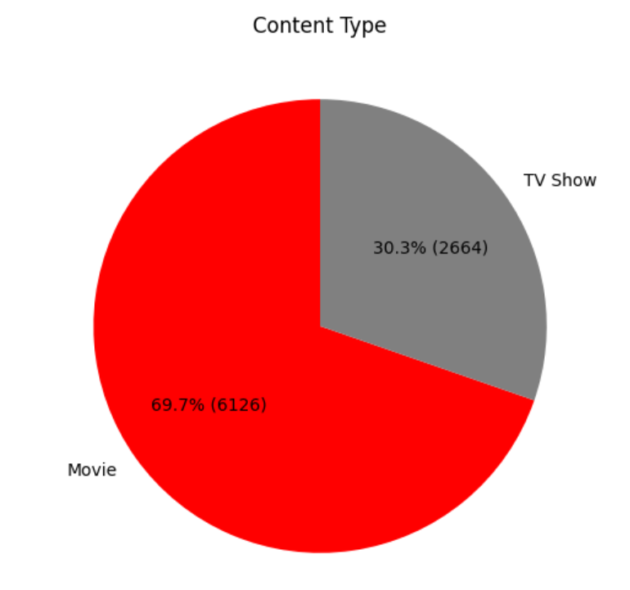
Content Analysis

Slide 13
Key Insights
Movies constitute 69.7% (6126 titles), and TV shows make up 30.3% (2664 titles) of the Netflix catalog.
Top genres include International Dramas (362), Documentaries (359), and Stand-Up Comedy (334).
Significant growth in content production is observed post-2000.
The United States, India, and the United Kingdom are the top three countries producing content for Netflix.
Rajiv Chilaka, Alastair Fothergill, Raul Campos and Jan Suter are among the most featured directors on Netflix.
TV-MA (mature audience) is the dominant content rating, followed by TV-14 and TV-PG.

Slide 14
POWER BI DASHBOARD

Slide 15
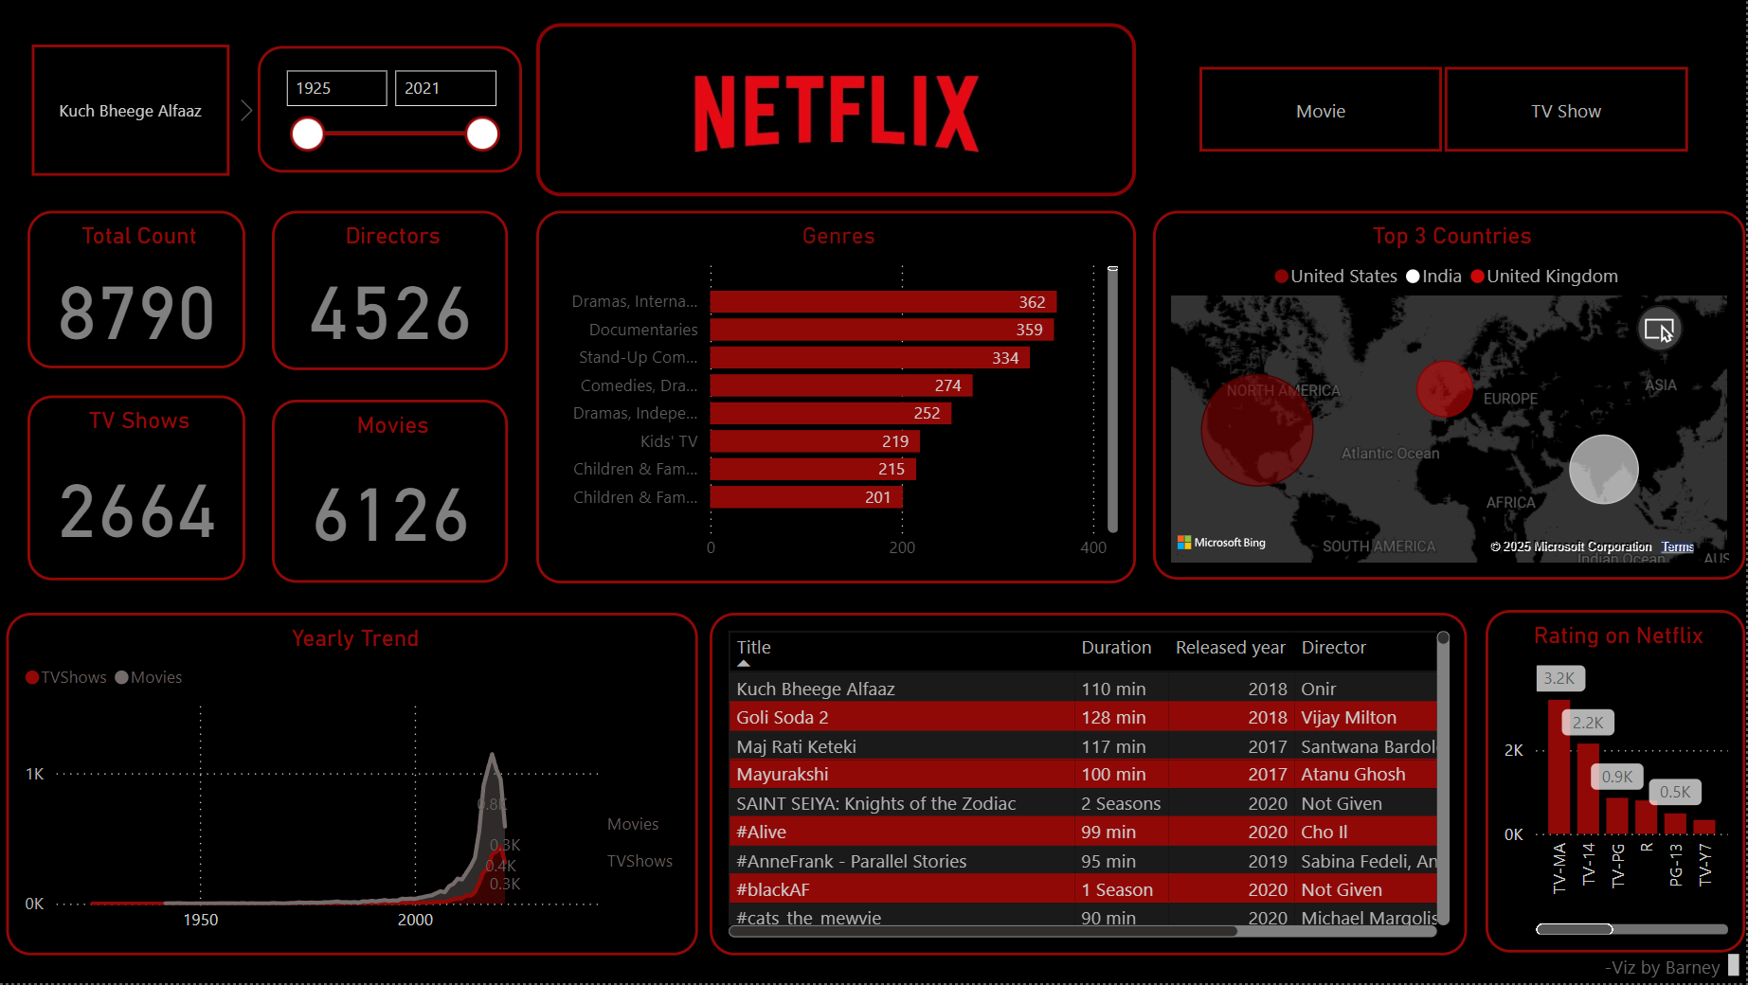

Slide 16
Conclusion
The Netflix dashboard created using Power BI and Python provides a comprehensive overview of the platform's content distribution, trends, and regional focus. The analysis reveals a significant growth in content production post-2000, driven by the platform's global expansion.

