Slide 1


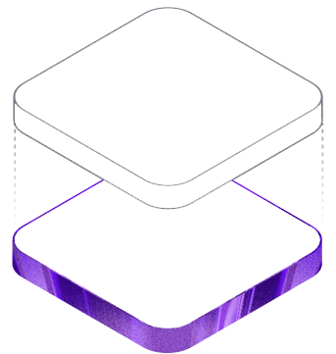


PURPLE INDUSTRIES · KUBERNETES LEARNER CONSOLE
Kubernetes
A hands-on CKA practice simulator
Inject faults, repair workloads, and get graded against real Kubernetes API behavior — no cloud account required.
purpleindustries.us/kubernetes
github.com/BarnsL/Kubernetes-Simulator
Notes:
Title. Purple Industries Kubernetes Learner Console — a hands-on CKA practice simulator. Two homes: the web console at purpleindustries.us/kubernetes and the open-source repo at github.com/BarnsL/Kubernetes-Simulator.

Slide 2

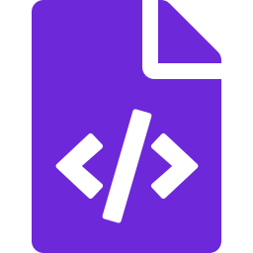
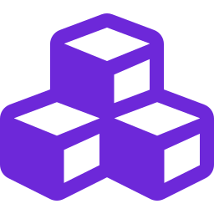


FOUNDATIONS
What is Kubernetes?
Kubernetes (K8s) is an open-source platform that automates the deployment, scaling, and operation of containerized applications across a cluster of machines.
Self-healing
Restarts, reschedules, and replaces unhealthy Pods automatically
Declarative
Desired state in YAML; controllers reconcile continuously
You declare the desired state — Kubernetes makes it real
Elastic scaling
Scale workloads up or down on demand or automatically
Tell the cluster "run 3 replicas of this image" and the control plane continuously reconciles reality toward that goal — restarting, rescheduling, and replacing as needed. A CNCF graduated project and the industry-standard container orchestrator.
Service discovery
Built-in DNS, networking, and load balancing for Pods
Kubernetes · CKA Practice Simulator
2 / 13
Notes:
Definition + four headline capabilities: self-healing, declarative, elastic scaling, service discovery.

Slide 3
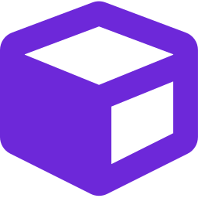

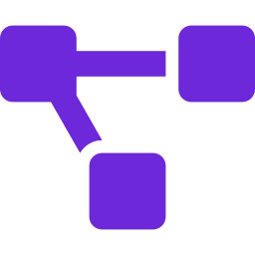
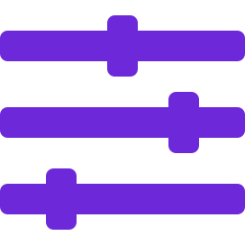
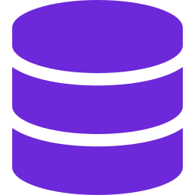


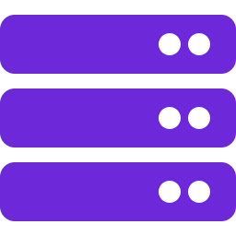
THE OBJECT MODEL
The core building blocks
Pod
Deployment
Service
ConfigMap & Secret
Smallest deployable unit — one or more containers
Declarative rollouts over self-healing ReplicaSets
Stable network identity for a set of Pods
Externalized configuration and sensitive data
PV & PVC
RBAC
Namespace
Node
Persistent storage requests bound to volumes
Roles and bindings that authorize every action
Scoping and isolation boundaries in a cluster
The worker machines that actually run Pods
Kubernetes · CKA Practice Simulator
3 / 13
Notes:
Eight objects every CKA candidate must master — each is the subject of one or more missions in the simulator.

Slide 4



THE PROJECT
Meet the CKA Practice Simulator
A Go CLI and web GUI for practicing Certified Kubernetes Administrator exam scenarios against a real or simulated cluster.
cka-sim — self-test
$ go build -o cka-sim ./cmd/cka-sim
$ ./cka-sim self-test
▶ scenario injected: demo-pod
image set to nginx:no-such-tag
status: Pending
✓ repair applied
image → nginx:1.25
✓ pod reached Running
RESULT: PASS
32 authentic mission labs
Pods, networking, storage, RBAC, scheduling & more
Inject → repair → grade loop
The same shape as real CKA exam tasks
Offline fake-client mode
Runs with no cluster and no cloud account
Kubernetes · CKA Practice Simulator
4 / 13
Notes:
What it is, in one slide: a Go CLI plus a React web GUI. The terminal shows the built-in self-test running the full inject → repair → grade loop with no cluster.

Slide 5




THE METHODOLOGY
How every mission works
1
2
3
4
INJECT
INSPECT
REPAIR
GRADE
A fault is injected into the cluster
Find the clue in events and spec
Apply one targeted, scoped fix
Spec + runtime checked, pass / fail
image → nginx:no-such-tag
kubectl describe pod
kubectl set image …
phase = Running ✓
You don’t just read about Kubernetes — you break it, diagnose it, and fix it like an operator.
Kubernetes · CKA Practice Simulator
5 / 13
Notes:
The signature loop. Injected fault, inspect for the clue, apply one scoped repair, then the grader validates both spec and runtime state.

Slide 6
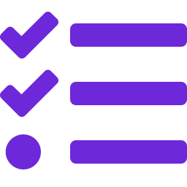



UNDER THE HOOD
Architecture
repo layout
Separation of concerns
cmd/cka-sim/ CLI entrypoint
internal/
grader/ pod state · image · readiness
injector/ broken images · misconfigs
scenarios/ scenario definitions
selftest/ end-to-end fake-client flow
web/ React + TypeScript GUI (Vite)
go test ./... all green
Scenario definitions live apart from grading logic
API is the source of truth
Validation reads real Kubernetes object state
Disposable-cluster first
Designed to run against throwaway local clusters
Offline by default
client-go/fake powers practice with no cluster
Kubernetes · CKA Practice Simulator
6 / 13
Notes:
Repo layout and the four design principles: separation of scenarios from grading, the API as source of truth, disposable-cluster-first, and offline by default via client-go/fake.

Slide 7


TWO WAYS TO RUN
Practice offline, or grade a real cluster
Fake-client mode
Live mode
OFFLINE
REAL CLUSTER
Runs entirely offline using client-go/fake
No cluster, no kubeconfig, no cloud account
Deterministic, repeatable scenarios
Study anywhere — on a plane, offline
Grades against a real kubeconfig cluster
Use kind, minikube, or a full cluster
Builds real kubectl muscle memory
Closest to actual exam conditions
VS
Kubernetes · CKA Practice Simulator
7 / 13
Notes:
Two modes from one codebase: fully offline fake-client for studying anywhere, or live grading against a real kind/minikube cluster for exam-realistic practice.

Slide 8


32 MISSION LABS
32 labs
Coverage across the CKA curriculum
Workloads & controllers
Config & storage
Networking & services
Pod image · Deployment rollout · readiness probe · CrashLoopBackOff · Job · CronJob · DaemonSet · StatefulSet
ConfigMap key · Secret env · resource requests · PV/PVC binding · finalizer troubleshooting
Service selector · Ingress backend · NetworkPolicy · EndpointSlice · DNS policy · cross-namespace lookup
Scheduling
Security & RBAC
Cluster setup & tooling
Node scheduling clinic · taint & toleration match · label selector repair
RBAC binding · ServiceAccount binding · token mount control · Pod Security Baseline
kubectl verify · kind bootstrap · minikube · Hello Minikube · kubeadm path · namespace cleanup
Kubernetes · CKA Practice Simulator
8 / 13
Notes:
All 32 labs grouped into six domains spanning the CKA curriculum — from core workloads to security, scheduling, and cluster bootstrap.

Slide 9

ANATOMY OF A MISSION
Pod image repair
BEGINNER
WORKLOADS
inspect → repair → verify
Identify a bad image value and recover a Pod to Running.
$ kubectl describe pod demo-pod
Image: nginx:no-such-tag
Events: Failed to pull image
$ kubectl set image pod/demo-pod \
app=nginx:1.25
pod/demo-pod image updated
$ kubectl wait --for=condition=Ready \
pod/demo-pod
pod/demo-pod condition met ✓
A Pod is stuck because its container image tag is invalid. The fix maps directly to one failing field — but a pass needs both the right image and a healthy runtime state.
BROKEN STATE demo-pod 0/1 Pending · nginx:no-such-tag
PASS CRITERIA
spec.image = nginx:1.25
status.phase = Running
Kubernetes · CKA Practice Simulator
9 / 13
Notes:
One mission end to end. Difficulty and domain, the learning goal, the injected broken state, the actual inspect-repair-verify commands, and the two pass criteria the grader enforces.

Slide 10
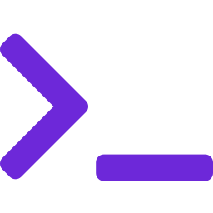
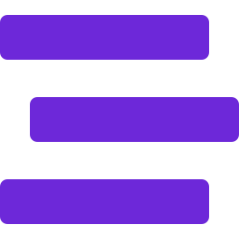

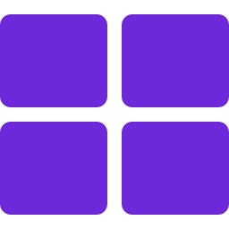


PURPLEINDUSTRIES.US/KUBERNETES
The web learning console
Learn Kubernetes concepts while you practice — terminal-first, with explanations at every step.
Simulated kubectl terminal
Token-by-token breakdown
Step-by-step tutorials
Run modeled commands safely against simulated state
Every part of a command explained as you type it
A guided inspect → repair → verify learning path
Mini cluster dashboard
Glossary & field guide
Free-play sandbox
Overview, workloads, services, config & storage, cluster
Understand exactly what the grader is checking
A mutable cluster for common kubectl verbs
Kubernetes · CKA Practice Simulator
10 / 13
Notes:
The web console at purpleindustries.us/kubernetes — six learning-first features built around a simulated terminal.

Slide 11

BEYOND THE MISSIONS
A sandbox with real cluster state
Modeled kubectl verbs
Dashboard information architecture
get
describe
create deployment
run
expose
Overview
set image
scale
label
annotate
taint
Workloads
delete
api-resources
explain
Services
Config & storage
The simulated cluster has state. Later reads reflect earlier mutations, so create → scale → get behaves like a real session — not canned output.
Cluster
Your latest command maps to the section that matters next.
Kubernetes · CKA Practice Simulator
11 / 13
Notes:
Free-play models 13 common kubectl verbs over a mutable cluster, and a learner-first dashboard mirrors the standard Kubernetes Dashboard layout.

Slide 12


QUICK START
Get started in minutes
Command-line (Go)
Web console
1
Build the CLI
1
Enter the web app
go build -o cka-sim ./cmd/cka-sim
cd web
2
Run the self-test
2
Install dependencies
./cka-sim self-test
npm install
3
Inject, then grade
3
Start the dev server
./cka-sim inject … && ./cka-sim grade …
npm run dev
Go 1.21+
Node.js 18+
kubectl (live mode)
MIT licensed
Kubernetes · CKA Practice Simulator
12 / 13
Notes:
Two onboarding tracks: build and run the Go CLI, or start the React web console. Prereqs are minimal and it is MIT licensed.

Slide 13
PURPLE INDUSTRIES
Break it. Fix it. Pass.
Hands-on Kubernetes practice that mirrors the real CKA exam — inject a fault, repair the workload, and let the grader confirm you got it right.
purpleindustries.us/kubernetes
github.com/BarnsL/Kubernetes-Simulator
Purple Industries © 2026
Notes:
Close. The pitch in three words — break it, fix it, pass. Point people to the web console and the repo.

